Slide 1
Dow Jones Index Data Set using K means Clustering
By,
Sahil Rahi
Kajal Sharma
Chinju Baby
Elda Varghese
Shanel Pinto

Slide 2
DOW Jones Dataset
Index | Attribute | Significance
1 | Quarter | The yearly quarter(1=Jan-Mar; 2=Apr-Jun)
2 | Stock | Stock symbol
3 | date | The last business day of the work which is typically Friday.
4 | open | The price of the stock at the beginning of the week.
5 | high | The highest price of the stock during the week.
6 | low | The lowest price of the stock during the week.
7 | close | The price of the stock at the end of the week.

Slide 3
8 | volume | The number of shares of stock that traded hands in the previous week.
9 | percent_change_price | The percentage change in price throughout the week.
10 | percent_change_volume_over_last_week | The percentage change in the number of shares of stock that traded hands for this week compared to the previous week.
11 | previous_weeks_volume | The no.of.shares of stocks that traded hands in the previous week.
12 | next_weeks_open | The opening price of the stock in the following week.
13 | next_weeks_close | The closing price of the stock in the following week.
14 | percent_change_next_weeks_price | The percentage change in the price of the stock in the following week.
15 | days_to_next_dividend | The number of days until the next dividend.
16 | percent_return_next_dividend | The percentage of return on the next dividend.

Slide 4
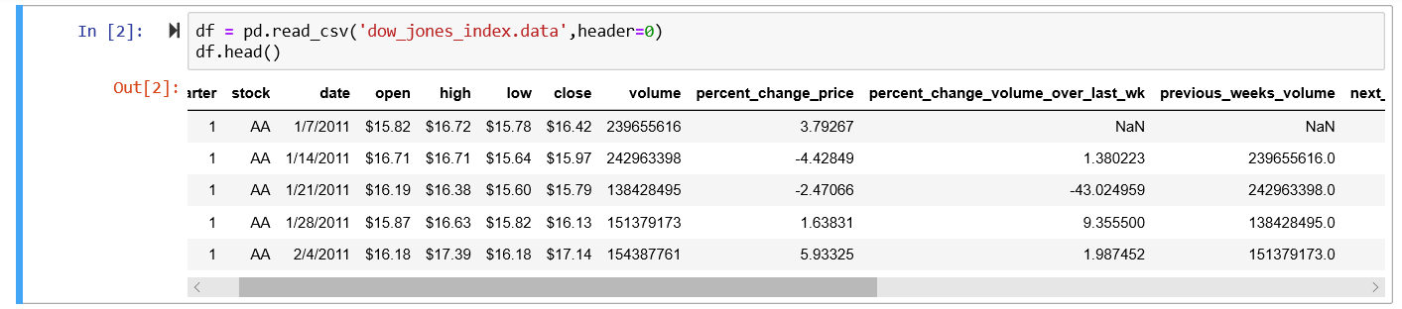

Data Cleaning
Missing values with ‘Nan’ in percentage_change_over_lst_wk and previous_weeks_volume columns

Slide 5
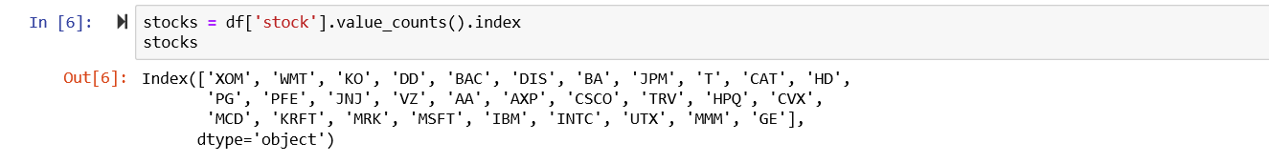
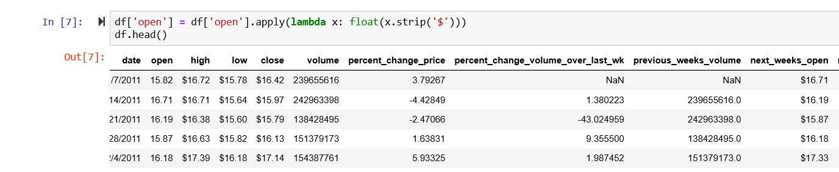
The below command gives the different stock names
Removing the $ sign from open column in the dataset for further analysis.

Slide 6
Data Transformation:
For stock market data the two most important factors are:
1.returns on the stock
2. volatility(stability) of the stock
Percentage returns on the stock is the mean of percent_change_price.
Volatility of the stock can be nothing but the standard deviation of the stock price.

Slide 7
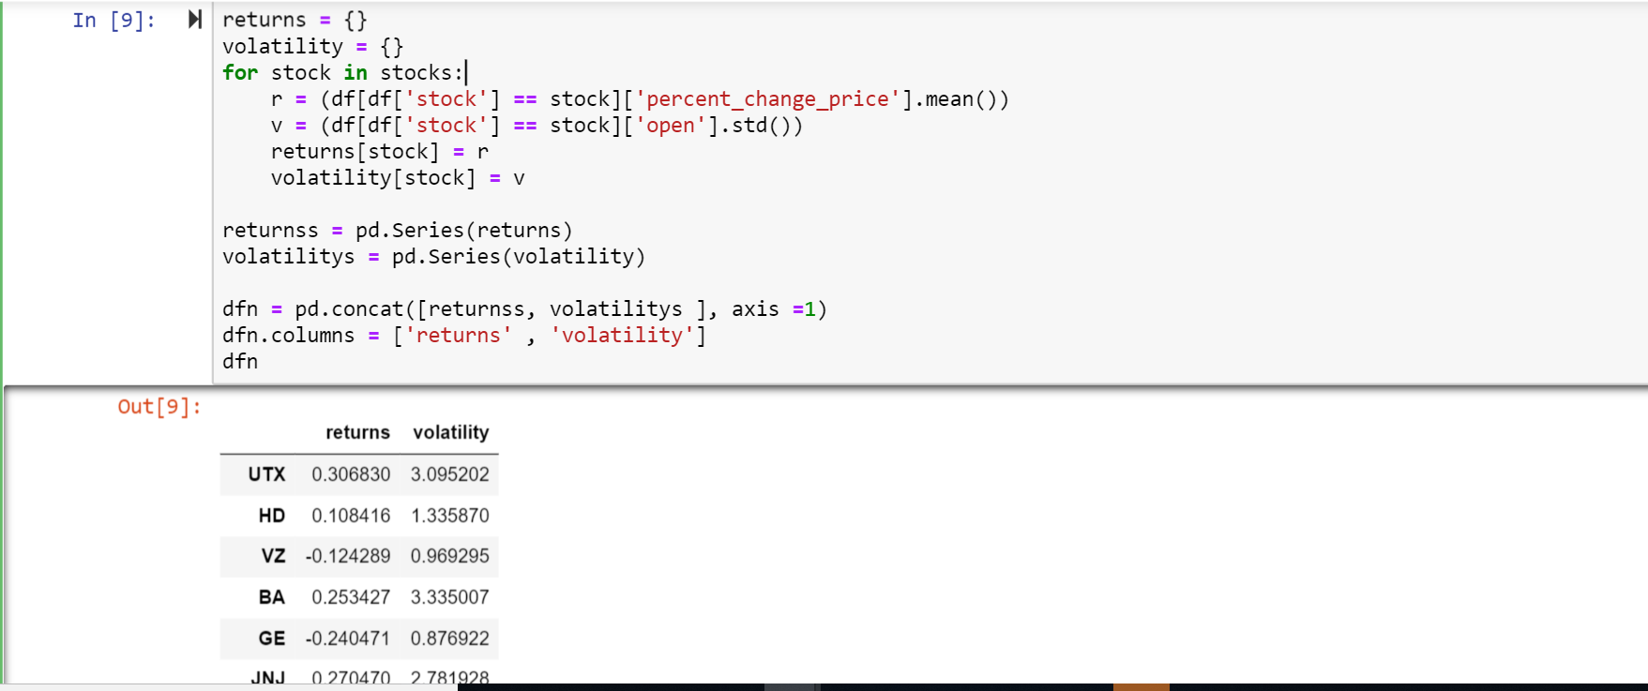
Feature Extraction:

Slide 8
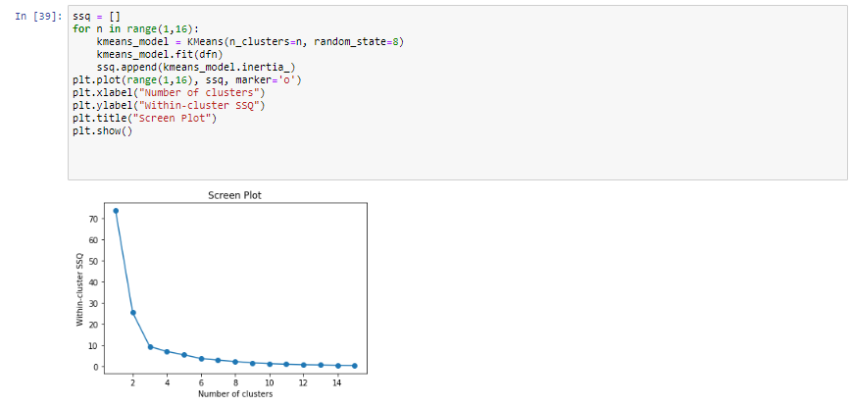
Clustering
Screen Plot: Screen plotting is a technique used to determine the number of clusters(K) which is called Elbow method.

Slide 9
Unsupervised Learning
Unsupervised learning is where you only have input data (X) and no corresponding output variables.
The goal for unsupervised learning is to model the underlying structure or distribution in the data in order to learn more about the data.
These are called unsupervised learning because unlike supervised learning above there is no correct answers and there is no teacher. Algorithms are left to their own devises to discover and present the interesting structure in the data.

Slide 10
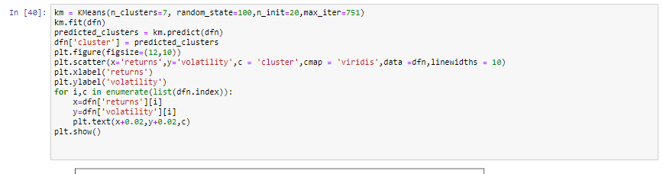
K- Means Clustering: K means clustering involves determining the number of clusters within an unlabeled multidimensional dataset.

Slide 11
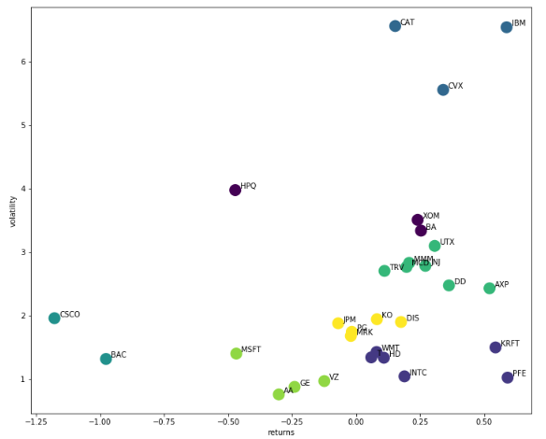

Slide 12
Silhouette Score: To depict the distance between the resulting clusters and the results is more effective if the distance between each point in a cluster is less so that the Silhouette score is nearing to 1.

Slide 13
Conclusion
IBM is High Volatile but is profitable stock as well. This stock can see high dramatic profits or loss. It is usually for traders who prefer taking risks.
PFE is Low Volatile and is profitable stock. New Stock Traders who want to invest can start with PFE as it wont have high loss but no high profits as well.
AA is the stock with most stability but loss as well.
For next week it is ideal to invest in PFE stock as it is giving highest return with more stability as well.

