Slide 1
Introduction to graphs

Slide 2
Section Overview
To learn what a graph is and how it is used.
To implement the graph abstract data type using multiple internal representations.
To see how graphs can be used to solve a wide variety of problems

Slide 3
Section Overview
Graphs are a more general structure than trees we can think of a tree as a special kind of graph.
Graphs can be used to represent many real-world things such as systems of roads, airline flights from city to city, how the Internet is connected, etc.
Once we have a good representation for a problem, we can use some standard graph algorithms to solve what otherwise might seem to be a very difficult problem.

Slide 4
Section Overview
Computers can operate well with information presented as a graph.
An example graph may be the course requirements for a computer science major

Slide 5
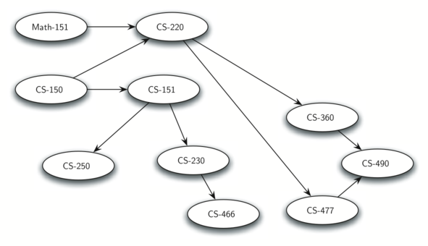
Example Graph

Slide 6
Vocabulary and Definitions
Now that we have looked at some examples of graphs, we will more formally define a graph and its components.
We already know some of these terms from our discussion of trees.

Slide 7
Vertex (Nodes)
A vertex (also called a “node”) is a fundamental part of a graph.
It can have a name, which we will call the “key.”
A vertex may also have additional information.
We will call this additional information the “payload.”

Slide 8
Edge
An edge connects two vertices to show that there is a relationship between them.
Edges may be one-way or two-way.
If the edges in a graph are all one-way, we say that the graph is a directed graph, or a digraph.
The class prerequisites graph shown previously is clearly a digraph since you must take some classes before others.

Slide 9
Weight
Edges may be weighted to show that there is a cost to go from one vertex to another.
For example in a graph of roads that connect one city to another, the weight on the edge might represent the distance between the two cities.

Slide 10
Formal Definition of a Graph
A graph can be represented by G where G=(V,E)
For the graph G, V is a set of vertices and E is a set of edges.
Each edge is a tuple (v,w) where w,v∈V
We can add a third component to the edge tuple to represent a weight.
A subgraph s is a set of edges e and vertices v such that e⊂E and v⊂V

Slide 11
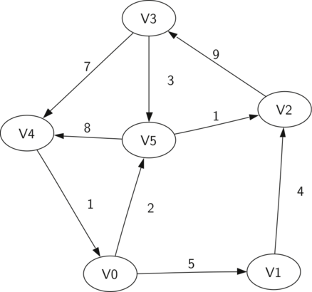
Example

Slide 12
Example
V={V0,V1,V2,V3,V4,V5}
E={(v0,v1,5),(v1,v2,4),
(v2,v3,9),(v3,v4,7),
(v4,v0,1),(v0,v5,2),
(v5,v4,8),(v3,v5,3),
(v5,v2,1)}

Slide 13
Path
A path in a graph is a sequence of vertices that are connected by edges.
Formally we would define a path as w₁,w₂,...,w_{n} such that (w_{i},w_{i+1})∈E for all 1≤i≤n−1
The unweighted path length is the number of edges in the path, specifically n−1.
The weighted path length is the sum of the weights of all the edges in the path.

Slide 14
Path Example
The path from V3 to V1 is the sequence of vertices (V3,V4,V0,V1)
The edges are {(v3,v4,7),(v4,v0,1),(v0,v1,5)}

Slide 15
Cycle
A cycle in a directed graph is a path that starts and ends at the same vertex.
A graph with no cycles is called an acyclic graph.
A directed graph with no cycles is called a directed acyclic graph or a DAG.
We will see that we can solve several important problems if the problem can be represented as a DAG.

Slide 16
Cycle Example
The path
(V5,V2,V3,V5)
is a cycle.

Slide 17
Review
Definition of a Graph
Important Graph Vocabulary Terms
Up next – how to represent and implement a Graph.

