Slide 1
Adjacency matrix and list

Slide 2
Section Overview
Learn how to represent graphs
  Adjacency Matrix
  Adjacency List
Implementation in next lecture

Slide 3
Adjacency Matrix
One of the easiest ways to implement a graph is to use a two-dimensional matrix.
In this matrix implementation, each of the rows and columns represent a vertex in the graph.
The value that is stored in the cell at the intersection of row v and column w indicates if there is an edge from vertex v to vertex w.
When two vertices are connected by an edge, we say that they are adjacent.

Slide 4
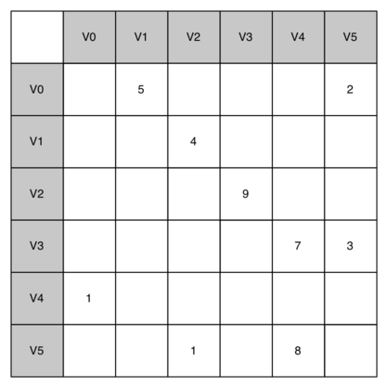
Adjacency Matrix

Slide 5
Adjacency Matrix
The advantage of the adjacency matrix is that it is simple, and for small graphs it is easy to see which nodes are connected to other nodes.
However, notice that most of the cells in the matrix are empty.
Because most of the cells are empty we say that this matrix is “sparse.”
A matrix is not a very efficient way to store sparse data.

Slide 6
Adjacency Matrix
The adjacency matrix is a good implementation for a graph when the number of edges is large.
Since there is one row and one column for every vertex in the graph, the number of edges required to fill the matrix is |V|².
A matrix is full when every vertex is connected to every other vertex.

Slide 7
Adjacency List
A more space-efficient way to implement a sparsely connected graph is to use an adjacency list.
In an adjacency list implementation we keep a master list of all the vertices in the Graph object and then each vertex object in the graph maintains a list of the other vertices that it is connected to.
In our implementation of the Vertex class we will use a dictionary rather than a list where the dictionary keys are the vertices, and the values are the weights.

Slide 8
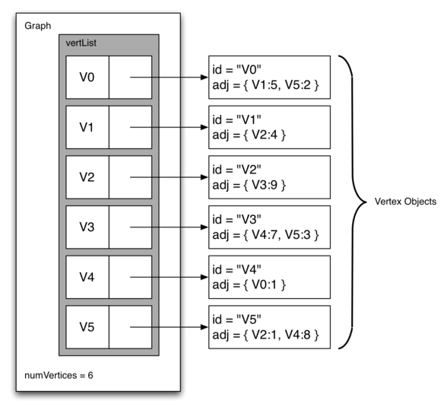
Adjacency List

Slide 9
Adjacency List
The advantage of the adjacency list implementation is that it allows us to compactly represent a sparse graph.
The adjacency list also allows us to easily find all the links that are directly connected to a particular vertex.

Slide 10
Adjacency List
Coming up … Implementation of an Adjacency List

