Slide 1
Depth First Search

Slide 2
Section Overview
Overview of General Depth First Search
Afterwards implementation walkthroughs
  Graphs
  BFS
  DFS

Slide 3
DFS
The knight’s tour is a special case of a depth first search where the goal is to create the deepest depth first tree, without any branches.
The more general depth first search is actually easier.
Its goal is to search as deeply as possible, connecting as many nodes in the graph as possible and branching where necessary.

Slide 4
DFS
The knight’s tour is a special case of a depth first search where the goal is to create the deepest depth first tree, without any branches.
The more general depth first search is actually easier.
Its goal is to search as deeply as possible, connecting as many nodes in the graph as possible and branching where necessary.

Slide 5
DFS
It is even possible that a depth first search will create more than one tree.
When the depth first search algorithm creates a group of trees we call this a depth first forest.
As with the breadth first search our depth first search makes use of predecessor links to construct the tree.

Slide 6
DFS
As with the breadth first search our depth first search makes use of predecessor links to construct the tree.
In addition, the depth first search will make use of two additional instance variables in the Vertex class.
The new instance variables are the discovery and finish times.
The discovery time tracks the number of steps in the algorithm before a vertex is first encountered.
The finish time is the number of steps in the algorithm before a vertex is colored black

Slide 7
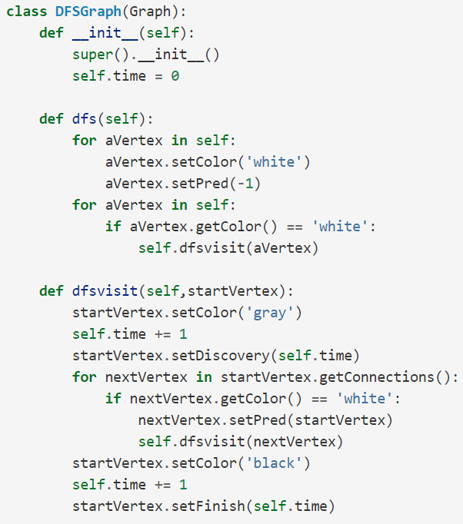
DFS

Slide 8
DFS

Slide 9
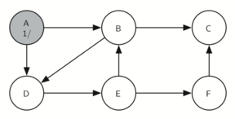
DFS
Constructing the Depth First Search Tree

Slide 10
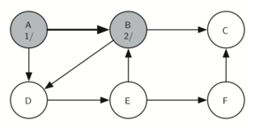
DFS
Constructing the Depth First Search Tree

Slide 11
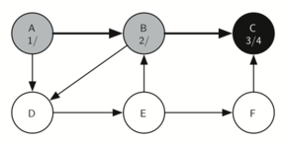
DFS
Constructing the Depth First Search Tree

Slide 12
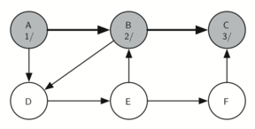
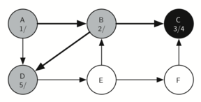
DFS
Constructing the Depth First Search Tree

Slide 13
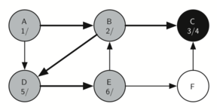
DFS
Constructing the Depth First Search Tree

Slide 14
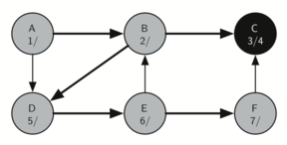
DFS
Constructing the Depth First Search Tree

Slide 15
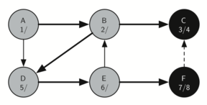
DFS
Constructing the Depth First Search Tree

Slide 16
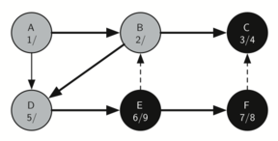
DFS
Constructing the Depth First Search Tree

Slide 17
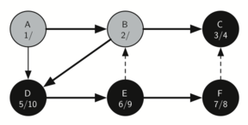
DFS
Constructing the Depth First Search Tree

Slide 18
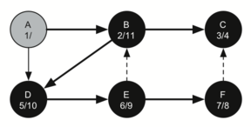
DFS
Constructing the Depth First Search Tree

Slide 19
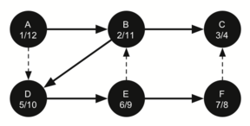
DFS
Constructing the Depth First Search Tree

Slide 20
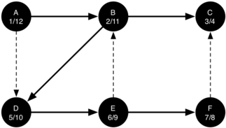
DFS
The starting and finishing times for each node display a property called the parenthesis property.
This property means that all the children of a particular node in the depth first tree have a later discovery time and an earlier finish time than their parent.

Slide 21
DFS
Up next…Live Code Implementation Walkthroughs
  Graph and Nodes
  Breadth First Search
  Depth First Search

