Slide 1
Knight’s Tour

Slide 2
Section Overview
Explain the Knight’s Tour Problem
Use Graphs to set up the solution
View a solution in Python
Continue on to Depth First Search

Slide 3
Knight’s Tour
The knight’s tour puzzle is played on a chess board with a single chess piece, the knight.
The object of the puzzle is to find a sequence of moves that allow the knight to visit every square on the board exactly once.

Slide 4
Knight’s Tour
We will solve the problem using two main steps:
  Represent the legal moves of a knight on a chessboard as a graph.
  Use a graph algorithm to find a path of length rows×columns−1 where every vertex on the graph is visited exactly once.

Slide 5
Knight’s Tour
We will solve the problem using two main steps:
  Represent the legal moves of a knight on a chessboard as a graph.
  Use a graph algorithm to find a path of length rows×columns−1 where every vertex on the graph is visited exactly once.

Slide 6
Knight’s Tour
To represent the knight’s tour problem as a graph we will use the following two ideas:
  Each square on the chessboard can be represented as a node in the graph.
  Each legal move by the knight can be represented as an edge in the graph.

Slide 7
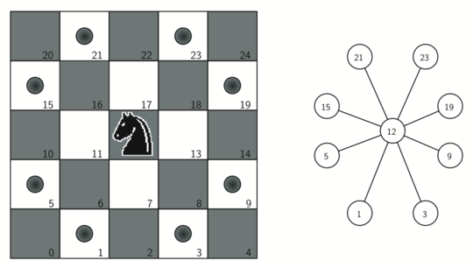
Knight’s Tour

Slide 8
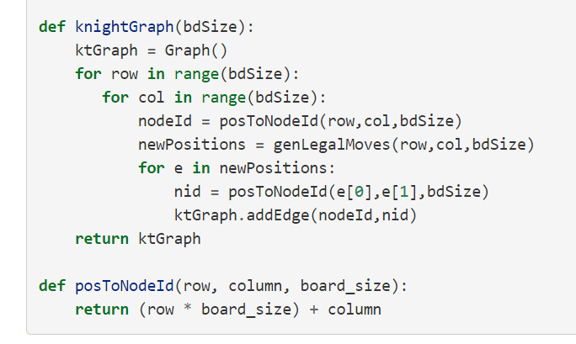
Knight’s Tour

Slide 9
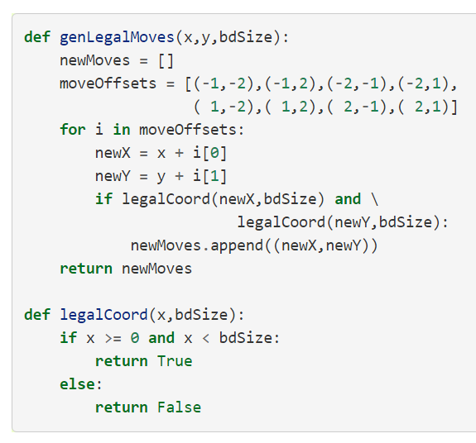
Knight’s Tour

Slide 10
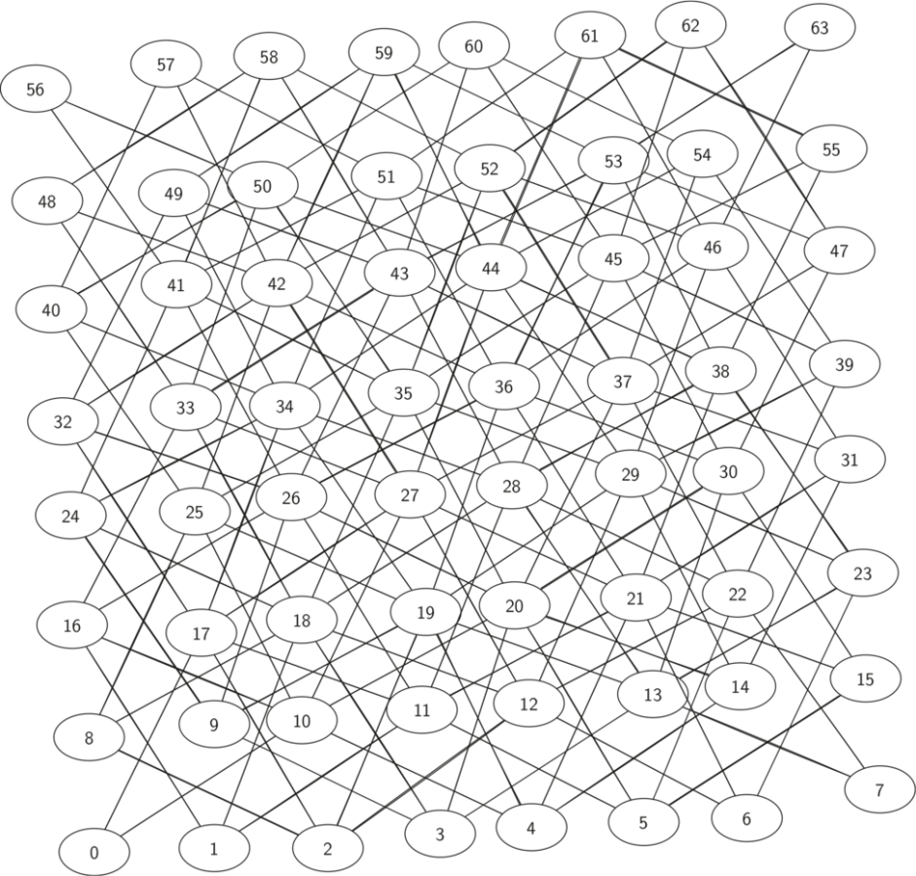
Knight’s Tour

Slide 11
Knight’s Tour
The search algorithm we will use to solve the knight’s tour problem is called depth first search (DFS).
Whereas the breadth first search algorithm discussed in the previous section builds a search tree one level at a time, a depth first search creates a search tree by exploring one branch of the tree as deeply as possible.

Slide 12
Knight’s Tour
In this section we will look at two algorithms that implement a depth first search.
The first algorithm we will look at directly solves the knight’s tour problem by explicitly forbidding a node to be visited more than once.
The second implementation is more general, but allows nodes to be visited more than once as the tree is constructed. (This will be the general DFS discussed later)

Slide 13
Knight’s Tour
The depth first exploration of the graph is exactly what we need in order to find a path that has exactly 63 edges.
We will see that when the depth first search algorithm finds a dead end (a place in the graph where there are no more moves possible) it backs up the tree to the next deepest vertex that allows it to make a legal move.

Slide 14
Knight’s Tour
The knightTour function takes four parameters:
  n, the current depth in the search tree
  path, a list of vertices visited up to this point
  u, the vertex in the graph we wish to explore
  limit the number of nodes in the path.
The knightTour function is recursive.

Slide 15
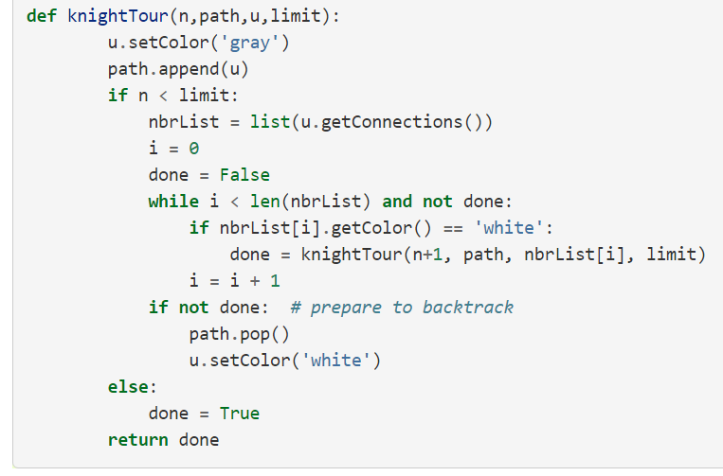
Knight’s Tour

Slide 16
Knight’s Tour
When the knightTour function is called, it first checks the base case condition.
If we have a path that contains 64 vertices, we return from knightTour with a status of True, indicating that we have found a successful tour.
If the path is not long enough we continue to explore one level deeper by choosing a new vertex to explore and calling knightTour recursively for that vertex.

Slide 17
Knight’s Tour
DFS also uses colors to keep track of which vertices in the graph have been visited.
Unvisited vertices are colored white, and visited vertices are colored gray.
If all neighbors of a particular vertex have been explored and we have not yet reached our goal length of 64 vertices, we have reached a dead end.
When we reach a dead end we must backtrack

Slide 18
Knight’s Tour
Backtracking happens when we return from knightTour with a status of False.
In the breadth first search we used a queue to keep track of which vertex to visit next.
Since depth first search is recursive, we are implicitly using a stack to help us with our backtracking.
When we return from a call to knightTour with a status of False we remain inside the while loop and look at the next vertex in nbrList.

Slide 19
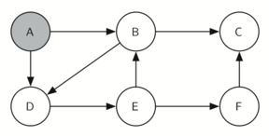
Knight’s Tour
Knight's tour example

Slide 20
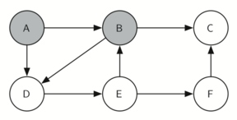
Knight’s Tour
Knight's tour example

Slide 21
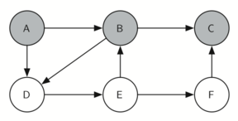
Knight’s Tour
Knight's tour example

Slide 22

Knight’s Tour
Knight's tour example

Slide 23
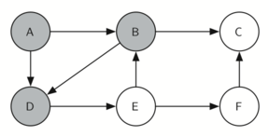
Knight’s Tour
Knight's tour example

Slide 24
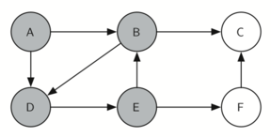
Knight’s Tour
Knight's tour example

Slide 25
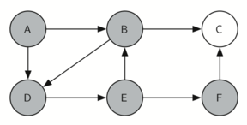
Knight’s Tour
Knight's tour example

Slide 26
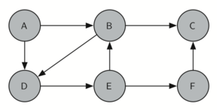
Knight’s Tour
Knight's tour example

Slide 27
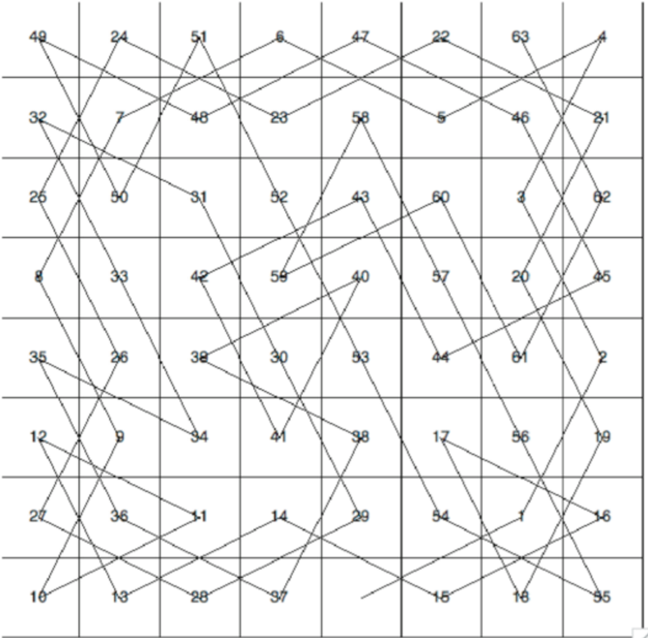
Knight’s Tour
Knight's tour example

Slide 28
Knight’s Tour
We’ve gotten a brief overview of possible special use case for depth first search.
Up next general DFS
Afterwards full walkthrough implementations

