Slide 1
Word Ladder Problem

Slide 2
Section Overview
Learn about the Word Ladder Problem
Solve problem with Graph
Implementation of solution in Python
Begin thinking about Graph Traversal

Slide 3
Word Ladder
Consider the following puzzle called a word ladder.
Transform the word “FOOL” into the word “SAGE”.
In a word ladder puzzle you must make the change occur gradually by changing one letter at a time.
At each step you must transform one word into another word, you are not allowed to transform a word into a non-word.

Slide 4
Word Ladder
FOOL
POOL
POLL
POLE
PALE
SALE
SAGE

Slide 5
Word Ladder
We can solve this problem using a graph algorithm.
  Represent the relationships between the words as a graph.
  Use the graph algorithm known as breadth first search to find an efficient path from the starting word to the ending word.

Slide 6
Word Ladder
Figure out how to turn a large collection of words into a graph.
What we would like is to have an edge from one word to another if the two words are only different by a single letter.
Then any path from one word to another is a solution to the word ladder puzzle.

Slide 7
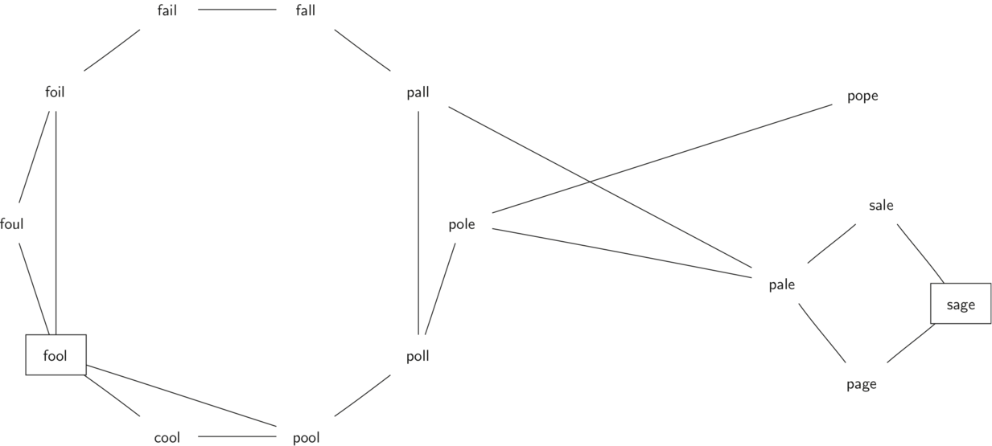
Word Ladder

Slide 8
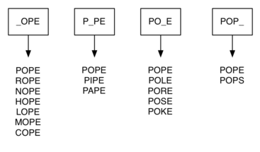
Word Ladder
Suppose that we have a huge number of buckets, each of them with a four-letter word on the outside, except that one of the letters in the label has been replaced by an underscore.

Slide 9
Word Ladder
We can implement the scheme we have just described by using a dictionary.
The labels on the buckets we have just described are the keys in our dictionary.
The value stored for that key is a list of words.

Slide 10
Word Ladder
Once we have the dictionary built we can create the graph.
We start our graph by creating a vertex for each word in the graph.
Then we create edges between all the vertices we find for words found under the same key in the dictionary.

Slide 11
Word Ladder
Let’s see the implementation in Python!

