Slide 1


CIS 631 PROJECT PROGRESS REPORT 1
Reliable ML-driven
marketing targeting
By Manav Mendonca and Srajan Jain

Slide 2

Problem statement and project objective
Problem
Traditional response models find likely buyers. Marketing teams need to know whose behavior changes because of a campaign, which treatment to send, and what to say when budgets limit contact volume.
Our Solution
Integrate segmentation, causal uplift modeling, and generative AI into a reliable framework for campaign targeting and personalized communication under limited budgets.
Notes:
The proposed system answers three linked business decisions: who to contact, which treatment to use, and what message to generate.

Slide 3
Research Questions
Customer Segmentation
What distinct customer profiles emerge from historical behavior and prior channels, and how do their observed campaign responses differ?
Propensity vs Uplift
How effectively does uplift modeling identify customers whose purchase probability changes because of an email campaign?
Generative AI
Can GenAI turn uplift-based profiles and treatments into relevant, grounded, and treatment-aligned multi-step messages?
Reliability
Treatment and Budget Optimization
How do T-Learner, X-Learner, and ensemble approaches maximize incremental conversions at 5%, 10%, and 20% contact limits?
How stable are uplift rankings and treatment recommendations across model specifications and training samples?

Slide 4
Related work shaping the project
Incremental Response:
Uplift modeling estimates the effect of contact rather than the probability of purchase alone.
Causal Meta-Learners:
T-Learner and X-Learner provide flexible estimates of heterogeneous treatment effects.
Grounded Generation:
The language model receives a model-based recommendation and generates copy from supplied facts.
Customer Profiles:
Clustering uses only information available before treatment, then outcomes profile each segment.

Slide 5
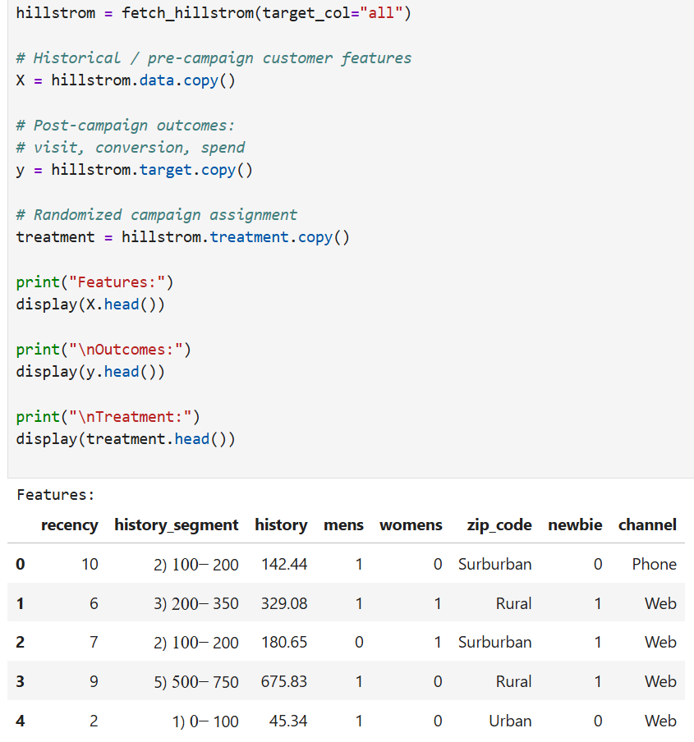
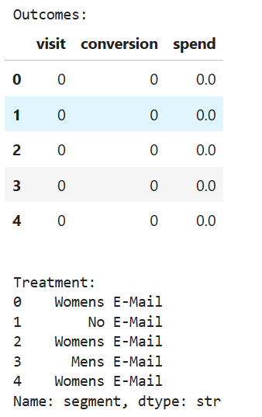
Data acquisition and experiment structure
64,000
12
customers
total columns
3
3
randomized groups
post-campaign outcomes
Treatments
Men's Email Women's Email No Email
Outcomes
Visit Conversion Spend

Slide 6
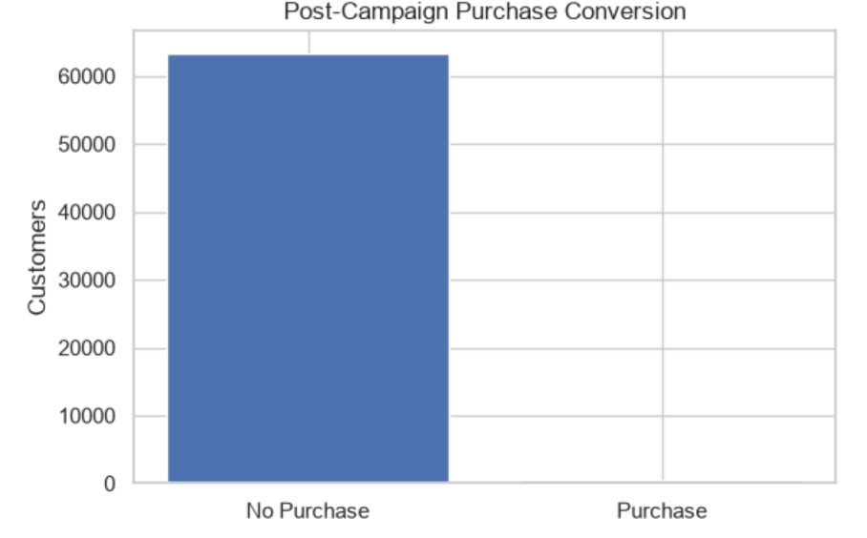
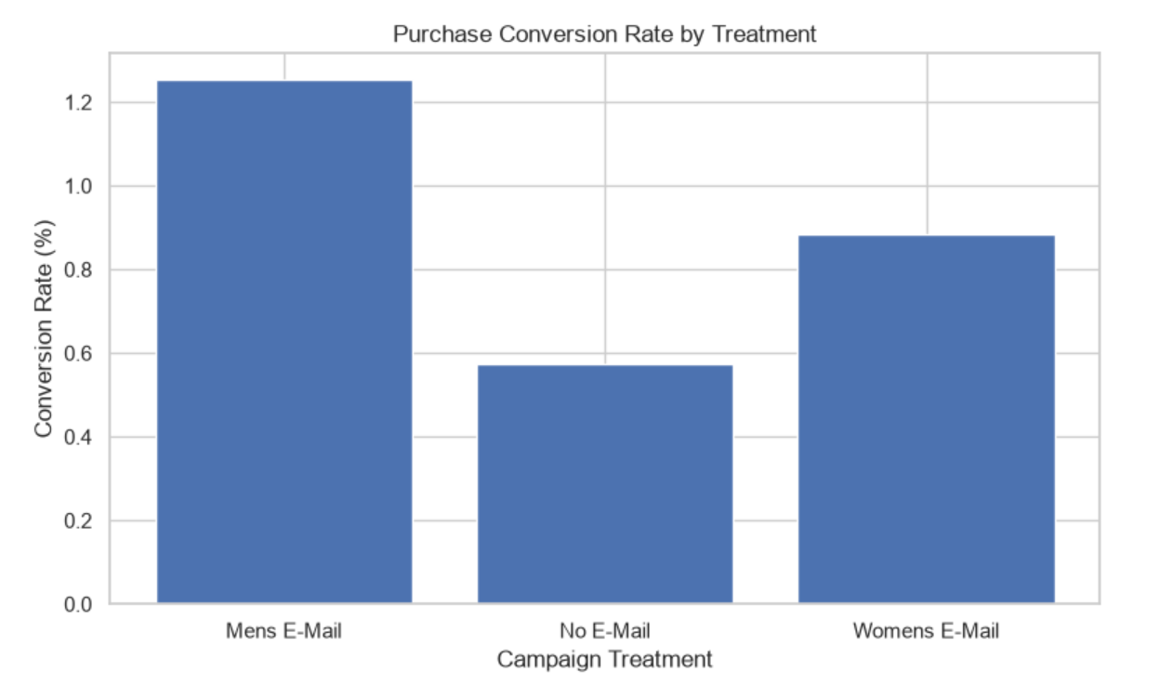
Initial Exploration
Outcome imbalance
Treatment-level response
578
0.90%
1.25%
0.57%
0.88%
Purchases
Overall Conversion
Men's Email
No Email
Women’s Email

Slide 7
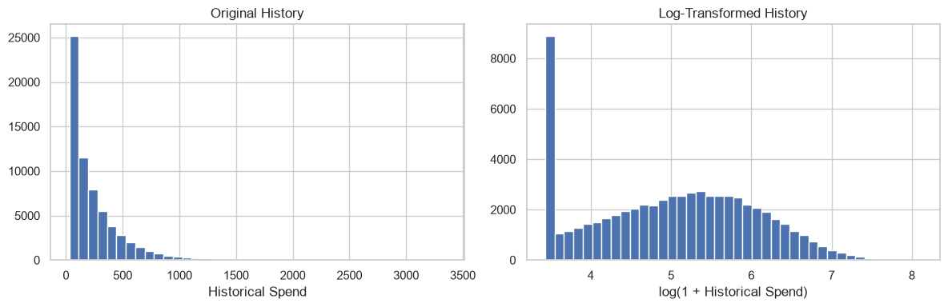
Preprocessing and feature preparation
Cleaning
Leakage control
Feature engineering
Trimmed string fields
Corrected Suburban label
Validated binary values
Checked 0 missing values
Excluded treatment, visit, conversion, and spend from customer segmentation inputs.
Log transformed history
Standardized numeric fields
One-hot encoded channel and geography
Prepared modeling objects
X_model
64,000 × 7 leakage-safe features
X_cluster
64,000 × 11 scaled and encoded features
X_encoded
64,000 × 11 supervised model features
Duplicate rows retained because the dataset has no unique customer ID.

Slide 8
Baseline implementation progress
Data and modeling foundation
Complete | Data Ingestion | All three outcomes and randomized treatment loaded
Complete | Exploration | Class balance, raw response rates, spending, and covariate balance
Complete | Preprocessing | Leakage-safe matrices for clustering and supervised models
Next Step | Propensity baseline | Traditional purchase-probability model has not yet been trained
Planned | Causal baselines | Men's and Women's treatments compared separately with control
Our data is ready for modeling but no predictive performance claims are being made yet.

Slide 9
Current roadblocks and design risks
Current Roadblocks and Design Risks
Rare purchases | Only 578 conversions limit signal strength and make accuracy a misleading metric.
Multiple treatments | Men's Email and Women's Email need separate effects relative to the same control group.
Reliable ranking | The project must test whether the top 5%, 10%, and 20% remain stable across samples and models.
Outcome limits | Hillstrom can validate audience and treatment recommendations, but it cannot prove that newly generated drip messages increase conversion.

Slide 10
Next steps and deliverables
Customer Segmentation
Select cluster count, fit segments, and profile treatment response after clustering.
Propensity vs Uplift
Train the propensity baseline, then T-Learner, X-Learner, and an ensemble for both email treatments.
Generative AI campaign orchestration
Budget and reliability evaluation
Compare incremental conversions at 5%, 10%, and 20%; repeat splits to measure ranking and recommendation agreement.
Generate multi-step messages from selected customer profiles and score relevance, factual grounding, and treatment alignment.

