Slide 1
CS5304 – JAVA PROGRAMMING PBL Project Review
LEARNSPHERE: PERSONALIZED LEARNING MANAGEMENT PLATFORM
Presented by:
S.Rajit (2104251040821)
Computer Science and Engineering
Mentor:
Mrs. M. Geetha . M.E.
Computer Science and Engineering
Date: 07/10/2026

Slide 2
Problem Statement
Traditional academic institutions rely on fragmented, manual systems for managing course delivery, student assessments, and performance tracking.
Students and faculty are affected by inefficient communication and lack of centralized access to learning materials.
Existing systems are often disjointed, requiring separate platforms for videos, quizzes, and grading.
LearnSphere provides a unified Java-based (Spring Boot) solution integrating courses, auto-graded quizzes, and GPA tracking into a single web application.

Slide 3
Objective & Expected Outcome
Objectives:
  Identify and analyse the fragmentation in college management.
  Design a unified Spring Boot platform for learning and academic management.
  Implement role-based access control, MCQ auto-grading, and GPA analytics using Java programming.
  Test and evaluate the application using H2 Database and Thymeleaf.
Expected Outcome:
  A functional Java-based LMS capable of addressing academic tracking efficiently and providing a unified, dark-themed user-friendly solution.

Slide 4
Input, Processing & Functional Analysis
Input / Data Sources:
  User credentials, MCQ answers, YouTube URLs, and internal/external marks.
Processing / Functional Analysis:
  Spring Security validates inputs and manages RBAC authentication.
  Service layer grades quizzes and automatically computes GPA/CGPA.
Key Functionalities:
  1. Role-Based Access Control (Student/Faculty/Admin)
  2. Course & Video Playlist Management
  3. Auto-Graded MCQ Quizzes
  4. GPA/CGPA Analytics Dashboard
  5. Interactive Performance Visualization (Chart.js)

Slide 5
Technical Approach
System Architecture:
  Users → Spring Security (Auth) → Controllers → Service Layer → JPA Repositories → H2 Database.
Java Concepts and Implementation:
  Utilizes Object-Oriented Design (Entities), Collections, Exception Handling, and Layered MVC Architecture.
Technology Stack:
  Programming Language: Java 17
  IDE: IntelliJ IDEA
  Database: H2 In-Memory (JPA / Hibernate)
  Frameworks: Spring Boot 3.2.5, Spring Security 6, Thymeleaf
  Tools: Maven, Git

Slide 6
Feasibility, Risk and Challenges
Feasibility:
  Technical: Developed entirely using open-source Java technologies.
  Operational: Simple and accessible via any web browser.
  Economic: Zero-cost tools (Spring Boot, H2, Bootstrap).
Risk and Challenges:
  Configuring comprehensive Role-Based Access Control accurately.
  Establishing proper JPA entity relationships (OneToMany) without circular dependencies.
  Designing a consistent dark-themed UI resolving CSS contrast issues.

Slide 7
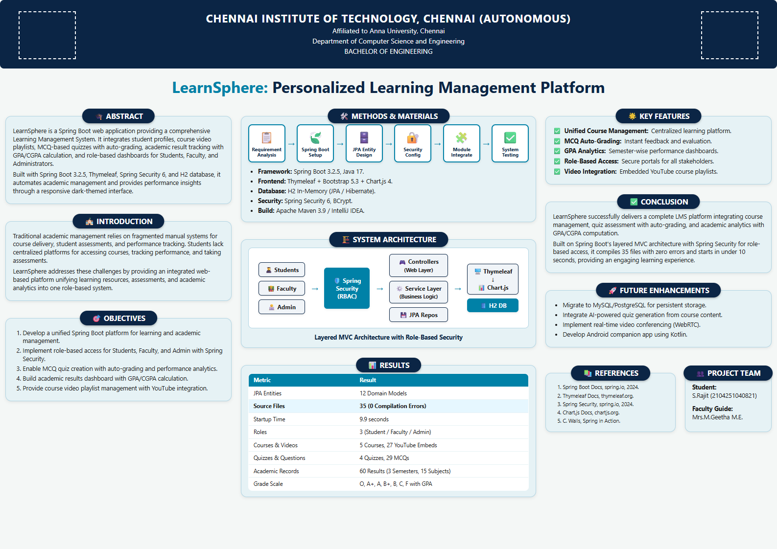
Result (Project Output)
LearnSphere fully compiles 35 Java source files with 0 errors and boots in <10 seconds.

Slide 8
Conclusion, Limitations & Future Scope
Conclusion:
  Developed LearnSphere using Java Spring Boot to address fragmented academic workflows. It successfully integrates courses, quizzes, and GPA analytics into a cohesive, secure LMS.
Future Scope:
  Migrate to MySQL/PostgreSQL for persistent storage.
  Integrate AI-powered quiz generation.
  Implement real-time video conferencing (WebRTC).
Limitations:
  In-memory H2 database resets data on restart.
  Quiz timer is enforced at UI level, not server side.

Slide 9
Thank You!
GitHub Repository:
  https://github.com/srajitcse2025-max/LearnSphere.git
S.Rajit (2104251040821)
Computer Science and Engineering
Date: 07/10/2026

