Slide 1
Coursera Capstone IBM Applied Data Science Capstone
Opening a New Shopping Mall in Mumbai, India
By: Sravya Kodavati

Slide 2

Business Problem
Location of the shopping mall is one of the most important decisions that will determine whether the mall will be a success or a failure
Objective: To analyze and select the best locations in the city of Mumbai, India to open a new shopping mall
This project is timely as the city is currently suffering from oversupply of shopping malls
Business question:
In the city of Mumbai, India, if a property developer is looking to open a new shopping mall, where would you recommend that they open it?

Slide 3
Data
Data required
List of neighborhoods in Kuala Lumpur
Latitude and longitude coordinates of the neighborhoods
Venue data, particularly data related to shopping malls
Sources of data
Wikipedia page for neighborhoods (https://en.wikipedia.org/wiki/Category:Suburbs_of_Mumbai)
Geocoder package for latitude and longitude coordinates
Foursquare API for venue data

Slide 4
Methodology
Web scraping Wikipedia page for neighborhoods list
Get latitude and longitude coordinates using Geocoder
Use Foursquare API to get venue data
Group data by neighborhood and taking the mean of the frequency of occurrence of each venue category
Filter venue category by Shopping Mall
Perform clustering on the data by using k-means clustering
Visualize the clusters in a map using Folium

Slide 5
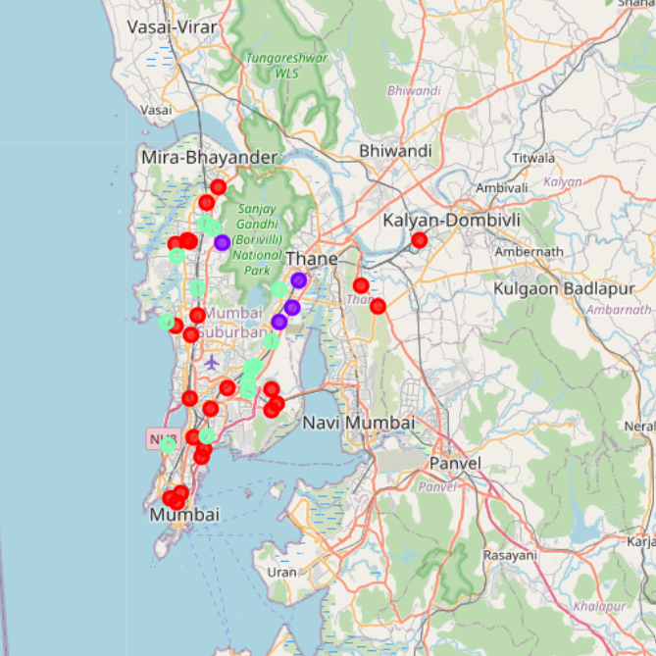
Results
Categorized the neighborhoods into 3 clusters :
Cluster 0: Neighborhoods with low number to no existence of shopping malls
Cluster 1: Neighborhoods with high concentration of shopping malls
Cluster 2: Neighborhoods with moderate number of shopping malls

Slide 6
Discussion
Most of the shopping malls are concentrated in the southern part of the city
Highest number in cluster 1 and moderate number in cluster 2
Cluster 0 has very low number to no shopping mall in the neighborhoods

Slide 7
Recommendations
Open new shopping malls in neighborhoods in cluster 0 with little to no competition
Can also open in neighborhoods in cluster 2 with moderate competition if have unique selling propositions to stand out from the competition
Avoid neighborhoods in cluster 1, already high concentration of shopping malls and intense competition

Slide 8

Thank You

