Slide 1
ANGULAR7 FEATURES
KVSREERAM

Slide 2
CONTENT
ANGULAR 7
FEATURES OF ANGULAR 7
ANIMATION
MATERIAL
GUARDS

Slide 3
WHAT IS ANGULAR
ANGULAR IS AFRAMEWORK WHICH HELPS IN BULIDING WEB APPLICATION AND IT IS ALSO POPULAR BECAUSE OF ITS UNIQUE FEATURES WHICH WILL HELP BULIDING APPLICATION EASY AND IT IS OPEN SOURCE FRAMEWORK AND IT COMPLETELY RELIES ON HTML AND JS AND TS WHICH HELPS IN BULIDING DYNAMIC WEB APPLICATION.

Slide 4
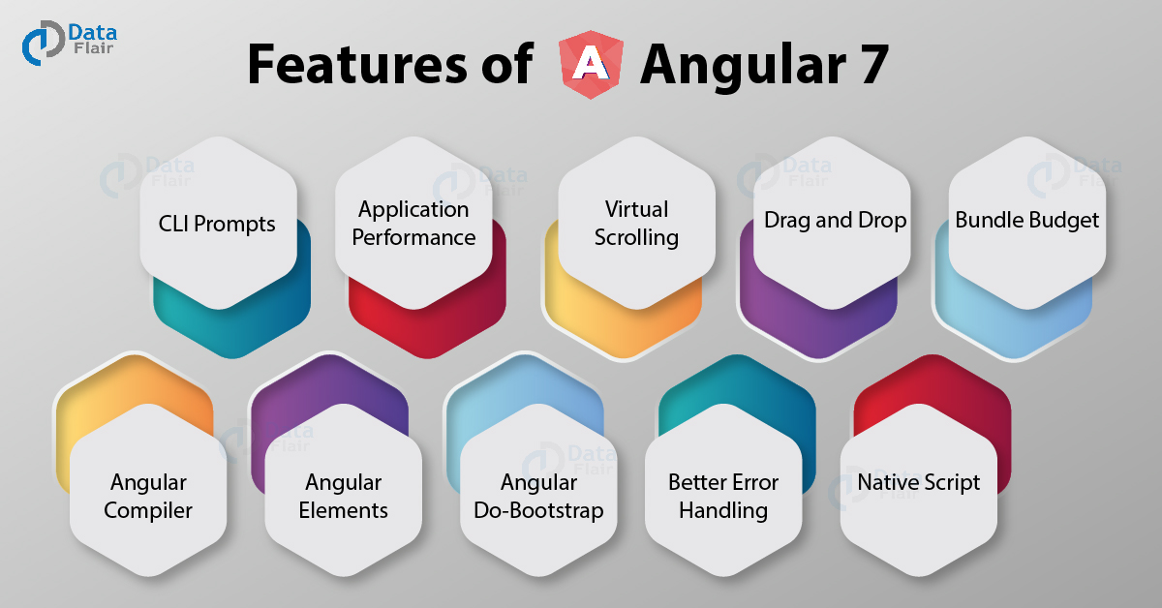
FEATURES OF ANGULAR 7

Slide 5
1. CLI Prompts
In angular 7, the command line interface (CLI) prompts has been modernized to version 7.0.2. With the new and updated version of angular CLI comes new features. When the user executes common commands like ng add @angular/material or ng new, it will prompt users. It helps users to explore the in-built SCSS support, routing, etc. To benefit all packages that publish schematics, CLI prompts have been added to schematics too.

Slide 6
2. Application Performance
Angular 7 is faster as compared to the previous versions of angular. Certain new features introduced as discussed above makes the app run faster and perform better. It does not only focus on making framework small but makes the app small too as much as possible. In version 7 the reflect-metadata polyfill (includes in production) remove automatically.

Slide 7
3. Virtual Scrolling
Angular 7 comes with virtual scrolling. Virtual scrolling allows users to bind a list of elements even its too long in small packets. As per the scroll movements, data will be supplied into packets at the user end. This is one of the Angular 7 features, which is beneficial for mobile apps where scrolling can affect performance. But useful for web applications too as even in web applications if we scroll a long list of data, performance gets affected.

Slide 8
4. Drag and Drop
dragging and dropping items in the list user can re-order the list. It also allows the transfer of elements between the lists. Using CDK drag handle, a user can customize the drag area as per requirement. Multiple handles apply on a single item if requires. As per the user’s command, the item may move along the X-axis or the Y-axis because the movement of drag and drop restricts along an axis.

Slide 9
5. Angular Compiler
The new angular compiler offers an 8-phase rotating ahead-of-time compilation. The NGCC (Angular Compatibility Compiler) will convert node_modules compiled with Angular Compatibility Compiler (NGCC), into node_modules which appear to have been composed with TSC compiler transformer (NTSC). Also, Ivy rendering engine can use such “legacy” package due to this compiler change

Slide 10
6. Angular Do-Bootstrap
It uses to bootstrap those modules which require bootstrap of components. Angular 7 offers interface (DoBootstrap) and new life-cycle hoop (ngDoBootstrap).

Slide 11
7. Better Error Handling
Angular 7 improves error handling in an angular application. @Output in angular7.0 has an improved error handling feature.

Slide 12
10. Native Script
Before Angular 7 developers have to create separate projects for mobile and web version of the application but Now through a single project, users can build a web and mobile app too. A native script schematics collection provide this functionality. The codes for the web and mobile apps will maintain in such a way that the shareable part keep at one place and non-shareable ones can create separately but in a single project.

Slide 13
GUARD
Guards are implemented as services that need to be provided so we typically create them as @Injectable classes.
Guards return either true if the user can access a route or false if they can’t.
They can also return an Observable or Promise that later on resolves to a boolean in case the guard can’t answer

Slide 14
GUARDS IN ANGULAR 7
.There are four different types of Guards:
CanActivate
Checks to see if a user can visit a route.
CanActivateChild
Checks to see if a user can visit a routes children.
CanDeactivate
Checks to see if a user can exit a route.
Resolve
Performs route data retrieval before route activation.

Slide 15
ANIMATIONS IN ANGULAR
Animation provides the illusion of motion: HTML elements change styling over time. Well-designed animations can make your application more fun and easier to use, but they aren't just cosmetic. Animations can improve your app and user experience in a number of ways:
Without animations, web page transitions can seem abrupt and jarring.
Motion greatly enhances the user experience, so animations give users a chance to detect the application's response to their actions.
Good animations intuitively call the user's attention to where it is needed.
Typically, animations involve multiple style transformations over time. An HTML element can move, change color, grow or shrink, fade, or slide off the page. These changes can occur simultaneously or sequentially. You can control the timing of each transformation.
Angular's animation system is built on CSS functionality, which means you can animate any property that the browser considers animatable. This includes positions, sizes, transforms, colors, borders, and more. The W3C maintains a list of animatable properties on its CSS Transitions page.

Slide 16
ANIMATIONS IN ANGULAR
To start with, we need to import the library with the below line of code −
import { BrowserAnimationsModule } from '@angular/platform-browser/animations';

Slide 17
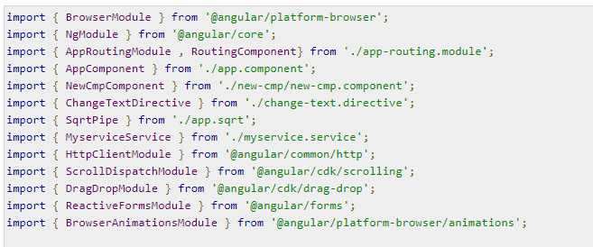
ANIMATIONS IN ANGULAR
The BrowserAnimationsModule needs to be added to the import array in app.module.ts as shown below −

Slide 18
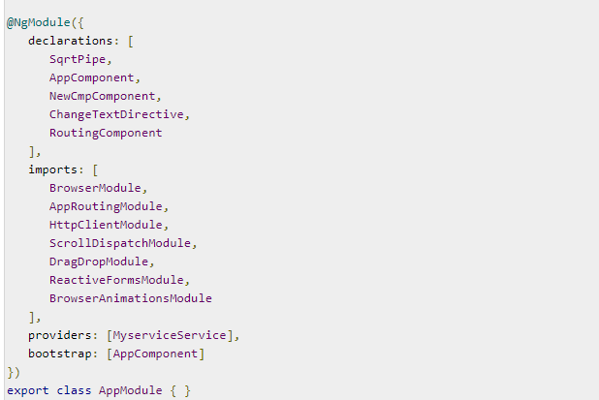
ANIMATIONS IN ANGULAR

Slide 19
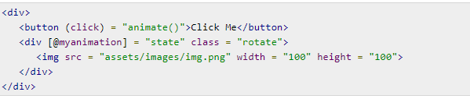
ANIMATIONS IN ANGULAR
Let us now see the app.component.ts where the animation is defined.

Slide 20
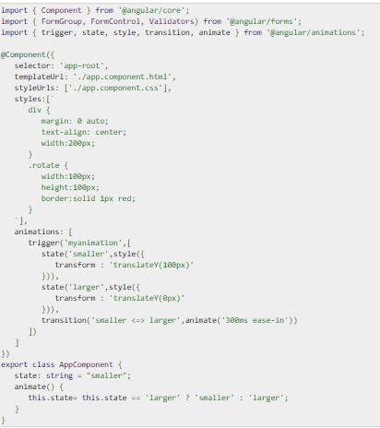
ANIMATIONS IN ANGULAR

Slide 21
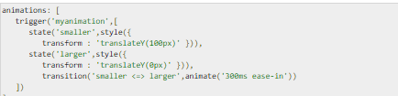
ANIMATIONS IN ANGULAR
We have to import the animation function that is to be used in the .ts file

Slide 22

ANIMATIONS IN ANGULAR
Let us now see the .html file to see how the transition function works

Slide 23

ANIMATIONS IN ANGULAR
Here, a special character [``] is used to add styles to the html element, if any. For the div, we have given the animation name defined in the app.component.ts file.
On the click of a button it calls the animate function, which is defined in the app.component.ts file −

Slide 24
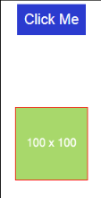
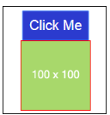
ANIMATIONS IN ANGULAR
This is how the output in the browser (http://localhost:4200/) will look like −

Slide 25
MATERIALS IN ANGULAR
.Angular Materials is a UI component for the Angular framework. Angular Material help to create attractive, consistent and functional web pages and also help to create modern web design principles like lightweight, device independence.
Materials offer a lot of built-in modules for your project. Features such as autocomplete, datepicker, slider, menus, grids, and toolbar are available for use with materials in Angular 7.

Slide 26
MATERIALS IN ANGULAR
To install Angular Material as a dependency of your project, run the following command:
npm install @angular/material @angular/cdk IS USED

Slide 27

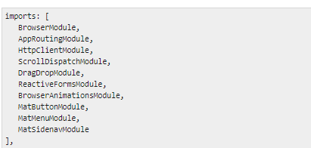
MATERIALS IN ANGULAR
In the above file, we have imported the following modules from @angular/materials.

Slide 28
MATERIALS IN ANGULAR
Let us now add the material-css support in styles.css
To add menu, <mat-menu></mat-menu> is used. The file and Save As items are added to the button under mat-menu. There is a main button added Menu. The reference of the same is given the <mat-menu> by using [matMenuTriggerFor]="menu" and using the menu with # in<mat-menu>.

Slide 29

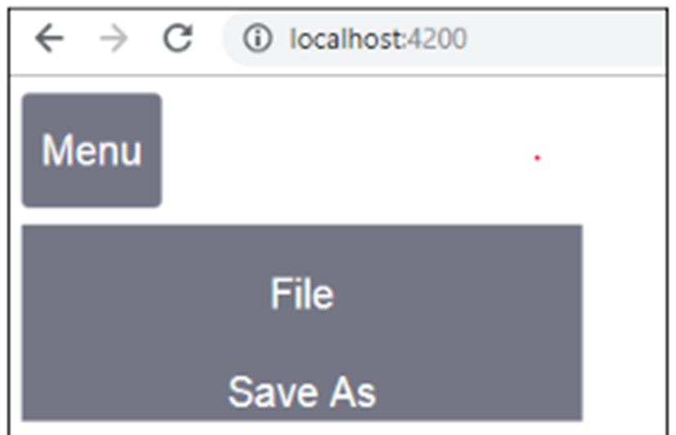
MATERIALS IN ANGULAR

