Slide 1
<theme word>
<theme word>
<theme word>
Please read the hidden slide following the walk-in to learn more about this editable walk-in slide utilizing the event thematic identity system.
Delete this text box.

Slide 2
Analytics for every need with Power BI
TECH-BAAI301
Adam Wilson
Group Program Manager, Power BI
#TECH-BAAI301

Slide 3
Confidentiality slide

Slide 4
Session objectives and takeaways
At the end of this session, you should be
better able to…
Describe the Power BI service roadmap for H2 CY17
Understand impact of June 1 licensing changes

Slide 5
Agenda
Free-free transition
Power BI Premium updates
New options for sharing and distribution
Automation, ALM, and more with APIs
Data sources
Governance and controls

Slide 6
Free-Free transition

Slide 7
Free-Free Transition
Starting June 1, Power BI free is purely a Personal solution
Most previous users on free will need to be covered by a paid subscription to continue to accomplish their tasks
There are important dates when your customers may experience these changes

Slide 8
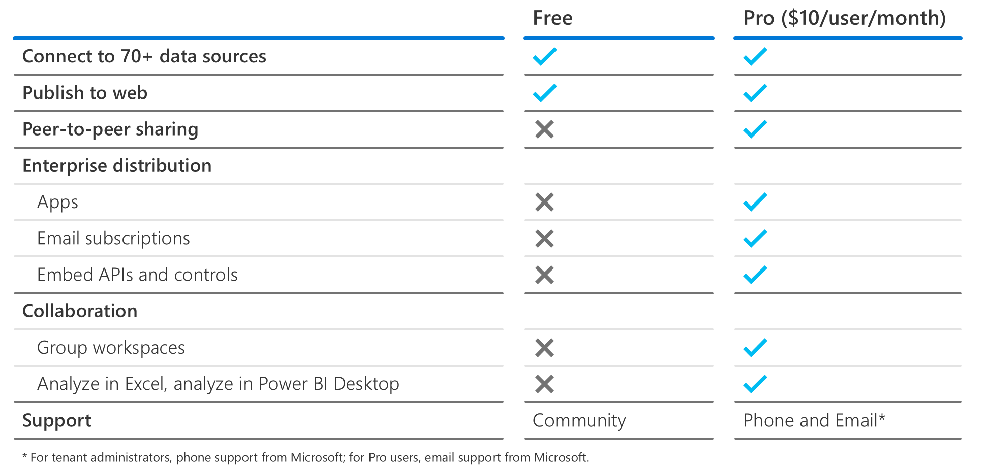
Power BI user license tiers
From Power BI Premium overview deck on https://aka.ms/bi (slide 16 - hidden)

Slide 9
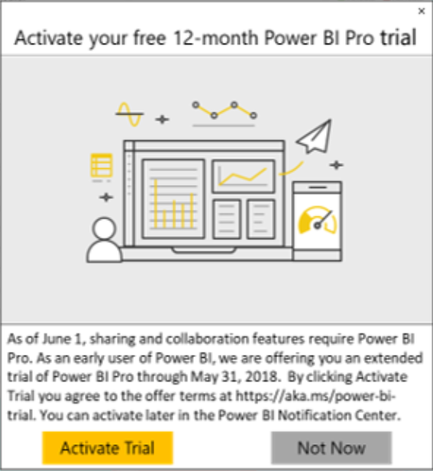
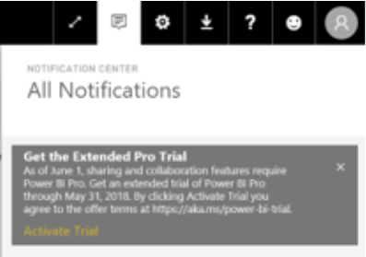
Impact of free changes on users
Existing active users that signed up before May 3, 2017
Eligible for an extended Pro trial through May 31, 2018 (requires activation on a per user basis).
Users that signed up for free from May 3-31, 2017
For an interim period, they had the previous definition of free, but on June 1 they would have transitioned to the new definition of free. If they used Pro features, they likely would have started the standard 60-day Pro trial.
If a user doesn’t activate the extended Pro trial but continues to use Pro features, they will get the standard 60-day Pro trial (but can activate the extended trial at any time).
New users that signed up starting June 1, 2018
Most new signups from the website or new user signups as a result of receiving shared content now automatically start the standard 60-day Pro trial.
See Extended Power BI Pro trial sign up user experience clickthrough deck on https://aka.ms/bi

Slide 10
Planning for free changes in your accounts
Existing mature deployments
Impact: Most or all users are eligible for an extended Pro trial through May 31, 2018.
Approach: Assist users with activating extended trials and plan for paid licensing by expiry date.
Existing growing deployments
Impact: Some users will be eligible for the extended Pro trial, but many new users will not.
New deployments
Approach: Plan for paid licensing now, either for only new users or entire user base.
Impact: New deployments will require paid licensing from the beginning.
Approach: Plan for paid licensing now.

Slide 11
Identifying free usage
Identify free user counts from the Power BI Lifecycle v-Next report.
Identify identities of free users from Azure Active Directory Integrated Applications report.
Assign Pro licenses automatically with PowerShell script.

Slide 12
Identifying free usage
Identify free user counts from the Power BI Lifecycle v-Next report. https://aka.ms/g01dv1
Identify identities of free users from Azure Active Directory Integrated Applications report. https://aka.ms/rje7fs
Assign Pro licenses automatically with PowerShell script. https://aka.ms/q6l9a8

Slide 13
Power BI Premium updates

Slide 14
Power BI Premium updates
Internal demo environment (Now available!)
Monthly offer for P1 for web direct purchase (Aug.)
Capacity Admin role update (Sept.)
V-Core Pooling (Sept./Oct.)
Capacity scale up/down (Sept./Oct.)
Larger model sizes (Sept./Oct.)

Slide 15
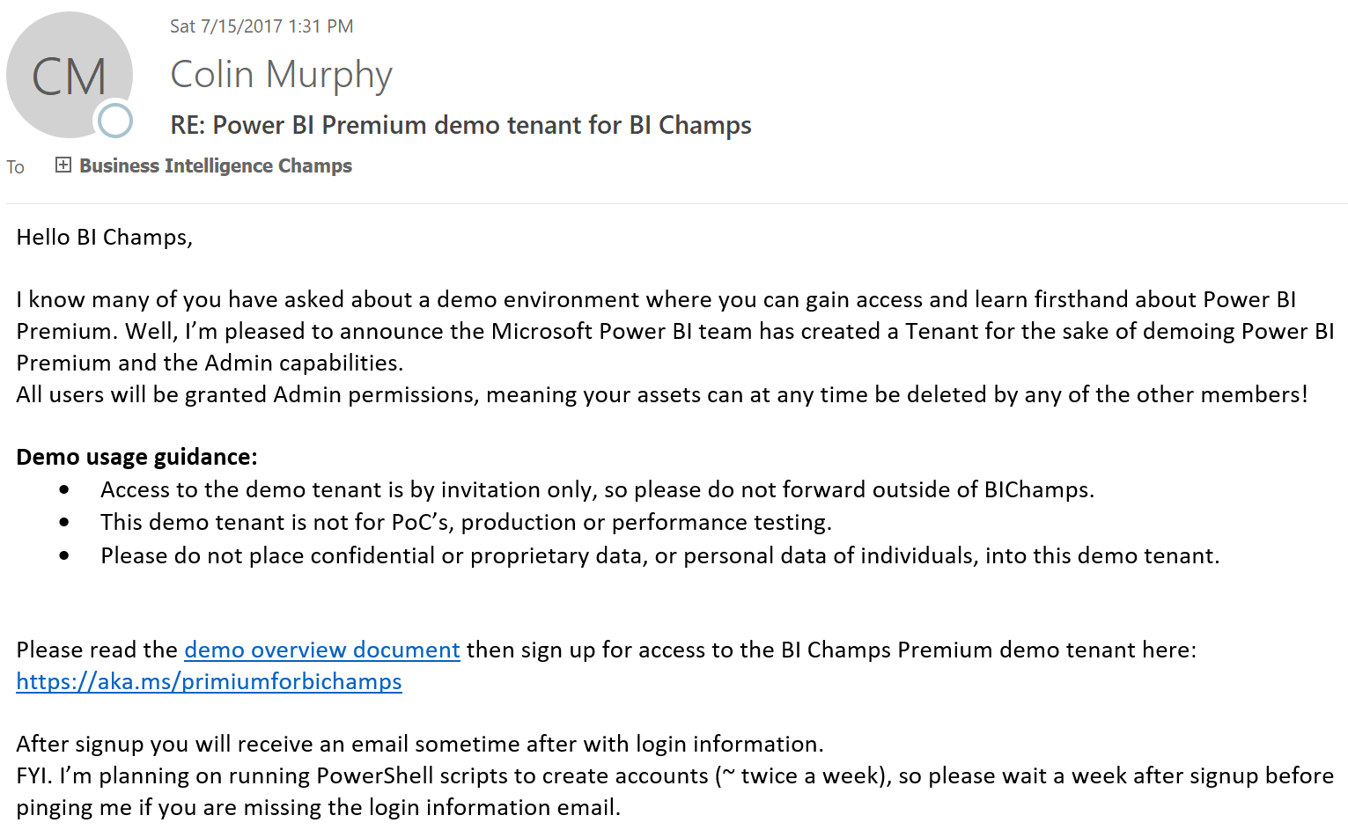
Internal demo environment

Slide 16
We Heard You: Provisioning Challenges
Annual offers make POCs hard
Penalty to grow deployments is unacceptable
Reconfiguration when scaling is a pain

Slide 17
Provisioning Today
SKUs
Provisioning
EM1, 1 v-core, $625
EM1, 1 v-core
EM2, 1 v-cores, $1,245
EM2, 1 v-cores
EM3, 4 v-cores, $2,495
EM3, 4 v-cores
Price / v-core is $625
P1, 8 v-cores, $4,995
P1, 8 v-cores
P2, 16 v-cores, $9,995
P2, 16 v-cores
P3, 32 v-cores, $19,995
P3, 32 v-cores

Slide 18
Provisioning with V-Core Pooling
SKUs
Provisioning
EM1, 1 v-core, $625
Premium v-core pool
EM1, 1 v-core
EM2, 1 v-cores, $1,245
EM2, 1 v-cores
EM3, 4 v-cores, $2,495
EM3, 4 v-cores
Price / v-core is $625
P1, 8 v-cores, $4,995
P1, 8 v-cores
P2, 16 v-cores, $9,995
P2, 16 v-cores
P3, 32 v-cores, $19,995
P3, 32 v-cores

Slide 19
Scaling to Larger Model Sizes in Premium
Streaming Models (Today)
Streaming Models with Efficiency Improvements (Sept./Oct.)
Pinned Models (TBD)
Aggregate model size for a capacity can far exceed available memory, so Power BI manages which models are in memory.
If a user loads a report and the model is not in memory, it is streamed, which takes < 1 minute for current supported model sizes.
We will increase the supported model size by making enhancements to the streaming approach:
More efficient streaming
UX when model is being streamed to message initial delay.
Plan to achieve 5 GB model sizes using this approach.
Allow the Capacity Admin to Pin models to the capacity, meaning they will always be in memory and will not need to be streamed.
Will support model sizes up to the available memory on the capacity.
Other capabilities may be required at this model size too (e.g. incremental refresh)

Slide 20
Sharing and distribution

Slide 21
Upcoming features for sharing/distribution
Share Report (Sept./Oct.)
AAD B2B (Sept.)
External user distribution for apps
External user sharing to consumer domains
Apps GA (Sept./Oct.)

Slide 22
AAD B2B
AAD capability to provide external users access to tenant resources
Supported by many apps, including SharePoint Online and Azure Analysis Services
Power BI will use AAD B2B for two scenarios:
Dashboard/report sharing (for new shares)
App access

Slide 23
AAD B2B – Adding Users
Users can be added two ways with B2B
By the tenant administrator. AAD B2B supports bulk invitations of users, which are useful for large rollouts where the user population is known in advance.
By the sharer. Inside Power BI, when an external user is given access to a dashboard/report/app, this triggers an invite flow for that user
If the external user is in an organization that uses AAD, the user can sign in with their existing credentials
AAD B2B supports external users even in consumer domains (using an existing Microsoft account or by creating a new password).

Slide 24
AAD B2B Invite Flow
External user already present in directory
Sharer gets link to the app. She can distribute link to both internal and external users
At any time, external user can click link to access the app in a simplified chrome
Sharer enters external user email in App Access pane
External user is given access to app
Power BI triggers AAD invite flow
AAD sends invite email to external user
External user claims invite & signs up
External user is automatically dropped in default landing page of app

Slide 25
Licensing with B2B
External users need a paid subscription
For dashboard/report sharing, external users need a Pro license
For app access, one of the following must be true:
External users have a Pro license
The app is in a Premium capacity
When assigning Pro licenses to external users, the licenses can be assigned either in the app’s tenant or in the external user’s tenant

Slide 26
Important considerations with B2B
Mapping identities when using RLS
B2B users’ UPNs will not exist in underlying data sources where we support RLS. UPN mapping capability in gateway can map these external user UPNs to one or more real AD accounts for RLS authorization.
AAD policies from the organization that hosts the Power BI content can be enforced
For example, AAD Conditional Access for MFA or IP access restrictions
You may want to adjust policies depending on the user experience you want

Slide 27
Apps GA
Push
Selective publish

Slide 28
Automation and ALM with APIs

Slide 29
Unlocking new value with APIs
Some capabilities will be delivered through APIs first
UX will be added as usage and demand dictates
Recently released APIs for
Trigger refresh and get refresh status
Clone/rebind report

Slide 30
Advanced ALM with APIs
Requirements that make it “advanced”
Report authors must develop on non-production data
Must have a QA environment to test final user experience before pushing to all users
Keep in mind, basic staging of changes requires no APIs (using app workspaces and, in the future, selective publish)

Slide 31



Advanced ALM Approach
Initial Setup
Power BI Service
Create report in Desktop using dev database.
Publish report to Dev App Workspace in service.
Build dashboards.
In Desktop, modify the connection string to create the prod report.
Publish to Prod App Workspace in service.
Build dashboards.
Dev App Workspace
Prod App Workspace
UAT App
Prod App
3
6
2
Power BI Desktop
5
dev
prod
1
dev
prod
4

Slide 32
Advanced ALM Approach
Auto Deployment
Power BI Service
Make changes in dev reports and test them locally in Desktop.
Run Publish to Dev script to republish reports to Dev workspace.
Test changes in service and, optionally, publish UAT app to testers.
Run Promote to Prod script to copy and rebind content to Prod workspace.
Test changes in service.
Publish prod app to users.
6
Dev App Workspace
Prod App Workspace
3
5
UAT App
Prod App
4
2
Power BI Desktop
dev
prod
1
dev

Slide 33
Advanced ALM Approach
Publish to Dev script
See publish API
Promote to Prod script
https://aka.ms/t86guy
You should delete report in target workspace before clone/rebind
Support for clone/rebind of dashboards coming in next 3 months

Slide 34
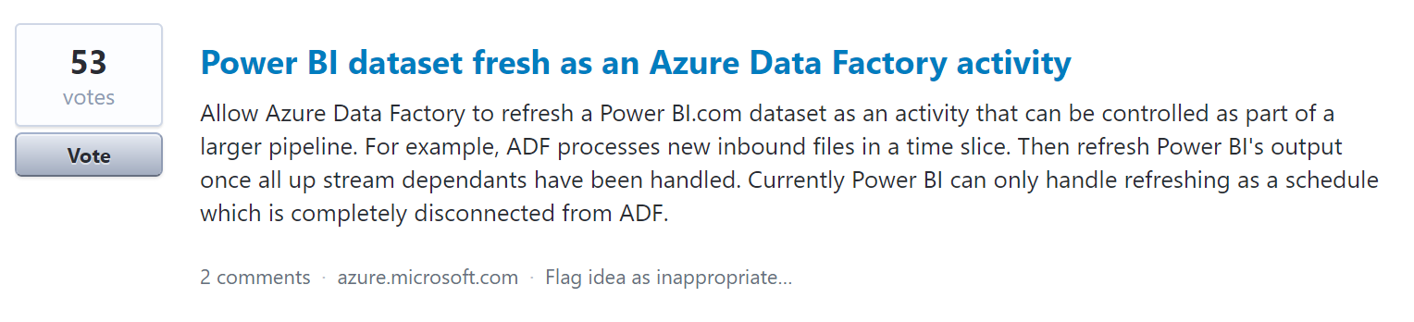
ETL Integration
Top 30 idea on Azure general feedback forum!

Slide 35
Data sources

Slide 36
Upcoming data source improvements
Improved error messages for data source and gateway setup
Gateway high availability (CY17)
SSO for Azure SQL Database (CY17)

Slide 37
Governance and controls

Slide 38
Governance
User details in dashboard/report usage metrics (Aug.)
Data will be backfilled at release
No separate admin control for user-level details (but control for usage metrics exists and disabling it will remove existing usage metrics reports)
Auditing GA (CY17)
Today audit logs are stored in the United States using the Office 365 infrastructure. At GA, they will be stored in the same region as the Power BI tenant.
New pipeline should bring better reliability and reduce latency.

Slide 39
Resources
Whitepapers
Power BI Premium whitepaper
Power BI Enterprise Deployment whitepaper (NEW!)
NDA Roadmap is updated for CY17 H2 items
Power BI Customer Team

Slide 40



Power BI Customer Advisory Team (C.A.T.) | One Slide
GET the CATBot!
BDM Showcase
We own demo resources for CxO-level conversations
Patterns & Practices
We curate content on cross-cutting technology topics
Sales Community Support
We support technical escalations & training opportunities
Engineering Feedback
We influence the products roadmap through engineering feedback rhythms
We engage with
strategic Power BI customers and
the sales professionals supporting them to
showcase and provide technical guidance ,
help drive product adoption and consumption
and influence our engineering
roadmap.
“
”
Call to action: Join the conversation on PBICAT @ Teams

Slide 41
Related content
Breakout Sessions
TECH-BAAI301 - Analytics for every need with Power BI
TECH-BAAI304 - Power BI Report Server: Self-service BI and enterprise reporting on-premesis TECH-BAAI209 - What’s New and What’s Coming in Power BI Desktop TECH-BAAI306 - Microsoft BI Data Connectivity and Extensibility
Instructor-led Labs
TECH-BAAI-ILL200 - Exploring Power BI Reports in Power BI Report Server Hands-on Labs
SPEC-MWP-HOL201 - Build and Deliver the Power BI in Action Demo TECH-BAAI-HOL200 - Creating a Power BI Desktop Solution
Competitive Content
TECH-BAAI200 - How to compete and win in the crowded BI space with Power BI

Slide 42
Recently released in Power BI
Distribution, collaboration, and administration | Content distribution and consumption Power BI Premium (June – Learn More) Usage metrics for dashboard and report creators (June – Learn More) Apps preview (May – learn more) SharePoint Online Web Part GA (May – learn more) Q&A in Spanish (April – learn more) View related content (March – learn more) Multiple URL filter parameters (March – learn more) Administration SOC certification Improved troubleshooting details for DAX queries (March – learn more) Granular admin controls (March – learn more) Custom cache refresh schedule (March – learn more) | Mobile New menus: ‘Shared with me’ and ‘Apps’ (May – learn more) Share with universal links (iOS) (May – learn more) Power BI Repot Server Preview (Android and iOS) (May – learn more) Use voice with conversational Q&A (April – learn more) Right to left language support for iOS (April – learn more) Tailor custom visuals for mobile (April – learn more) Background color for mobile reports (April – learn more) Slicer improvements (March – learn more) 3D touch integration (iOS) (March – learn more) SSRS – Multi-server support (Android) (March – learn more) Request for dashboard access (Android) (March – learn more)
Microsoft Confidential—Subject to NDA. Preliminary Information. Microsoft makes no warranties, express or implied.

Slide 43
Coming soon in Power BI (approx. 3 months)
Data connectivity | New data sources Kerberos Single Sign-On for SAPA HANA, Azure SQL DB Google BigQuery connector ServiceNow connector Snowflake, and Spark Direct Query connectors in Power BI service | On-prem data gateway High availability Custom AD mapping
Modeling, reporting, and analytics | Modeling & data prep Direct Query performance improvements Visuals New table and matrix GA Custom visuals gallery integration Visio online custom visual Power Apps custom visual Control over visual defaults from themes | Analytics Additional quick measures Quick insights in desktop What-if parameters Reporting Bookmarks Custom navigation Drill-through pages for entities Show/Hide Report Elements Relative date report filter UX improvements for slow data sources Descriptions for fields in model
Microsoft Confidential—Subject to NDA. Preliminary Information. Microsoft makes no warranties, express or implied.

Slide 44
Coming soon in Power BI (approx. 3 months)
Premium | Higher limits Clustered capacity Seamless node scale-up Larger model sizes | Administration and monitoring Capacity assignment enhancements Monitoring enhancements Manage email subscriptions for others
Distribution, collaboration, and administration | Content distribution Apps improvements and GA AAD B2B Global artifact search in web and Cortana Share reports Dashboard email subscriptions Administration and governance Data source governance More admin controls | Content management Copy content between workspaces Dashboard performance inspector Additional usage metrics Mobile Improved filtering experience Q&A quick insights Responsive visualizations
Embedded analytics | Licensing EM-series SKUs
Microsoft Confidential—Subject to NDA. Preliminary Information. Microsoft makes no warranties, express or implied.

Slide 45

Enjoy a session
Fill out an eval
Win a prize
Make MS Ready better
Evaluations can be submitted via
Laptop/Mobile connect to Schedule Builder on www.microsoftready.com
Windows/Windows Phone MS Ready App (Search “MS Ready” in the Store)
Your Mobile Device scan the QR code to reach your evals
*If you plan to remain in this room for the next session, please be sure to scan your badge again at the door prior to the session starting

Slide 46
Q&A
If you have questions please proceed to the Q&A MICROPHONE located in your session room.

