Slide 1
dream
learn
succeed

Slide 2
BI Data Connectivity Roadmap & Extensibility
TECH-BAAI306
Matt Masson & Miguel Llopis
Program Managers
Gateways & Connectors team
#AUDIENCE-SESSIONCODE

Slide 3
Confidentiality slide

Slide 4
Session objectives and takeaways
At the end of this session, you should be
better able to…
Understand current Data Connectivity capabilities across Microsoft BI products, including Power BI, Excel and SSAS
Learn about upcoming connectivity enhancements, new connectors, etc. for the rest of CY17
Understand how customers and ISVs can build data connectors and easily plug them into our products, using the Data Connectors SDK

Slide 5
Data Acquisition in today’s BI world
Finding & Connecting to data is easy for users
Experiences for data connectivity are common across different tools
Data is always in the desired shape for analysis/consumption
Reshaping data is easy and quick, so can be done multiple times without effort
Combining data from multiple sources is straightforward
Data Volumes are small and manageable, data usually comes from a single type of data source, data refresh is never a problem

Slide 6
In reality…
Finding & Connecting to data is too difficult
Experiences for data connectivity are too fragmented
Data often needs to be reshaped before consumption
Any shaping is one-off and not repeatable
Combining data from multiple sources is difficult
Volume, Velocity & Variety

Slide 7
How does Power Query help?
Discovery and connectivity to a wide range (75+) of data sources, including publicly available data of all sizes & shapes.
Highly interactive and intuitive experience for rapidly and iteratively building queries over any data source, any size.
Consistency of experience, and parity of query capabilities over all data sources.
Combine data across different data sources; ability to create custom views over data that can then be shared with others in your organization.
Power Query provides a unified “Data Connectivity and Preparation” experience
across Microsoft BI products, including Excel 2010/2013/2016, Power BI and Analysis Services

Slide 8
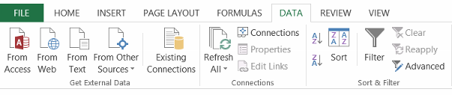
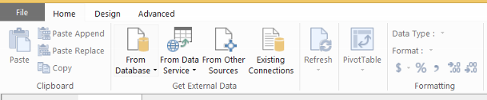
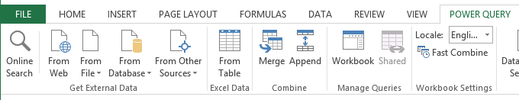
Data Import Experiences in Excel 2013

Slide 9
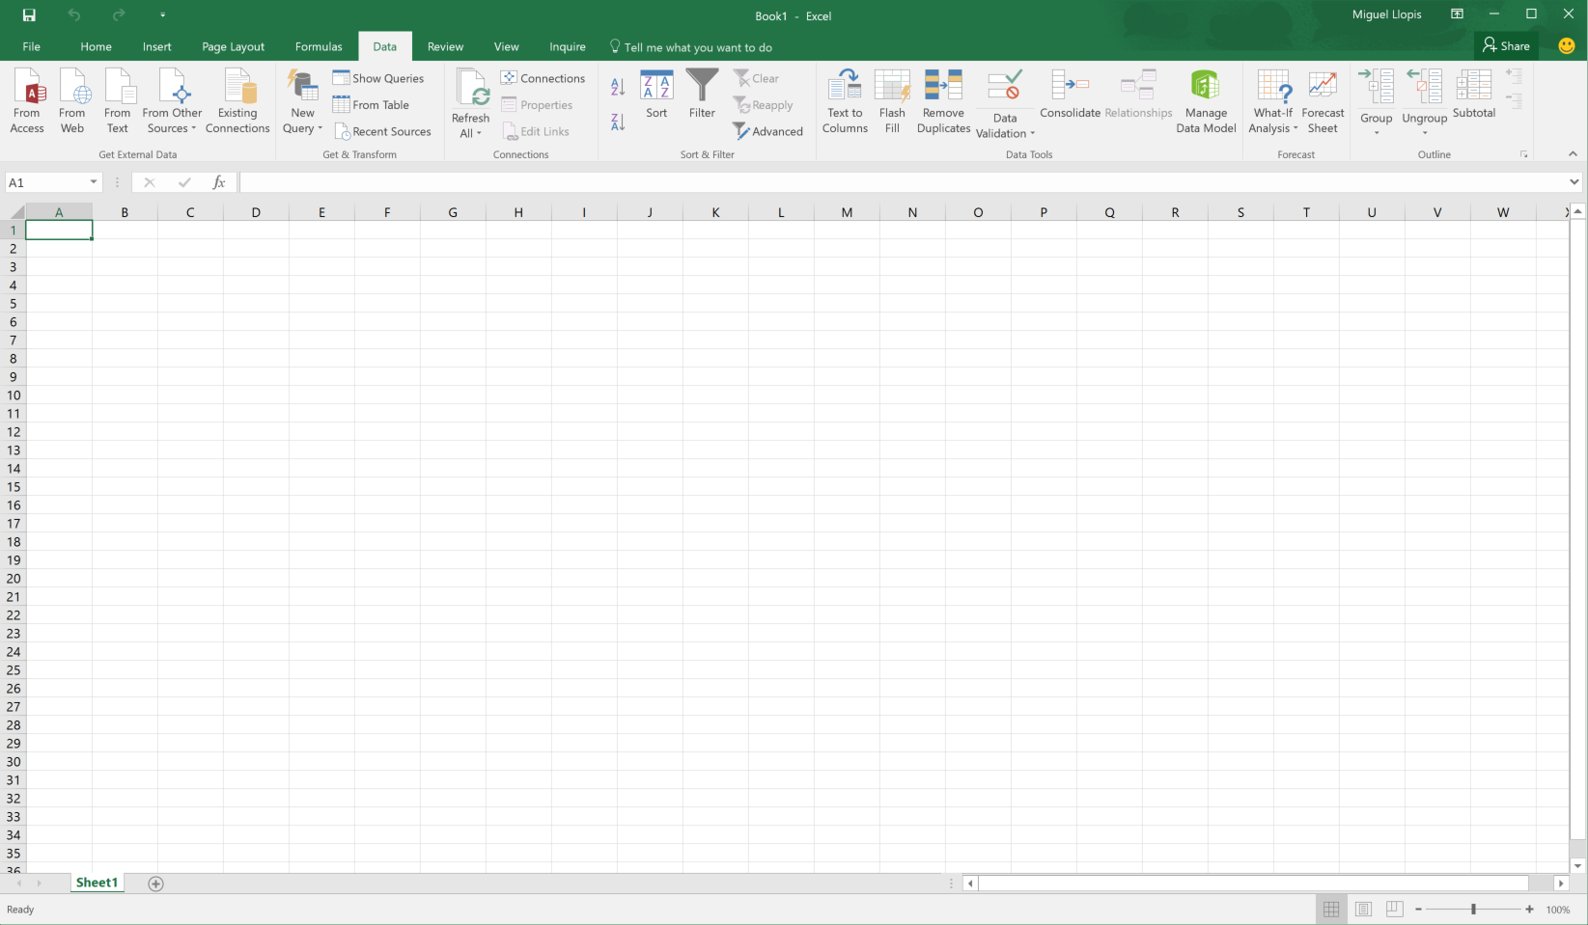
Power Query in Excel 2016

Slide 10
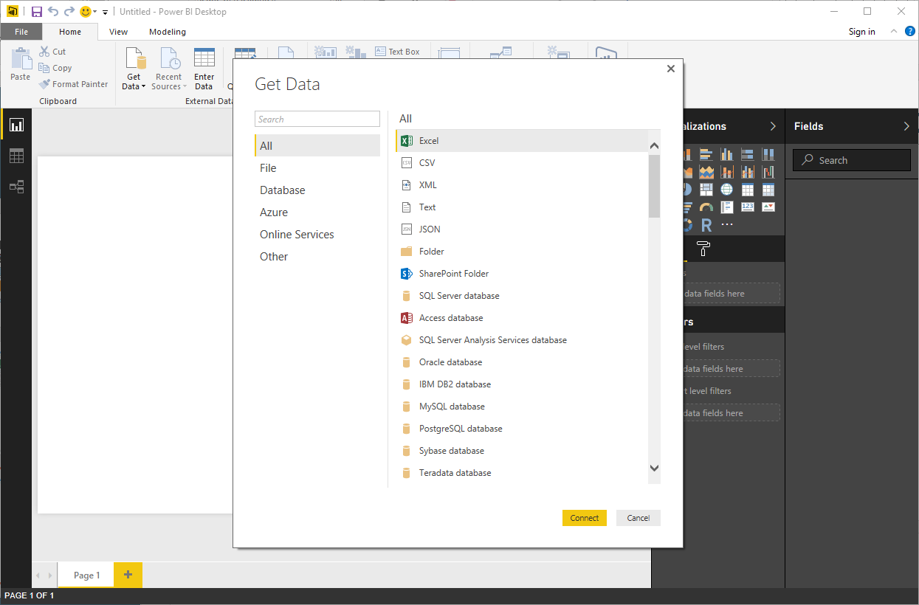
Power Query in Power BI Desktop

Slide 11
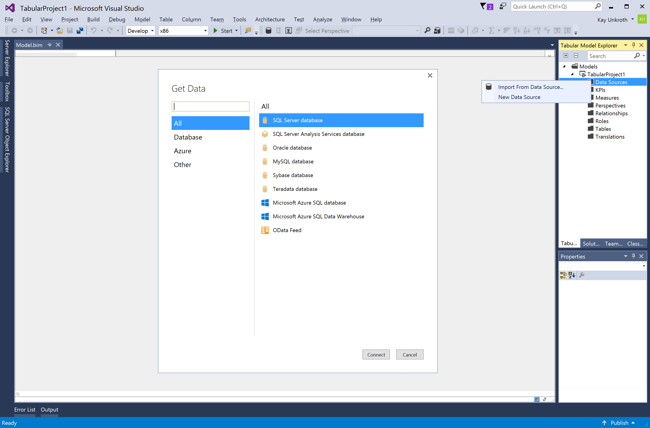
Power Query in SQL Server v.Next Data Tools

Slide 12
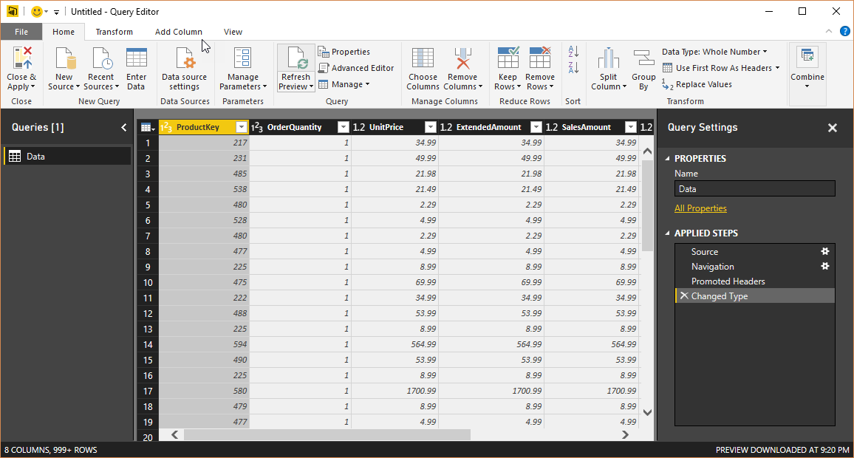
Query Editor

Slide 13
Demo
Power Query Deep Dive

Slide 14
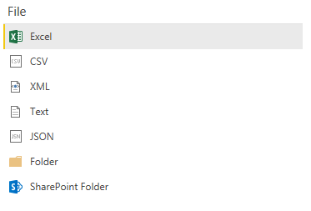
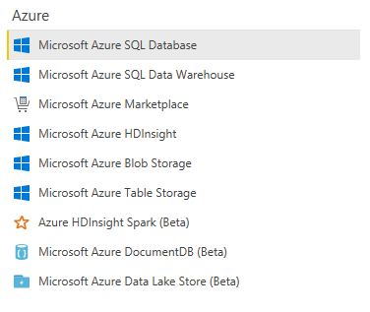
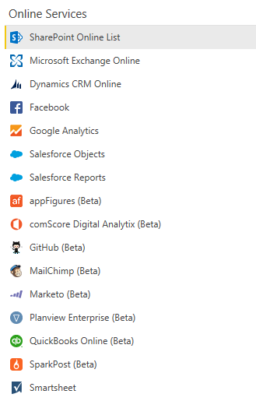
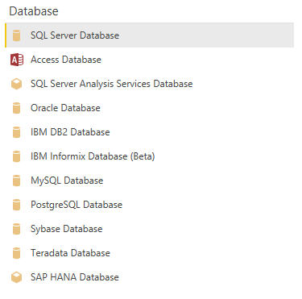
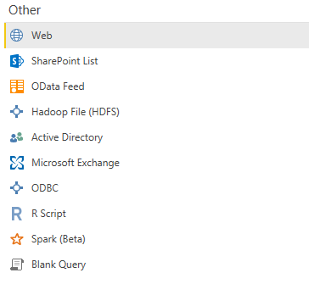
Connectivity – Where we’re investing
SAP connectivity & certification
DirectQuery
Multi-dimensional Experiences
Enterprise grade capability (SSO, …)
Extensibility & Custom Data Sources

Slide 15
Roadmap for CY17 H2
New Data Connectors: IBM Netezza, Google BigQuery, ServiceNow, HP Vertica, MapR Drill, IBM DB2 DirectQuery, Presto, etc.
New Data Transformations & Query Editor Enhancements
Vote for what you’d like to see next at http://ideas.powerbi.com

Slide 16
Demo
Coming Soon: Google BigQuery connector

Slide 17
SAP Connectivity

Slide 18
SAP HANA – Current state + looking ahead
Current State | Looking Ahead
Specialized connector for SAP HANA Uses SAP’s HANA ODBC Driver Treats HANA more or less as a relational source Import & DirectQuery modes Supported via On-Prem Data Gateway for Refresh/DQ scenarios Supports HANA Information Models (Analytic/Calculation views) Direct SQL Support for Row & Column Tables Optimized Navigation for HANA Models Improved Navigator experience: optional previews, column selection, technical names support (Limitation) Sub-optimal / inaccurate treatment of non-additive measures | Multi-Dimensional connector that treats HANA like a “cube” source Support for accurate treatment of measures Direct Query and Import modes will be improved Kerberos based Single Sign-On SAP Certification

Slide 19
SAP BW – Current state + looking ahead
Current State | Looking Ahead
Specialized connector for SAP BW. Supports SAP BW 7.x+ Requires SAP NetWeaver RFC SDK Import mode only Connect to InfoCubes & QueryCubes (including BEx queries) Supports Display Names & Technical Names for easier navigation Supported via On-Prem Data Gateway for Refresh scenarios Multi-Dimensional DirectQuery connector that supports the nuances of BW more accurately (hierarchies, variables, etc.) | Support for additional MDX Member Properties (such as Key, Short/Long Text, etc.) Ability to specify Message Server (i.e. Load Balancer) Supported via On-Prem Data Gateway for Refresh & DQ scenarios Windows Authentication support in Power BI Desktop Kerberos based Single Sign-On SAP Certification

Slide 20
Data Connectors SDK

Slide 21
What can you do with a Data Connector?
Connect to new data sources from Power BI
Create a business analyst friendly view for a REST API
Implement custom OAuth v2 authentication flows
Use as building block for a Power BI App / Content Pack
Enable Direct Query for an ODBC based data source

Slide 22

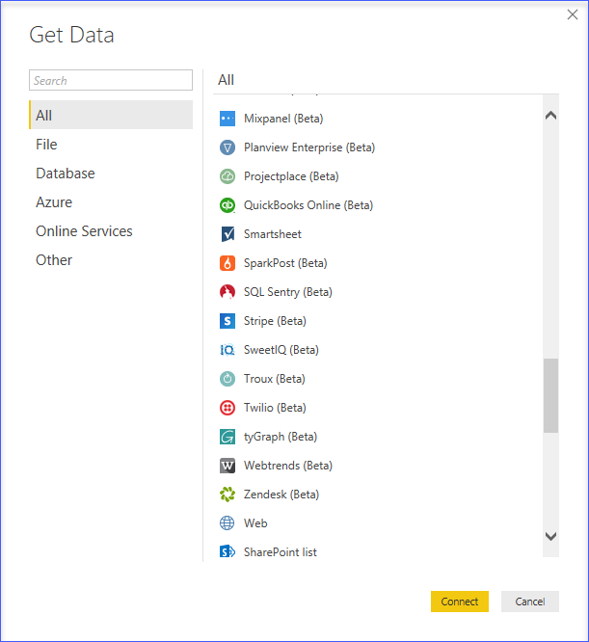



How it Works
M

Slide 23
Data Connector Roadmap
Today
Custom Connectors supported in Power BI Desktop
Certified Content Pack program for ISVs
Planned for CY2017 H2
Distribution through the Office Store
Support in the On-Prem Data Gateway
Versioning and dependency reporting
Improved support for library function extensions

Slide 24
Demo
Creating a custom data connector for a web API

Slide 25
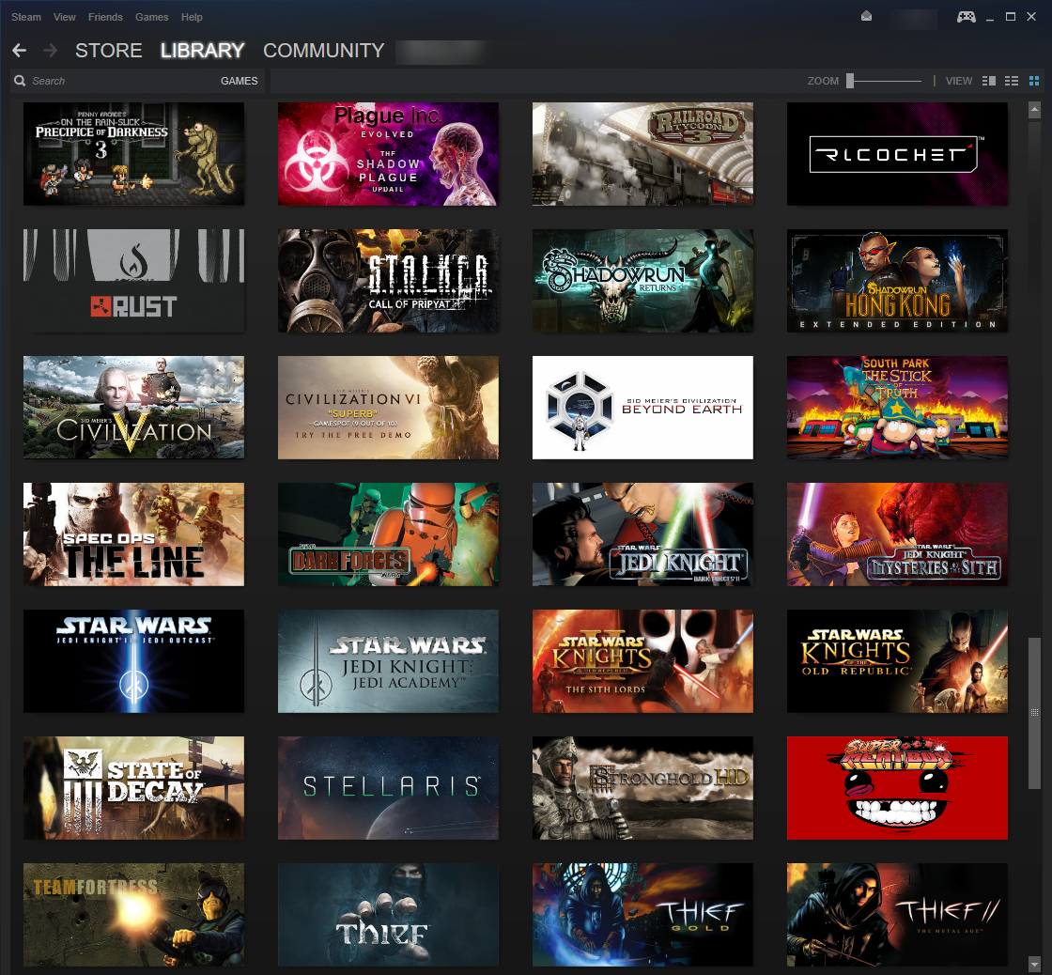
Getting the list of games I own on Steam
What I want to do:
Use the Steam API to get the list of games I own
Get average rating for each game
Write a report to help me decide which game I should play next
Steps:
Signed up for API key
Looked over the documentation
Figured out I need to:
Lookup my “steamID”
Call GetOwnedGames endpoint
Process the JSON results

Slide 26
Demo Summary
Create Data Connectors using the Power Query SDK
Supports Visual Studio 2015 and 2017
Connectors written in M
Use base data connectivity functions, like Web.Contents
Manipulate and shape data using Power Query user experience
Currently supported in Power BI Desktop only
Other Power Query experiences and on-premises Data Gateway support for scheduled refresh and direct query coming soon!

Slide 27
Data Connector Implementation Options
Technology | Direct Query | Complexity | Comments
OData | No | @ | Automatically inherits all built-in OData behavior (including schema and query folding). Extension is essentially just branding and auth.
ODBC | Yes | @@ | Complexity depends on adherence to ODBC specification and support for ANSI SQL 92 syntax at the driver level. Capabilities and SQL generation can be overridden at the connector level.
Rest | Future | @@ to @@@@@ | Simple extensions provide branding, authentication, and navigation experience. Complexity increases with paging, dynamic request logic, and query parameters. Supporting full Direct Query is rocket science (but getting easier).
ADO.Net | Future | Varies | Allows you to plug in .NET code, but connector needs to implement its own command text (SQL) generation logic. ODBC is recommended for integration with relational data sources, particularly if you want Direct Query support.
Other | Future | Varies | Made up of calling other M library functions. We currently do not allow File access through an extension, but this limitation may be lifted in the future.

Slide 28
Power Query: Beyond BI…
Common Data Service integration – available today (Private Preview)!
https://aka.ms/pqocdspp
Integration with Flow and PowerApps actively being worked on…

Slide 29
Helpful Links
Data Connectors github repo
https://aka.ms/DataConnectors
Data Connectors session from Data Insights Summit
https://www.youtube.com/watch?v=ecfRTEoYadI
Additional samples
https://github.com/mattmasson/PowerQuery
M Deep Dive video
https://channel9.msdn.com/Events/Ignite/Australia-2017/DA326
See TripPin tutorial for step by step Data Connector example

Slide 30
Related Sessions
Connections Points: Join us for connector hackathons
Power BI Desktop: What’s New and What’s Coming -
Wednesday 5.30 PM – Venetian L5 Palazzo Ballroom J
Keeping your data up to date with the On-premises data Gateway –
Thursday 5 PM – Venetian L5 Palazzo Ballroom D
Date | Location | Start
Wednesday | Venetian/Sands Expo Hall C | 11:30am
Wednesday | Venetian/Sands Expo Hall C | 3:35pm
Thursday | Venetian/Sands Expo Hall C | 12:40pm
Thursday | Venetian/Sands Expo Hall C | 3:05pm

Slide 31
Q&A

Slide 32

Enjoy a session
Fill out an eval
Win a prize
Make MS Ready better
Evaluations can be submitted via
Laptop/Mobile connect to Schedule Builder on www.microsoftready.com
Windows/Windows Phone MS Ready App (Search “MS Ready” in the Store)
Your Mobile Device scan the QR code to reach your evals
*If you plan to remain in this room for the next session, please be sure to scan your badge again at the door prior to the session starting

