Slide 1
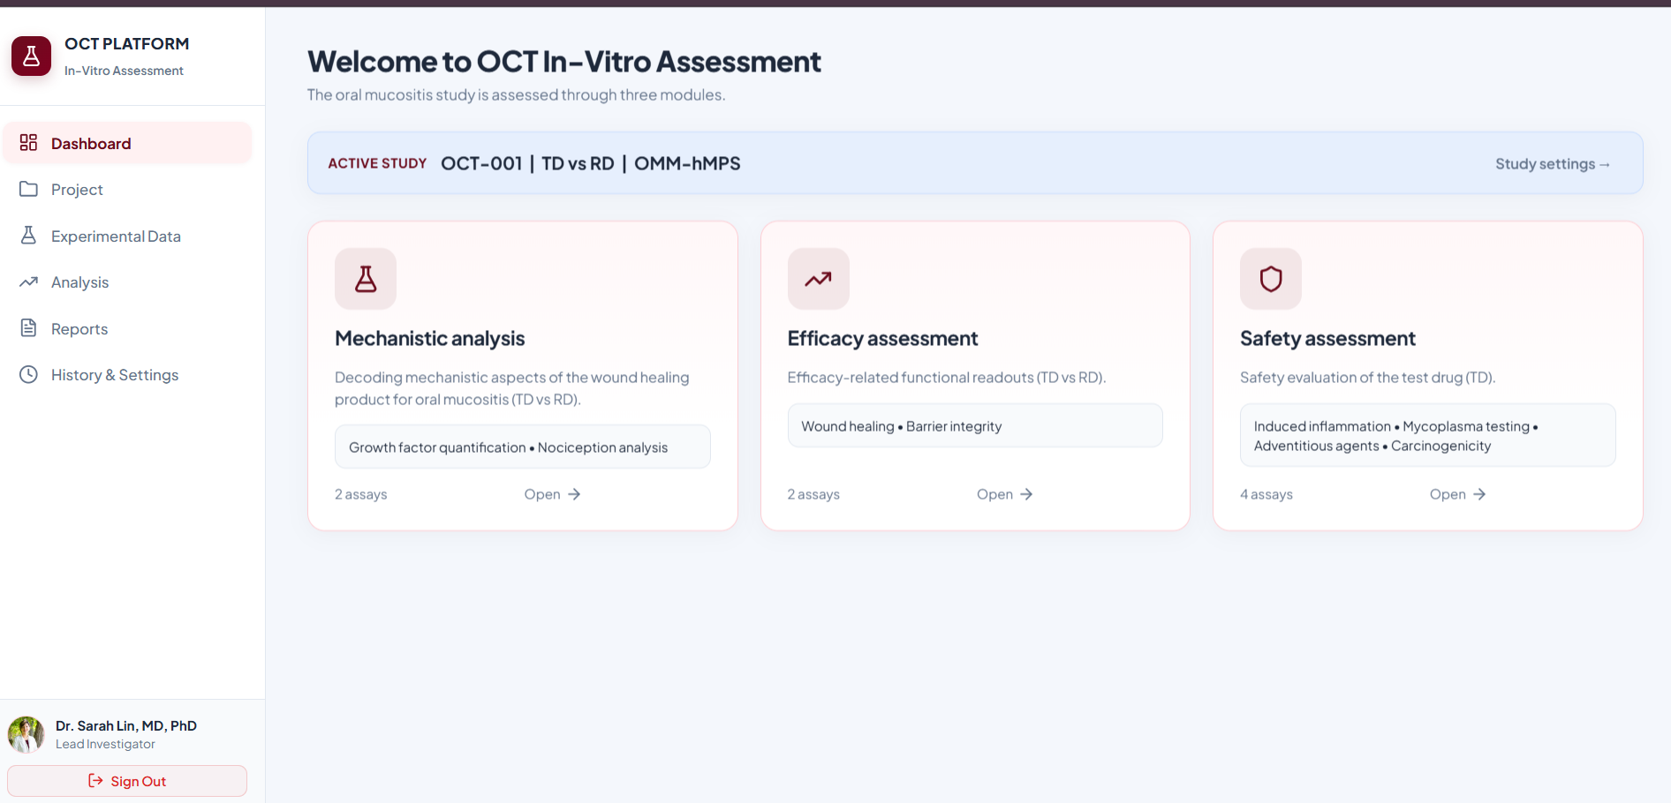
3D Oral Mucosa Platform (OCT)
OCT IN-VITRO ASSESSMENT
Clinical assay data management and automated densitometry.
React 18 · TypeScript · Redux Toolkit (RTK Query) · Vite · REST API
Notes:
This is the 3D Oral Mucosa platform, the OCT in-vitro assessment application. It manages clinical assay data for the OMM-hMPS tissue model and automates Western blot densitometry.

Slide 2
Dashboard & Navigation
OVERVIEW
Active study context
OCT-001: Test Drug vs Reference Drug on OMM-hMPS tissue.
Three assessment modules
Mechanistic analysis, Efficacy assessment and Safety assessment.
Guided navigation
Sidebar links to Project, Experimental Data, Analysis, Reports and History & Settings.
3
assessment modules: Mechanistic, Efficacy, Safety
Notes:
Researchers see the active study immediately and can jump straight into the assessment module they need.

Slide 3
Step 1: Upload & Lane Mapping
WESTERN BLOT · STEP 1
Dual image upload
Target protein and β-actin loading-control blot images.
Lane mapping
Per-lane number, category, group (TD, RD, Control, Ignore/Ladder) and estimated center percentage.
Readiness checks
Both images and the lane mapping are validated before analysis is enabled.
2–12
configurable lane counts
Notes:
Step 1 gives researchers full control over lane mapping and center percentages before the payload goes for automated processing.

Slide 4
Automated Analysis Pipeline
WESTERN BLOT · ANALYSIS
Base64 payload
Blot images are encoded in the browser and sent as a standard JSON payload.
One-click analysis
Analyze & View Results triggers an RTK Query mutation to /analyze.
Error handling
Loading states, user toasts and a local fallback if the backend is unavailable.
1 click
from lane mapping to results
Notes:
The frontend builds the base64 payload and dispatches the request in the background, without blocking the interface.

Slide 5
Step 2: Densitometry Results
WESTERN BLOT · STEP 2
Overlay verification
Processed blots show detected band zones and lane dividers.
Quantification table
Background-subtracted intensity, β-actin normalization, fold change vs reference, ranking and active/excluded status.
Clinical KPIs
Mean TD expression, mean RD expression and the TD/RD ratio.
3
KPIs: Mean TD, Mean RD, TD/RD ratio
Notes:
When the analysis returns, the UI shows the quantified bands, normalizes expression against the loading control and highlights the TD/RD ratio.

Slide 6
Charts & Comparison
WESTERN BLOT · CHARTS
Two visual modes
Publication-quality graph image and an interactive SVG grouped bar chart.
Metric switcher
Normalized expression, fold change or target intensity.
Interactive details
Hover states, baseline threshold lines and replicate tracking.
3
switchable metric views
Notes:
Both views are available: an interactive chart for exploration and a publication-grade graph for dossiers.

Slide 7
Multi-Assay Suite
ASSAY SUITE
Mechanistic analysis
Growth factor induction (VEGF, TGF-β1, EGF, KGF) and nociception RT-PCR (2^-ΔΔCt).
Efficacy assessment
Wound healing (closure %, migration rate) and barrier integrity (TEER).
Safety assessment
Induced inflammation, mycoplasma testing, adventitious agents and carcinogenicity.
8
assays across three modules
Notes:
The platform covers the full preclinical suite for the 3D oral mucosa model, not only Western blot, with formula computation for the efficacy and safety assays.

Slide 8
Export & Reporting
OUTPUTS
CSV export
Tabular results for LIMS or statistical tools such as GraphPad Prism, R and Python.
Graph download
High-resolution figure for dossiers and slide decks.
Report download
Structured report with study parameters, raw values and normalized results.
3
downloads: CSV, graph PNG, report
Notes:
All quantified data and figures can be exported in one click for traceability and reporting.

Slide 9
Technical Summary
SUMMARY
Typed data flow
React, TypeScript and Redux Toolkit with RTK Query for API state.
Guided lab workflow
A two-step upload-and-results flow replaces manual spreadsheet calculations.
Extensible design
Modular assay structure can add tissue models or higher throughput.
2-step
upload → results workflow
Notes:
To summarize: a typed, modular web application that takes laboratory blot images through quantification, charting and export in a guided two-step workflow.

