Slide 1
Effective Real-time Pothole Finder
SUDHARSHAN G - 17BEC1122
VENKATESH T – 17BEC1138
SOWDESHWARS -17BEC1196

Slide 2
Introduction
Pothole is a common problem in damaged roads and pavements. Vehicles get damaged, people get stumbled, drivers lose control over the car and accidents take place. A system is required that can detect potholes as fast as possible and help to avoid them.
Potholes cause huge trouble in regular transportation system. Vehicles may get damaged when they hit pothole. People who are visually impaired face a great problem due to potholes while navigating.
A system is being described which is capable of detecting potholes in video frames as well as localizing and tracking them. The system can also make instantaneous signal and warn about the detected potholes. It works in real-time even in mobile devices like android smart- phone.

Slide 3
Technical Requirements
The following technical requirements were identified for the research, preliminary system development, testing and deployment—
A dataset of images is required to be fed the model for training purpose. In case of video, frames can be extracted as images and must be annotated.
Dataset images must be annotated in such a way that the regions of interest i.e. image-areas having pothole must be selected e.g. as bounding-boxes.
For model train-up, a digital workstation computer is recommended with “at least” following configurations—
CPU: 2.2 GHz (6 Gen)
RAM: 16 GB (2400 MHz DDR4)
GPU:
VRAM: 12GB
Computing Capability: 5
CUDA support.

Slide 4
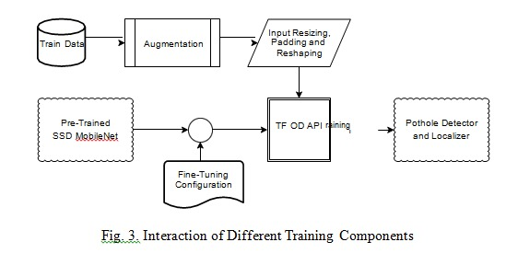
Interaction of Different Training Components
Figure illustrates the interaction of different components during training. The whole model was trained and evaluated on the Google Colaboratory.

Slide 5
Steps Involved
Model creation in Google colab jupyter notebook
Data storage in Fire base
App creation using android studio

Slide 6
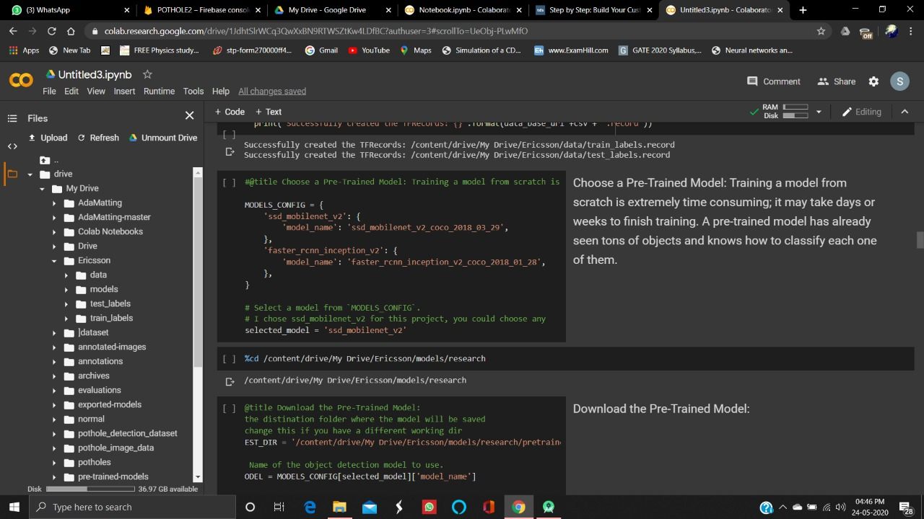
Google colab jupyter notebook
The model is built using Google colab jupyter notebook.

Slide 7
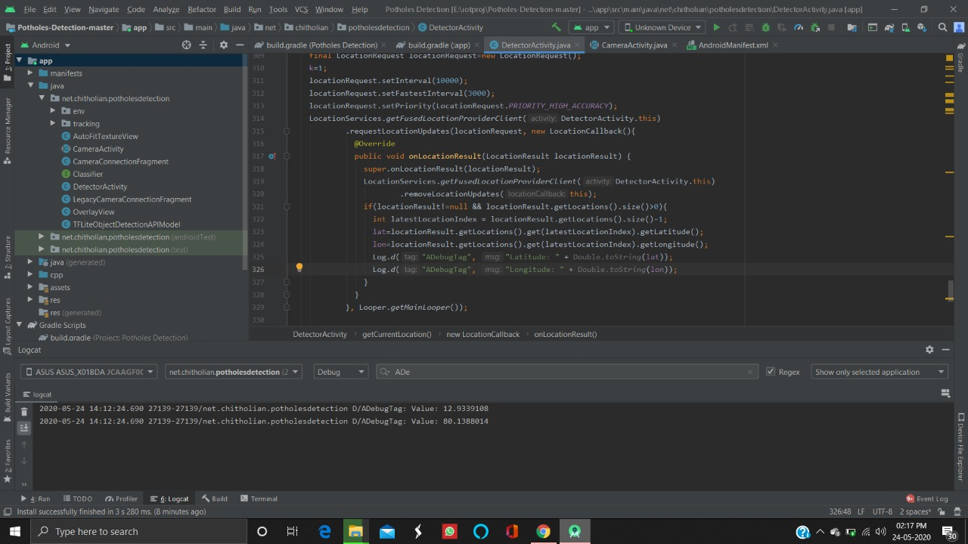
Fire Base
The coordinates of the potholes are stored in fire base.

Slide 8
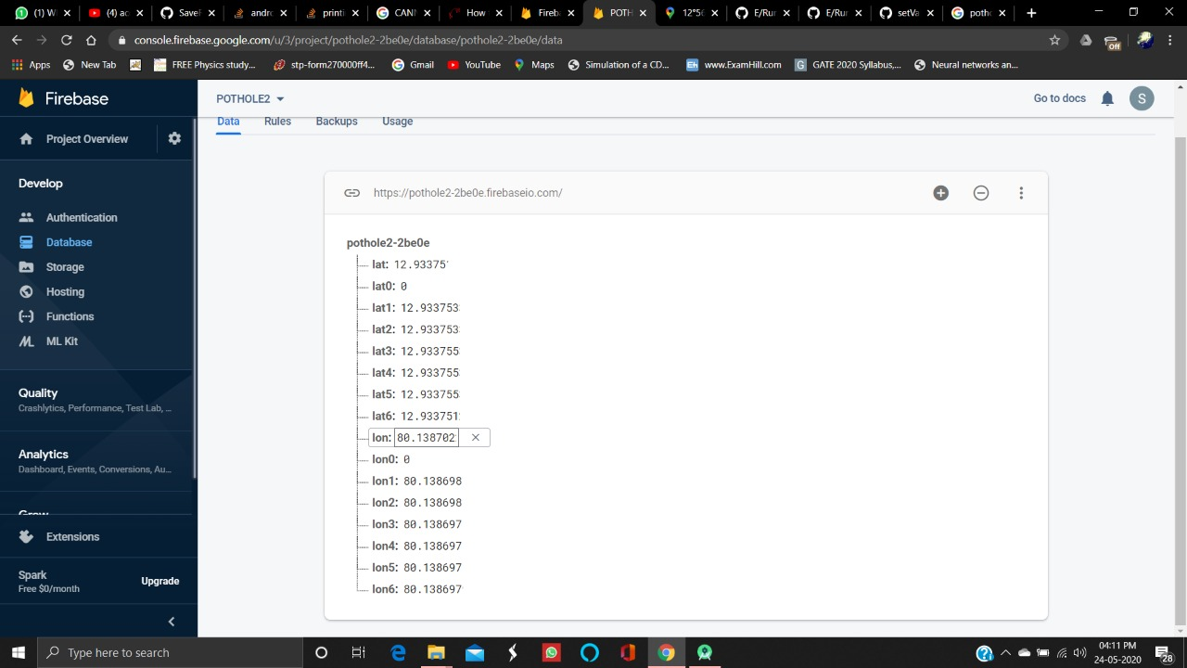
Android Studio
The app is built using Android studio. After interfacing , the app indicates the potholes using the datas stored in firebase.

Slide 9
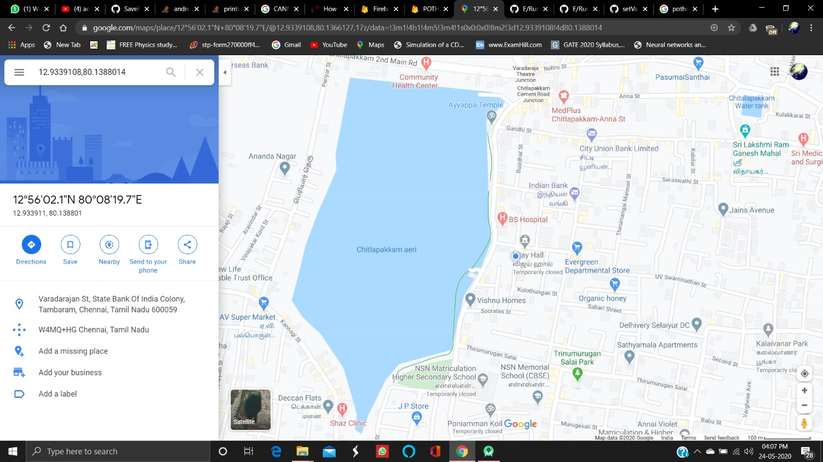
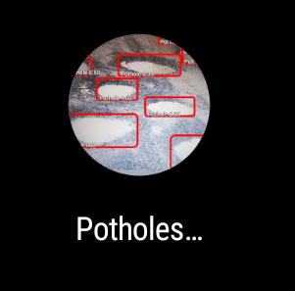
Output

Slide 10
