Slide 1
Project #3 - Robot Follower
Sprint #4

Slide 2
Current Sprint
Added XInput for controller
Connecting client to server
Getting Car to Respond to Changes
Beginning work on video feed stream
Documentation

Slide 3
Asynchronous Tasking in Desktop App
The device ping scan used asynchronous tasks to ping all devices on local network locally.
Migrate to BackgroundWorker interface.
Can extend this work in order to update video feed from PiCar asynchronously.

Slide 4
Video Stream Implementation
3 New Message Types:
StartVideoStream
ImageCapture
Contains the byte string of an image from the webcam in jpg format
EndVideoStream
Upon receiving a StartVideoStream message, the PiCar will send ImageCapture messages which are to be displayed by the desktop application. The stream stops upon receiving an EndVideoStream message.
Implemented server side, but not implemented into desktop app yet.

Slide 5
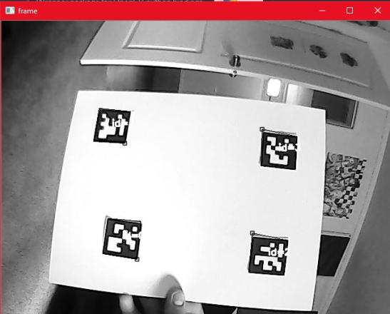
Image Recognition
Identification of markers complete
Next Step- Use Marker orientation to calculate needed movements

Slide 6
Risks & Challenges
Each car configured differently
Broken servos
Using own router on campus makes iteration difficult due to no internet access
Inexperience with asynchronous programming for desktop application
Meetings are becoming harder

Slide 7
Mitigation Plan
Purchased more servos
Small group meetings
Configuration file for each car
Wrappers for each car to normalize servo and motor differences

Slide 8
Next Sprint
Follower Code
Visual Recognition
Video Streaming
Documentation

Slide 9
DEMO

