Slide 1



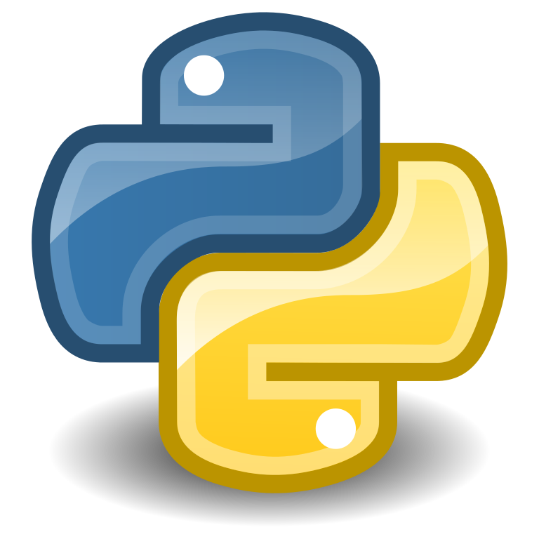
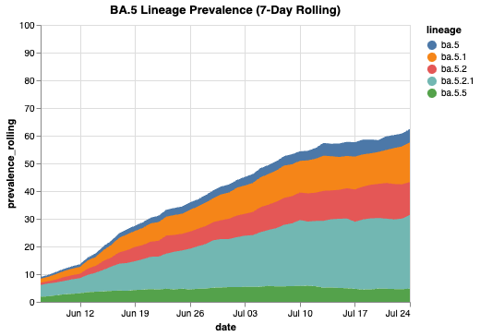
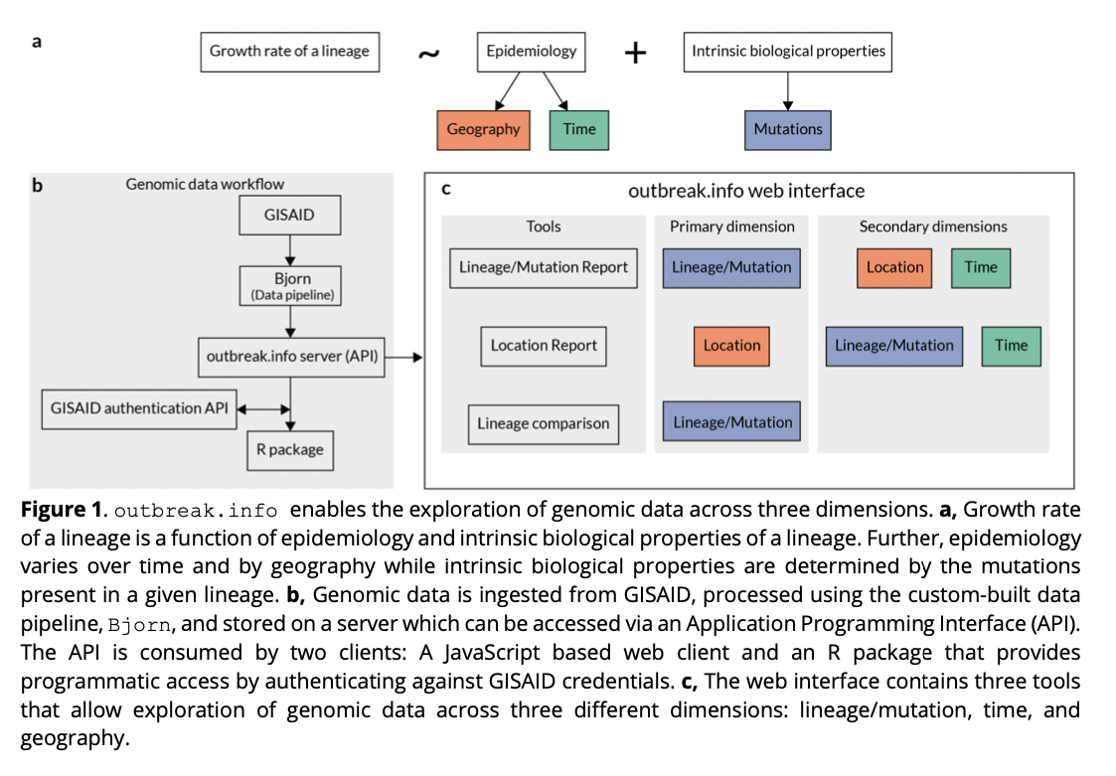
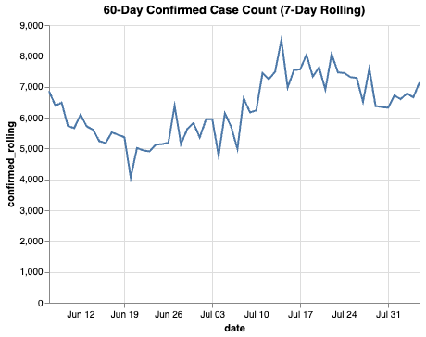
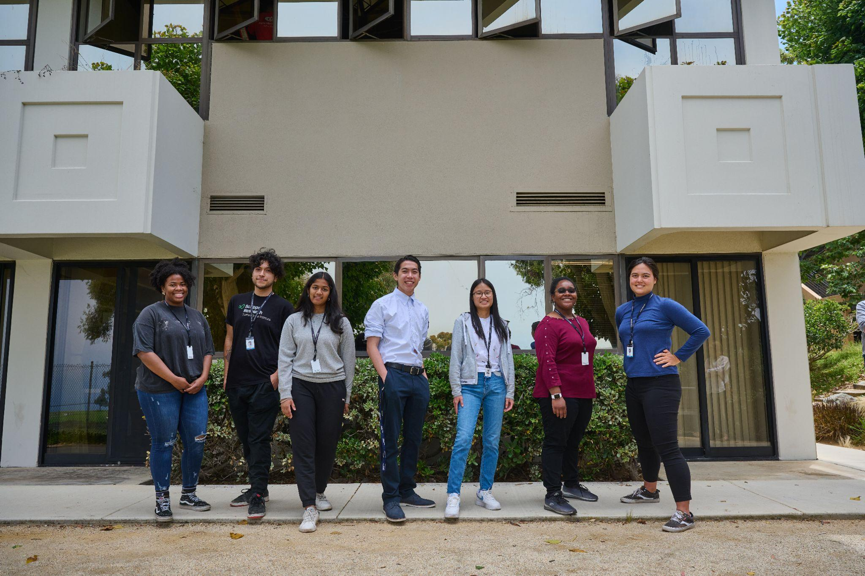
Implementing Outbreak.info API in Python will Expand Access to SARS-CoV-2 Data and Allow for Flexible Data Analysis
Introduction
Expanding Outbreak.info
Results
Conclusion
What is an API?
The term API is an acronym that stands for “Application Programming Interface.” APIs are used in everyday technological use. From digital maps and location tracking to social media platforms, APIs allow users to quickly access services or information through a piece of software that connects the user’s requests to the server containing the requested data. Outbreak.info is one such API that is specifically developed for tracking relevant SARS-COV-2 genomic and epidemiologic data worldwide. Tracking over 11.8 million sequences across 7,000+ locations, the API provides quick dissemination of standardized data, scalable ingestion and data parsing, and intuitive, client-friendly visualizations.
Importance of Outbreak.info
In response to the emergence of SARS-CoV-2, the global scientific community has worked to sequence and document millions of genome in order to keep close tabs on the spread of the virus. However, the rapid evolution of the virus has created new variants of concern (VOCs), leading to renewed surges worldwide. The need for real-time genomic surveillance has prompted the development of a more practical way to keep track of SARS-COV-2 VOCs and inform public health interventions.
Previously existing tools (e.g. NextStrain¹, CoVarient²) and frameworks such as Microreact³ use a traditional phylogenomic approach to monitor viral evolution. However, these tools do not provide API endpoints for easy data access. Building phylogenies for large-scale data tends to be computationally expensive and time consuming to update regularly. The Outbreak.info API was designed to provide access to millions of SARS-COV-2 sequences in real-time. The function and scale of Outbreak.info API is helping provide insight to data analysts and public health officials to help them make timely, well-informed decisions.
New Python Outbreak.info Package
Our goal is to give SARS-COV-2 data access out to as many people as possible. Currently, the data processing package is only available in the R programming language. Expanding our toolset to become more accessible to people from different coding backgrounds is the ideal. Python is an industry-wide used language that is highly useful in data manipulation and analysis. A Python package utilizing the Outbreak.info API will broaden user scope to those who are familiar with either R or Python.
We demonstrate the usefulness of the Python API package’s ability to create visualizations of contemporary and long-scale data. New York is one of the most densely populated states in the U.S. Graphical data helps others see how SARS-COV-2 is behaving over time.
Fig. 1 utilizes the ‘genomic’ endpoint to visually represent the prevalence of five BA.5 lineages between June 6, 2022 - July 24, 2022.
Fig. 2 utilizes the ‘covid19’ endpoint to show the number of cases in New York over the past 60 days.
We created the Outbreak.info API as a more practical tool to monitor the evolution of SARS-COV-2 while giving more people access to the latest genomic and epidemiologic data. Compared to other existing phylogenetic tools, Outbreak.info allows for flexible data analyses, complex visualizations, and faster data dispensation. The Outbreak.info Python API package will expand access to data for those studying SARS-COV-2.
Future work:
Implementing simple vignettes and visualizations.
Publicizing the package via GitHub and wrapping Python outbreak.info into a conda package
Accomplishments:
My role in this project was to create functions for the Python API package, allowing users to retrieve data from the API and make specific data queries from Outbreak.info. My hope is that my work will allow for greater accessibility to SARS-COV-2 information to help scientists, public health officials, and the general public stay informed about SARS-COV-2
Methods
We coded a series of functions in Python that are capable of drawing raw data from the Outbreak.info API and formulating it into an easy-to-read table data frame. This was done by hitting specific endpoints and passing parameters that allow for both simple and complex queries.
References
Fig.1: Prevalence of five BA.5 lineages between June 6, 2022 - July 24, 2022
Outbreak.info Project
Gangavarapu, Karthik, Alaa Abdel Latiff, Julia L. Mullen, Manar Alkuzweny, Emory Hufbauer, Ginger Tsueng, Emily Haag et al. "Outbreak. info genomic reports: scalable and dynamic surveillance of SARS-CoV-2 variants and mutations." medRxiv (2022).
Similar tools:
CoVarients:
Emma B. Hodcroft. 2021. "CoVariants: SARS-CoV-2 Mutations and Variants of Interest." https://covariants.org/
Nextstrain:
Hadfield et al., Nextstrain: real-time tracking of pathogen evolution, Bioinformatics (2018)
Microreact:
Argimón, Silvia, Khalil Abudahab, Richard JE Goater, Artemij Fedosejev, Jyothish Bhai, Corinna Glasner, Edward J. Feil et al. "Microreact: visualizing and sharing data for genomic epidemiology and phylogeography." Microbial genomics 2, no. 11 (2016).
My Project
I implemented the ability to access Outbreak.info API endpoints using Python, enabling users to make specific API queries for raw SARS-COV-2 data.
What I Did:
Developed appropriate tests to check data and input validity
Implemented ‘genomic’ API endpoint function to collect viral genomic data on SARS-COV-2 variants, mutations, prevalence and frequency
Designed function to hit ‘Covid19’ endpoint to collect epidemiological data related to number of SARS-COV-2 cases in a specified region
Acknowledgements
Special thanks to my mentor Chrissy Aceves and Emory Hufbauer for helping me with this project. Thank you to everyone in the Andersen Lab, Su Lab and Wu Lab for making Outbreak.info possible.
Fig. 2: Number of confirmed cases in New York based on a 7-day rolling count since June 6, 2022.
About Me
My name is Sarah Randall, and I’m a rising 3rd year undergraduate student from Biola University in La Mirada, CA. I’m majoring in Biology with a minor in Chemistry, and my future goal is to study cellular treatments and technologies for the medical field.

