Slide 1
APPSWITCH: RESOLVING THE APPLICATION IDENTITY CRISIS
Presented by: Sneha Rangari
17th October 2018

Slide 2
AGENDA
ABSTART
BACKGROUND
COUPLING BETWEEN APPLICATIONS AND THE NETWORK
EXISTING APPROACHES AND RELATED WORK
COMPARISON OF APPROACHES
APPSWITCH MODEL
APPSWITCH ARCHITECTURE
TRAP MECHANISM
PRELIMINARY RESULTS
CONCLUSION

Slide 3
ABSTART
Problem with Networked applications:
Derive their identity from the identity of the host on which they run.
Results in subtle and substantial problems - Application deployment, discovery and access
Solution:
APPSWITCH - a novel transport layer network element.
Decouples applications from underlying network at the system call layer.
Benefits:
Without changes to existing applications, it removes the cost and complexity.
Removes the performance penalty associated with unnecessary data path processing.

Slide 4
BACKGROUND
Applications and infrastructure hosts need to be referenced independently by very different entities.
Traditional Vs Distributed applications:
Acceptable for early networked applications - undistributed, deployed on a dedicated host, undisturbed for a long time.
Modern distributed applications - mobile, ephemeral and run on multi-tenant infrastructure, do not support this simplistic model.
Noval Transport Layer:
APPSWITCH - forms a clear interface between the application and network.
Operates at the transport layer, provides mutual discovery and connectivity to applications.
Uses the system call interface to decouple applications from the network.
Notes:
A web server, for example, is identified by an IP address even though IP addresses were designed to identify network hosts rather than application endpoints.
Traditional Vs Distributed applications:
Acceptable for one-to-one mapping between the application and its host - for early networked applications which were undistributed, deployed on a dedicated host and left undisturbed for a long time.
Modern applications, which are distributed, mobile, ephemeral and run on multi-tenant infrastructure, no longer conform to that simplistic model.
2. In particular, improperly defining and identifying applications leads to subtle and substantial problems related to common network functions with which applications have to directly interface.
3. While lower level network functions such as packet switching do not depend on applications, network functions such as application discovery, segmentation, firewalls, load balancers, VPN gateways, implicitly depend on well-defined application identities.
4. A number of mechanisms and elaborate devices have been built over the years to work around the symptoms of application misidentification. The workarounds only address the issues indirectly and incompletely and typically produce new problems.

Slide 5
COUPLING BETWEEN APPLICATIONS AND THE NETWORK
Traditional network stack:
Uses well-defined layers - separate application and network level functionality.
Applications are closely tied to network level artifacts such as IP addresses.
Architecture is built for interoperability between layers.
Modern Distributed Applications:
Requires a clean separation between applications and underlying network - to run across hosts.
Problems:
Impact on the cost of operating applications.
Any change to the application’s host or its identity invalidates previously advertised references to the application.
Application needs to be moved to a different host or a region, the operations team would have to reassign the IP addresses and update firewall rules accordingly.
Notes:
A host reboot, expiration of DHCP lease, rescheduling
of the application instance to a different host or live migration
of the underlying VM to a different subnet etc. could
all cause the application to become unreachable at its former
identity. Any policy specification that references application
endpoints through their host identities would become
invalid as application’s identity changes. For example, any
firewall rules meant to segregate application endpoints established
within the network infrastructure would become
invalid.

Slide 6
EXISTING APPROACHES AND RELATED WORK
3 approaches for decoupling applications from network & provide distinct identity:
Support the behavior of modern distributed applications and their operating environments.
Support existing applications and existing network infrastructure.
Approach must not introduce unacceptable operational or computational cost.
Existing Approach:
Use of combination of IP address and port number does not meet these requirements.
Not provide both uniqueness and consistency required to support distributed applications.
Examples:
Docker assigns each application container a different IP address
Envoy assigns each application service a unique port number
Notes:
IP addresses are unique in a network but they cannot serve as consistent application identifiers because they cannot remain constant as the application moves from host to host. Port
numbers on the other hand can be consistent because the same port number may be available on every host.

Slide 7
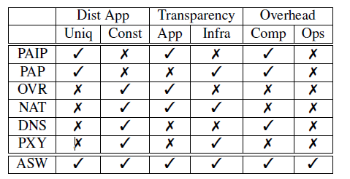
COMPARISON OF APPROACHES
FreeFlow - addresses the performance, doesn’t support existing applications and relies on container-specific frameworks.
Consul - provides a central registry of services that arbitrates discovery between clients and servers.
Calico - treats each application container as a network host in its own right and assigns it a routable IP address.
Table 1: Comparison of approaches that address identity of distributed applications
Notes:
Calico [1] for example treats each application container
as a network host in its own right and assigns it a routable
IP address. Using NAT to multiplex applications through
the same interface would not solve the problem because assigning
the same IP address to multiple applications would
prevent them from being scheduled to different hosts without
changing their identity.

Slide 8
APPSWITCH MODEL
Serves as an interface between applications and the network.
APPSWITCH instances provides seamless discovery and connectivity to the applications.
Tracks the applications’ execution to detect server applications and their service ports, propagates their location information across the cluster over a gossip protocol.
Methods for Decoupling applications from the network:
User assigns an application a virtual IP address.
The virtual IP address serves as a unique and consistent identifier representing the application.
User specifies application identity as a DNS name rather than an IP address.
APPSWITCH assigns it an internal IP address.
A built-in DNS server overrides client application’s DNS lookups.
User qualifies the application’s identity with a set of tags (key-value pairs) which are propagated along with the location information.
Client tries to reach a service, respective tags are consulted for a match before the connection.
Notes:
When an
application is brought up, the user optionally assigns it a virtual
IP address, completely independently of underlying network,
simply by specifying it as a parameter to APPSWITCH
when the application is added. The virtual IP address serves
as a unique and consistent identifier representing the application.
Even though the identifier takes an IP address format,
it bears no relation to the IP addresses carried by network
hosts. The choice is only driven by backward compatibility
with existing applications that expect an IP address.
The user may also specify application identity as a DNS
name rather than an IP address, in which case APPSWITCH
assigns it an internal IP address. A built-in DNS server overrides
client application’s DNS lookups to return the internal
IP address. When the client in turn asks to connect to that
IP address, its request is transparently directed to the server
represented by the name.
the user may also qualify the application’s
identity with a set of tags in the form of key-value
pairs which are propagated along with the location information.
Tags could represent attributes such as security groups
that the application belongs to. When a client tries to reach a
service, respective tags are consulted for a match before the
connection is allowed. Connection requests to APPSWITCHmanaged
applications from unidentified clients are disallowed.
While a simple grouping may suffice in most cases, a more
expressive policy could be easily supported.

Slide 9
APPSWITCH MODEL
APPSWITCH removes the operational friction of acquiring IP addresses and names.
Network level identifiers referenced by intermediate network infrastructure can be machine-generated.
Cases:
If the user does not name the application:
Would not carry any externally referenceable identifier
Would not be able to act as a server application.
Still be a client application that accesses other servers.
If the user does name an otherwise client application:
Specified IP address is conveyed as client’s identity to the servers the application connects to.
If the user specifies the same IP address to multiple applications:
Would be treated as being a part of the same distributed application - provides a common port namespace stretching across those applications.
If multiple applications of a distributed application bind to the same port:
Would be treated as instances of the same load balanced service.
Notes:
By empowering the user to directly specify application
identities, APPSWITCH removes the operational friction of
acquiring IP addresses and names. While network level identifiers
referenced by intermediate network infrastructure can
be machine-generated, the responsibility of assigning a meaningful
name to a high-level application service ultimately
rests with a human user, typically in the role of an application
or a network architect. In that role, the user would have
a global view of the broader distributed application and its
environment and would be able to ensure that unique names

Slide 10
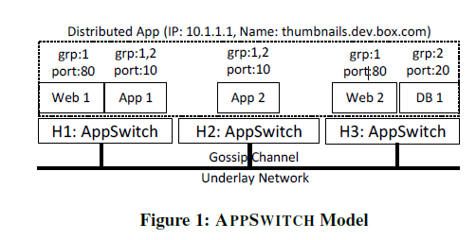
APPSWITCH MODEL
Services provided by these applications are consistently identified by port numbers from a global namespace spanning the distributed application.
Instances of Web and App are consistently represented by their same respective ports even though they belong to the same distributed application.
Two groups, 1 and 2, respectively consisting of Web and App, and App and DB are defined by attaching grp tags to the applications such that Web applications cannot directly talk to DB.

Slide 11
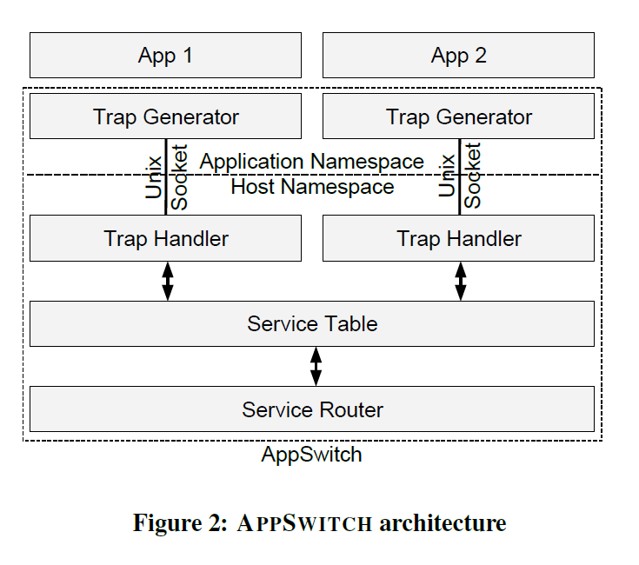
APPSWITCH ARCHITECTURE
Two key components
Trap mechanism
Service router which share a data structure called service table
Maintains a mapping between application identifiers and network level identifiers.
It propagates the contents of service table with other instances of APPSWITCH on other hosts over a gossip protocol

Slide 12
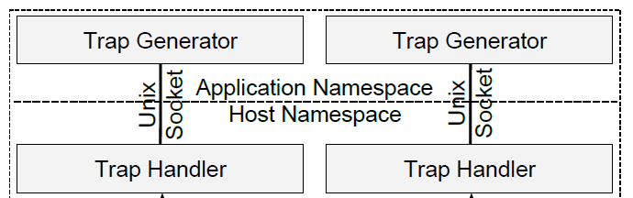
TRAP MECHANISM
Provides transparent application instrumentation
Conceptually similar to FUSE
Redirects the network primitives of an application to a user space handler by interposing its network-related system call.
Two components:
Trap generator - intercepts network control plane system calls
Trap handler - services them and returns result back to trap generator

Slide 13
TRAP MECHANISM
An application first added to APPSWITCH
A new network namespace created to host the application
Instance is associated with trap mechanism
This mechanism extend host’s network connectivity into application’s network namespace.
It forms the only means of network access for the application
Network namespace also provides a convenient abstraction
They are connected through a Unix domain socket - allows active file descriptors to be passed
Trap generator forwards socket system call made by the application
Trap handler creates the socket in the host namespace and pass its reference to the application.
Trap handler performs appropriate security checks, matches relevant tags and negotiates socket connections.
Trap handler stays out of the data path once the connected socket is passed to the application.

Slide 14
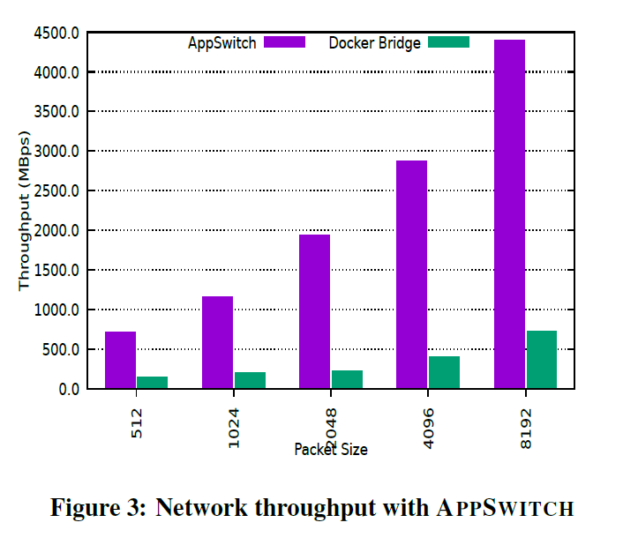
PRELIMINARY RESULTS
Experiment was conducted with the standard Docker network configuration - uses a Linux bridge for inter-container connectivity and with APPSWITCH as the network backend.
Measured the throughput between the client and server instances of iperf-2.0.9
Throughput was generally higher at larger packet sizes, it was several times higher with APPSWITCH compared to Linux bridge in each case.

Slide 15
CONCLUSION
It removes the cost and complexity of operating modern distributed applications - decoupling from the underlying network at the system call layer.
Default identity of the applications acquired from the hosts on which they run - root cause of several subtle and substantial problems
System call layer provides a convenient and efficient interposition point to address them.

Slide 16
THANK YOU

