Slide 1
FreeFlow: High Performance Container Networking
Presented by: Sneha Rangari
5th September 2018

Slide 2
AGENDA
Abstract
Ways to improve performance
Experiments and observations
Freeflow solutions
Overview
High network performance without sacrificing portability
Architecture of freeflow
Design
Preliminary implementation
Conclusion and discussion:

Slide 3
ABSTRACT
Problem with Networking Solutions:
Poor performance or poor portability
Solution for desirable results:
FreeFlow
FreeFlow leverages two insights:
A central entity i.e. the orchestrator.
Loose isolation among containers belonging to same application.
Benefits:
Use shared memory and RDMA - improve network performance
Higher throughput, lower latency, less CPU overhead with full portability

Slide 4
WAYS TO IMPROVE PERFORMANCE
Non-Portable Applications:
Tailored for specific platforms.
Non-Isolation:
Isolation between applications was non-existent.
TCP/IP layering:
Operating systems offered isolation and portability.
Solutions till date:
DPDK, RDMA, virtualization but the network performance got further reduced.
Container has no external dependencies - making it highly portable, sacrificing performance.
Notes:
Containerization: By wrapping a process together a complete filesystem and namespace cell, a container has everything needed to run the process, including executables, libraries and system tools.

Slide 5
EXPERIMENTS AND OBSERVATIONS
Two Docker containers - 3 ways to communicate on a single server :
Shared Memory:
Special setup to bypass the namespace isolation
Least isolation and portability
Host mode:
Container binds an interface and a port on the host - uses the host’s IP to communicate.
Containers are not truly isolated.
Overlay mode:
Host runs a software router - connects all containers on the host via a bridge network.
Maximum portability.
Observations:
Throughput and latency
Host and overlay modes are worse than shared.
Both modes require a “hairpin” path through the full TCP/IP stack.
Performance
Overlay is worse than host mode.
In overlay networking, hairpinning happens twice.

Slide 6
FREEFLOW SOLUTIONS
Virtualization vs Containerization:
Virtualization suffers from inefficiencies, address them using techniques like SR-IOV and NetVM.
Cannot be directly applied to the container world.
SR-IOV scales to 10s of VMs per server but there are 100s of containers per server.
FreeFlow Solutions:
To achieve these goals, observed an opportunity to leverage two key aspects:
Managed by a central orchestrator (E.g., Mesos, YARN and Kubernetes)
Deployed over managed network fabrics (e.g., a public cloud provider).

Slide 7
OVERVIEW
Containers:
Chroot mechanism - provide namespace isolation.
The dependencies - bundled together with the application.
Deployed within a VM or on bare metal, supported by Linux and Windows operating system.
Containerized Applications:
Multiple layers deployed with multiple containers in each layer. E.g each mapper and reducer node in Hadoop.
Multi-host server cluster, and is controlled by a cluster orchestrator.
Advantage: Easier to upgrade the nodes or mitigate failures.
Container networking solution:
Maximum portability - containers use overlay networks.
Host (server/VM) runs the software router connecting host and containers on the host.
Tunneling to move traffic between the physical network and the overlay fabric.
BGP to connect with software routers on other hosts.
Throughput and CPU utilization - Overlay network is better as compared with host network.

Slide 8
HIGH NETWORK PERFORMANCE WITHOUT SACRIFICING PORTABILITY
Performance and Portability:
Portability: Overlay-based networking – not to worry about where the other endpoint.
Performance gets affected for good portability - traffic needs to go through a deep software stack.
How to achieve: Avoid any performance bottlenecks in the data-plane.
Containers within a single host - communicate via a shared memory channel
Overlay routers in different hosts - talk via RDMA (or DPDK).
Key idea and issue:
One container should decide how to communicate with another according to the latter’s location.
How to discover the real-time locations of containers;
How to enable containers to use different mechanisms to communicate with different peers.
Solution:
To depend on containerized applications .
Using a (conceptually) centralized orchestrator.
Container clusters are managed by a centralized cluster orchestrator.

Slide 9
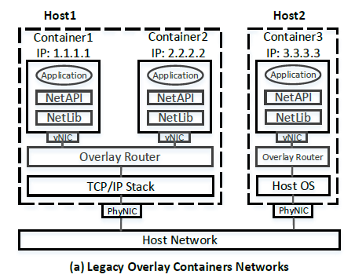
ARCHITECTURE OF FREEFLOW:
Existing overlay networking solutions for containers:
Container has a virtual NIC attached to the overlay router of the host via a software bridge.
Overlay routers exchange routing information and build routing tables via standard routing protocols, such as BGP.
The fabric is data-plane for packets traversing the overlay from container to another one.
Inside each container, applications use standard network APIs to access the network.
The API calls are implemented in network libraries, such as glibc for Socket API, and libibverbs for RDMA Verbs API.

Slide 10
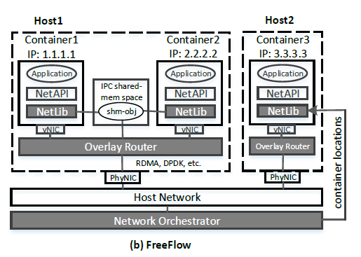
ARCHITECTURE OF FREEFLOW:
FreeFlow networking solution:
Reuses control-plane features
Modifies multiple existing modules in the networking stack
Three key building blocks of FreeFlow:
1. Customized Network Library:
Decides which communication paradigm to use
Supports standard network programming APIs
Queries the network orchestrator for the location of the container it wishes to communicate with.
Uses shared memory to communicate with the other container, bypassing overlay router.
2. Customized Overlay Routers:
The traffic between routers and its local containers goes through shared-memory instead of software bridge; and
The traffic between different routers delivered via kernel bypassing techniques, e.g. RDMA or DPDK
3. Customized Network orchestrator
Keeps track of the realtime locations of each container in the cluster.
It also allows FreeFlow’s network library to query for the physical deployment location of each container.

Slide 11
THE ARCHITECTURE OF FREEFLOW
Traffic among containers flow through an efficient data-plane:
Shared-memory for intra-host cases and
Shared-memory plus kernel bypassing networking for inter-host cases
Two Challenges:
Support multiple standard network APIs - transparency and backward compatibility.
Inter-host and intra-host cases:
Overlay routers should connect the shared-memory channel with local containers
And should connect the kernel bypassing channel between physical NICs to avoid overhead caused by memory copying.

Slide 12
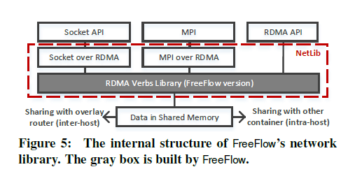
DESIGN - THE NETWORK LIBRARY OF FREEFLOW
Goals:
Supporting most common network APIs, such as Socket (TCP/IP), Verbs (RDMA), MPI (parallel computing), etc.
Selecting the most efficient communication paradigm despite which network API.
Building network library:
Develop several independent libraries dealing with a specific network API
Writing different libraries is clearly suboptimal
To develop a new library for RDMA API, use existing “translation” libraries.
RDMA API as our primary interface - provides a message-oriented interface
TCP/IP sockets interface - easily implemented over RDMA.

Slide 13
DESIGN - THE NETWORK LIBRARY OF FREEFLOW
Working:
Checks the receiver container’s location.
If the container is on the same host - shared memory block
Pointer of the memory block to the receiver’s network library module.
API semantics - notify the data is ready to read.
If the receiver container is on a different host - overlay router on the same host
Overlay router send the data to the receiver container’s IP.
Relies on the overlay routers to deliver the data to the destination.

Slide 14
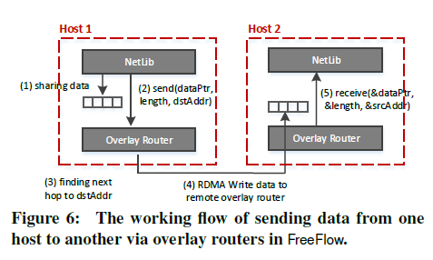
DESIGN - THE OVERLAY ROUTER OF FREEFLOW
Has functionalities in both control-plane and data-plane.
In control-plane - allocates IP addresses for new containers according to default or manually configured policies.
Exchanges routing information and compute routes to all containers in the cluster.
FreeFlow inherits the control-plane behaviors from existing overlay network solutions.
In the data-plane, FreeFlow has its own implementation to make the data transfer more efficient.

Slide 15
DESIGN - THE OVERLAY ROUTER OF FREEFLOW
Working:
The network library in the sender container share the data with its local overlay router – container on another host.
The network library tell the overlay router to send the data to the receiver’s IP address.
The overlay router check its routing table to find the next hop router towards the receiver
It writes the data to the next hop overlay router via RDMA (or DPDK, if available).
If RDMA or DPDK are not available, normal IP communication is used.
Receiver is on its host - shares the received data on the same host and notifies the latter that the data is ready to fetch.

Slide 16
DESIGN - 3. THE NETWORK ORCHESTRATOR
Maintain the real-time information of container locations and VM locations
Containers are started and managed by a cluster orchestrator
Container to host mapping can be easily accessed from the cluster orchestrator.
FreeFlow only adds a small module into existing clusters orchestrator
Allow the network library modules to query the container-to-host mapping
Note: Orchestrator can either push the mappings to network libraries, or the libraries can pull it.

Slide 17
PRELIMINARY IMPLEMENTATION
Dataplane mechanism - on the location of two containers:
Intra-host: shared-memory mechanism
Inter-host: RDMA
FreeFlow implemented the shared-memory via multiplexing IPC namespace
Containers to use RDMA by using the host mode.
Achieves higher throughput and lower latency as compared to overlay network.
The CPU utilization per bit/second - lower for FreeFlow
FreeFlow always selects the most efficient communication mechanism in different settings

Slide 18
CONCLUSION AND DISCUSSION:
FreeFlow offers high performance, good portability and acceptable isolation.
Design of FreeFlow enables containers to communicate most efficiently
Important Considerations:
Live migration:
Network library to interact with the orchestrator more frequently
Maintain additional per-connection state within the library.
Security and middle-box:
FreeFlow would only allow shared-memory among trusted containers,
E.g container belongs to the same vendor (e.g., running spark or storm).
VM environment:
Issues, such as efficient inter-VM communication need to be addressed,
Can be done within the context of FreeFlow design.
Scalability:
Router may end up maintaining one queue pair for each pair of communicating containers.
Solution: Multiplex a single queue pair on overlay routers for multiple container sessions.

Slide 19
Thank you

