Slide 1
Icosatree Data Partitioning of Massive Geospatial Point Clouds with User-Selectable Entities and Surface Modeling

Slide 2
Thesis Advisory Panel
Dr. Reynold Bailey
  Committee Chair
  Associate Professor
  Associate Undergraduate Coordinator
Dr. Joe Geigel
  Committee Reader
  Professor
Dr. Zack Butler
  Committee Observer
  Associate Professor
  Associate Graduate Coordinator

Slide 3
In Partial Fulfillment of the Requirements for the Degree of
Master of Science in Computer Science
By Stephen Ranger
December 12, 2016

Slide 4
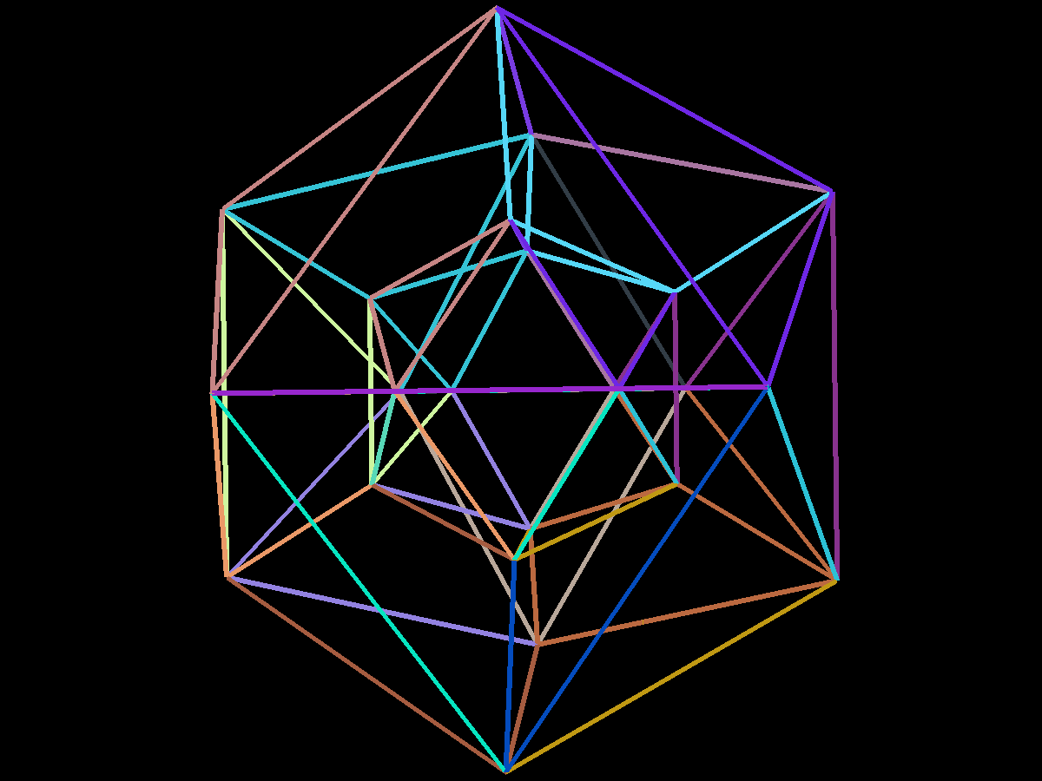
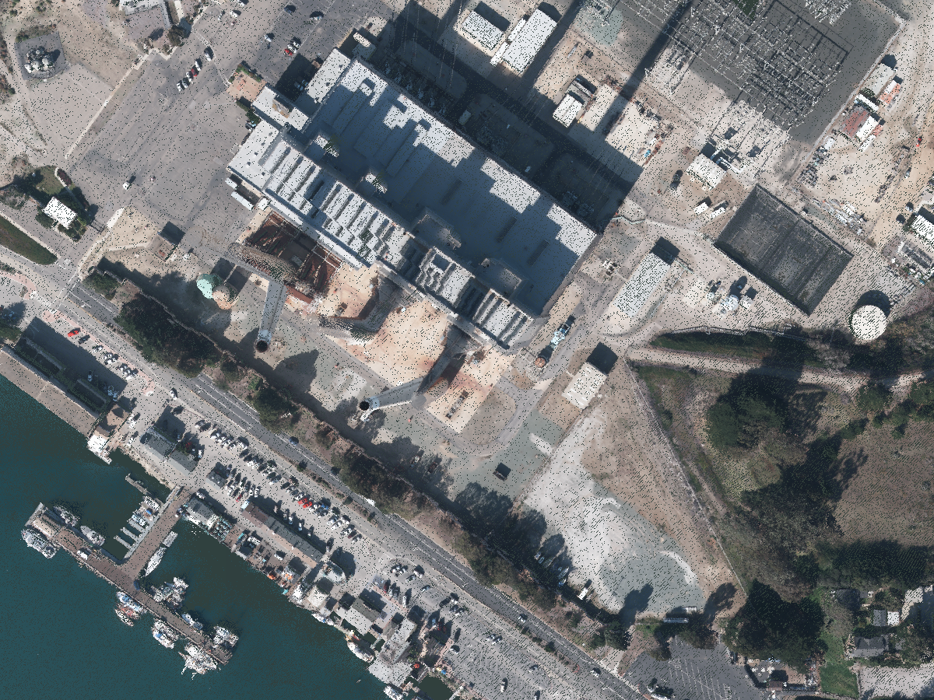
Introduction
Applying Icosatree Data Structure and Adding Selection, Triangulation, and Export Options to Point Clouds

Slide 5
Related Work
Lingyun Yu, Konstantinos Efstathiou, Petra Isenberg, and Tobias Isenberg. 2016
  CAST: Effective and Efficient User Interaction for Context-Aware Selection in 3D Particle Clouds
Ruggero Pintus, Enrico Gobbetti, and Marco Agus. 2011
  Real-time Rendering of Massive Unstructured Raw Point Clouds using Screen-space Operators
K Wenzel, M Rothermel, D Fritsch, and N Haala. 2014
  An out-of-core octree for massive point cloud processing
Prashant Goswami, Yanci Zhang, Renato Pajarola, and Enrico Gobbetti. 2010
  High quality interactive rendering of massive point models using multi-way kd-trees
Jürgen Richter, RicoDöllner. 2010
  Out-of-core real-time visualization of massive 3d point clouds

Slide 6
Methods: Overview
Icosatree designed to apply Cartesian values to projected surface
  Tree cells tangential to WGS84 projection
  Higher fill ratio compared to Octree
  Uniform cell shape in visualization
Selection algorithm adds analysis utility to visualization
  2D lasso selection for intuitive interaction
  Configurable steps allow tailoring to use-case
  Export functionality to support external processing

Slide 7
Methods: Icosatree
Icosatree: Icosahedron Data Structure
  Based on Octree algorithm
  Root cell splits into twenty triangular prism cells
    Labeled A-T
  Triangular prism cells split into eight child cells
    Labeled 0-7
  Traversed in same manner as Octree

Slide 8
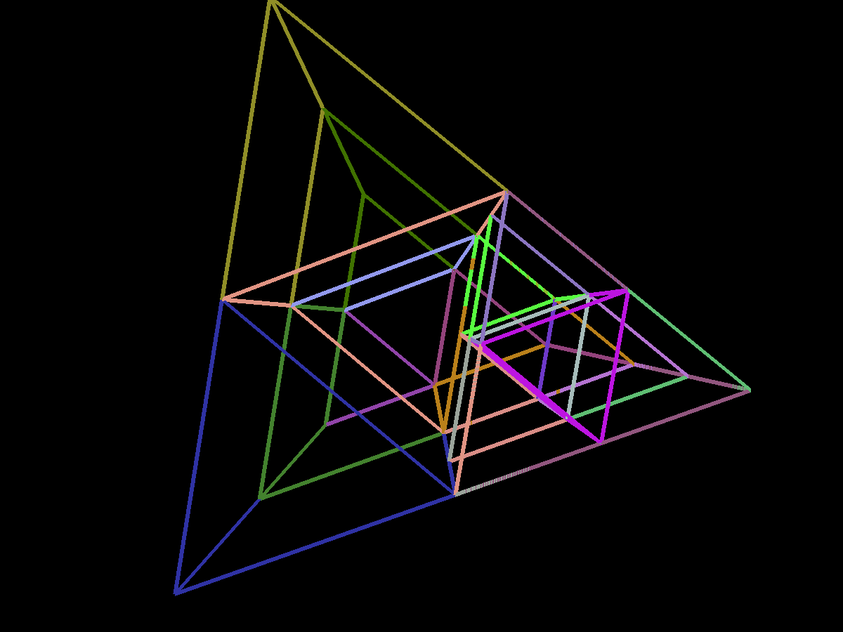
Methods: Icosatree
Root cell defined as axis-aligned bounding box
  Does not store point data
Twenty triangular prism cells encompass WGS84 surface
  Average Effective altitude range: [-1434 km, 1465 km]
    Corners of bottom face to center of top face
  Max radius based on Octree radius (2²³ meters)
  Min radius = Max radius / 2.0

Slide 9
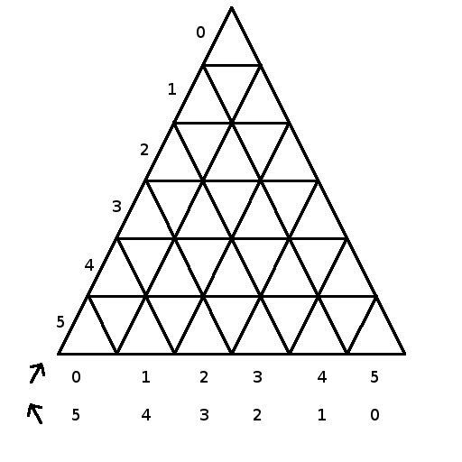
Methods: Icosatree
Triangular Prism Point Allocation
  Split into sub-cells
  Triangular Coordinates used for indexing
Tree insert
  Find child of root containing point
  Insert into child
  Compute triangular coordinate index
  If sub-cell empty: insert point
  Else:
    If new point closer to sub-cell center: swap point
    Insert remaining point into child cell

Slide 10
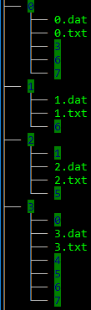
Methods: Tree Data Structure
Data structure built separately from visualization
Application stores data structure in file structure defined by cell path
Root directory contains point attribute CSV file and cell point statistics
Each directory contains
  Directories for child cells
  Data file for stored points
  Text file listing available child cells
Accessible from local file system or over HTTP connection

Slide 11
Methods: Visualization Application
OpenGL / Java based (JOGL)
Geospatial Navigation
WGS84 based Earth
Digital Elevation Model support
Slippy map tiles imagery support (ie. OpenStreetMap, Stamen)

Slide 12
Methods: Tree Structure Rendering Element
Handles Octree and Icosatree implementations
Initializes tree with metadata (CSV attributes and cell statistics)
Stores cell point data in Dynamic Vertex Buffer Pool
Rendering Operations
  Compute cells to render (frustum culling)
  Upload any pending cells to vertex buffer pool
  Build bounding volume for clipping planes
  Render points
    For each VBO pool, render all cells mapped to each VBO segment
    Limit enable/disable calls

Slide 13
Methods: Tree Structure Rendering Element
Determining cells to render
  Starting with root cell
  Frustum intersection test
    IN: Skip frustum tests for remaining cells below this cell
    INTERSECTS: Continue as-is
    OUT: Return, skip children
  Check level of detail
    On-screen area vs. user-defined area threshold
  If level of detail within threshold, mark to render
    If no point data, skip children, don't render, and queue point request
  If cell has children, continue at start for each child

Slide 14
Methods: Selection and Triangulation
2D lasso defined by user using mouse
Closed polygon from lasso created
Projected into scene as selection frustum
Points within frustum are stored and highlighted

Slide 15
Methods: Selection and Triangulation
User defined pruning stage order
Orthonormal
Obstruction
Altitude threshold

Slide 16
Methods: Selection and Triangulation – Orthonormal Pruning
Orthonormal Pruning
  Computes global eigenvector as surface normal
  For each point, compute local eigenvector
    Remove point if furthest neighbor is outside of grid size * 2 (outlier removal)
  If dot product between global and local normal above threshold; remove point
    Normal threshold of 1.0 means normals are parallel, 0.0 means perpendicular
Useful for removing flat surfaces
Unfortunately removes flat building roofs
  However, triangulation does successfully connect building edges
  Doesn’t work if no points for sides of buildings (aerial scans)

Slide 17
Methods: Selection and Triangulation – Obstruction Pruning
Obstruction Pruning
  For each point:
    Compute angle between current point and all other points relative to camera
    If computed angle less than threshold value AND behind test point; remove current point
Useful for removing points hidden by others
Not useful for natural surfaces; removes detail
Helps triangulation build smoother surfaces

Slide 18
Methods: Selection and Triangulation – Altitude Threshold Pruning
Altitude Threshold Pruning
  Compute min/max altitude of all points
  Remove any points within threshold of minimum
Useful for cropping noise or ground level unevenness

Slide 19
Methods: Selection and Triangulation
Once all points are collection and (optionally) pruned
  Convert XYZ coordinates into XY-depth in screen space
  Optionally remove occluded screen space points
  Use Delaunay triangulation algorithm to compute triangle mesh
  Project XY-depth mesh back to XYZ coordinates
  Send list of triangles to rendering component

Slide 20
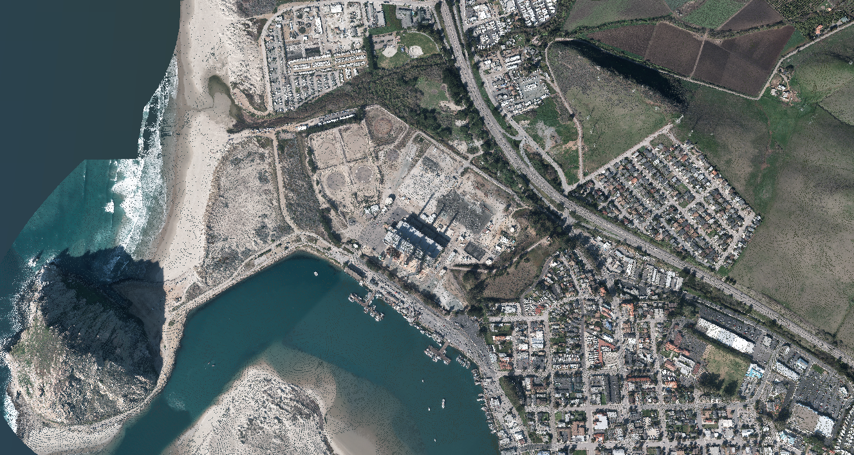
Results: Point Cloud Dataset
Morro Bay, San Simeon, CA
  Geodesic Bounds: (-120.88, 35.36), (-120.84, 35.40)
  163,251,931 total points

Slide 21
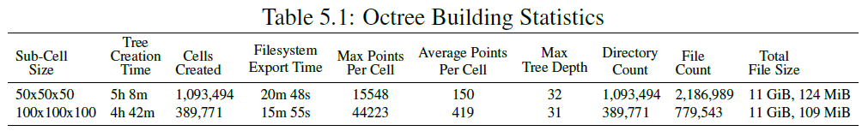
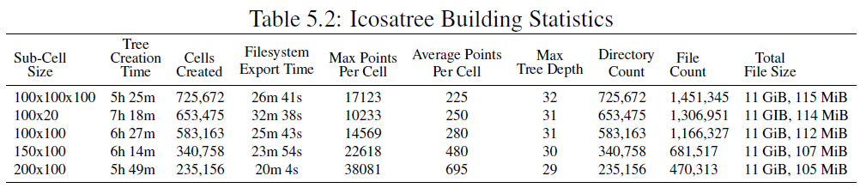
Results: Dataset Analysis
Dataset construction

Slide 22
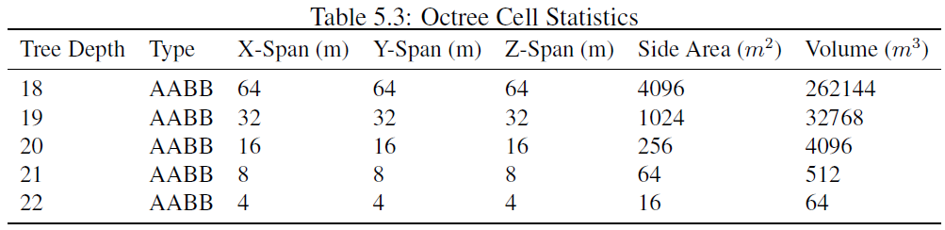
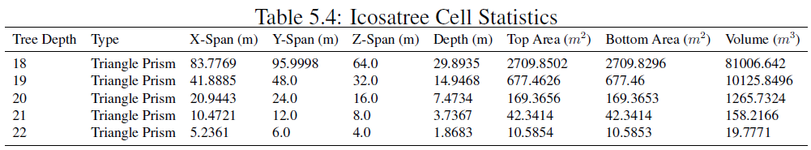
Results: Dataset Analysis
Data Structure Statistics

Slide 23
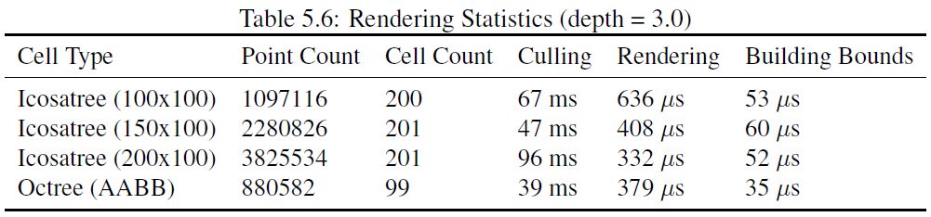
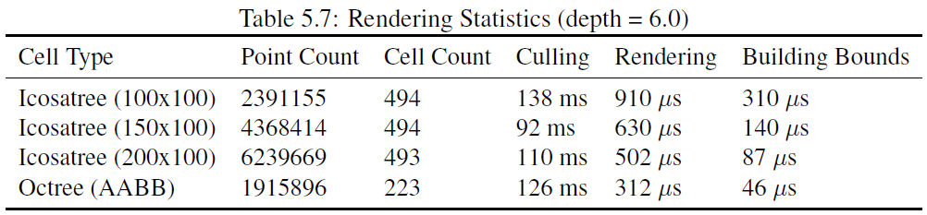
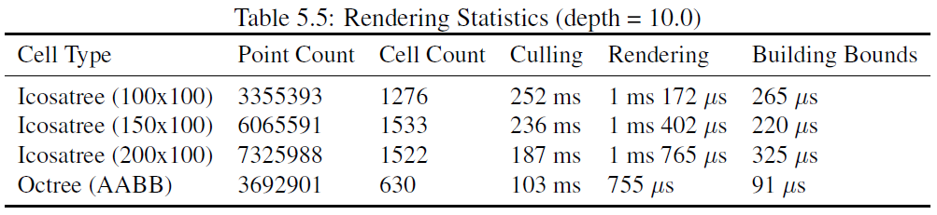
Results: Rendering Analysis

Slide 24
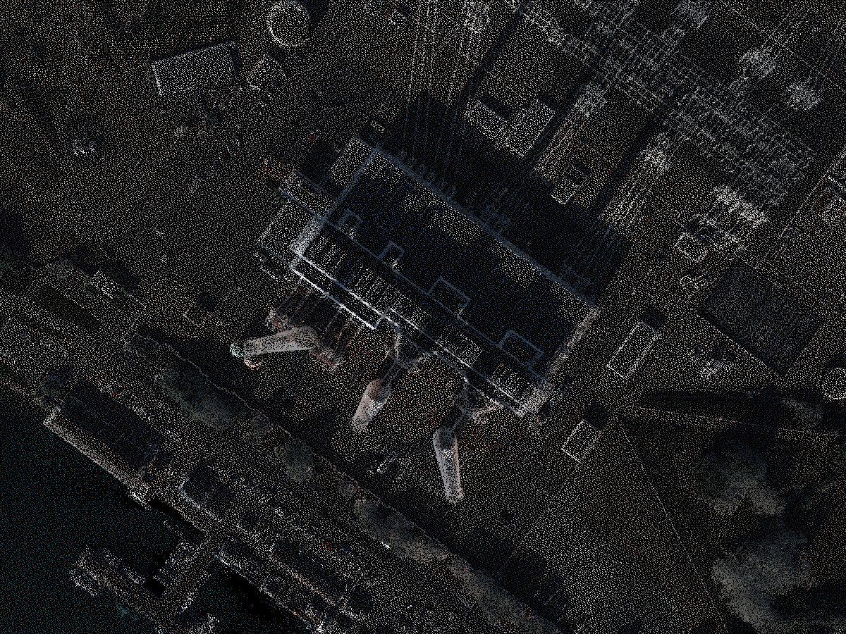
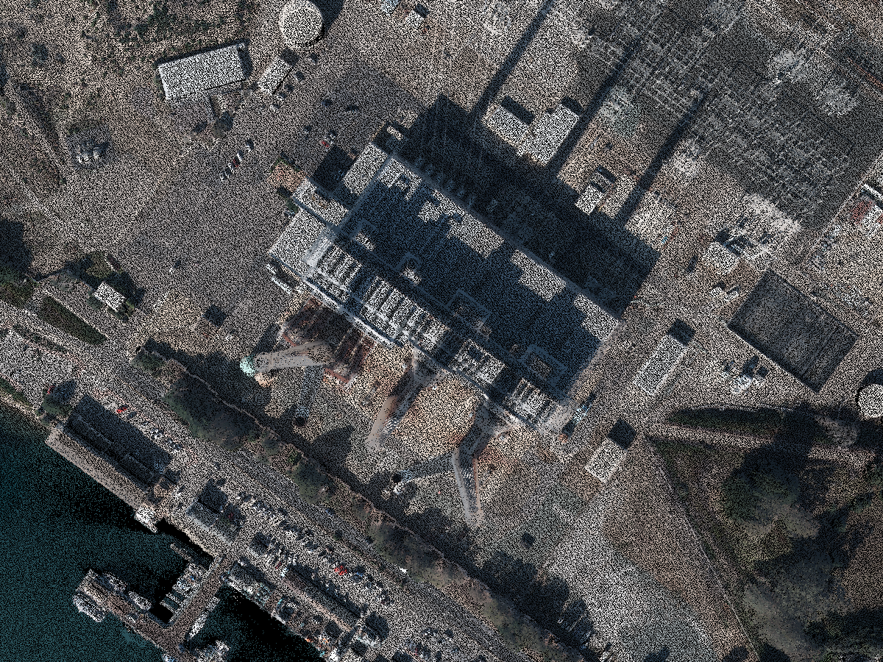
Results: Rendering Analysis
Rendering with level of detail
Depth = 3.0 Depth = 6.0 Depth = 10.0

Slide 25
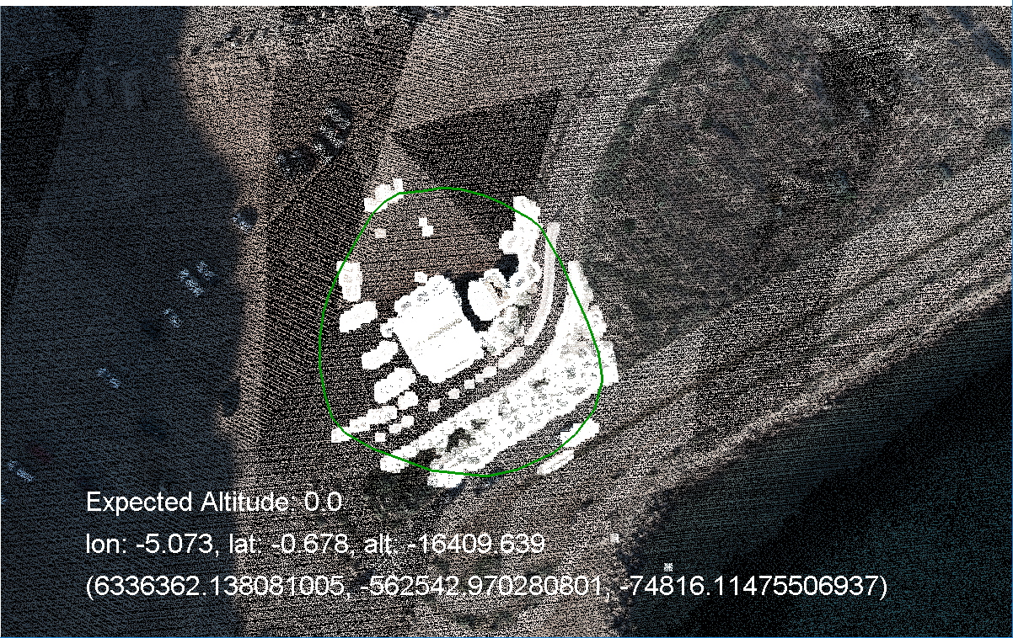
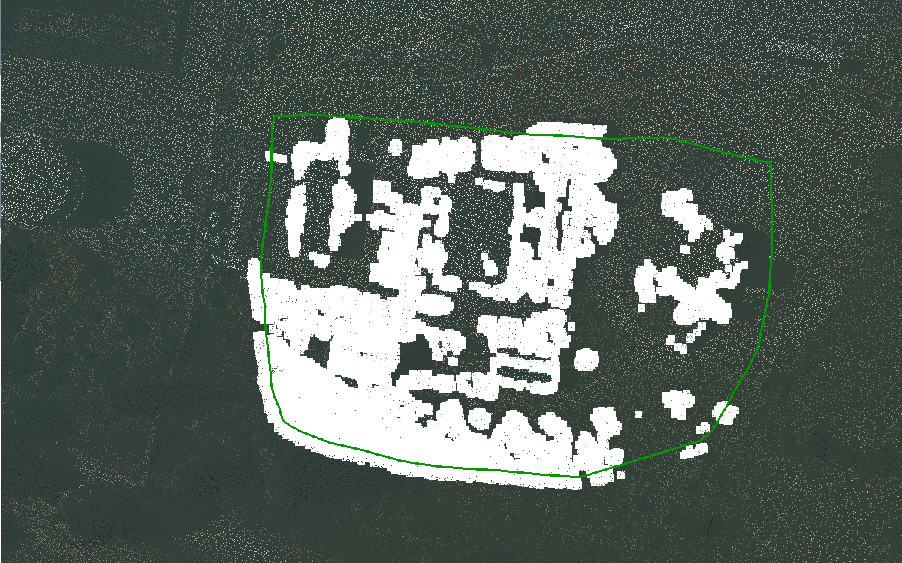
Results: Point Selection Output

Slide 26
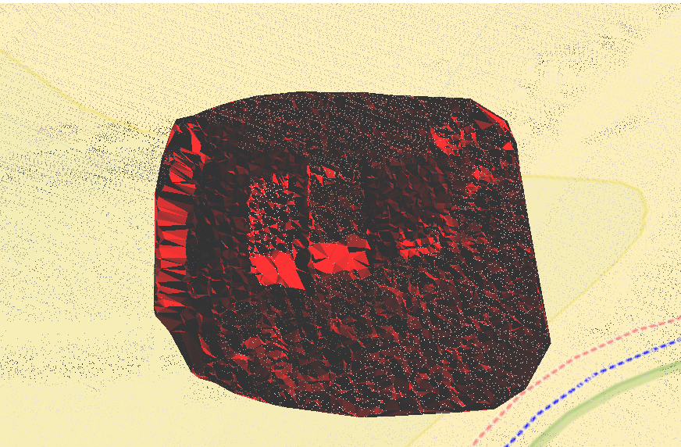
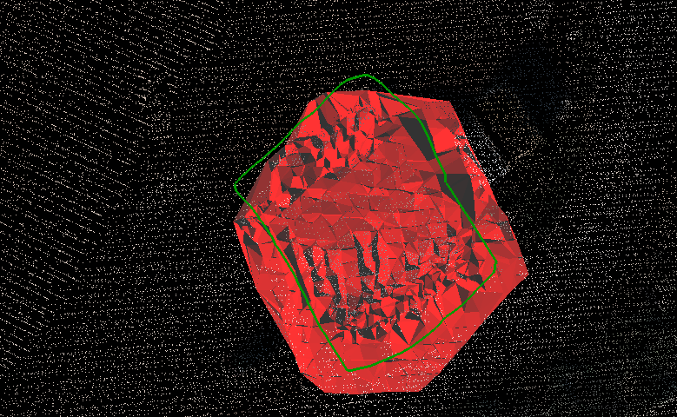
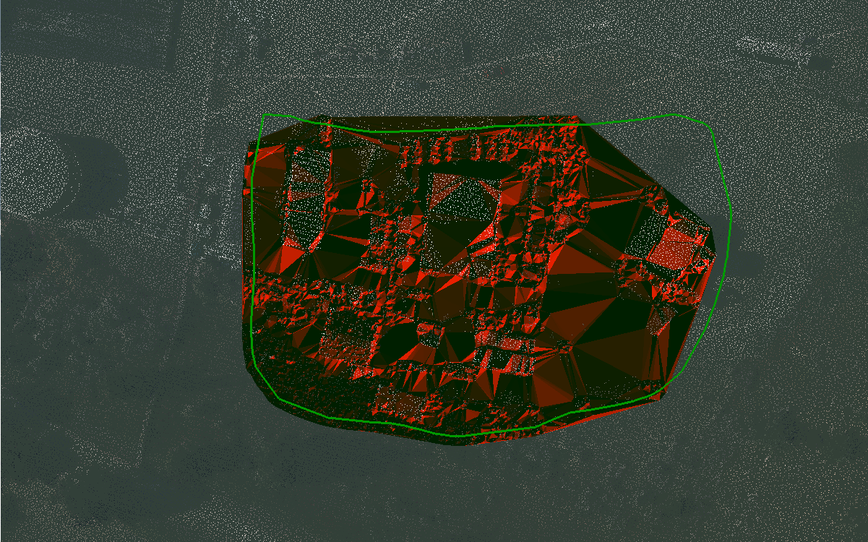
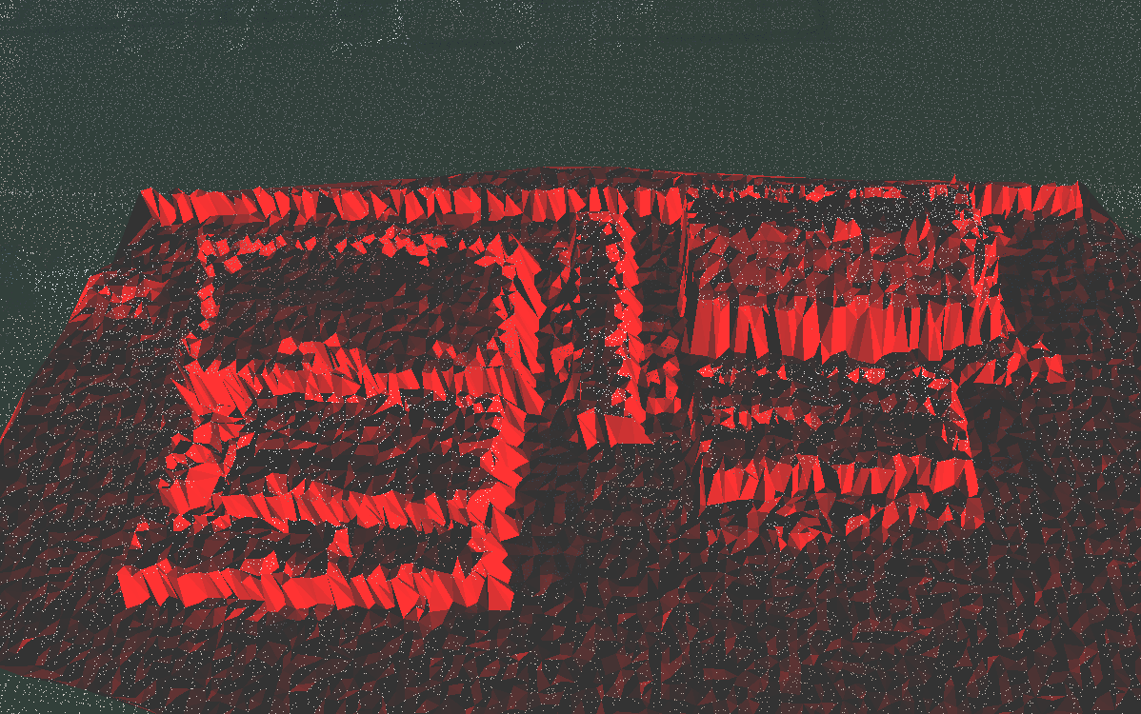
Results: Triangulation Output

Slide 27
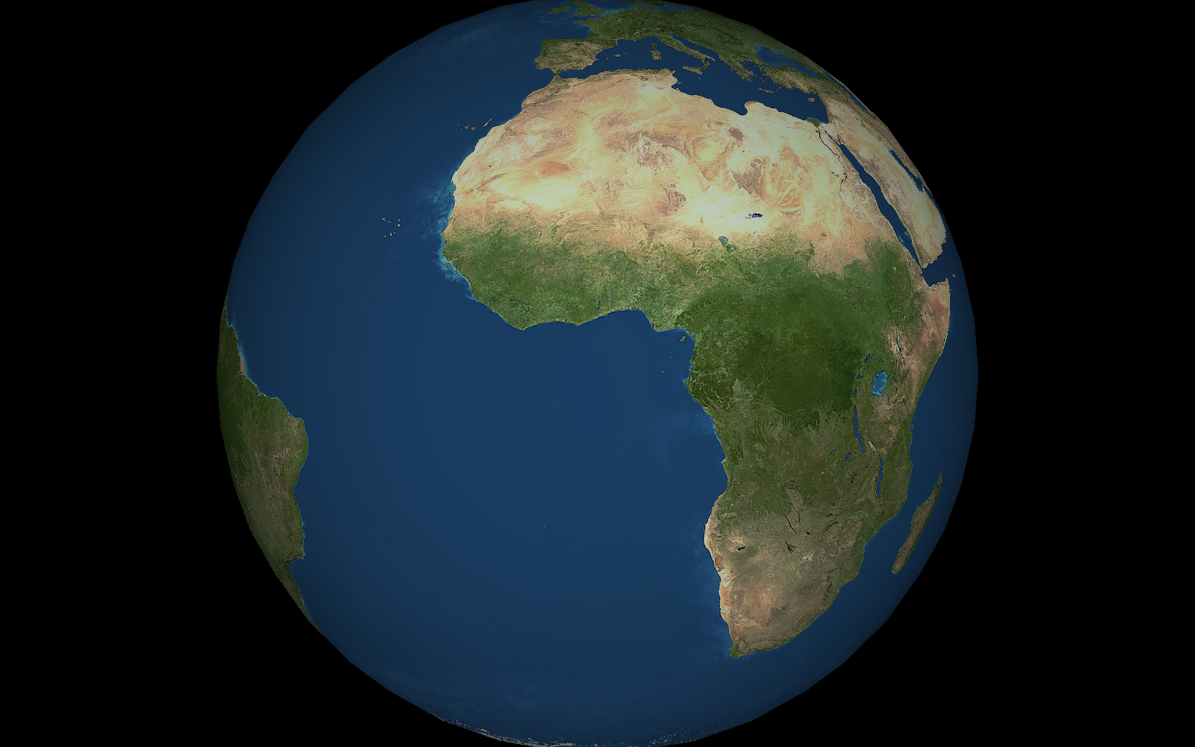
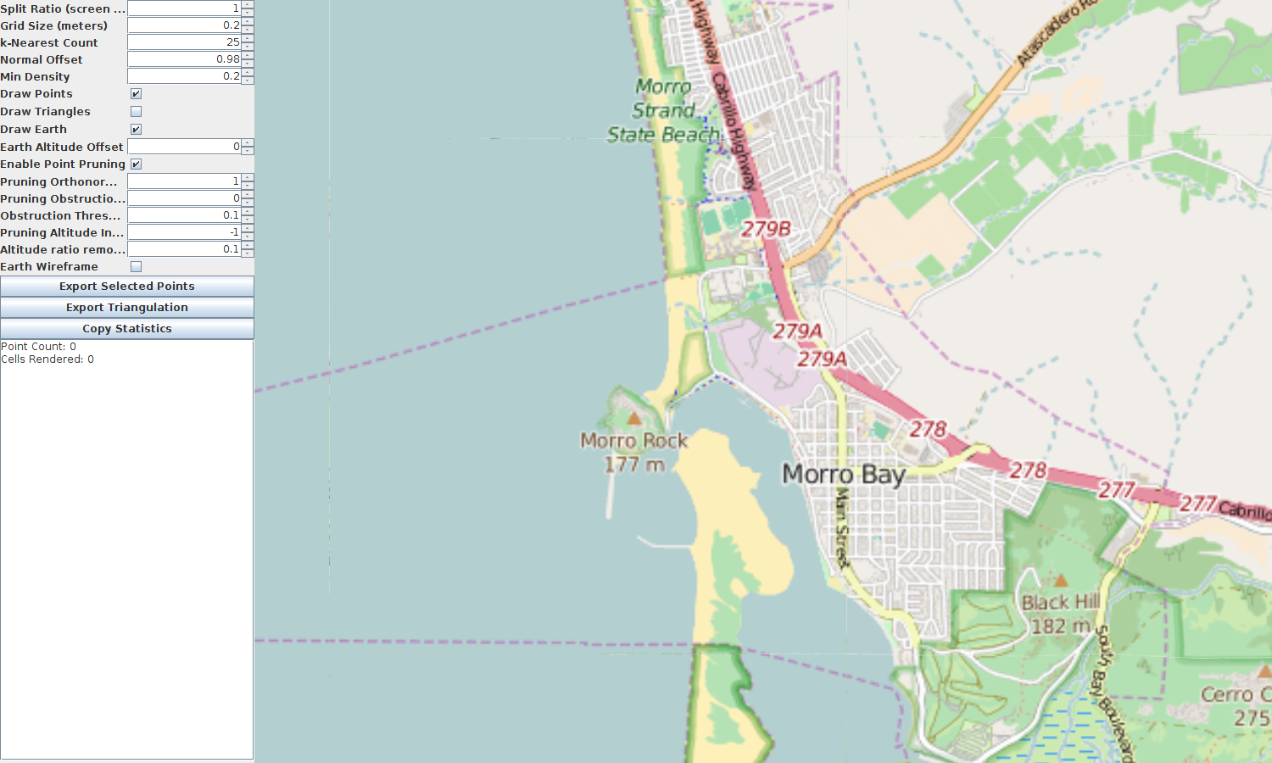
Discussion: Current Status
Octree/Icosatree dataset creation and rendering
  X, Y, Z, Red, Green, Blue, Altitude, Intensity attributes
Geospatial camera navigation
  Geodesic anchor
  Spherical offset
Earth scene element
  WGS84 ellipsoid
  Digital Elevation Model for altitude
  Slippy Map Tiles for imagery
  Tessellated level of detail

Slide 28
Discussion: Current Status
Point Selection with lasso
- Point pruning
  Orthonormal surface
  Obstruction
  Altitude
Triangulation using Delaunay algorithm
Export using PLY format

Slide 29
Conclusion
Performance overall promising
  Icosatree cells visually pleasing
  Cell point allocation more efficient
  Difficult to determine optimal sub-cell sizes
    Cells can end up too large for GPU
    Requires more cells to be rendered
  Triangular Prism Bounds computationally intensive compared to axis-aligned bounds
  Point Selection fairly quick
  Pruning and Tessellation are slow

Slide 30
Future Work
Custom point attribute mappings
Import LAS/LAZ files directly
Icosatree cell and sub-cell size optimization
Updated dataset creation tool (threading, in-place file caching)
Pruning and triangulation optimizations
OpenCL or CUDA support
Various rendering engine fixes

Slide 31
End

Slide 32
Geospatial Navigation
WGS84 Surface navigation
  Geospatial anchor
  Spherical coordinate offset
  Left mouse intersects navigation surface (ellipsoid) to set anchor
  Right mouse modifies elevation and azimuth offset
  Middle mouse scroll modifies range

Slide 33
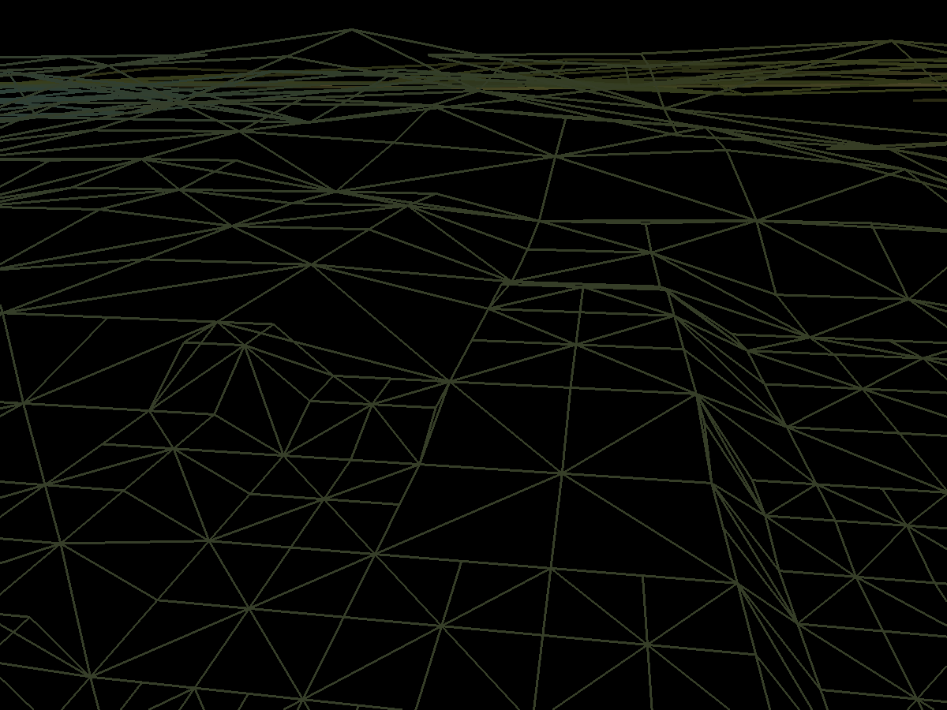
WGS84 Earth
Tessellated ellipsoid
Level of detail based on distance of camera from geometry
Digital Elevation Model data used for ellipsoid elevation
Slippy map tiles used for imagery

Slide 34
Digital Elevation Model
Digital Elevation Model
  Creates index of all available DEM files
  Location set with JVM flag -Ddem3.directory
  Recursively searches directory for .hgt files
  Stores lookup using lon/lat integer index
  File random access for runtime value lookup

Slide 35
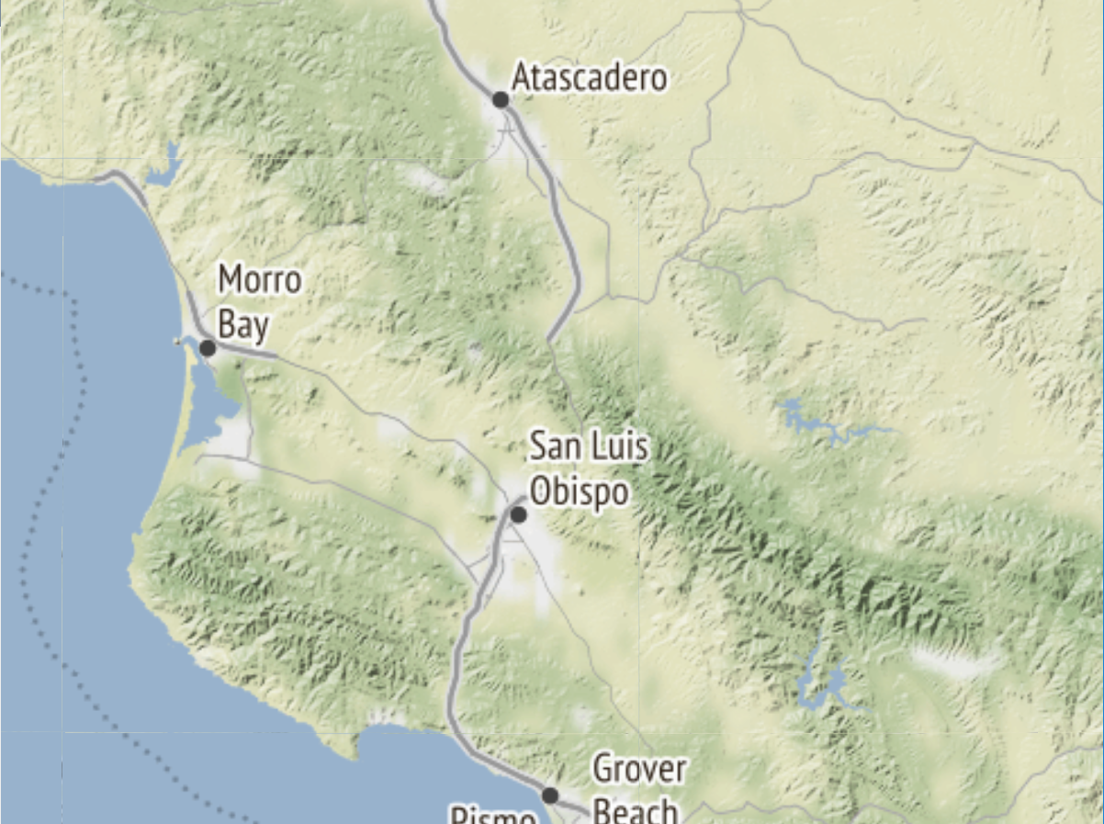
Slippy Map Tiles
Slippy map tiles
  Support for OpenStreetMap and Stamen
    -Dosm.server=<base_url>
    -Dstamen.server=<base_url>
    -Dimage.cache=<filesystem_path>
  URL format for geospatial tile imagery
  Quadtree based tiling system
  <base_url>/zoom/x/y.png (or .jpg for Stamen)
  256px images

Slide 36
Dynamic Vertex Buffer Pool
Dynamic Vertex Buffer Object Pool
  Actually pool of pools
  Defines max segment size and number of segments per VBO
  Pools created for max segment size and below
    Loops until segment pool is less than 100 points
    ie. max = 1000, pools = {1000, 500, 250, 125, 62}
  Pool starts with one VBO and adds/removes additional as necessary
  Each pool stores global index so number of VBO's seamless
  Tree Cells store pool index and segment index for rendering
  Allows tree cells to be at least 50% space efficient

