Slide 1
Step-by-Step Detection of Personally Collocated Mobile Devices
Animesh Srivastava – Duke University
Jeremy Gummeson, Mary Baker, and Kyu-Han Kim – HP Labs Palo Alto
HotMobile 2015 Santa Fe, New Mexico
02.13.2015

Slide 2
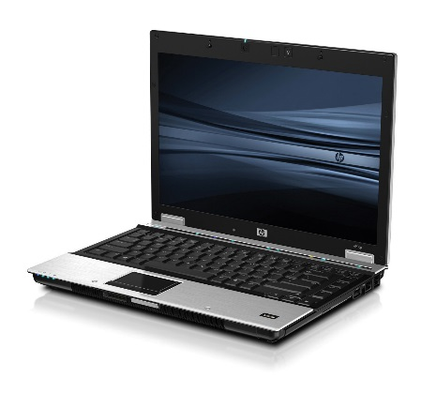
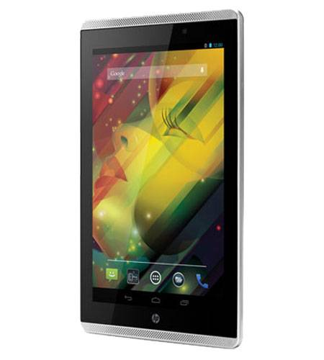
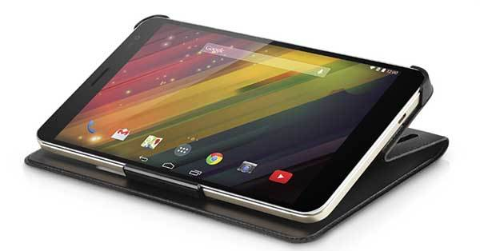
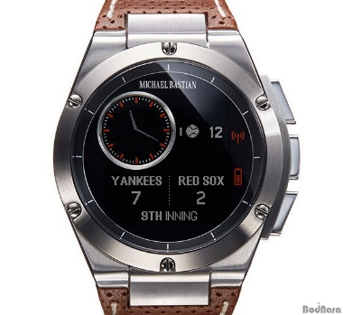
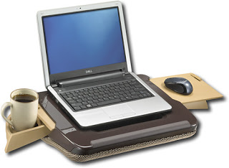


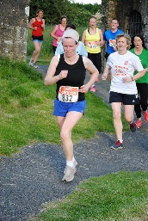
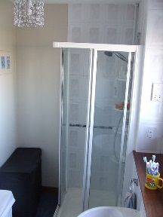

Mobile Devices are NOT Always with Us
Laptops
Tablets
Phones
Wearables
Varies spatially and temporally; different dynamics for different people
Notes:
I’d like to start off the talk with a simple observation: mobile devices are growing in quantity and number of available form factors – these devices are built for different purposed and are not always with us. For example, a Laptop computer is with us at the office during the day and might be carried with us in a bag. A phone might be with us most of the time, but many not be suitable for all activities like exercise. Even devices like wrist wearables that are supposed to be always with us might need to be removed while we are bathing. Of course, this behavior changes with time and location and will be unique to an individual.

Slide 3
Mobile Devices are Hard to Keep Track Of!
Have you ever:
Forgotten to lock your device when you walked away?
Didn’t remember to bring your laptop to work?
Didn’t put your fitness tracker back on after getting out of the shower?
Left your phone on the bus or at a bar?
A set of devices that are on your person, in your immediate vicinity, and under your physical control are said to be personally collocated
Notes:
Consequently, the collection of mobile devices we carry with us from time to time can be hard to keep track of! Here are a few examples you might be more familiar with than you’d like to admit:
-You’ve forgotten to lock your phone’s screen when you left in on your desk.
-You’ve left your laptop at your home and driven to work without it.
-Maybe you left your mobile phone at a bar or on a bus
In this work, we’d like to automatically recognize which set of devices are currently with a given user at any moment in time.

Slide 4

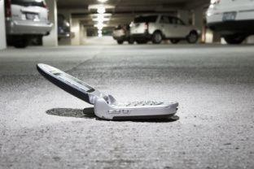
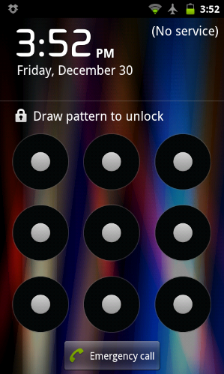
Some Services Enabled by Personal Collocation
Forgot My Device
Early Screen Lock
Automated Message Responses
Requirements:
Fast: determine changes in collocation state quickly
Accurate: correctly report devices’ collocation state
Low Cost Implementation: Don’t require expensive hardware to determine personal collocation
Energy Efficient: Should not significantly impact device battery life
Notes:
As a consequence of understanding which devices are currently personally collocated, we can enable some services that depend on this knowledge
Forgot my device
Notification delivered to wearable device about missing other device
Early screen lock
Walk away from a phone or laptop; lock the screen early if left unintentionally unlocked
Automated email / SMS responses
If I’m not around to respond, a device can respond on my behalf.
Requirements: Collocation state should be determined quickly, accurately, easy to implement across all device and be low power enough to run continuously in the background!

Slide 5

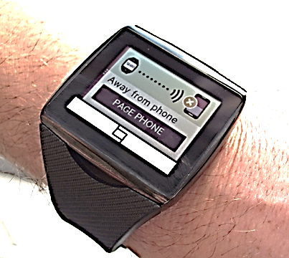

The De-facto Standard: RSSI-based Collocation
Proximity
close
medium
???
Collocation
far
Separation undetectable until ~45 meters!
Notes:
Unfortunately, state-of-the-art methods in understanding collocation relationships don’t suitably meet the requirements I just mentioned. The current de-facto standard in detecting collocation is using radio received signal strength. RSSI is currently most used in proximity beacons, such as Apple’s iBeacon standard. To understand how this approach works in practice, we measured the signal strength detected by a Bluetooth low energy device as we increased the transmission distance from another Bluetooth low energy device. In this example both devices were in line of sight and we still observe that RSSI is not monotonically decreasing. As a consequence, beacons will typically report distance as a relative quantity in several bins such as close, medium and far. Other devices, such as the Qualcomm Toq shown in the lower right attempt to use RSSI for personal collocation. In this case, the Toq is notifying the user that they have left their mobile phone behind – we found that in practice it takes a long time to receive these notifications. To better understand the lack of performance, we performed more measurements between a pair of Bluetooth Smart device – this time one of them was worn on the wrist, while the other device was near by or on the user. Because human beings are especially good at absorbing RF, this signal strength can vary quite a bit and it’s hard to relate this quantity to how proximite the phone is to the user. According to these measurements, we wouldn’t reliably detect the devices are separated until they are more than 45 meters apart. At a typical human walking speed, this would be a detection latency of over 30 seconds.
This increased latency could be the difference between you reclaiming the phone you left on the bus because of a handy alert or only receiving the alert in time to see the bus drive away with your phone!

Slide 6
Our Approach: Track Footsteps on Each Device
Collocated
Separated
Collocated
Research Challenge: How do we transition between collocated and separated states accurately, with low latency, and with minimal energy overhead?
Notes:
WHY NOT MOTION IN GENERAL???
Instead of detecting collocation using RF, which varies wildly as a function of both human presence AND the environment, we track a quantity that tends to change more specifically to human beings. Suppose a user carries both a smartphone in their pocket and wears a smart watch on their wrist – both of these devices will experience the same changes in acceleration induced by human footsteps. After we observe enough of them, we can say with confidence that both devices are on the same person. If I sit at a desk for a period with both devices with me, I will notice lack of acceleration since both devices are at rest, then one will observe footsteps while the other does note. After some time, we can confidently say they have separated. When I go back and pick up the phone, I can once again re-establish a collocation relationship.
Making this determination has a few research challenges I’d like to discuss more in this talk. And the overall question we ask is: (read question)

Slide 7



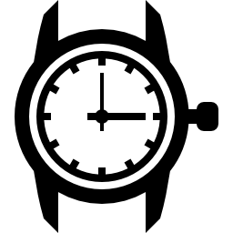
Our Approach: Track Footsteps on Each Device
Notes:
CAVEAT: Similar Mobility WRT footsteps
I’d now like to make our technique of detecting personal collocation more clear with a state machine and a concrete example. In this example, we have a user who is walking. He is currently walking, and is wearing a smartwatch and carrying a mobile phone in their pocket. Let’s assume that our state is pre-initialized to the collocated state. Both devices will remain in this state since they are experiencing similar mobility. If our user decides to sit down at his desk, both devices will experience the same lack of motion, but since they haven’t moved they should still be collocated since they haven’t been able to move away from each other. Now, say our user leaves their phone on the desk and walks away while wearing their smartwatch – the smartwatch will detect footsteps, while the mobile phone does not. This will cause them to transition to state separated. The devices will remain in this state as the user walks around, or even if sits back down at the desk next to the phone he left behind. Once he picks up his phone and walks away with it in his pocket, we can detect that both devices are collocated once again and this will continue to hold true whether he is stationary or moving.

Slide 8
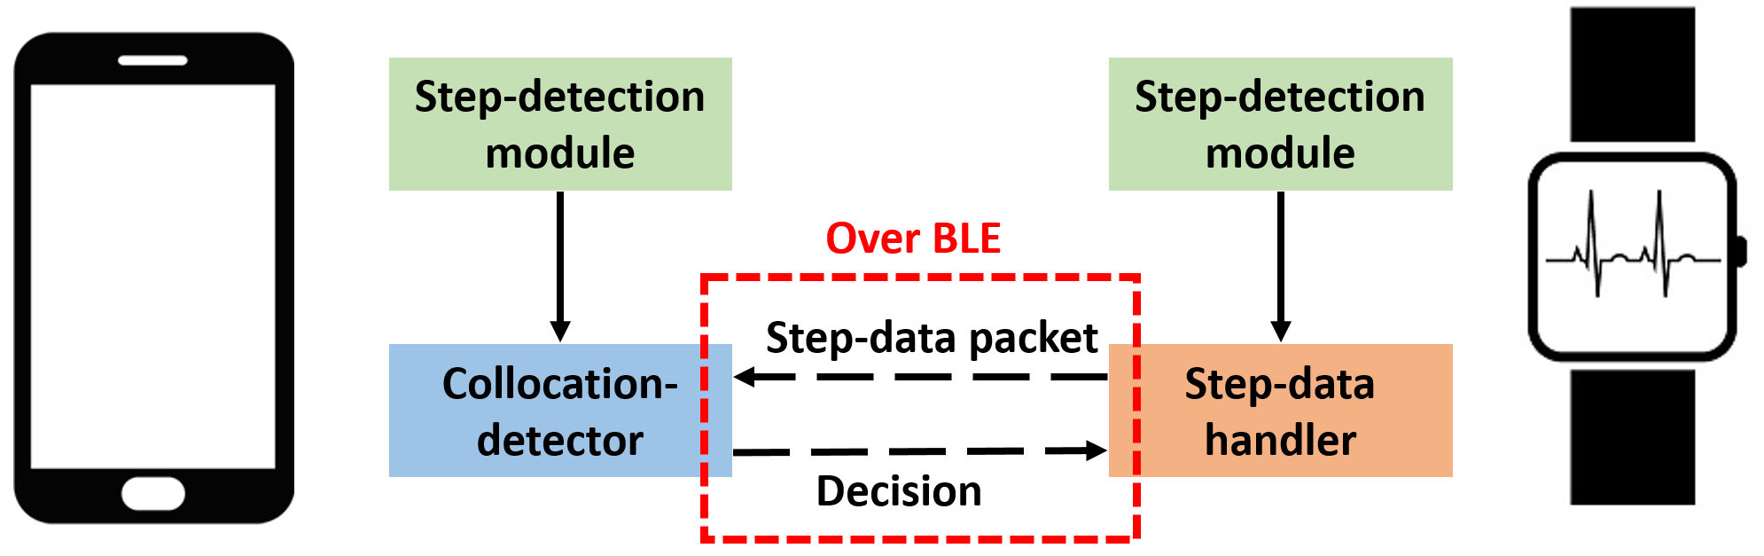
Implementation and Experimental Setup
Once per second!
Evaluate:
Stability of collocation state while stationary and collocated
Latency of establishing collocation and separation
Energy efficiency of Bluetooth Smart Implementation
Notes:
Now lets look at how this collocation technique is implemented. I’m going to skip over many of the details due to time constraints, but you can find them in our paper. On both an android mobile phone and a Bluetooth smartwatch, we implement a simple, time domain based step-detection algorithm. This can be made quite power efficient since mobile phones now have detected motion co-processors and accelerometers on smartwatches run at extremely low power and can internally buffer acceleration samples. Once ever second, the smartwatch reads out buffered acceleration values from the accelerometers and they are fed into a step data handler. The timing of the individual footsteps are stuffed into a single Bluetooth Low Energy packet and sent to the mobile phone over an active Bluetooth low Energy connection. After receiving this packet, the mobile phone compares the number of steps and timing of steps reported by the smartwatch to the set it detected. After this comparison, the mobile phone sends back a single packet as an ACK that updates the collocation state on the smartwatch.
Next, I’m going to show you a few evaluation results that show how this works in practice. First, we will look at the stability of the collocation state while a user is sitting still. Since we need motion in order to establish collocation in the first place, spurious motions falsely detected as footsteps could result in the two devices transitioning to a separated state. They won’t be collocated again until the user walks around for a while, so it is important we properly filter these spurious motions. Next I’ll show an evaluation of separation detection latency as compared to RSSI. For other latency results, please refer to the paper. Finally I’ll show you the energy efficiency of our solution and how it has negligible impact on the energy budget of a smartwatch.

Slide 9
Experimental Evaluation: Stability While Stationary
Acceleration Dynamics of Wrist for Several Activities
Filtering Extraneous Wrist Motion
Dataset | Mean (g) | Std (g) | Min (g) | Max (g)
Drinking | 0.94 | 0.08 | 0.75 | 1.70
Typing | 0.93 | 0.04 | 0.53 | 1.21
Gesturing | 0.97 | 0.14 | 0.44 | 1.86
Walking | 1.08 | 0.19 | 0.69 | 1.83
Running | 1.91 | 1.17 | 0.39 | 6.56
Stairs | 1.06 | 0.21 | 0.57 | 1.79
Require 0.4 g acceleration magnitude for step detection
Require 9 consecutive intervals with detected steps before state transition
Notes:
AGAIN, WITH RESPECT TO FOOTSTEPS
In order to understand how difficult it might be to distinguish between spurious motions and actual footsteps, we collected several minutes of data from an individual performing a variety of activities. Most importantly, we would like to be able to distinguish between spurious motions falsly detected as footsteps while an individual is stationary and actual footsteps detected by an individual that is actually moving. When we look at several statistics computed for these activities we note that some exhibit more motion than others. While drinking from a cup or typing on a keyboard, a smartwatch doesn’t experience significant acceleration. Based on these results, we can filter many motions by mandating a 0.4 g difference in magnitude of detected acceleration for a potential footstep. However, a person gesturing with their hands at a desk, which could be common while on skype, for example, it can be more difficult to differentiate these spurious motions from footstep-based mobility.
Our current approach to filtering these extraneous motions takes advantage of the observation that these motions tend to be bursty in nature. Using a trace driven simulation, we continuously run our step detection algorithm. Instead of directly computing collocation state during each one second interval, we wait a certain number of intervals before deciding the two device have entered state separated. We require that during each interval we encounter at least one potential footstep. The number of intervals we wait before making this determination, we refer to as the consecutive interval theresold. In the traces that we looked at, waiting 9 seconds, we avoid any false separation events.

Slide 10
Experimental Evaluation: Latency Improvement over RSSI approach
Step-based Collocation offers 3x performance improvement over RSSI
Notes:
Next I’d like to show you what step-based collocation detection buys you over the RSSI-based approach I showed earlier. During these experiments, a user carries with them a smartphone and wears a smartwatch – the state is preconfigured to collocated. The user leaves the mobile phone on a table, and presses a button on the smartwatch so we now the ground truth of when this occurred. After walking for some distance, we make the determination that the two devices have separated – of course, this latency increases as we increase the consecutive interval threshold parameter. When we assume that it takes the 32 seconds for the RSSI based approach I showed a few slides ago, we still perform 3 times better in terms of latency, even when using an aggressive threshold that avoids false separation events from gesturing.

Slide 11
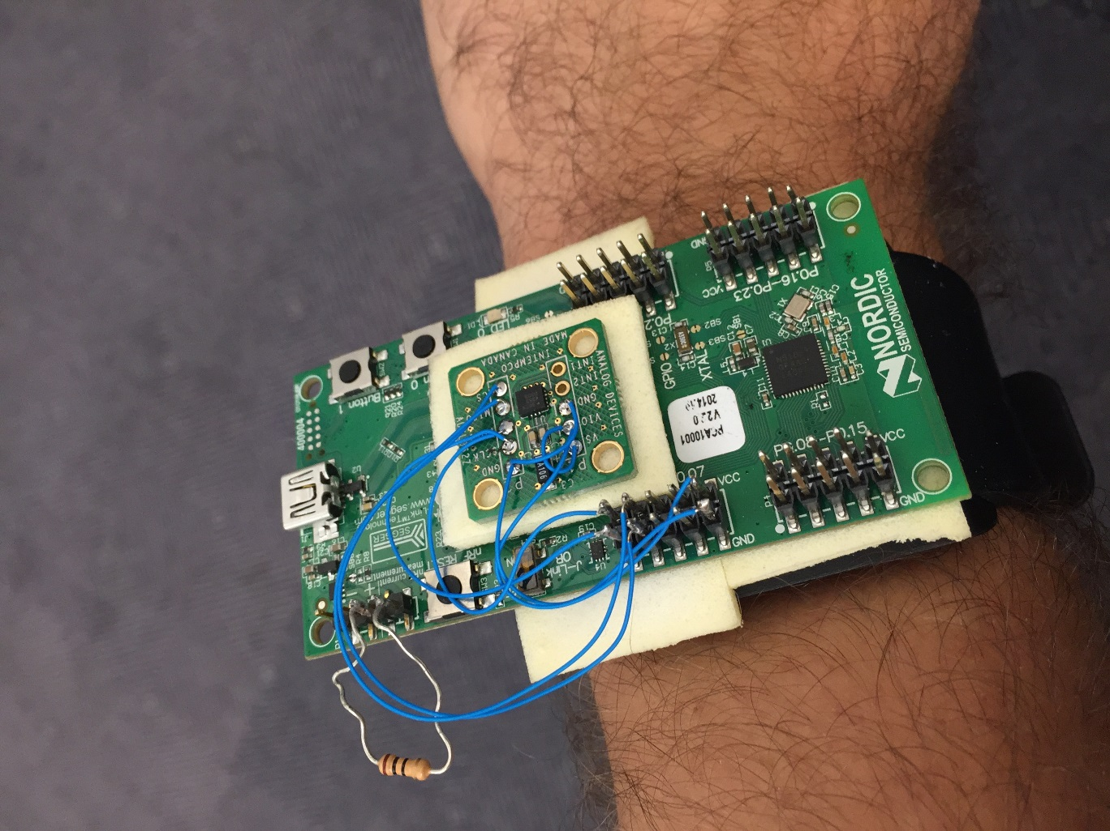
Experimental Evaluation: Energy Efficiency
Implemented Step-based collocation service for nRF51822 Bluetooth Low Energy Reference Platform + ADXL362 3-Axis Accelerometer
Step Detector Service consumes average power of 21.4 µW of power on smartwatch
Service only consumes 1.94 Joules per day out of typical ~4000 Joule smartwatch battery!
Notes:
Finally I’d like to report a little but about energy efficiency. We implemented step-based collocation for a Bluetooth Smart system on chip augmented with a low power 3-axis accelerometer. The accelerometer runs continuously, and the microcontroller wakes up once per second to read out the accumulated acceleration values. It then runs our step detection algorithm, send a Bluetooth packet and goes back to sleep. When considering the costs of running the microcontroller, radio, and accelerometer, the collocation service only consumes around 22 microwatts on average. To put this in perpective, this only consumes a couple of joules of the 4000 joules found in a typical smartphone battery.

Slide 12
Discussion and Conclusion
Step-based approach detects collocation state quickly and efficiently
Easy to implement for any device that has an accelerometer
Our current approach suffers from the following limitations:
Vulnerable to spoofing
Not suitable for limited / non-step based mobility
Future Work: Combine with Frequency Domain and RSSI Techniques
RSSI Trend Combined with step data can be used to decrease latency
Apply frequency domain techniques before declaring a state transition – will seldom be invoked
Dynamic thresholds
Questions?

Slide 13
Questions?
animeshs@cs.duke.com
jeremy.gummeson@hp.com
mary.baker@hp.com
kyu-han.kim@hp.com

Slide 14
Transition Latency Results
Latency in Transition
to Collocated State
Latency in Transition
to Separated State

Slide 15
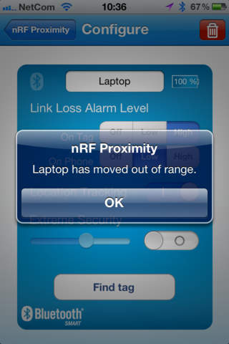
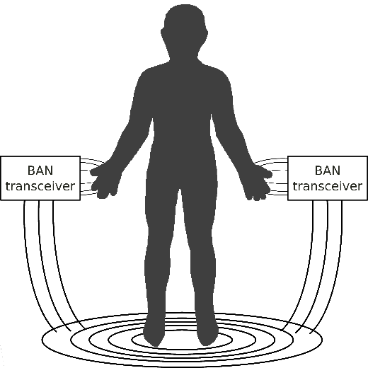
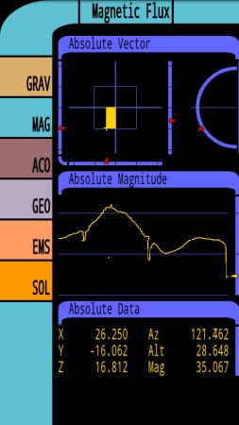
How to Determine Personal Collocation?
Measure distance between devices
Radio RSSI / Audio Amplitude – Audio attenuated by clothing; RSSI stability vulnerable to multipath reflections, attenuation by water in human body
On-body communication (capacitive)
Not all devices touch our skin; only suitable for wearable devices; requires specialized hardware
Measure sensor correlations between devices
Pressure, Temperature, GPS, Compass, Acceleration

Slide 16
Our Approach: Track Footsteps on Each Device
Time-Domain Step Detection
Encode Step Timestamps in BLE Packet
Compare Step Timestamps from Each Device
Compute Collocation State after n intervals

