Slide 1
14/03/2025
Introduction to machine learning and deep learning in Python
Session 2
Rao

Slide 2
Overview
Intro to deep learning
Intro to image data
What is a neural network
What is a convolutional neural network
Terminology
Fine-tuning a pre-trained network
Other kinds of NNs

Slide 3
Introduction to Deep Learning
Deep learning is a subset of machine learning
Neural networks with multiple layers learn to extract complex patterns from data.
Widely used for tasks like image recognition, natural language processing, and more.
In contrast to other ML approaches, DL is a ‘black box’
the network determines the relative importance of combinations of features through an iterative process

Slide 4

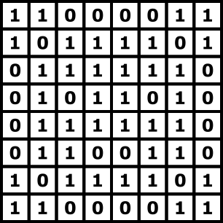
Introduction to image data

Slide 5
Practical – understanding image data

Slide 6
What is a 'Neuron'?
A neuron in a neural network is a mathematical function
Takes inputs, applies weights and biases, and outputs an activation.
Inspired by biological neurons, though greatly simplified.
y = wx + b

Slide 7
How Does a Neural Network 'Learn'?
Neural networks learn through a process of forward and backpropagation:
Forward propagation calculates the output based on inputs and weights.
Backpropagation adjusts weights based on the error in output, reducing the error over time.

Slide 8
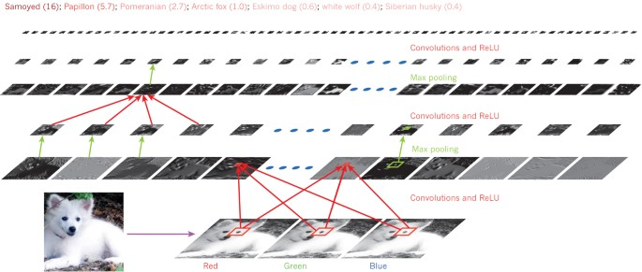
What is a Convolutional Neural Network?
A CNN is a type of neural network designed specifically for image processing tasks.
Uses convolutional layers to detect spatial features and hierarchies in data.
LeCun et al., Nature 2015
https://www.nature.com/articles/nature14539

Slide 9
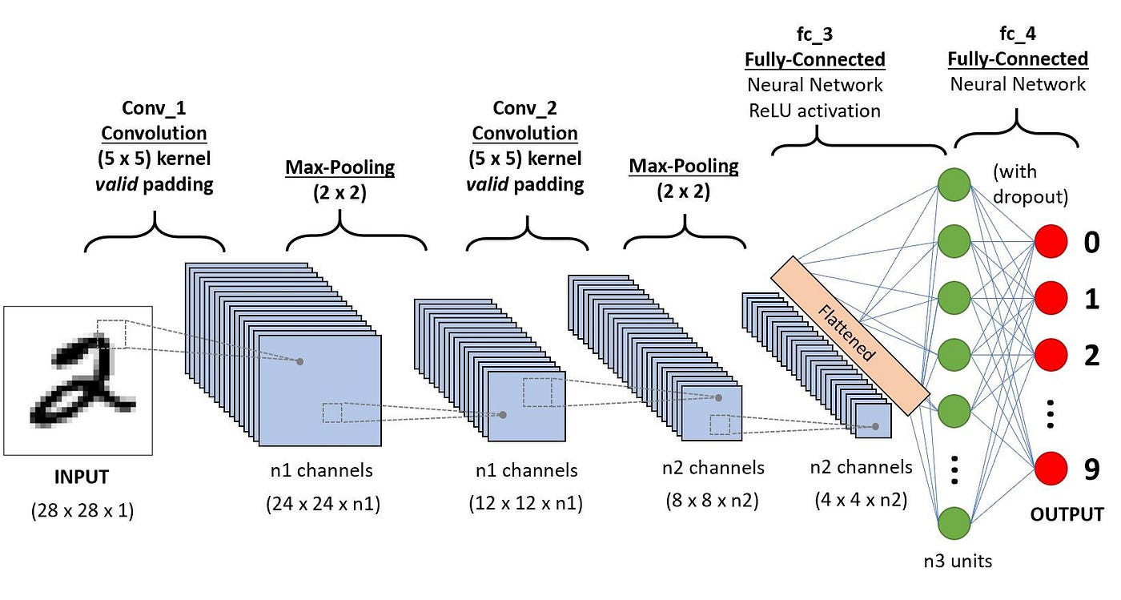
Convolutional Neural Network
http://medium.com/@alejandro.itoaramendia/convolutional-neural-networks-cnns-a-complete-guide-a803534a1930

Slide 10
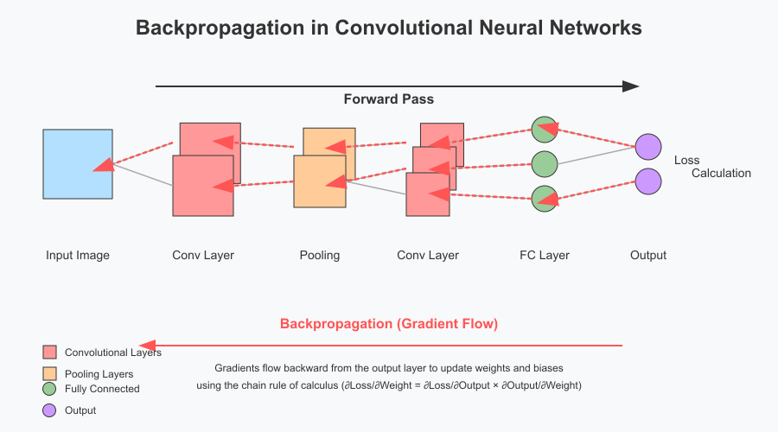
Forward pass and backpropagation

Slide 11
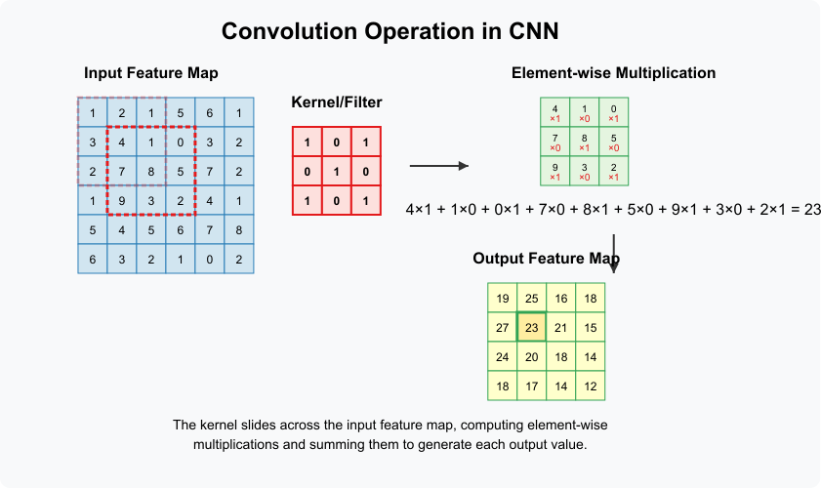
A kernel or filter

Slide 12
Practical – understanding a kernel

Slide 13
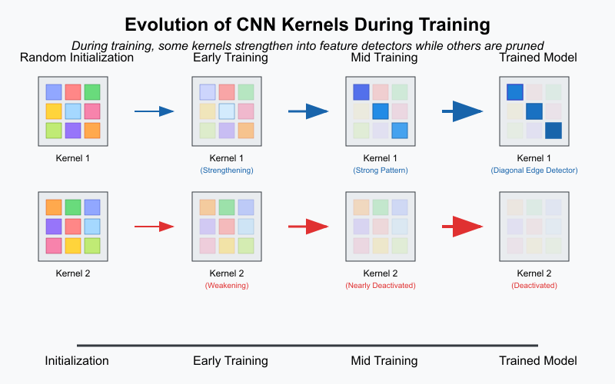
Initialisation with random kernels

Slide 14
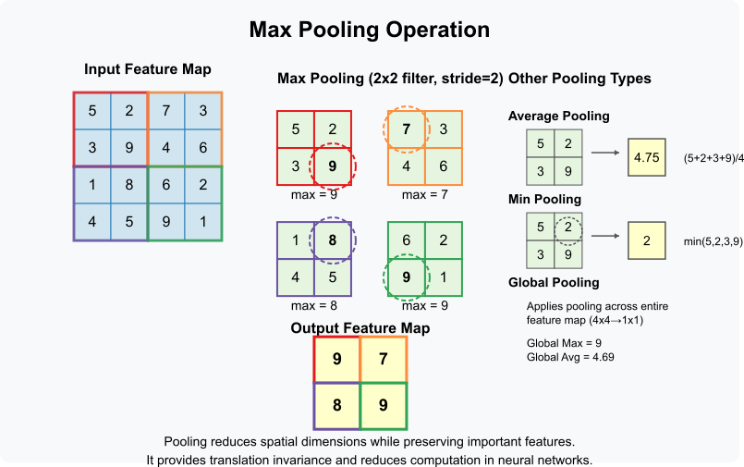
Pooling

Slide 15
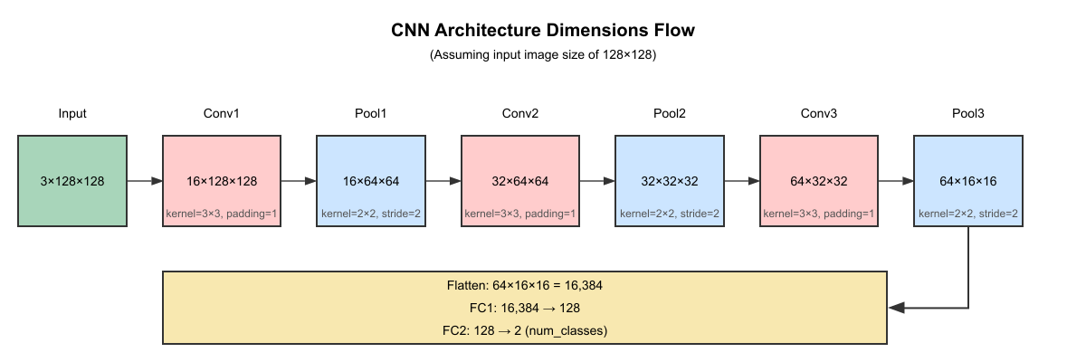
Dimensions as we go through the CNN

Slide 16
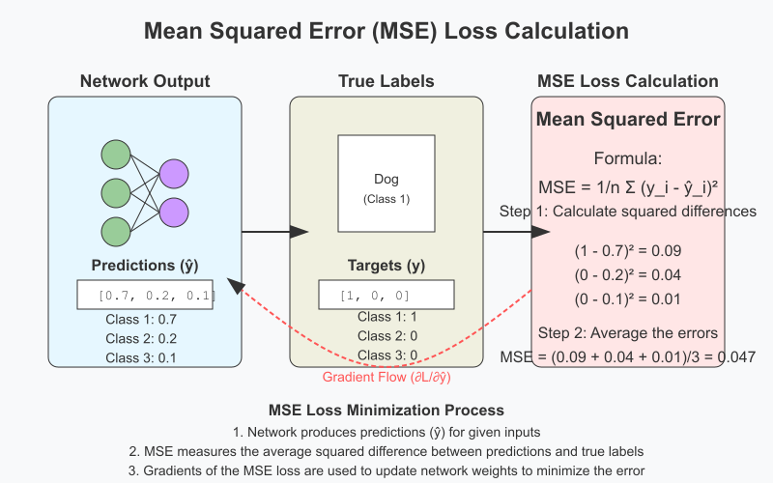
Loss calculation

Slide 17
Some terms
ReLU: An activation function that introduces non-linearity by converting negative values to zero.
Softmax: A function that converts outputs to probabilities, used in classification tasks.
Pooling: A layer that reduces spatial dimensions, helping with feature abstraction and reducing computation.
Loss function: a mathematical function that quantifies the deviation of the predictions from the actual targets.
Optimizer: a method to alter the weights and biases to minimize the loss.
Epoch: One complete pass through the entire training dataset

Slide 18
What are Hyperparameters?
Hyperparameters are configurations external to the model which impact model performance and training efficiency
learning rate
batch size
number of layers

Slide 19
Practical – Building a CNN

Slide 20
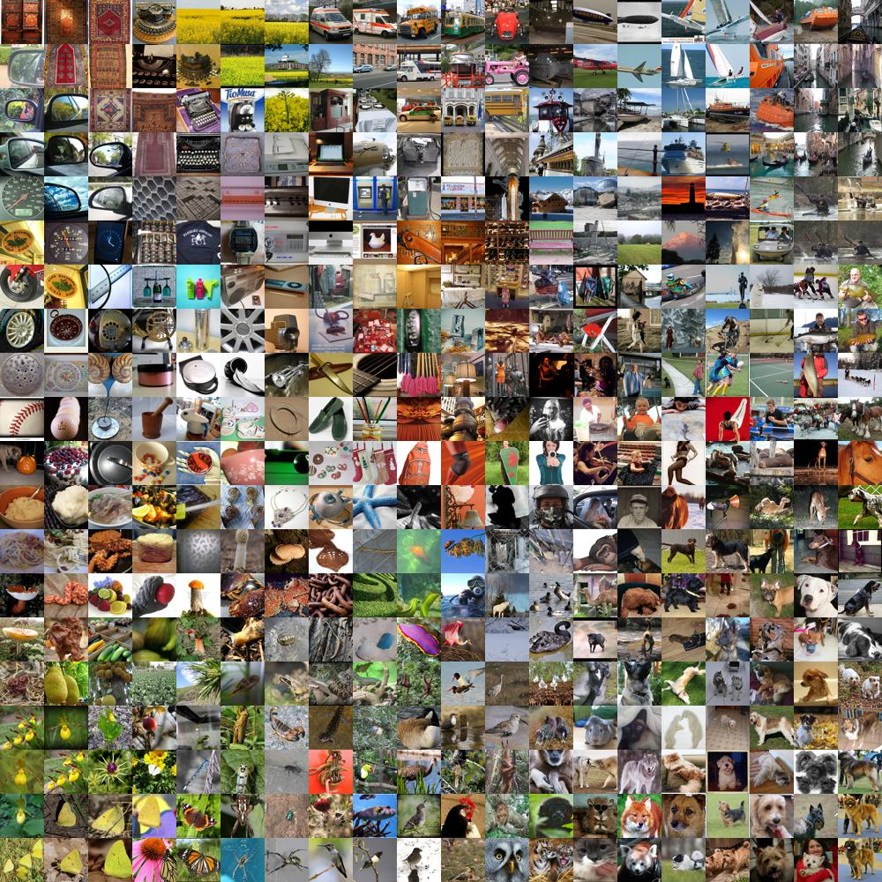
How Can You Use Pre-trained Models?
Pre-trained models are neural networks that have been trained on large datasets.
They can be fine-tuned for specific tasks, saving time and resources.
Pre-training done on general image dataset such as ImageNet
https://cs.stanford.edu/people/karpathy/cnnembed/

Slide 21
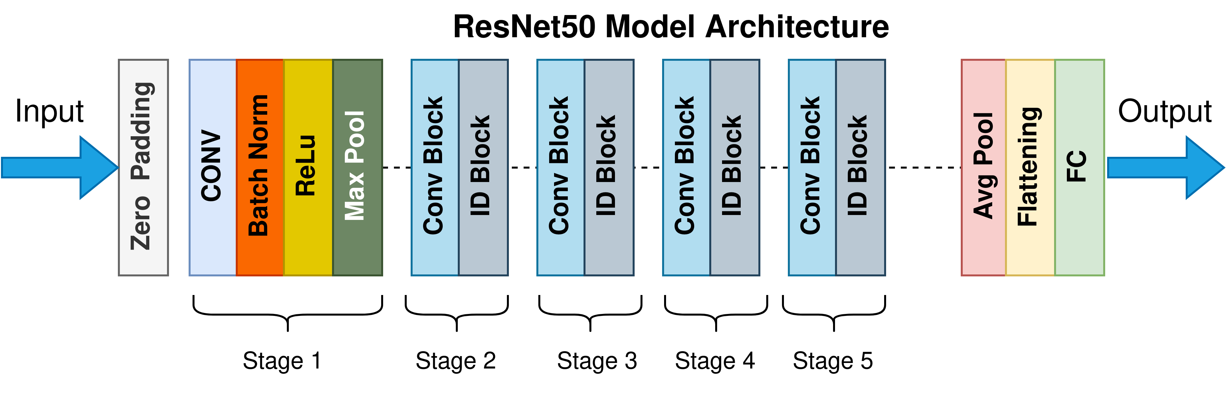
How Can You Use Pre-trained Models?
https://towardsdatascience.com/the-annotated-resnet-50-a6c536034758/

Slide 22
Practical – using a pre-trained network

Slide 23
Transformer Models
Transformers, initially developed for NLP, have been applied to image analysis (VisionTransformer)
Self-attention
Compared to CNNs:
Advantages: Better handling of long-range dependencies, flexibility in tasks.
Disadvantages: Higher computational cost, especially for large inputs.

Slide 24
Additional resources
Hands-on Machine Learning https://www.oreilly.com/library/view/hands-on-machine-learning/9781098125967/
Deep Learning from scratch https://www.oreilly.com/library/view/deep-learning-from/9781492041405/
CNN explainer https://poloclub.github.io/cnn-explainer/
Dive into DL https://www.d2l.ai/index.html

