Slide 1
3/03/2025
Introduction to machine learning and deep learning in Python
Session 1
Irina & Rao

Slide 2
Before we start…
List of the Python SciPy libraries required for this session:
scipy
numpy
matplotlib
pandas
Sklearn
Note: tutor will be using Spyder IDE through Anaconda, however, it’s up to you what to use!
Python scripts and slides available at Github
https://github.com/sraorao/ML_DL_intro_python_HT2025_2

Slide 3
Introduction to Machine Learning (ML)
Definition: Extracting information from data to make predictions or decisions.
Interdisciplinary Field: Intersection of statistics, artificial intelligence, and computer science.
Key Idea: Algorithms improve automatically through experience/training.
How it Works:
Based on training data, algorithms build models.
Models make predictions for new, unseen data (test data).
Why Python?: Extensive libraries for data processing, model building, and evaluation.

Slide 4
Types of Machine Learning
Supervised Learning:
Uses input variables (X) and output variable (Y).
Builds a model based on labeled data to make predictions for new data.
Examples:
Classification: SVM, Random Forest
Regression: Linear Regression, Random Forest
Unsupervised Learning:
Only input data (X) is provided; no output labels.
The algorithm identifies patterns or groupings within data.
Examples:
Clustering: K-means
Association: Apriori algorithm
Semi-Supervised Learning:
Large amount of input data (X), but only some data is labeled (Y).
Combines supervised and unsupervised approaches for cases where labeling is expensive or impractical.

Slide 5
Feature selection
Feature selection is primarily focused on removing non-informative
or redundant predictors from the model.
— Page 488, Applied Predictive Modeling, 2013.
Filter methods
Stats
Wrapper methods
Embedded methods
Backward Elimination, Forward Selection, Bidirectional Elimination and Recursive Feature Elimination (RFE)
Regularization:
LASSO, Elastic Net, Ridge Regression

Slide 6
Which feature selection method to use?
Filter method is less accurate. It is great for exploratory data analysis and can also be used for checking multi co-linearity in data. Good for extensive datasets with 100 or 1000s features.
Wrapper and Embedded methods give more accurate results but as they are computationally expensive. These methods are suitable for data with less total number features (<=50).
But there is no single right way!
*See backup slides for more information on each method

Slide 7
Supervised Learning – Classification Problems
Answering “Is this class A, B, or C...?”
Target Variable: A categorical variable (binary or integer).
Typical Methods:
Logistic Regression (LR)
K-Nearest Neighbors (KNN)
Decision Tree Classifier (DTC)
Support Vector Machine (SVM)
Random Forest (RF)

Slide 8
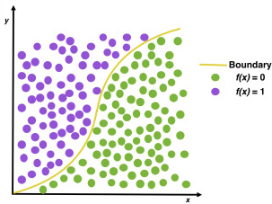
Logistic Regression (LR)
A statistical model that predicts the probability of a binary outcome. It’s well-suited for binary and multi-class classification, especially when relationships are linear, and is both interpretable and efficient.
It differs from linear because it uses a sinusoidal curve, delineating a boundary between 2 categories.
https://doi.org/10.1016/j.wnsx.2019.100012

Slide 9
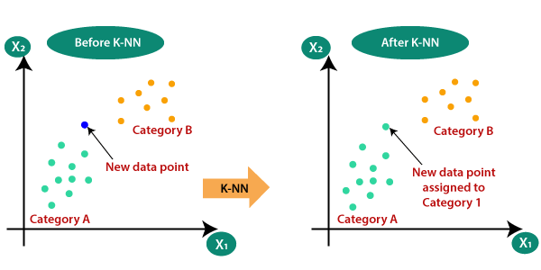
K-Nearest Neighbors (KNN)
An instance-based classifier that assigns a label based on the majority class among the closest data points.
It’s simple and effective for small to medium datasets, especially when similar instances have similar labels.
https://medium.com/swlh/k-nearest-neighbor-ca2593d7a3c4 - further reading

Slide 10
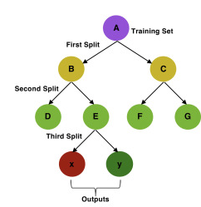
Decision Tree Classifier (DTC):
A tree-structured model that makes decisions by recursively splitting data based on feature values.
It handles both categorical and numerical data, is highly interpretable, and performs well on non-linear relationships.
https://doi.org/10.1016/j.wnsx.2019.100012

Slide 11
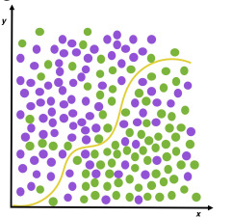
Support Vector Machine (SVM):
A robust classifier that finds the optimal boundary to separate classes, with a gamma parameter to control influence radius and probability estimates.
It’s especially powerful for high-dimensional data and complex boundaries, particularly when classes are well-separated.
https://doi.org/10.1016/j.wnsx.2019.100012

Slide 12
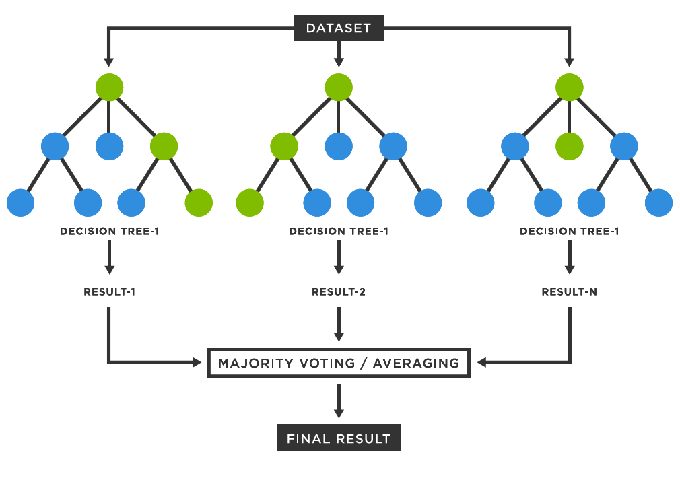
Random Forest (RF):
An ensemble method that averages results from multiple decision trees for better accuracy and stability.
It is robust to overfitting and performs well on complex classification problems by combining multiple trees to boost prediction power.

Slide 13
Breast Cancer Dataset
Problem Type
Type: Supervised Learning
Sub-type: Classification
Purpose: Predict if a breast tumor is malignant or benign.
Features: 10 key cell characteristics
Target variable (Class):
0 = Benign (non-cancerous)
1 = Malignant (cancerous)
Id | Sample code number
Cl. thickness | Clump Thickness
Cell. size | Uniformity of Cell Size
Cell. shape | Uniformity of Cell Shape
Marg. adhesion | Marginal Adhesion
Epith. c. size | Single Epithelial Cell Size
Bare. nuclei | Bare Nuclei
Bl. cromatin | Bland Chromatin
Normal. nucleoli | Normal Nucleoli
Mitoses | Mitoses

Slide 14
Discover dataset
Load the dataset;
Summarize the dataset;
Clean-up dataset/impute missing values
Separate out train and test datasets
Apply feature selection (optional)
Evaluate some algorithms
Set-up the test harness to use 10-fold cross validation;
Build multiple different models to predict diagnosis;
Select the best - finalized model
Make predictions
Make predictions on test set;
Evaluate the predictions:
- Accuracy;
- Confusion matrix;
- Sensitivity and specificity;
- ROC curve
Export/import the model
Linear Models
Logistic Regression (LR):
LogisticRegression(max_iter=500)
Non-Linear Models
K-Nearest Neighbors (KNN): KNeighborsClassifier()
Decision Tree Classifier (DTC): DecisionTreeClassifier(random_state=1)
Support Vector Machine (SVM): SVC(gamma='auto', probability=True)
Random Forest (RF): RandomForestClassifier(random_state=1)

Slide 15

Let’s explore practically

Slide 16
Supervised Learning – Regression Problems
Answering “How Many/How Much?”
Target Variable: Real Numbers
Typical Methods:
Linear Models
Linear Regression (LR)
Ridge Regression (R)
Lasso Regression
ElasticNet (EN)
Non-Linear Models
K-Nearest Neighbors (KNN)
Decision Tree Regressor (DTR)
Support Vector Regressor (SVR)
Random Forest (RF)

Slide 17
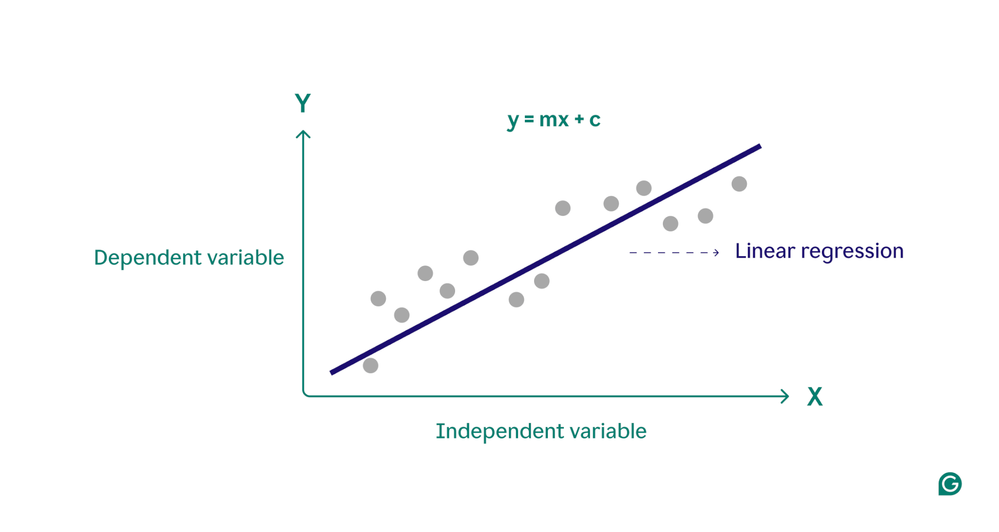
Linear Regression (LR)
A basic linear model that estimates the relationship between the target variable and one or more predictor variables by fitting a linear equation to the observed data.

Slide 18
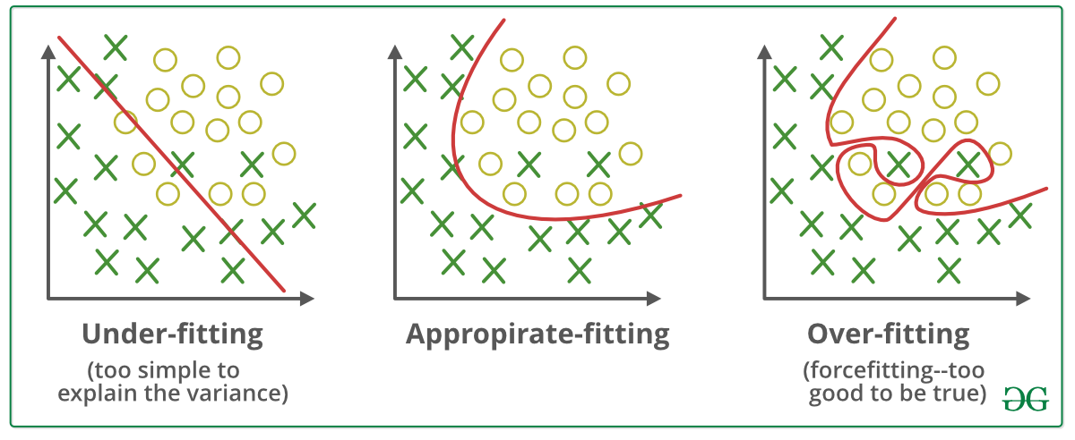
What is overfitting and why do we need to avoid it?
An overfit model captures noise or random fluctuations in the data rather than the underlying patterns because it is too complicated and fits the training data too well.
On fresh, untested data, this may lead to poor generalization performance.
By including a penalty term to the loss function, regularization is a machine learning technique that seeks to stop overfitting.
Regularization is used to achieve a balance between the model’s level of complexity and its goodness of fit.
https://medium.com/

Slide 19
Linear Models with regularization
Ridge Regression (R): A linear model that includes L2 regularization to prevent overfitting by penalizing large coefficients, making it suitable for multicollinearity.
Lasso Regression: A linear model with L1 regularization that can shrink some coefficients to zero, effectively performing variable selection.
ElasticNet (EN): Combines both L1 and L2 regularization, allowing for a balance between Ridge and Lasso, useful when multiple features are correlated.
*See backup slides for details of L1/L2

Slide 20
Linear Models with regularization
Typical Methods:
Linear Models
Ridge Regression (R): A linear model that includes L2 regularization to prevent overfitting by penalizing large coefficients, making it suitable for multicollinearity.
Lasso Regression: A linear model with L1 regularization that can shrink some coefficients to zero, effectively performing variable selection.
ElasticNet (EN): Combines both L1 and L2 regularization, allowing for a balance between Ridge and Lasso, useful when multiple features are correlated.
Non-Linear Models
K-Nearest Neighbors (KNN): A non-parametric model that predicts the target variable based on the average of the k-nearest data points in the feature space.
Decision Tree Regressor (DTR): A model that splits the data into subsets based on feature value thresholds, creating a tree-like structure to make predictions.
Support Vector Regressor (SVR): A model that uses support vector machines for regression tasks, trying to find the best hyperplane that fits the data while maintaining a margin of tolerance.
Random Forest (RF): An ensemble method that builds multiple decision trees and merges them to improve accuracy and control overfitting.
*See backup slides for details of L1/L2

Slide 21
Linear Models with regularization
Typical Methods:
Linear Models
Ridge Regression (R): A linear model that includes L2 regularization to prevent overfitting by penalizing large coefficients, making it suitable for multicollinearity.
Lasso Regression: A linear model with L1 regularization that can shrink some coefficients to zero, effectively performing variable selection.
ElasticNet (EN): Combines both L1 and L2 regularization, allowing for a balance between Ridge and Lasso, useful when multiple features are correlated.
Non-Linear Models
K-Nearest Neighbors (KNN): A non-parametric model that predicts the target variable based on the average of the k-nearest data points in the feature space.
Decision Tree Regressor (DTR): A model that splits the data into subsets based on feature value thresholds, creating a tree-like structure to make predictions.
Support Vector Regressor (SVR): A model that uses support vector machines for regression tasks, trying to find the best hyperplane that fits the data while maintaining a margin of tolerance.
Random Forest (RF): An ensemble method that builds multiple decision trees and merges them to improve accuracy and control overfitting.
*See backup slides for details of L1/L2

Slide 22
Non-Linear Models
K-Nearest Neighbors (KNN): A non-parametric model that predicts the target variable based on the average of the k-nearest data points in the feature space.
Decision Tree Regressor (DTR): A model that splits the data into subsets based on feature value thresholds, creating a tree-like structure to make predictions.
Support Vector Regressor (SVR): A model that uses support vector machines for regression tasks, trying to find the best hyperplane that fits the data while maintaining a margin of tolerance.
Random Forest (RF): An ensemble method that builds multiple decision trees and merges them to improve accuracy and control overfitting.

Slide 23
OWID COVID dataset
Problem Type
Type: Supervised Learning
Sub-type: Regression
Purpose: Predict COVID-19 deaths per million based on various socioeconomic and health-related features.
Features: Key indicators, including cases per million, median age, GDP per capita, human development index (HDI), and life expectancy.
Target variable:
deaths_per_million: The number of COVID-19-related deaths per million population, used to gauge the impact of factors on COVID-19 mortality rates.

Slide 24
Discover Dataset
Load the COVID dataset;
Summarize the dataset;
Clean up and transform data (log-transform to reduce skewness);
Apply Feature Selection
Split data into training and test sets;
Use Pearson correlation to select features with high correlation to deaths_per_million;
Identify and handle multicollinearity between selected features
Evaluate Algorithms
Set up 10-fold cross-validation;
Define regression models to predict deaths per million
Make Predictions
Train the best-performing model;
Make predictions on the test set
Evaluate predictions using:
Mean Squared Error (MSE)
Mean Absolute Error (MAE)
R² Score
Analyze Results
Plot Actual vs. Predicted values;
Visualize feature importance based on model coefficients;
Comparison Table; Histogram of Prediction Errors
Linear Models
Linear Regression (LR): LinearRegression()
Ridge (R): Ridge()
Lasso: Lasso()
ElasticNet (EN): ElasticNet()
Non-Linear Models
K-Nearest Neighbors (KNN): KNeighborsRegressor()
Decision Tree Regressor (DTR): DecisionTreeRegressor(random_state=1)
Support Vector Regressor (SVR): SVR(gamma='auto’)
Random Forest (RF): RandomForestRegressor(random_state=1)

Slide 25
Let’s explore practically

Slide 26
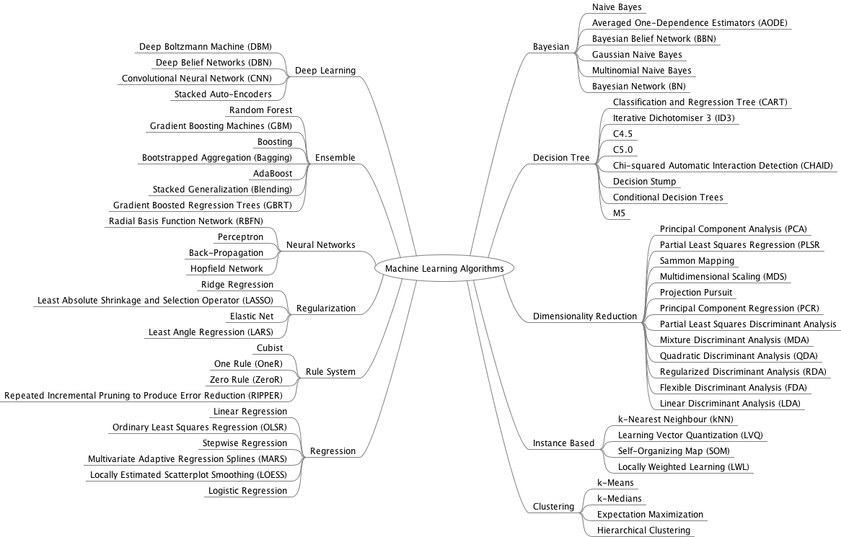
Overview of ML algorithms
https://machinelearningmastery.com

Slide 27
ML problems
Supervised ML
Unsupervised ML
input variables (x) + output variable (Y)
only input data (X)
Classification
Regression
Ex. SVM, Random forest
Clustering
Association
Ex. K-means
Ex. Linear regression, Random forest
Ex. Apriori
Semi-supervised ML
large amount of input data (X)
+ only some of the data is labeled (Y)

Slide 28
Feature selection algorithms in more details

Slide 29
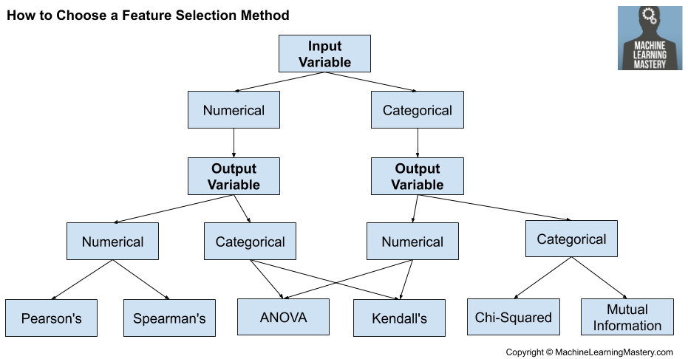
Filter methods
Image Source: Analytics Vidhya

Slide 30
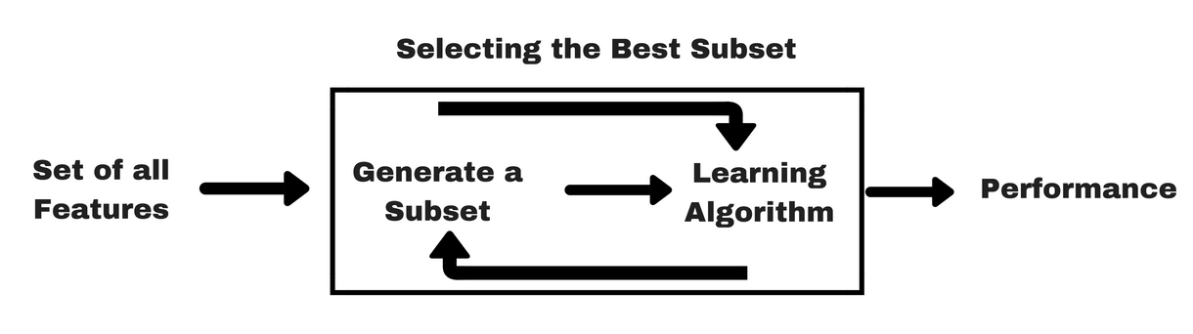
Wrapper methods
A wrapper method needs one machine learning algorithm and uses its performance as evaluation criteria.
Feed the features to the selected Machine Learning algorithm and based on the model performance you add/remove the features.
It is an iterative and computationally expensive process but it is more accurate than the filter method.

Slide 31
Wrapper methods
Step Forward Selection
We start with having no feature in the model. In each iteration, we keep adding the feature which best improves our model till an addition of a new variable does not improve the performance of the model.
Backward Elimination
We start with all the features and remove the least significant feature at each iteration which improves the performance of the model. We repeat this until no improvement is observed on removal of features.
Recursive Feature Elimination (RFE)
It is a greedy optimization algorithm which aims to find the best performing feature subset. It repeatedly creates models and keeps aside the best or the worst performing feature at each iteration. It constructs the next model with the left features until all the features are exhausted. It then ranks the features based on the order of their elimination.

Slide 32
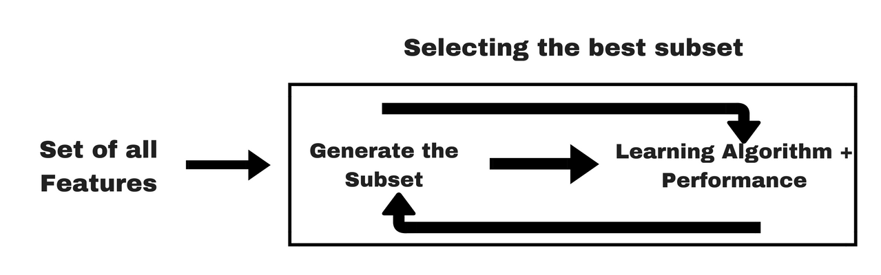
Embedded methods
It takes care of each iteration of the model training process and carefully extracts those features which contribute the most to the training for a particular iteration. Regularization methods (LASSO and Ridge) are the most commonly used embedded methods which penalize a feature given a coefficient threshold.
Image Source: Analytics Vidhya

Slide 33
Understanding L1 and L2 Regularization
L1 Regularization (Lasso): L1 regularization adds a penalty equal to the absolute value of the magnitude of coefficients. This encourages sparsity in the model, effectively driving some coefficients to zero. As a result, L1 regularization not only helps in preventing overfitting but also assists in feature selection by identifying and retaining only the most significant predictors. This can be particularly useful when dealing with high-dimensional datasets.
L2 Regularization (Ridge): L2 regularization adds a penalty equal to the square of the magnitude of coefficients. This approach does not necessarily reduce coefficients to zero but instead shrinks them towards zero. By doing this, L2 regularization addresses multicollinearity and stabilizes the solution. It is effective when you have many predictors and want to include all of them in the model, albeit with reduced impact.

Slide 34
Some further resources for practice, learning and reading
Machine Learning Mastery - https://machinelearningmastery.com/
Kaggle - https://www.kaggle.com
Hands-On Machine Learning with Scikit-Learn, Keras, and Tensorflow: Concepts, Tools, and Techniques to Build Intelligent Systems by Aurélien Géron

