Slide 1
Intro to R for biologists
Basic concepts
Your R environment
Getting help
Assignment to variables
Data types
Data structures
Subsetting

Slide 2
You R environment
Script
Console
Help/Plots/Files
Environment/History

Slide 3
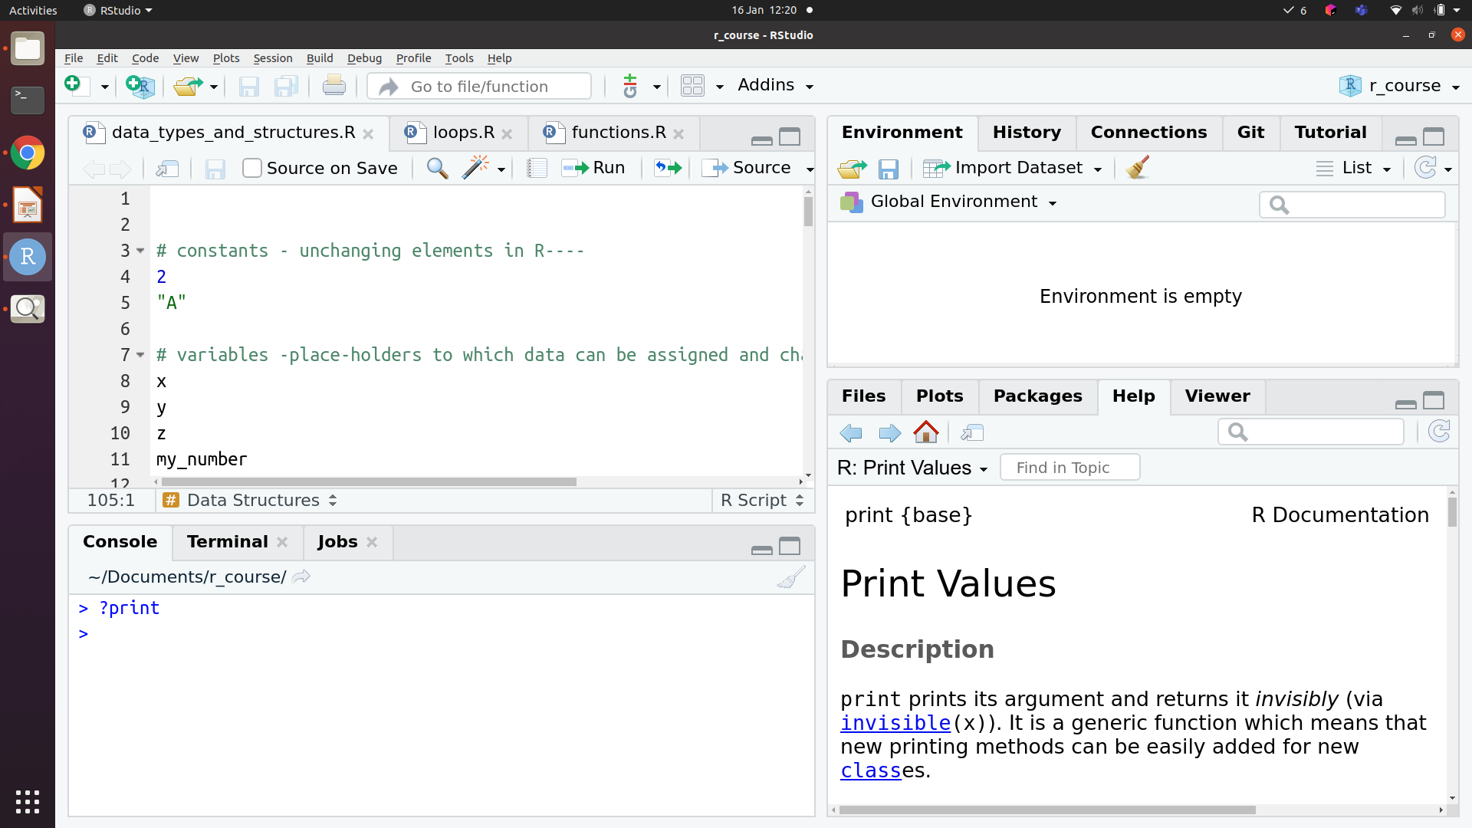
Script
Environment / History
Help / Plots /
Files
Console

Slide 4
Constants vs variables
Constants are unchanging
Pi, Avogadro’s number
Variables are placeholders
X = 10, y = 20; x + y = 30

Slide 5
How to get help
? and ??
Google!
help()

Slide 6
Assignment of data to variables
The ‘arrow’: x <- 2
Equals sign: x = 2

Slide 7
Data types in R
Character
“a”, “apple”
Numeric
1, 23, 3.14
Logical
TRUE, FALSE
Factor
For categorical variables, when data is classified into groups

Slide 8
Conversion (and coercion)
as.character()
Numeric, logical and factor types can be converted to character
as.numeric()
Logical, and character variables that are purely numbers can be converted to numeric
as.logical()
“FALSE” or 0 is converted to FALSE, “TRUE” or any non-zero number is converted to TRUE
Factor
Any other data type can be converted to a factor

Slide 9
Conversion (and coercion)
as.character()
Numeric, logical and factor types can be converted to character
as.numeric()
Logical, and character variables that are purely numbers can be converted to numeric
as.logical()
“FALSE” or 0 is converted to FALSE, “TRUE” or any non-zero number is converted to TRUE
Factor
Any other data type can be converted to a factor
The ‘NAs introduced by coercion’ warning

Slide 10
Data Structures
Atomic vector
All elements are of the same type
Matrix
All elements are of the same type, data organised in rows and columns
List
Elements can be different types
Dataframe
Data organised into rows and columns; elements of each column are of the same type, but different columns can be of different types

Slide 11
Atomic vector
1
2
3
4
1
2
3
4
1
2
3
4
1
1
1
Matrix
2
2
2
3
3
3
1
2
3
1
2
3
4
1
1
List
2
2
3
3
1
2
3
4
1
Dataframe
2
3

Slide 12
Math operations
Add, subtract, divide, multiply
+ - / *
Modulo (remainder of division)
%%
Exponent
^
Rounding
round(), floor(), ceiling()

Slide 13
Comparisons
Comparison between two objects returns TRUE or FALSE or NA
==
<
>
<=
>=
!=

Slide 14
Conditional execution
If(TRUE or FALSE) {
Do something
}

Slide 15
Loops

