Slide 1
Intro to R for Biologists Session 2 Data exploration
Irina & Rao
Hilary 2022

Slide 2
Intro to R for biologists
Data exploration
Reading and writing data files
Managing working directory
Functions to explore data
Cleaning data
Functions to modify a data.frame
Basic plots to visualize data
Basic statistics
Filtering data

Slide 3
Math operations
Add, subtract, divide, multiply
+ - / *
Modulo (remainder of division)
%%
Exponent
^
Rounding
round(), floor(), ceiling()

Slide 4
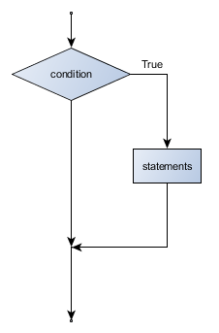
Conditionals if statement
if(TRUE or FALSE) {
Do something
}
x <- 4
if(x > 0) {
print("Positive number")
}
x <- -4

Slide 5
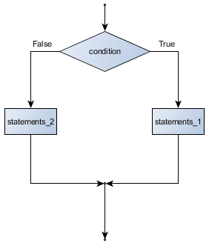
Conditionals if … else statement
if(TRUE or FALSE) {
Do something
} else {
Do some other thing
}
else block
If block
x <- 4
if(x > 0) {
print("Positive number")
} else {
print(”Not positive number")
}
x <- -4

Slide 6
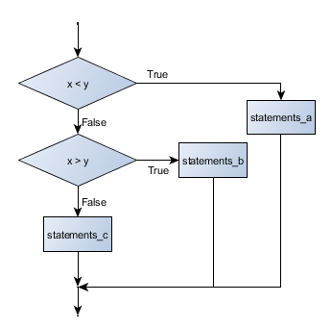
Chained conditionals if … else if … else
if (x < y) {
STATEMENTS_A
} else if (x > y) {
STATEMENTS_B
} else {
STATEMENTS_C
}
x <- 0
if (x < 0) {
print("Negative number")
} else if (x > 0) {
print("Positive number")
} else {
print("Zero")
}

Slide 7
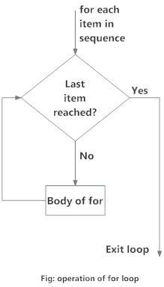
Loops for
for (val in sequence)
{
statement
}
for (year in c(2011,2012,2013,2014,2015,2016))
{
print(paste("The year is", year))
}

Slide 8
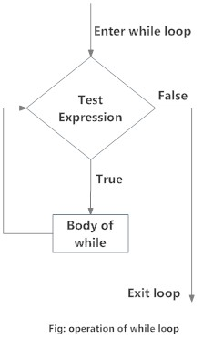
Loops while
while (test_expression)
{
statement
}
i <- 1
while (i < 6) {
print(i)
i = i+1
}

Slide 9
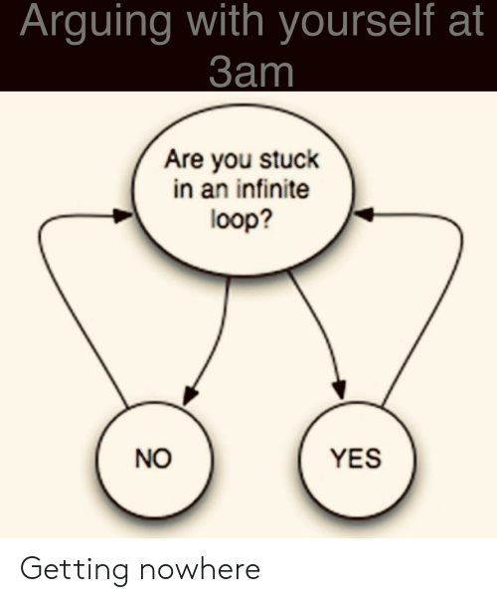
Infinite loops
x <- 1
while (x=1)
{
Print(“Let’s move on!”)
}
Something to keep in mind!
*break and next statements might help –
advanced level

Slide 10

Let’s explore practically

Slide 11
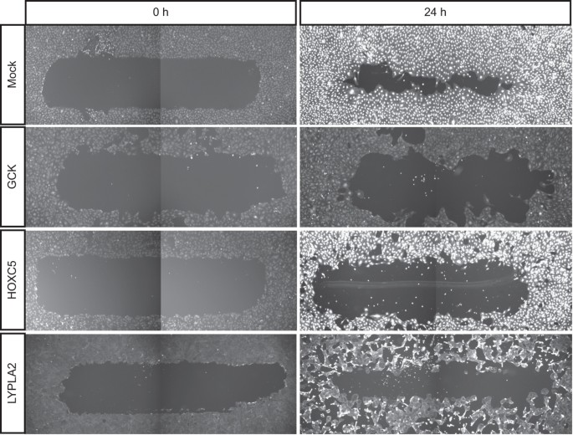

Migration and morphology data
Table 1: Migration data
col1: reagent_id
col2: gene_symbol
col3: migration
Table 2: Morphology data
col1: reagent_id
col2: gene_symbol
col3: elongatedness

Slide 12
Basic statistics
Correlations – cor(), cor.test()
T-test (parametric):
Unpaired 2-group t-test
t.test(y~x) # where y is numeric and x is a binary factor
t.test(y1,y2) # where y1 and y2 are numeric
Paired 2-group t-test
t.test(y1,y2, paired=TRUE) # where y1 & y2 are numeric
Non-parametric tests:
Unpaired 2-group Mann-Whitney U Test
wilcox.test(y~A) # where y is numeric and A is A binary factor
wilcox.test(y,x) # where y and x are numeric
Paired 2-group Wilcoxon Signed Rank Test
wilcox.test(y1,y2, paired=TRUE) # where y1 and y2 are numeric
More than 2 groups - analysis of variance (ANOVA, parametric)
aov(), anova()

Slide 13
Useful functions for summarisation
Center: mean(), median()
Spread: sd(), IQR()
Range: min(), max(), quantile()
Position: first(), last()
Count: n(), n_distinct()
Logical: any(), all() ...

Slide 14
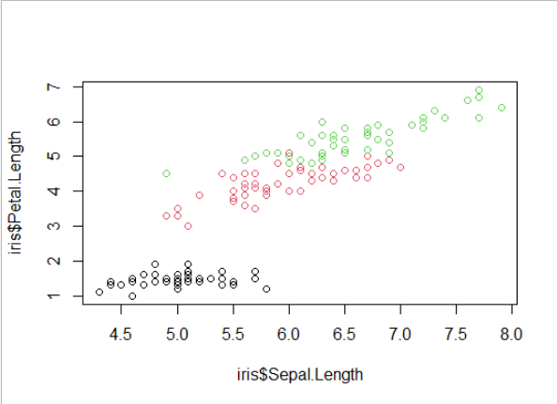
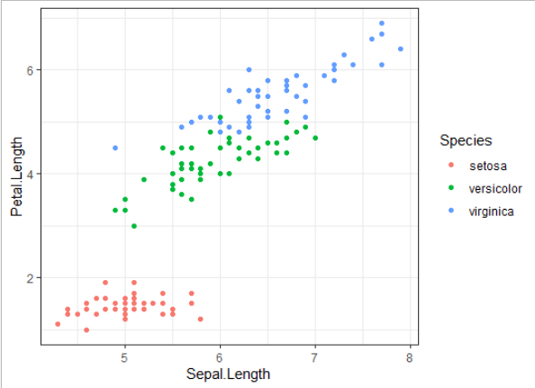
Visualising data
Base R plotting
Great for initial exploration
Quick
Simple syntax – many things can be plotted with just plot()
Not easy to modify colours, aesthetics, etc.
ggplot2 package
Modular – graphs can be built element-by-element
Need to remember a few different functions
Possible to produce publication quality figures with relative ease

Slide 15
Let’s explore practically

Slide 16
Packages/libraries
A package is a collection of R functions, data and compiled code. The location where the packages are stored is called the library.
Package extends basic R functionality and standardizes the distribution of code. For example, a package can contain a set of functions relating to a specific topic or tasks.

Slide 17
Where to get the libraries/packages?
CRAN (https://cran.r-project.org)
Install:
install.packages("dplyr")
Activate:
Library("dplyr")
Bioconductor (https://bioconductor.org)
if (!requireNamespace("BiocManager", quietly = TRUE))
install.packages("BiocManager”)
BiocManager::install("limma")
Github (https://github.com)
install.packages("devtools")
library(devtools)
install_github("hadley/dplyr”)

Slide 18
Functions
Functions are created using the function() directive and are stored as R objects just like anything else. In particular, they are R objects of class “function”.
f <- function(<arguments>) {
## Do something interesting
}
Note: majority of the functions you would try to create already exist in the libraries!

Slide 19
Loop functions
lapply() – perform an action on each element of a vector: returns list
sapply() – as above, returns a simplified object (variable)
apply() – loop over rows or columns of a matrix or df
tapply() – loop over a vector, split based on a factor
mapply() – loop over more than one vector
> my_list = list(a = c(1, 2, 3), b = c(4, 5, 6), c = c(7, 8, 9))
> lapply(my_list, mean)
$a
[1] 2
$b
[1] 5
$c
[1] 8

Slide 20
Resources
R Programming for Data Science (Roger Peng) – Ch. 3, 4, 5, 9
Swirl – Interactive learning
https://www.tidyverse.org/
https://www.r-graph-gallery.com/
Advanced R course for data analysis and visualisation: https://www.medsci.ox.ac.uk/study/skillstraining/calendar/data-analysis-visualisation-in-r-for-biologists-online

Slide 21
Useful reference
R Programming for Data Science (Roger Peng) – Ch. 3, 4, 5, 9
Swirl – Interactive learning
Part II
COURSE FORMAT
The course is structured into 3 half-day sessions as follows:
Session 1 - filtering, merging, grouping, aggregating data - Introduction to common packages such as dplyr and data.table
Session 2 – visualising data and statistical information with ggplot2 and its extensions
Session 3 – advanced visualization and plots for high-dimensional data (heatmaps, PCA), interactive plots with Shiny/Plotly

