Slide 1
UNIQ+ R COURSE
Friday 7th July
Oxford 2023

Slide 2
Merging data.frames
Joining two data.frames based on one or more columns - merge()
Columns
Columns
Rows
id
age
pet_ins
Rows
id
pet
al
28
T
lee
dog
al
28
T
lee
dog
1
1
2
pat
23
F
pat
23
F
pat
hamster
pat
hamster
2
3
ed
13
T
al
mouse
ed
13
T
al
mouse
3
4
lee
6
T
4
ed
cat
lee
6
T
ed
cat

Slide 3
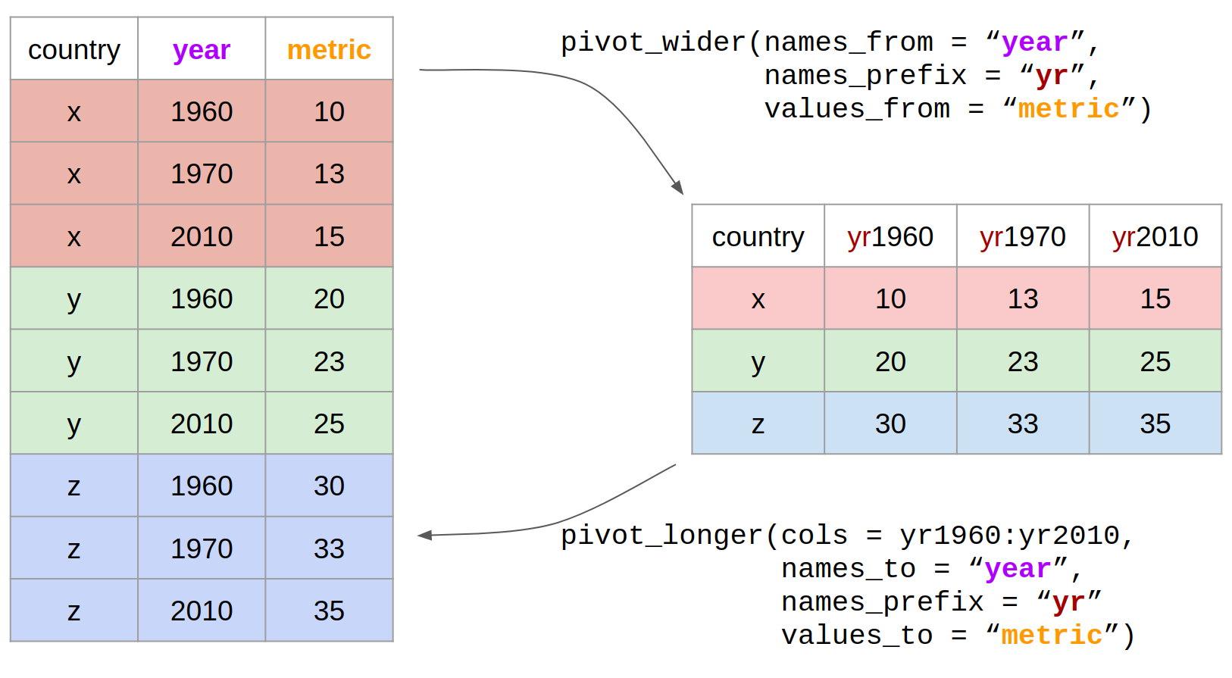
Reshaping
Wide to long with pivot_longer()
Long to wide with pivot_wider()

Slide 4
Basic statistics
Correlation – relationship between two continuous variables
cor.test()
Comparison of means
t.test()
wilcox.test()
Random number generation
rnorm()
sample()
set.seed()

Slide 5
Datasets for project
Best songs on Spotify (headstart)
Student mental health (headstart)
Diabetes (headstart)
US births
Glass Door Gender Pay
WHO Life Expectancy
UFO sightings (Excel file – either save as .csv in Excel an then load into R, or load the Excel file directly into R using the readxl package)
Bladder cancer (3 files)
Fitbit (2 files)

Slide 6
Loop functions
apply(), lapply(), mapply() can be used instead of the for loop – effectively the same result, but syntactically easier sometimes

