Slide 1
UNIQ+ R COURSE
Friday 7th July
Oxford 2023

Slide 2
R markdown
Friday 7th July
Oxford 2023

Slide 3
R markdown
Easy way to combine:
Plain text
Code
Data analysis (plots & tables)
Hyperlinks
…into a single nicely formatted and reproducible document
Oxford 2023

Slide 4
R markdown
Why?
Transparency
Reproducibility (links your data with your R code)
You can create a variety of output formats
Increases efficiency if something needs to be changed
Oxford 2023

Slide 5
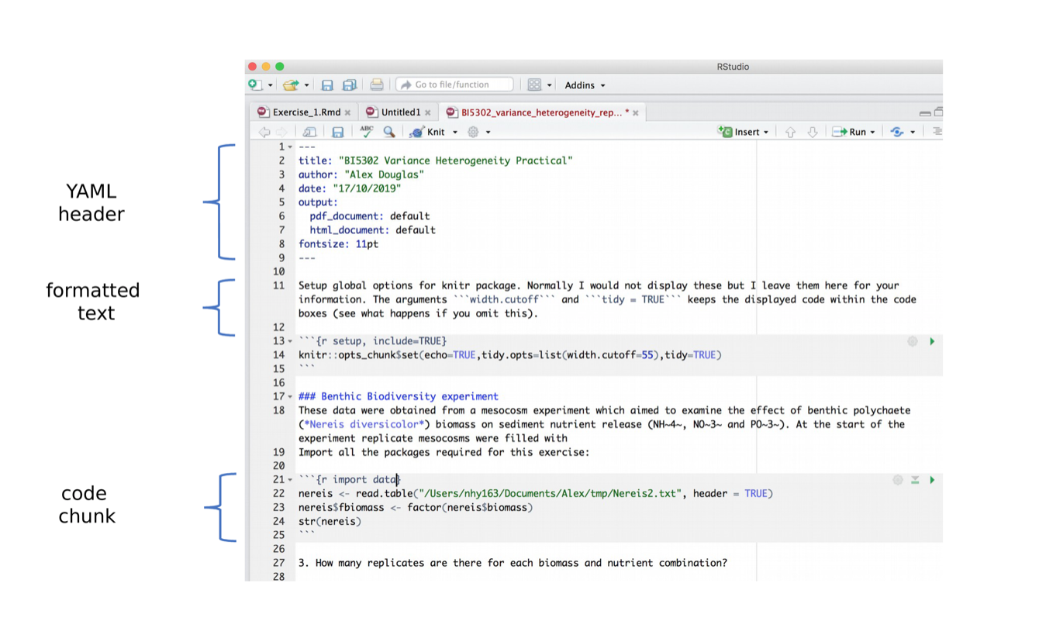
R markdown
https://intro2r.com/r-markdown-anatomy.html

Slide 6
R markdown
https://www.rstudio.com/wp-content/uploads/2015/02/rmarkdown-cheatsheet.pdf
https://intro2r.com/r-markdown-anatomy.html

