Slide 1
Workflow management with Snakemake
S. Rao

Slide 2
Outline
Running a very simple workflow on the cluster
Covers: cluster profiles
Constructing a workflow to preprocess sequencing data
Fastq > align with bwa > sort > mark dups > plot duplication metrics
Covers: conda and environment modules, passing input/output/params to R/Python scripts
Input functions
Covers: custom functions for input/params arguments
Before we start:
Install snakemake > v5.26 or load module on cluster
Clone github repo https://github.com/sraorao/snakemake_code_clinic_2
Change REF37 path in config.yaml
Change project name in profile/cluster.yaml
Python/snakemake code
Terminal commands/arguments

Slide 3
Running snakemake workflows on the BMRC cluster
$ snakemake --max-status-checks-per-second 0.01 \
--cluster-config cluster.json \
--cluster “qsub –N {cluster.job-name} –o {cluster.output} –q {cluster.time} –P {cluster.project} –pe shmem {cluster.slots} –j y”
$ cat cluster.json
{
“__default__”:
{
“time”: “short.qc”,
“slots”: 1,
“project”: “project.prjc”,
“output”: “path/to/output_folder/”
“job-name”: “default_job”
}
}
Monitoring not perfect
Snakemake may not notice when jobs are killed by scheduler

Slide 4
Running on the BMRC cluster - PROFILES
$ snakemake --profile profile/
github.com/snakemake-profiles
Takes time to set up, but:
Give greater flexibility over job submission, monitoring
Per-rule job configuration, similar to cluster-config

Slide 5
Running on the BMRC cluster - PROFILES
profile/config.yaml
Cluster configuration
profile/cluster.yaml
Default or per-rule settings to pass on to qsub
profile/sge-jobscript.sh
Template jobscript
profile/sge-submit.py
Submit script that is called by snakemake; parses settings and jobscript files
profile/sge-status.py
Monitoring script called by snakemake; calls qstat and qacct periodically

Slide 6
A simple snakemake rule
snakemake --snakefile Snakefile_cluster.smk --profile profile/
rule get_hostname:
input: "Snakefile_cluster.smk“ # dummy input
output: "hostname.txt"
shell: "hostname > {output}"

Slide 7
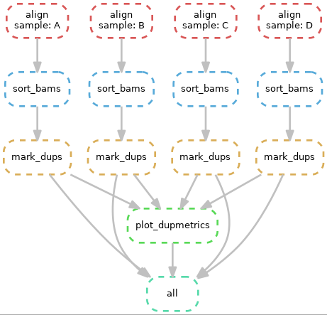
A typical workflow
snakemake --snakefile Snakefile --use-conda --use-envmodules --profile profile/

Slide 8
Conda environments (per-rule)
envs/bwa.yaml
Pros:
Fully reproducible
Software versions
No clash of dependencies (if conda environments are minimal)
Cons:
First run takes time to install conda env
BMRC-specific – conda envs built using submission node but may raise ‘illegal instruction’ error when cpu architecture doesn’t match (e.g. C and D nodes)
channels:
- conda-forge
- bioconda
dependencies:
- bwa=0.7.17

Slide 9
Environment modules (per-rule)
envmodules: “R/default”
Pros:
BMRC-specific – software matched to cpu architecture, so can be submitted to any node
Quicker to start
Cons:
Not reproducible on another system
Software you want may not be installed

Slide 10
Best of both worlds?
snakemake --snakefile Snakefile --use-conda --use-envmodules --profile profile/
Both Conda and envmodules can be specified
Envmodules used where specified
conda used when envmodules not specified
Where required, rule-specific settings can be changed to account for cpu architecture

Slide 11
Passing input/output/params to scripts - R
R script invoked by snakemake contains a snakemake S4 object
Accessed by
snakemake@input # list
snakemake@output
snakemake@params
snakemake@threads
snakemake@config
Example:
inputfile <- snakemake@input[[1]]
gatk_param <- snakemake@params[[“gatk”]]

Slide 12
Passing input/output/params to scripts - Python
Python script invoked by snakemake contains a snakemake object
Accessed by
snakemake.input # list
snakemake.output
snakemake.params
snakemake.threads
snakemake.config
Example:
inputfile = snakemake.input[0]
gatk_param = snakemake.params[“gatk”]

Slide 13
Input functions
A function to generate a list of input files
Takes wildcards as argument
Function returns a list or dict
Can be lambda function
def get_ref(wildcards):
if config["REF_VERSION"] == 37:
return [config["REF37"]]
elif config["REF_VERSION"] == 38:
return [config["REF38"]]
else:
print("incorrect value for reference!")

