Slide 1

SQL PROJECT ON IMDB MOVIES
TEAM ID:PTID-CDA-JAN-26-1134
PROJECT ID: PRSQL-01 IMDB MOVIES
NAME:SRASHTI DUBEY
EMAIL ID:srashtidubey73@gmail.com

Slide 2
Introduction
IMDB MOVIES
IMDB Movies Data Analysis is an SQL-based project aimed at extracting insights from movie and director data. The project involves data cleaning, table joining, and analytical querying to identify popular, profitable movies and key director trends.
To analyze IMDB movie and director data using SQL queries.
To establish a relationship between Movies and Directors tables using primary and foreign keys.

Slide 3
IMDB MOVIES
Tools & Technologies Used
Tools: MySQL Workbench
Technologies: SQL, RDBMS
Concepts: Joins, Aggregations, Subqueries, Data Cleaning
Data Analysis Techniques
Technologies:-
SQL:-Core language used for:
  Data extraction
  Data cleaning
  Filtering and aggregation
  Joins and subqueries
Key SQL Concepts Applied
* SELECT, WHERE, ORDER BY
* GROUP BY, HAVING
*INNER JOIN
*Aggregate Functions (COUNT, SUM, MAX)
*Subqueries
*Filtering using LIKE and IN

Slide 4

IMDB MOVIES
DATASET DESCRIPTION
Table Movies:
ID: Unique Id for Movies
Original title: Movie name
Budget: Budget of the movie
Popularity: Popularity of the Movie Release Date: Release date for the movies Revenue: Revenue collected movie
Title: Initial title of the movie
Vote Average: Average IMDB rating
Vote Count: Number of Vote the movie got Overview: Description of the movie Tagline: Tagline of the Movie
UID: Unique ID for Movie
Director ID: Director ID
Table Directors:
Name: Name of the Director
ID: Unique ID of the Directors
Gender: Gender of the Director→ 0/2=Male, 1=Female Department: Department of the Directors

Slide 5
IMDB MOVIES
KEY SQL CONCEPTS DEMONSTRATED
Data Filtering and Cleaning:-
Applied NULL value checks and validation to ensure data accuracy before analysis.
Multi-Table Joins and Relational Mapping:-
Used INNER JOIN to combine Movies and Directors tables through primary–foreign key relationships.
Aggregation and Grouping for Trend Analysis:-
Implemented COUNT, SUM, MAX, and GROUP BY to analyze movie performance and director productivity.
String and Date Manipulation:-
Used LIKE, IN, and date filters to extract meaningful subsets of data.
Readable and Optimized SQL Queries:-
Queries were written with clear structure and proper formatting for better performance and maintainability.
Business-Driven SQL Logic:-
Applied real-world business logic to identify popular movies, bankable directors, and voting trends.

Slide 6
IMDB MOVIES
Data Preparation Workflow
DATA CONNECTION
SQL DATA EXPLORATION
INSIGHTS
SQL ANALYSIS
(TASK)

Slide 7
IMDB MOVIES
Business Problem
a)Can you get all data about movies?
b)How do you get all data about directors?
c)Check how many movies are present in IMDB.
d)Find these 3 directors: James Cameron ; Luc Besson ; John Woo
e)Find all directors with name starting with S.
f)Count female directors.
g)Find the name of the 10th first women directors?
h)What are the 3 most popular movies?
i)What are the 3 most bankable movies?
j)What is the most awarded average vote since the January 1st, 2000?
k)Which movie(s) were directed by Brenda Chapman?
l)Which director made the most movies?
m)Which director is the most bankable?

Slide 8

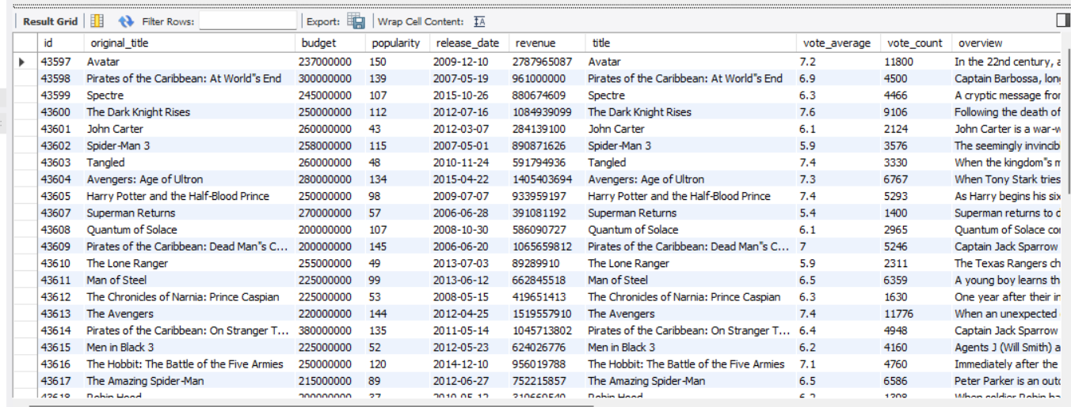
IMDB MOVIES
Table Relationship & Data Merging Logic
SELECT * FROM movies m
JOIN directors d
ON m . Director_id = d.id;
Note:- To merge this both tables use id as primary key from table directors and drop id from table movies and replace directors_id to id.

Slide 9
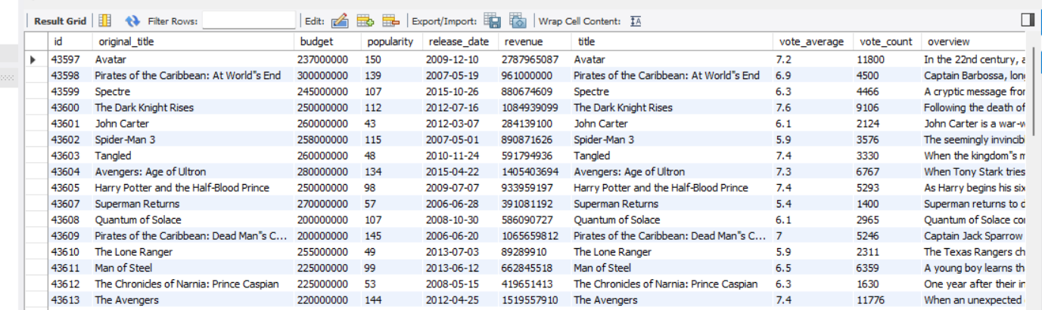
IMDB MOVIES
a) Can you get all data about movies?
SELECT * FROM movies;

Slide 10
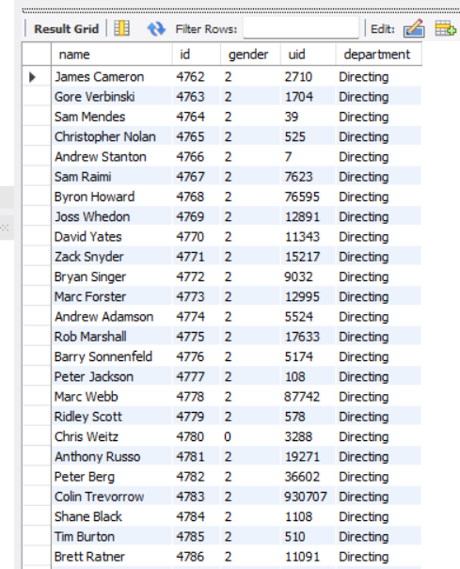
IMDB MOVIES
SELECT * FROM directors;
b) How do you get all data about directors?

Slide 11
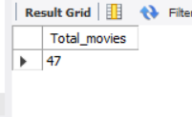

IMDB MOVIES
c) Check how many movies are present in IMDB.
SELECT count(*) as Total_movies from movies;

Slide 12

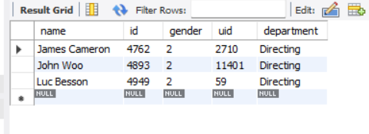
IMDB MOVIES
d) Find these 3 directors: James Cameron ; Luc Besson ; John Woo
SELECT * from directors
where name IN ('James Cameron' , 'Luc Besson' , 'John Woo');

Slide 13
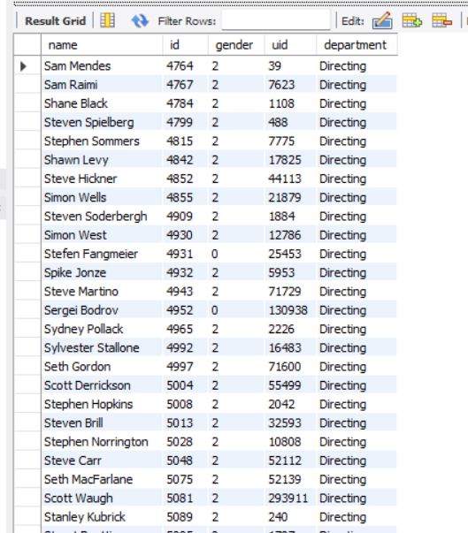
IMDB MOVIES
e) Find all directors with name starting with S.
SELECT * from directors
WHERE name LIKE 'S%';

Slide 14
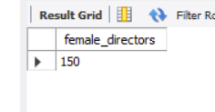
IMDB MOVIES
f) Count female directors.
SELECT COUNT (*) AS female_directors
FROM directors
WHERE gender = 1;

Slide 15

IMDB MOVIES
g) Find the name of the 10th first women directors?
SELECT * FROM directors
WHERE gender = 1
ORDER BY id
LIMIT 1 offset 9;

Slide 16

IMDB MOVIES
h) What are the 3 most popular movies?
SELECT id , original_title , title , popularity , release_date
FROM movies
ORDER BY popularity desc
LIMIT 3 ;

Slide 17
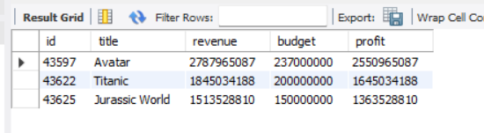
IMDB MOVIES
i) What are the 3 most bankable movies?
SELECT id, title, revenue, budget, (revenue - budget) AS profit
FROM movies
ORDER BY profit DESC
LIMIT 3;

Slide 18
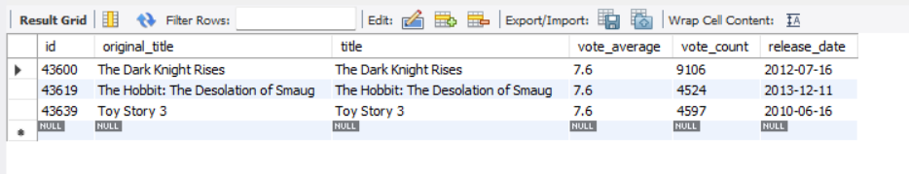
IMDB MOVIES
j) What is the most awarded average vote since the January 1st, 2000?
SELECT id , original_title , title , vote_average , vote_count , release_date
FROM movies
WHERE release_date >= '2000-01-01’
AND vote_average = (
SELECT MAX(vote_average)
FROM movies
WHERE release_date >= '2000-01-01' );

Slide 19

IMDB MOVIES
k) Which movie(s) were directed by Brenda Chapman?
SELECT m.id, m.original_title, m.title, m.release_date, d.name AS director
FROM movies m
JOIN directors d
ON m.director_id = d.id
WHERE d.name = 'Brenda Chapman';
There are no movies in the dataset that were directed by Brenda Chapman.

Slide 20
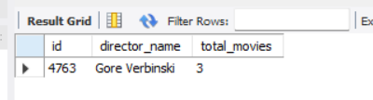
IMDB MOVIES
l) Which director made the most movies?
SELECT
d.id, d.name AS director_name,
COUNT(m.id) AS total_movies
FROM movies m
JOIN directors d
ON m.director_id = d.id
GROUP BY d.id, d.name
ORDER BY total_movies DESC
LIMIT 1;

Slide 21
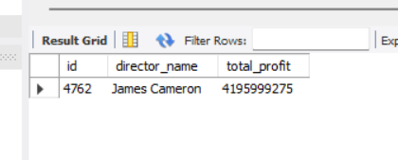
IMDB MOVIES
m) Which director is the most bankable?
SELECT
d.id, d.name AS director_name,
SUM(m.revenue - m.budget) AS total_profit
FROM movies m
JOIN directors d
ON m.director_id = d.id
GROUP BY d.id, d.name
ORDER BY total_profit DESC
LIMIT 1;

Slide 22
IMDB MOVIES
INSIGHTS
The dataset contains 47 movies and 2349 directors, with clean and validated data in
all critical columns.
Only 150 female directors were identified, highlighting low female representation
in movie direction.
The top 3 most popular movies based
on popularity score are:-
1.Jurassic World
2.Captain America: Civil War
3.Avatar
James Cameron emerged as the
most bankable director, generating a
total profit of 4,195,999,275.
Movie bankability was evaluated using profit (revenue − budget) rather than revenue
alone, providing a more accurate
financial insight.
The highest average vote since
January 1, 2000 is 7.6, achieved by:-
1.The Dark Knight Rises
2.The Hobbit: The Desolation of Smaug
3.Toy Story 3
Gore Verbinski directed the highest number
of movies (3 movies) in the dataset.
No movies directed by Brenda Chapman
were found in the dataset, indicating
data limitation or scope restriction.

Slide 23

IMDB MOVIES
Business Recommendations
Focus on profit-based decision making rather than revenue alone to accurately evaluate movie success.
Invest in high-performing directors like James Cameron, who have demonstrated consistent profitability.
Use popularity metrics along with financial indicators to better predict audience engagement.
Encourage and support female directors, as data shows low representation despite growing market demand for diverse content.
Prioritize projects with a balanced combination of budget control, popularity, and audience ratings.
Apply data-driven analysis early in the production planning phase to reduce financial risk.

Slide 24


