Slide 1
NBA Team Dynamics
Is there a winning formula for a team to become an NBA Champion?

Slide 2
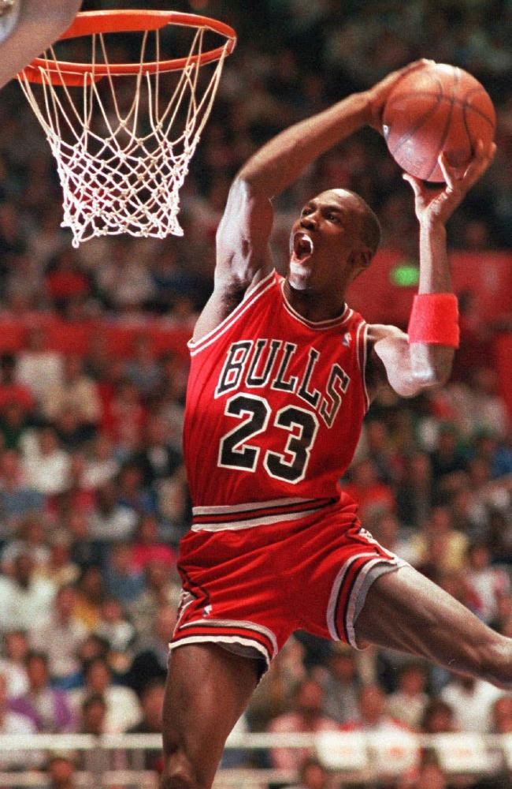
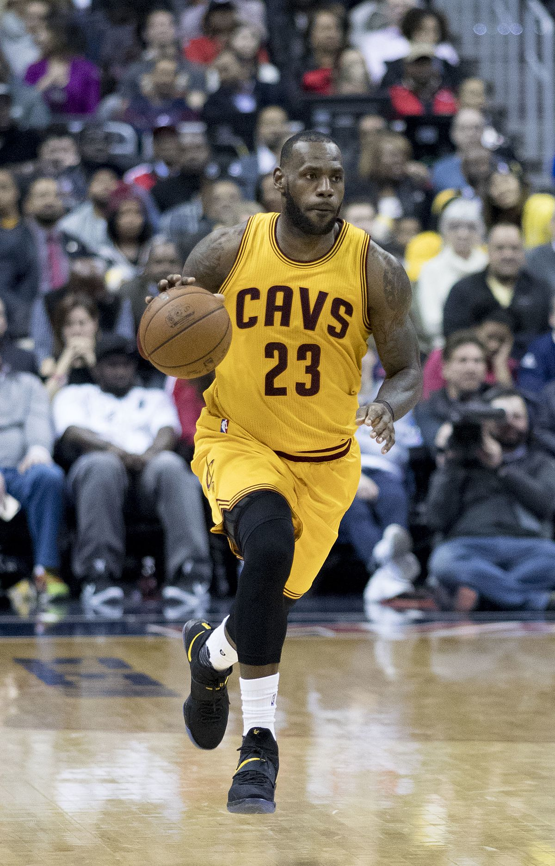
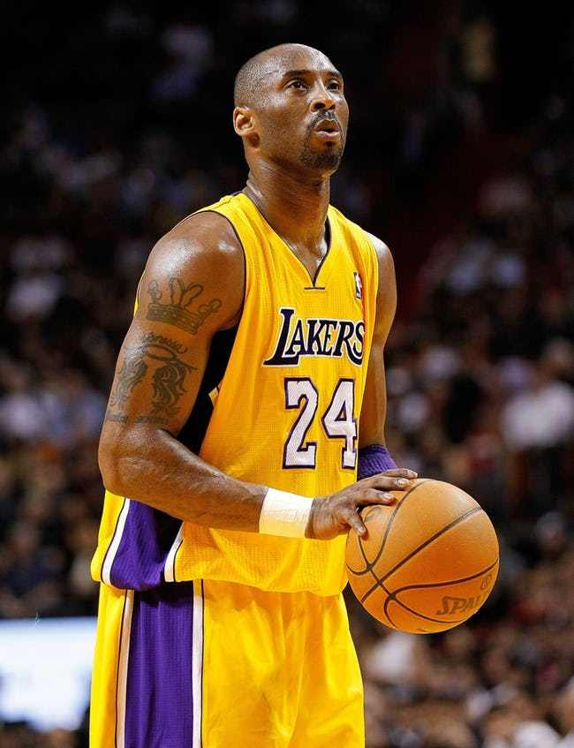

Slide 3



Slide 4
Project Questions
Ultimate Goal:
- Can we create a model based on team NBA statistics that can accurately predict which team will win the NBA championship?
Sub-questions:
- Do historical NBA championship have certain characteristics in common e.g. more offensive/defensive oriented? Play with fast pace vs. slow place?
- Can we create clusters of NBA championship teams with certain sets of characteristics?

Slide 5
Gathering Data
Source: basketball-refrence.com, Team Season play index https://www.basketball-reference.com/play-index/tsl_finder.cgi
Available Stats:
Team Total (PTS, RB, ST, etc.)
Team Shooting
Team Per Game
Advanced
Pace: An estimate of possessions per 48 minutes
ORtg (Offensive Rating): An estimate of points produced or scored per 100 possessions
DRtg (Defensive Rating): An estimate of points allowed per 100 possesions
eFG%: This statistic adjusts for the fact that a 3-point field goal is worth one more point than a 2-point field goal
Data Gathered:
All team’s Advanced statistics for the last 30 NBA regular seasons
Championship winning and runner-up teams for the last 30 NBA regular seasons

Slide 6
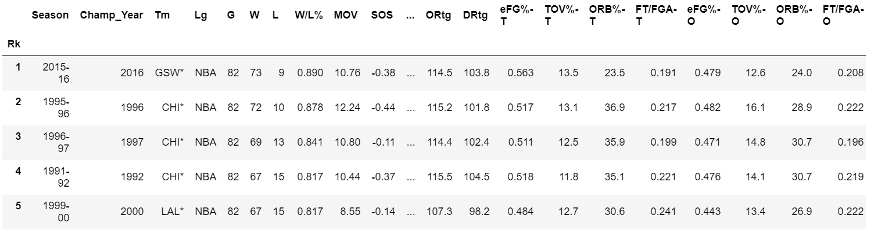
Data Cleanup
2 Dataframes:
Seasons

Slide 7
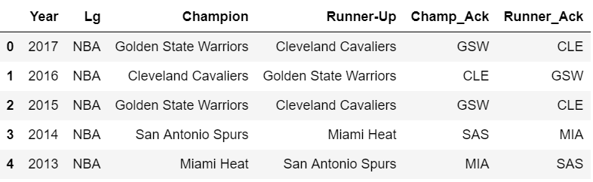
Data Cleanup (cont.)
Champions

Slide 8
Data Cleanup(cont.)
Goal: In Seasons dataframe, add yes/no (1,0) flag identifying team as winner and yes/no flag identifying team as runner up
Issues/Tasks:
1. Team name in Seasons has asterisk for certain rows
Solution: seasons['Tm'] = seasons['Tm'].map(lambda x: x.rstrip('*'))
2. Creating the flag for iswinner and isrunner in Seasons datafram
Approach:
Create new column concatenating ‘Tm’ and ‘Champ_Year’ in Seasons and two new columns concatenating ‘winner_ack’ and ‘Year’ and ‘runner_ack’ and ‘Year’ in Champions. Code: seasons['team_year'] = list(zip(seasons.Tm, seasons.Champ_Year))
Create new columns in seasons mapping value from champions when ‘team_year’ in Seasons matches ‘winner_year’ and ‘runner_year’. Code: seasons['iswinner'] = seasons['team_year'].map(champions.set_index('winner_year')['Year'])
Set all non-null values = 1. Code: seasons.loc[seasons['isrunner'].notnull(), 'isrunner'] = 1
Set all null values = 0. Codes: seasons['iswinner'].fillna(0, inplace=True)

Slide 9
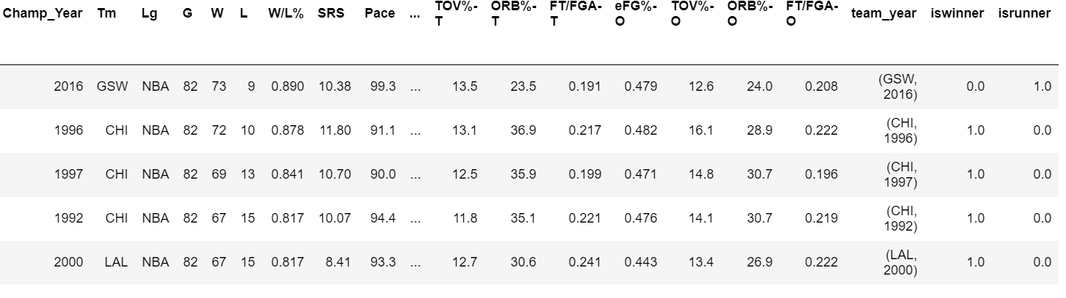
New dataframe

Slide 10
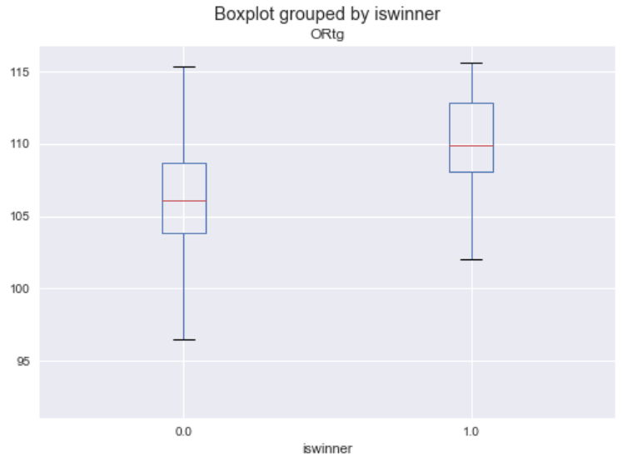
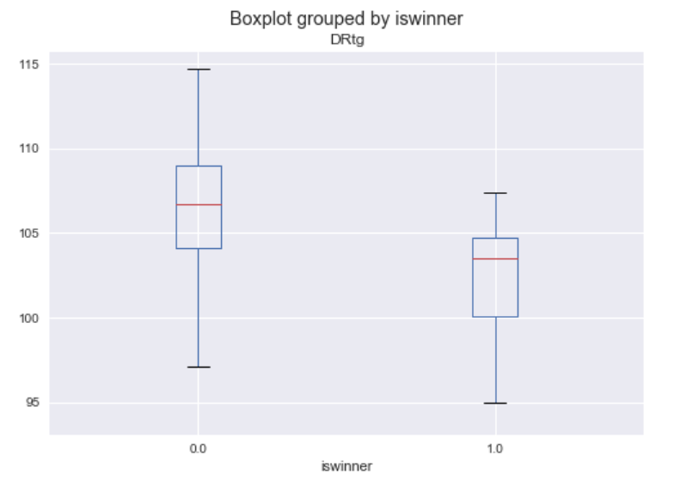
Initial Data Exploration

Slide 11
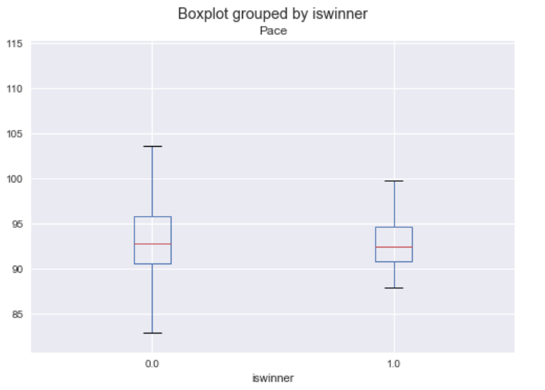
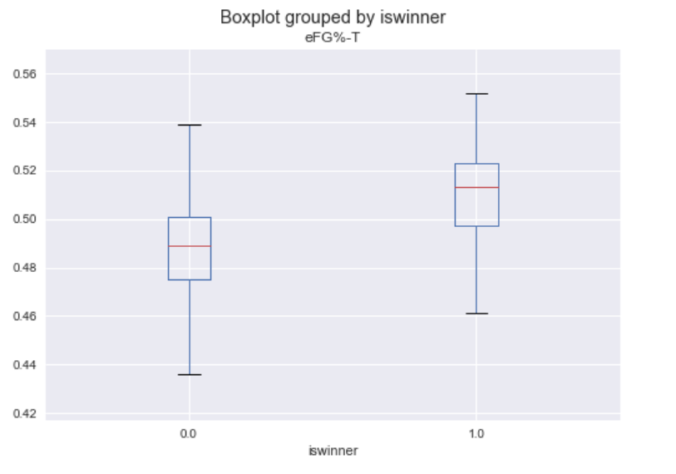
Initial Data Exploration (cont.)

Slide 12
Next Steps
- Can I answer my questions with this approach?
Looking like it may be possible! Winning championship teams do appear to have a higher offensive rating, lower defensive rating, and higher effective field goal percentage than non-winning teams
- Planned next steps:
Test other Advanced stats
Rank Teams for the stats that are worth including in a predictive model by Season
Every season is different and looking at ranks within season can potentially improve model accuracy
Try different predictive models
Regression
Clustering
Random Forests

