Slide 1

2D Graphics Programming with OpenGL Example Program – Projection, viewport
Sukanya Ratanotayanon
Creative Technology@KMUTT

Slide 2
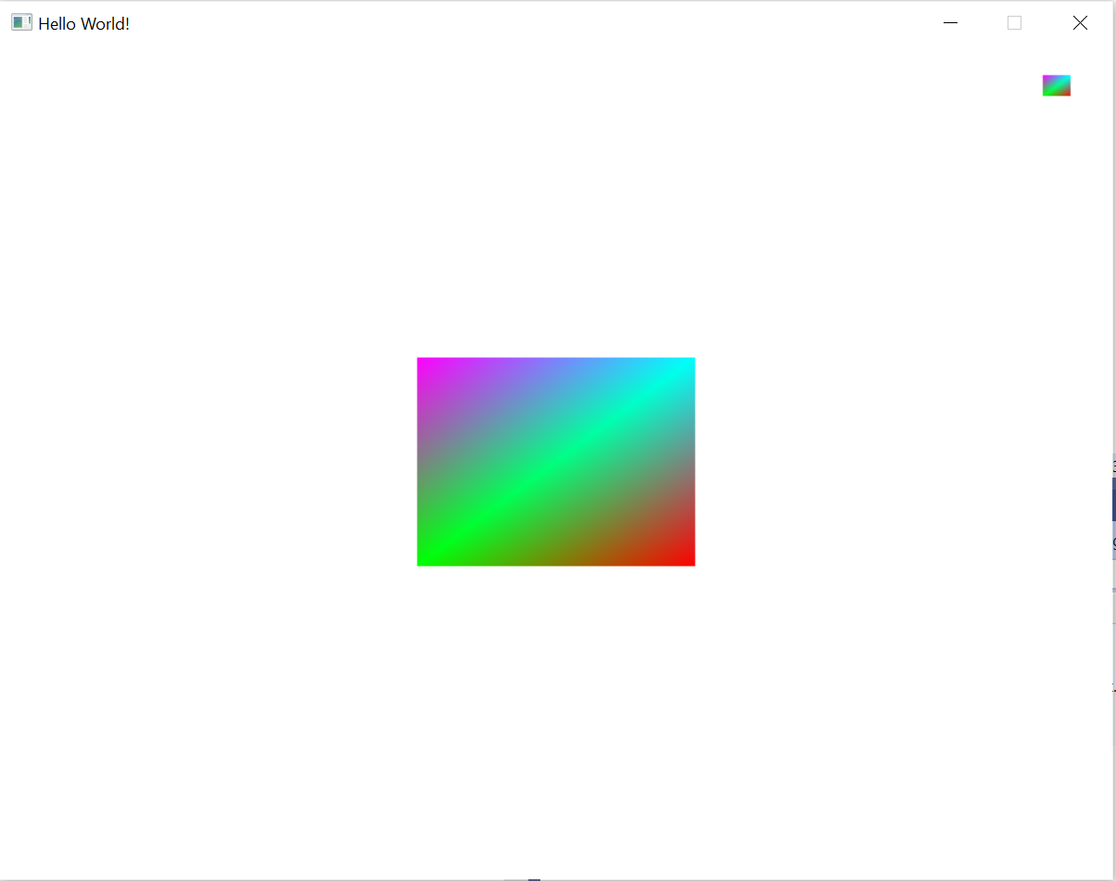
Objective
Add a color attribute
Apply Orthographic projection
Change viewport

