Slide 1

2D Graphics Programming with OpenGL 4 Representing Vertex Data Coordinate & Color
Sukanya Ratanotayanon
Creative Technology @ KMUTT

Slide 2
How to represent the data?

Slide 3
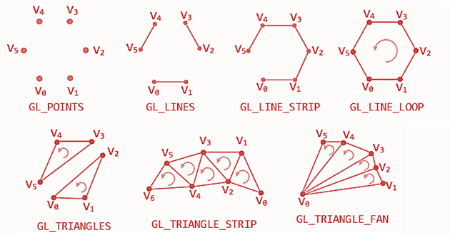
OpenGL Primitives

Slide 4
Coordinate System
y+
y+
(1,1)
z-
x+
x-
x+
x-
(0,0)
(1,0)
z+
y-
y-
Cartecian Coordinate(x,y,z)
without projection transformation the coordinate is between (-1,-1,-1) and (1,1,1)
Vertex – point on a coordinate system that will be joined to form a line or a polygon
specify using 2D or 3D coordinate
e.g. (0,0) (1,0) (1,1) or (0,0,0) (1,0,0) (1,1,0)

Slide 5
Color
Vector of 4 components – R G B A
Combination of Red Green Blue (RGB) Light
Alpha value for transparency
the value we use is between 0-1
https://www.rapidtables.com/web/color/RGB_Color.html
0.12 - 0.6 - 0.67

