Slide 1

2D Graphics Programming with OpenGL Projection Transformation &Viewport
Sukanya Ratanotayanon
Creative Technology@KMUTT

Slide 2
Projection Transformation
Orthographic (Parallel) and Perspective
Need to create projection Matrix for transformation using glm and pass it as to a uniform variable of the vertex shader
It is usually left-most matrix to be applied

Slide 3
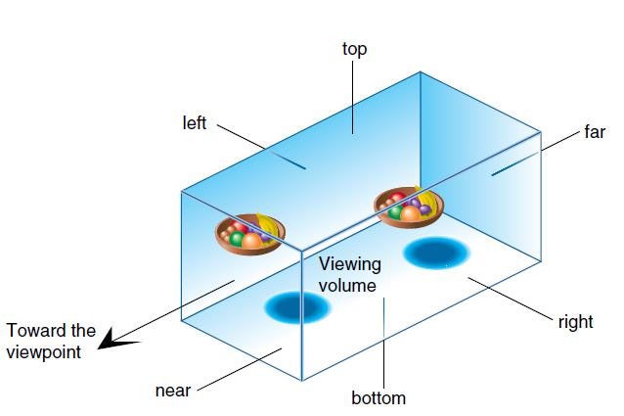
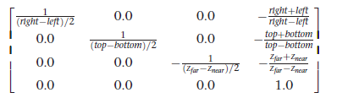
Orthographic Projection
Viewing volume has the same logical width front, back, top, bottom, left, right
Parallel projection – usually used for 2D graphic

Slide 4
GLM
A header file containing C++ mathematics functions and classes for graphics software
Example Types – must include proper header files ,e.g glm.hpp
mat4, mat3, vec4, vec3
Example Functions – must include “gtc/matrix_transform.hpp”
rotate (mat4, angle, vec3)
translate(mat4, vec3)
scale (mat4, vec3)
perspective(angle, aspect ratio, near, far)
ortho(left, right, bottom, top, near,far)

Slide 5
Uniform Variables
A global shader variable declared with keyword uniform
uniform mat4 pMatrix = mat4(1.0);
For each glDrawArrays, or glDrawElements execution, the value of this variable will be the same for every vertex
Can be declared in both vertex shader and fragment shader
if you declare uniform variables in both shaders with the same name, they will be the same variable

Slide 6
Data In Rendering Pipeline
Vertex
data
Attributes
VBO
Vertex Shader
output
input
Uniforms
Varyings (In/Out)
Fragment Shader
input
input
Frame Buffer

Slide 7
Projection Transformation Example
Vertex Shader
#version 330
uniform mat4 pMatrix = mat4(1.0);
in vec2 LVertexPos2D;
in vec2 vColor;
out vec3 color;
void main() {
gl_Position = pMatrix* vec4( LVertexPos2D.x, LVertexPos2D.y, 0, 1 );
color = vColor;
}
Code for passing a projection matrix
GLuint pMatrixId = glGetUniformLocation(gProgramId, "pMatrix");
glm::mat4 projectionMatrix = glm::ortho(-3.f,3.f,-3.f,3.f);
glUniformMatrix4fv(pMatrixId, 1, GL_FALSE, glm::value_ptr(projectionMatrix));
** Need to include gtc/matrix_transform.hpp, gtc/type_ptr.hpp and glm.hpp

Slide 8
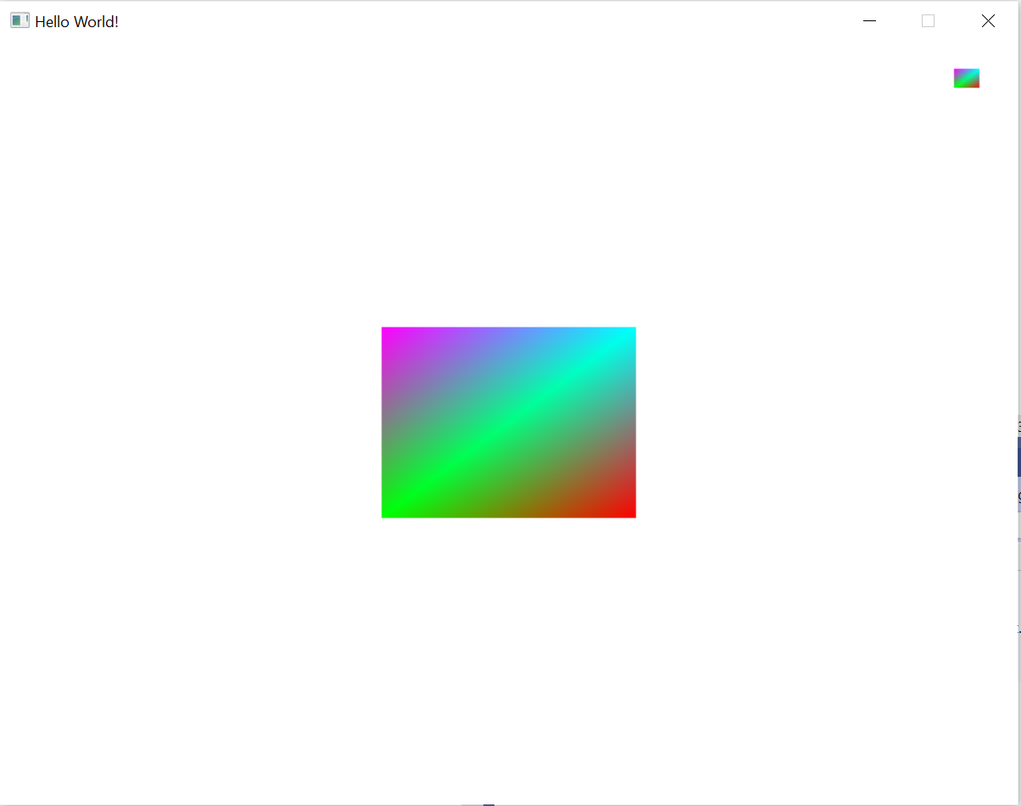
Viewport
Set where and how big the rendered image should appear on the window
glViewport(x, y, width, height)
glViewport(0, 0, 800, 600);
glDrawArrays(GL_TRIANGLE_FAN, 0, 4);
glViewport(720, 540, 80, 60);
glDrawArrays(GL_TRIANGLE_FAN, 0, 4);

