Slide 1
Classification of Prostate Cancer Patients into Indolent and Aggressive Using Machine Learning
Presented by
Yashwanth Karthik Kumar Mamidi
Saiful Ratul

Slide 2
Contents
Introduction
Classification Algorithm (Gleason Score)
Objective
Prostate Cancer Dataset
Project Design
MRMR (Feature Selection)
SMOTE (Imbalanced Dataset)
Results
Conclusion

Slide 3


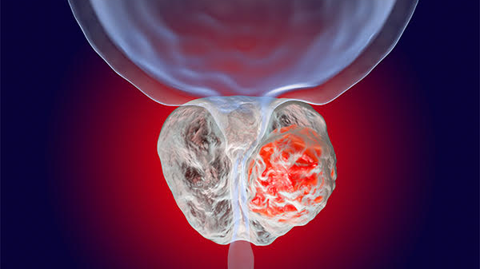
Introduction
The prostate is a gland located below the bladder and in front of the rectum.
Most diagnosed cancer and the second cause of cancer related death in men in the US.
In 2019, an estimated 174,650 men were diagnosed with prostate cancer and 31,620 people died due to this disease in US (ACS).
Symptoms:
Problems passing urine.
Low back pain.
Pain with ejaculation.
Blood in the urine or serum.
Notes:
Most common among older men and rare in men younger than 40.
Prostate-specific antigen (PSA) screening has enabled early detection of prostate cancer and the reduction in mortality rates.
However, PSA screening has resulted in unintended consequence of over diagnosis and over treatment.
A critical problem faced by clinicians and oncologists is stratifying patients into those with indolent and those with aggressive tumors using Gleason score

Slide 4

Classification Algorithm (Gleason Score)
Notes:
The most important predictor of mortality is the Gleason Score [1, 2].
Gleason score ranges from 6 to 10.

Slide 5
Objective
To develop a Machine Learning algorithm for classifying prostate cancer patients into two different class (Indolent and Aggressive) with better accuracy.
Current classification algorithm used for diagnosing prostate cancer patients with indolent and aggressive could lead to measurable changes distinguishing the two patient groups.

Slide 6
Prostate Cancer Dataset
Downloaded and extracted data from GDC-TCGA.
Gene-probes : 60483
Samples: 547
Indolent = (190)
We filtered gene-probes from the data which have at least ~30% (165) values greater than 0 .
Resulting gene-probes: 34956.
Aggressive = (305)
GS: 7 (4+3), 8, 9, 10
Normal (52)
GS: 6 and 7 (3+4)

Slide 7
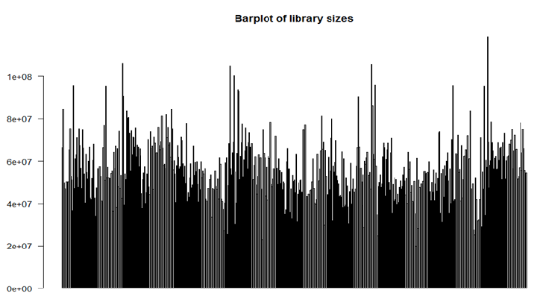
Library size
Samples
TMM normalization is used to normalize data before applying ML.
Notes:
Library sizes of all samples expressed using a barplot constitutes the data quality and unnormalized library sizes.

Slide 8
Project design
Normalized Data
MRMR
Feature Selection
SMOTE
Machine Learning

Slide 9
Maximum Relevance and Minimum Redundancy (MRMR)
MRMR is a feature selection approach in Machine Learning.
Tends to select features with a high correlation with the class (output) and low correlation between themselves.
Features are selected one by one by applying a greedy search to maximize the objective function.
MRMR provides output with ranks for all features.
2074 features are extracted using MRMR feature selection.
Notes:
Objective function is a function of relevance and redundancy
Two commonly used types of the objective function are MID (Mutual Information Difference criterion) and MIQ (Mutual Information Quotient criterion) representing the difference or the quotient of relevance and redundancy, respectively

Slide 10
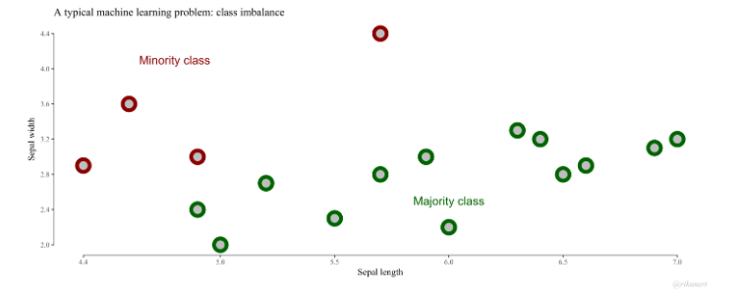
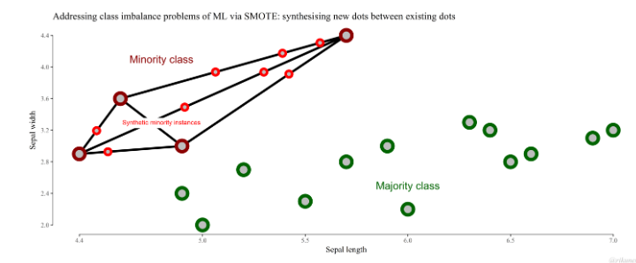
SMOTE (class imbalance problem)

Slide 11
Results
Accuracy
Classifiers

Slide 12
Accuracy
Classifiers

Slide 13
Conclusions
Results show that current classification algorithm could misclassify the prostate cancer patients.
Using Machine learning algorithms can classify the patients into correct groups (Indolent and Aggressive).
We improved the accuracy from ~74% to ~88% using Machine Learning classifiers.
In order to classify all samples, Single Cell based analysis or Methylation based analysis can be implemented to yield better results.

Slide 14
Thank you
&
Any Questions?

