Slide 1
Introduction.
A Competitive programming tracker for coders all around the globe to check :
Profile Data of a programmer
Submissions of programmers
Compare any two programmer’s stats
This application is specially designed to deal with Codeforces platform.

Slide 2
It is easy to use this web application for programmers and this project is inspired by StopStalk
User first need to create an account
After creation of account user has to update his codeforces id then user can check his profile data ,submissions and attended contests related information
Comparison of two programmers is done in a tabular format
Users can know where they lag and can improve their performance

Slide 3
Abstract.
This application is specially designed to track Codeforces users.
Here we can get information of programmer and we can also compare two programmers in a tabular format
We get the data from API which is provided by Codeforces.
If we enter the codeforces id of the programmer, data can be easily fetched.

Slide 4
Objective
The ultimate objective of this web-application is to get the data of
programmer and display it on a web page and compare two programmers efficiently
It helps the user to see where he/she lags when compared to other programmer
and can improve his/her skills

Slide 5
Proposed work
Data is being fetched from Codeforces API and processed in server with the help of NodeJS
Server acts as API helper and also helps in adding authentication feature when user logins and it is useful for signup process.It interacts with database
We used MongoDB as database to store users credentials and their codeforces ID

Slide 6
Front-end is developed using Angular Framework
Front-end makes request to server which deals with codeforces API and database
URL of deployed Web-Application
https://codeforces-tracker.herokuapp.com/

Slide 7
Features
SignUp: Create account of new user
Login: User can login by giving correct credentials
Update Codeforces ID: User can submit or change his Codeforces Id
Retrieve User’s Information: User can fetch his data
Data: Profile data , attended contest information, submitted problems status
Retrieve Other User’s Information: User can fetch other programmer’s data
Compare: User can compare two programmers by giving their Codeforces IDs as input

Slide 8
Technologies
Front-End: Angular Framework
Backend: NodeJS,ExpressJS
DataBase:MongoDB

Slide 9
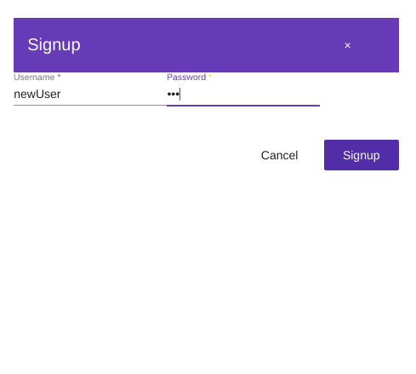
Steps:
User can give new Id and password for registration

Slide 10
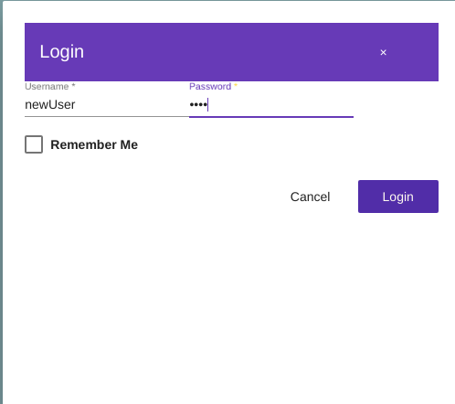
User can login by giving unique Id and password

Slide 11
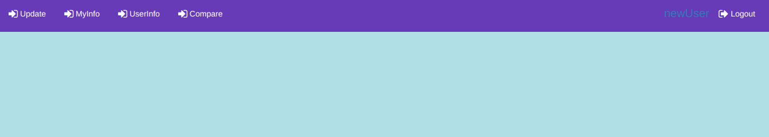
After giving correct credentials It gives below result

Slide 12
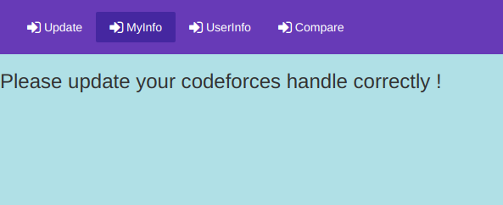
If user wants to know his Codeforces data then he should update his Codeforces ID

Slide 13
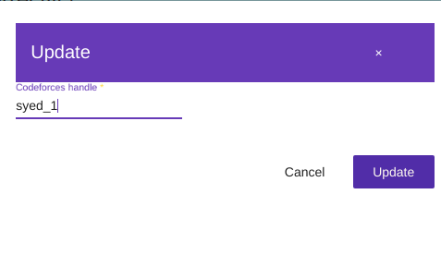
In this way user can update his/her codeforces ID

Slide 14
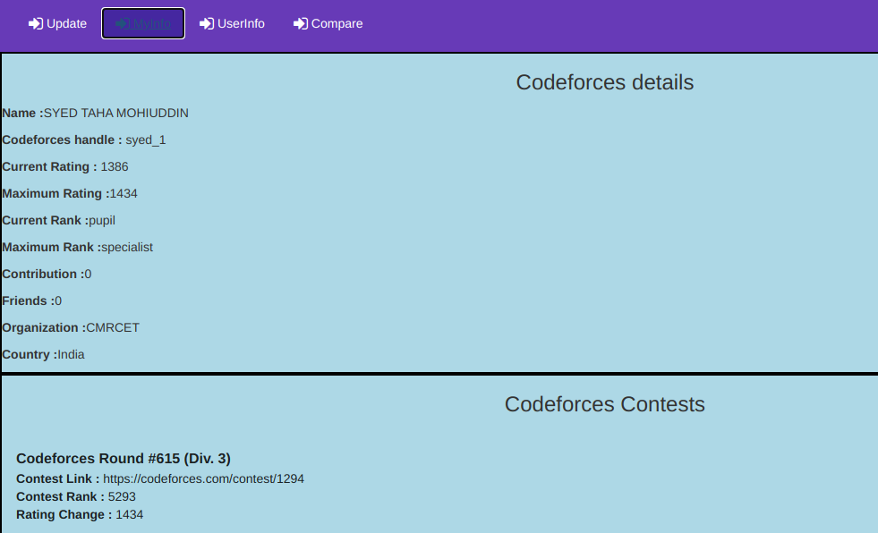
After updating Codeforces Id,User can see his codeforces data

Slide 15
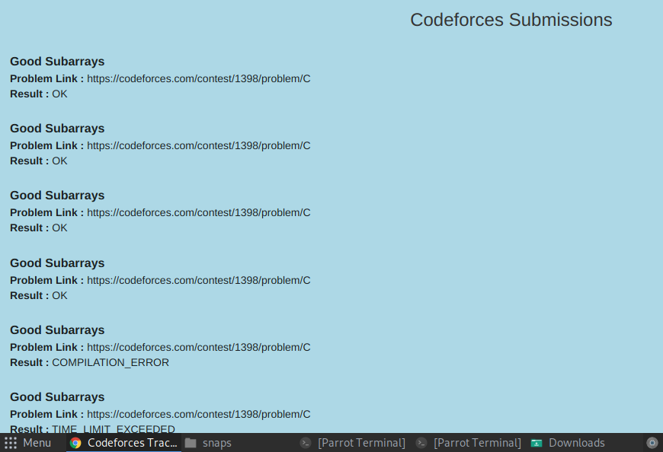

Slide 16
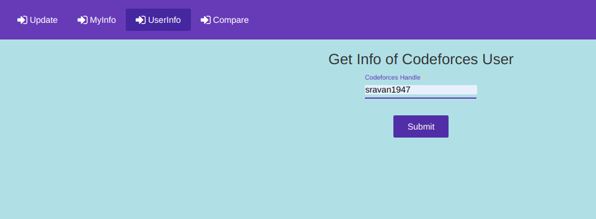
In the similar way User can check other programmers data by giving their Codeforces Id

Slide 17
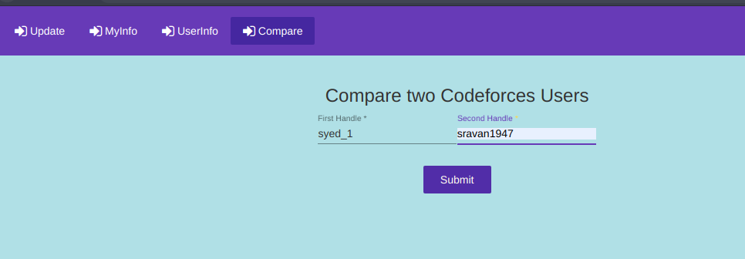
User can compare two programmer by giving their codeforces IDs

Slide 18
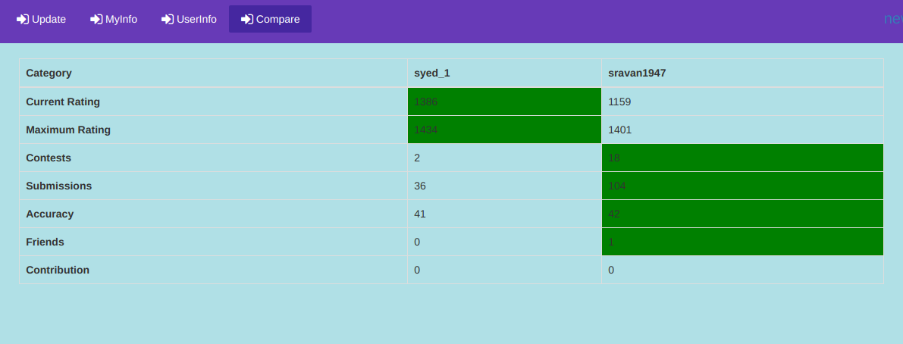

Slide 19
Conclusion
It was a wonderful learning experience for us while working on this project. This project took us through the various phases of project development and gave us real insight into the world of software engineering

Slide 20
Thank You

