Slide 1





NEXT GEN EMPLOYABILITY PROGRAM
Creating a future-ready workforce
Team Mem bers
College Name
Student Name: Beeram Sravan Kumar
Jct College of Engineering & Technology-Coimbatore
Reddy
Student id: 720921104016

Slide 2


CAPSTONE PROJECT SHOWCASE
Next Gen Employability Program
Project Title
Notes Sharing Web Application using Django Framework
Abstract | Problem Statement | Project Overview | Proposed Solution | Technology Used | Modelling & Results | Conclusion

Slide 3

Next Gen Employability Program
Abstract
I n t h e d i g i t a l e r a , t h e n e e d f o r e f f i c i e n t a n d a c c e s s i b l e e d u c a t i o n a l r e s o u r c e s i s m o r e pronoun ced t h a n ever. T hi s pa p e r pres e nt s the de ve l op m e nt of a c oll aborative notes s h a r i n g w e b a p p l i c a t i o n d e s i g n e d t o m e e t t h i s d e m a n d b y f a c i l i t a t i n g t h e s h a r i n g of a c a d e m i c m a t e r i a l s a m o n g s t u d e n t s . U t i l i z i n g t h e D j a n g o f r a m e w o r k , a h i g h - l e v e l P y t h o n w e b f r a m e w o r k t h a t encourages r a p i d development a n d p r a g m a t i c design, this application offers a ro b u s t p l a t f o r m f o r u s e r s t o u p l o a d , d o w n l o a d , a n d s h a r e n o t e s i n v a r i o u s f o r m a t s . T h e sys tem a rc hi tec t ure is built on Django's M o d e l - V i e w - Te m p l a te ( M V T ) a rc h i t e c t u re , ensuring a c l e a r s e pa r a t i on of c on c e r n s , s ca l a b i l i t y, a n d ease of m a i n t e n a n c e . K e y fe a tu re s i nc l ud e us e authentica t i on, file m a n a g e m e n t , a search functionality for ease of access to specific m a t e r i a l s a n d a c a t e g o r i z a t i o n s y s t e m f o r o rg a n i z i n g notes by s u b j e c t , t o p i c , o r course . P r e l i m i n a r y testing indicates a u s e r- f r i e n d l y i nte r fac e a n d a positive reception f r o m t he t a r g e t audi ence suggesting t h e a p p l i c a t i o n' s p o t e n t i a l to s i g n i f i c a n t l y e n h a n c e t h e l e a r n i n g e x p e r i e n c e by p rom ot i ng collaborati ve s t u d y a n d resource shari ng. F u t u re w o r k w i l l focus on i nc o r p or a t i n g advance d f ea ture s such as col l aborative e di t i ng, i n t e g r a t i o n w i t h cloud storage ser vices, a n d the implementation of machine learning algorithms to recommend personalized content to
users based on their interests and study habits.
Source :Gpt 4

Slide 4

Next Gen Employability Program
Problem Statement
The p r i m a r y challenge addressed by this proje ct is the lack of a n i nt u i t i v e , effi c ie nt, a n d collaborative p l a t f o rm specifically designed for the sharing a nd m a n a g e m e n t of ac adem i c notes and resources among students and educators. Despite the availability of various online p l a t f o r m s , the re re m a i n s a s ignifi cant gap in ser vices t h a t c a t e r specifically to a c a de m i c collaboration, w i t h m a n y students resorting to f ragmented and less secure means of sharing s t udy m a te r i a l s . This pro j e ct a i m s to leverage the Django f r a m e w o r k to develop a u s e r- f r iendly, secure, and scalable web application th a t not only facilitates the easy sharing and organization of notes but also enhances the overall learning experience through collaborative features and a community- driven approach.
Source :

Slide 5

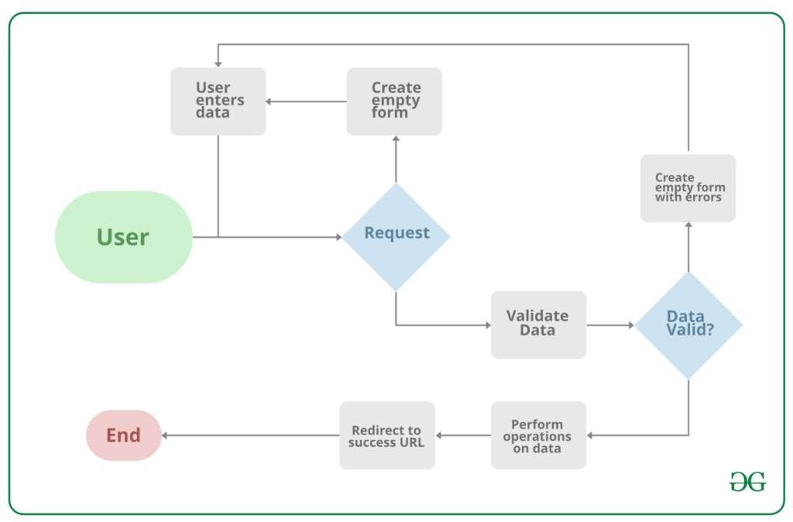
Next Gen Employability Program
Project Overview
Source :google

Slide 6

Next Gen Employability Program
Proposed Solution
The proposed solution is to develop a comprehensive, secure, and user- friendly Notes
Sharing Web Application tailored for students, educators, and academic institutions. This application will leverage the Django f ramework for its robustness, security features, and scalability. Below are the key components of the proposed solution:
1 . System Architecture
Backend Development: Utilize Django for server- side logic, database management, user authentication, and session management, ensuring a secure and efficient backend
structure.
Frontend Integration: Employ H T ML , CSS, and Java Script, alongside Django’s template
system, to create an intuitive and responsive user interface that enhances user experience.
Database Design: Design a relational database schema that efficiently stores user data, notes, categories, and interactions to facilitate quick retrieval and secure storage of
information.
2 . Core Features
User Authentication and Authorization: Implement Django’s built- in authentication system to manage user accounts, secure login/logout processes, and ensure user data privacy.
•Notes Management: Enable users to upload, download, and manage notes in various
formats ( PD F, DOCX , P P T, etc.), with features for creating, editing, and deleting notes. Collaboration Tools: Incorporate features for users to comment on notes, rate them, and
.
Source : GPT 4

Slide 7

Next Gen Employability Program
3 . Security and Privacy
Implement Django’s security best practices to protect against common vulnerabilities such as SQ L injection, Cross- Site Scripting ( XSS), and Cross-Site Request Forgery ( CSRF).
Ensure data privacy by adhering to regulations such as G D P R for the handling of personal information.
4 . Scalability and Performance
Design the application with scalability in mind, allowing for easy adaptation to increased user numbers and data volume without performance degradation.
Utilize Django’s caching f ramework to enhance application performance and reduce server load.
5 . User Experience ( UX) Design
Follow a user- centered design approach to create an accessible and engaging platform, ensuring that the UI/ UX caters to the needs and preferences of the target audience.
Implement responsive design principles to ensure the application is accessible across various devices and screen sizes.
6 . Testing and Quality Assurance
Conduct thorough testing, including unit tests, integration tests, and user acceptance testing ( UAT) , to ensure the application is reliable, secure, and user- friendly.
•Utilize Django’s testing f ramework to automate test cases and ensure code integrity.
Source :GPT 4

Slide 8

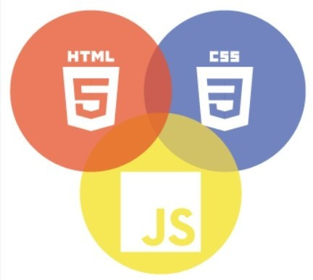

Next Gen Employability Program
Technology Used
Front-end
Back-end
Source :

Slide 9

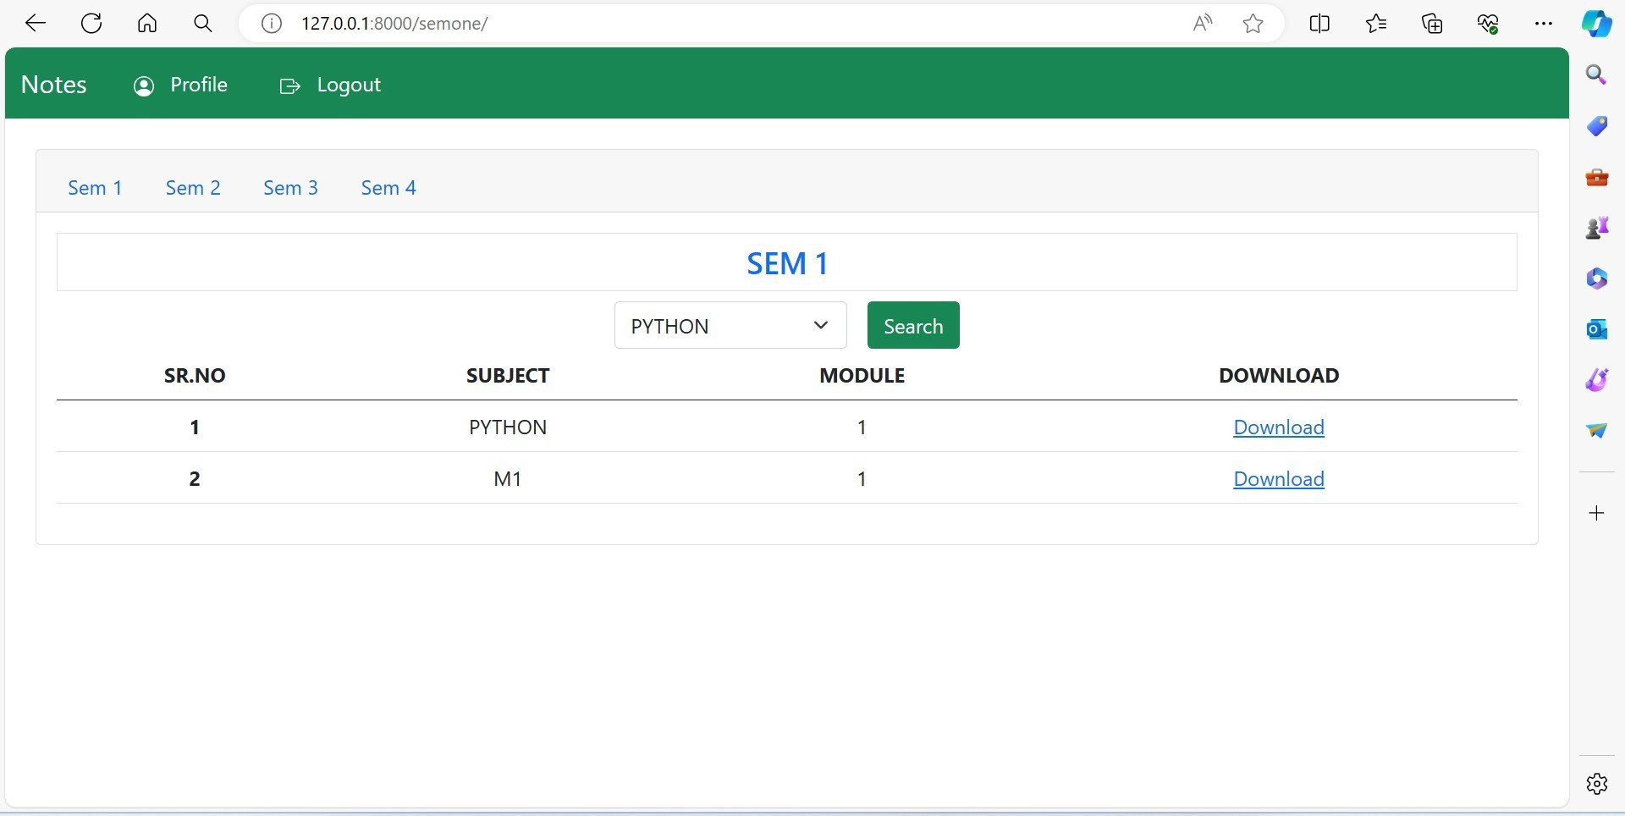
Next Gen Employability Program
Modelling & Results
Source :

Slide 10

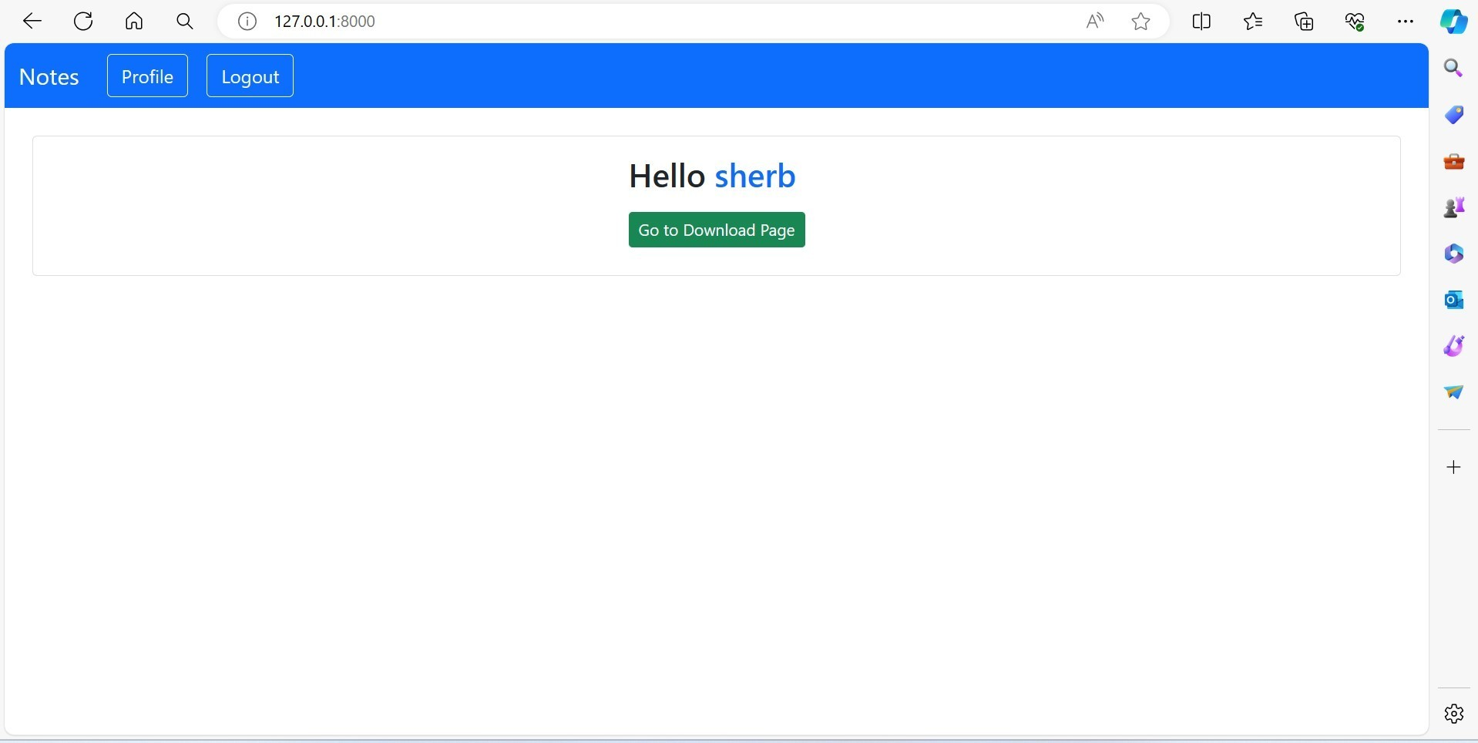
Next Gen Employability Program
Homepage

Slide 11

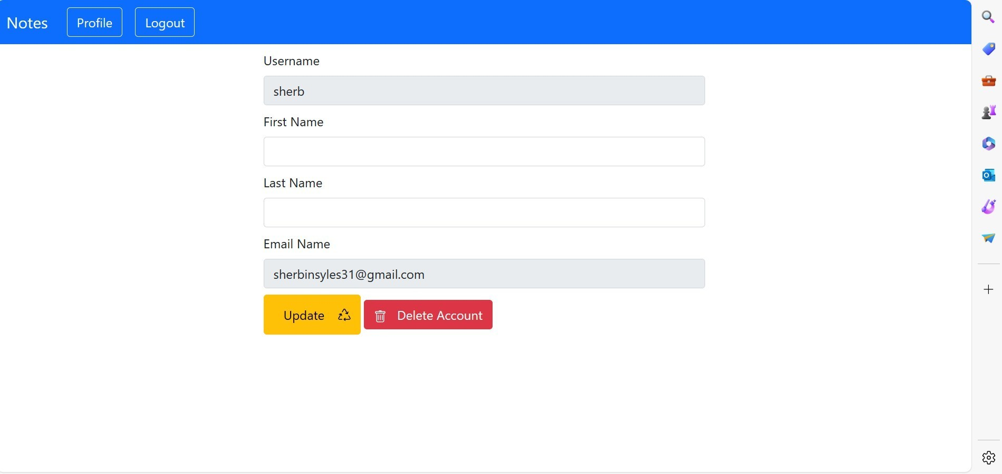
Next Gen Employability Program
User-Profile

Slide 12

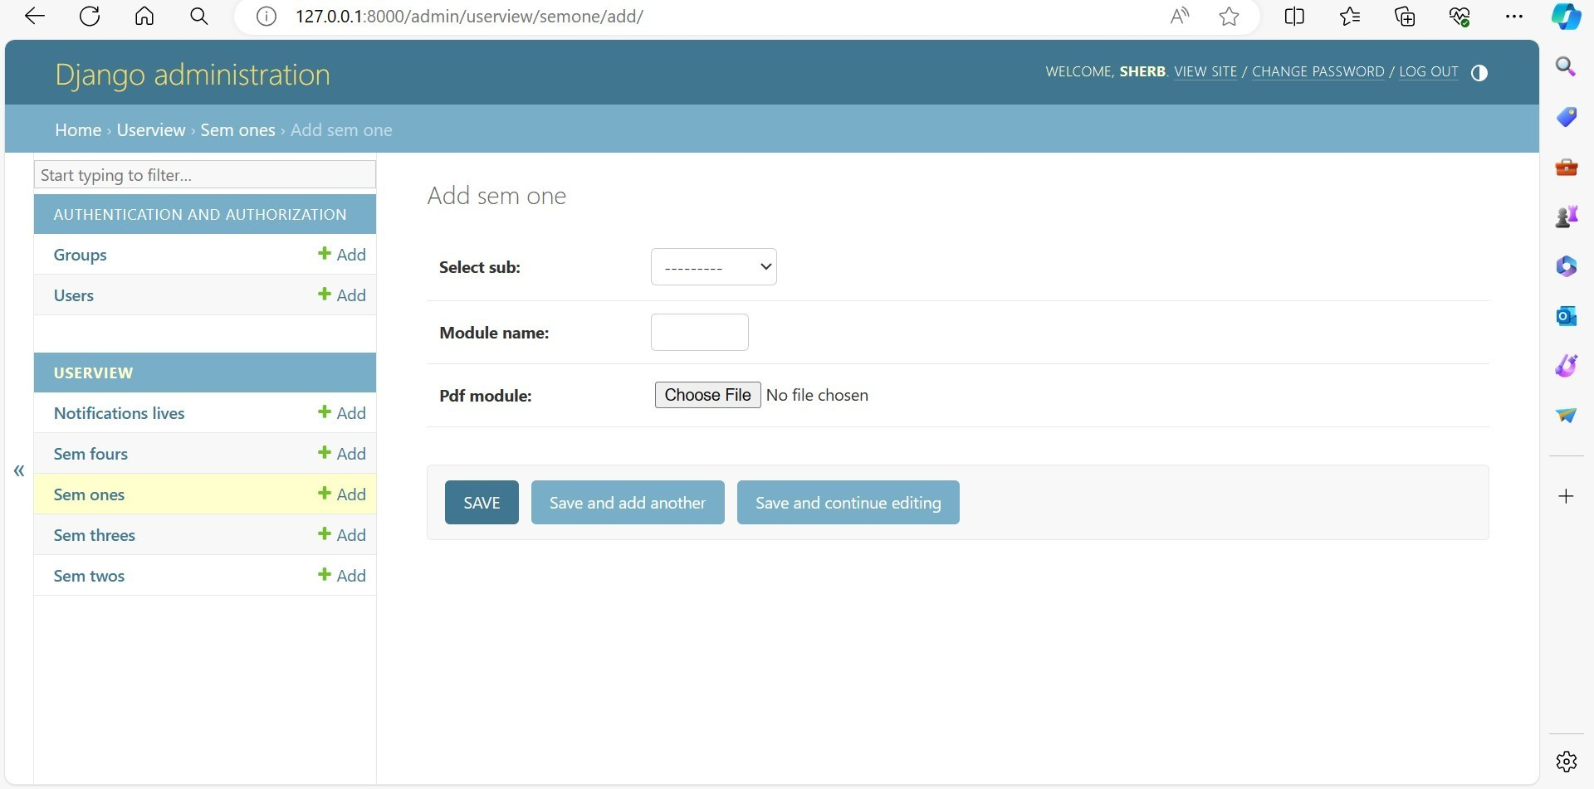
Next Gen Employability Program
Admin-Page

Slide 13

Next Gen Employability Program
Departments-Page

Slide 14

Next Gen Employability Program
Future Enhancements:
1 . Artificial Intelligence and Machine Learning Integration
Content Recommendation System: Implement machine learning algorithms to analyze user behavior, preferences, and interactions with the content to provide personalized note
recommendations.
Automatic Categorization: Utilize natural language processing ( NLP) techniques to
automatically categorize notes based on their content, making the upload process more efficient and improving the discoverability of resources.
2 . Enhanced Collaboration Features
Real- Time Collaboration: Introduce real- t ime editing and commenting features, allowing multiple users to work on the same document simultaneously, similar to Google Docs.
Study Groups: Enable users to create and join study groups within the application, fostering a more organized and collaborative learning environment.
3 . Integration with External Platforms
Cloud Storage Services: Offer integration with cloud storage platforms (e.g., Google Drive, Dropbox) to allow users to easily upload and backup their notes.
Educational Tools and Platforms: Integrate with other educational platforms and tools,
providing a seamless experience for users to access a wide range of resources and tools f rom within the application.

Slide 15
Next Gen Employability Program
Conclusion
In conclusion, note sharing applications serve as versatile tools that facilitate collaboration, knowledge exchange, and organization across various domains. Whether utilized for educational purposes, professional endeavors, or personal organization, these platforms offer a centralized hub for users to create, share, and collaborate on notes. By promoting efficient communication, enhancing productivity, and fostering learning and growth, note sharing applications play a crucial role in empowering individuals, teams, and communities to connect, collaborate, and succeed in today's digital age. As technology continues to evolve, the significance and impact of note sharing applications are expected to grow, providing invaluable support for collaboration and knowledge sharing in diverse contexts.
Source :

Slide 16

Next Gen Employability Program
Thank You!

