Slide 1
Titanic Survival Analysis
Task 4: Data Storytelling And Statistical Validation
NAME: MADDALA SRAVANI
INTERNSHIP PROJECT
APEX PLANET

Slide 2

Business Objective
The objective of this analysis is to understand
the factors that influenced passenger survival
on the Titanic and identify key patterns using
data analysis and statistical validation.

Slide 3
Dataset Overview
Dataset: Titanic Dataset
Key Features:
• Passenger Class
• Gender
• Age
• Fare
• Survival Status
Total Records: 891

Slide 4
Key Insights
• Female passengers had higher survival rates.
• First-class passengers survived more often
than second and third-class passengers.
• Passenger class influenced survival chances.
• Survival varied significantly across groups.

Slide 5
Data Story
Analysis revealed that survival was strongly associated with gender and passenger class.
Female passengers had a much higher chance of survival compared to males.
Passengers travelling in first class also experienced better survival outcomes.
These findings suggest that social and economic factors played an important role during the disaster.

Slide 6
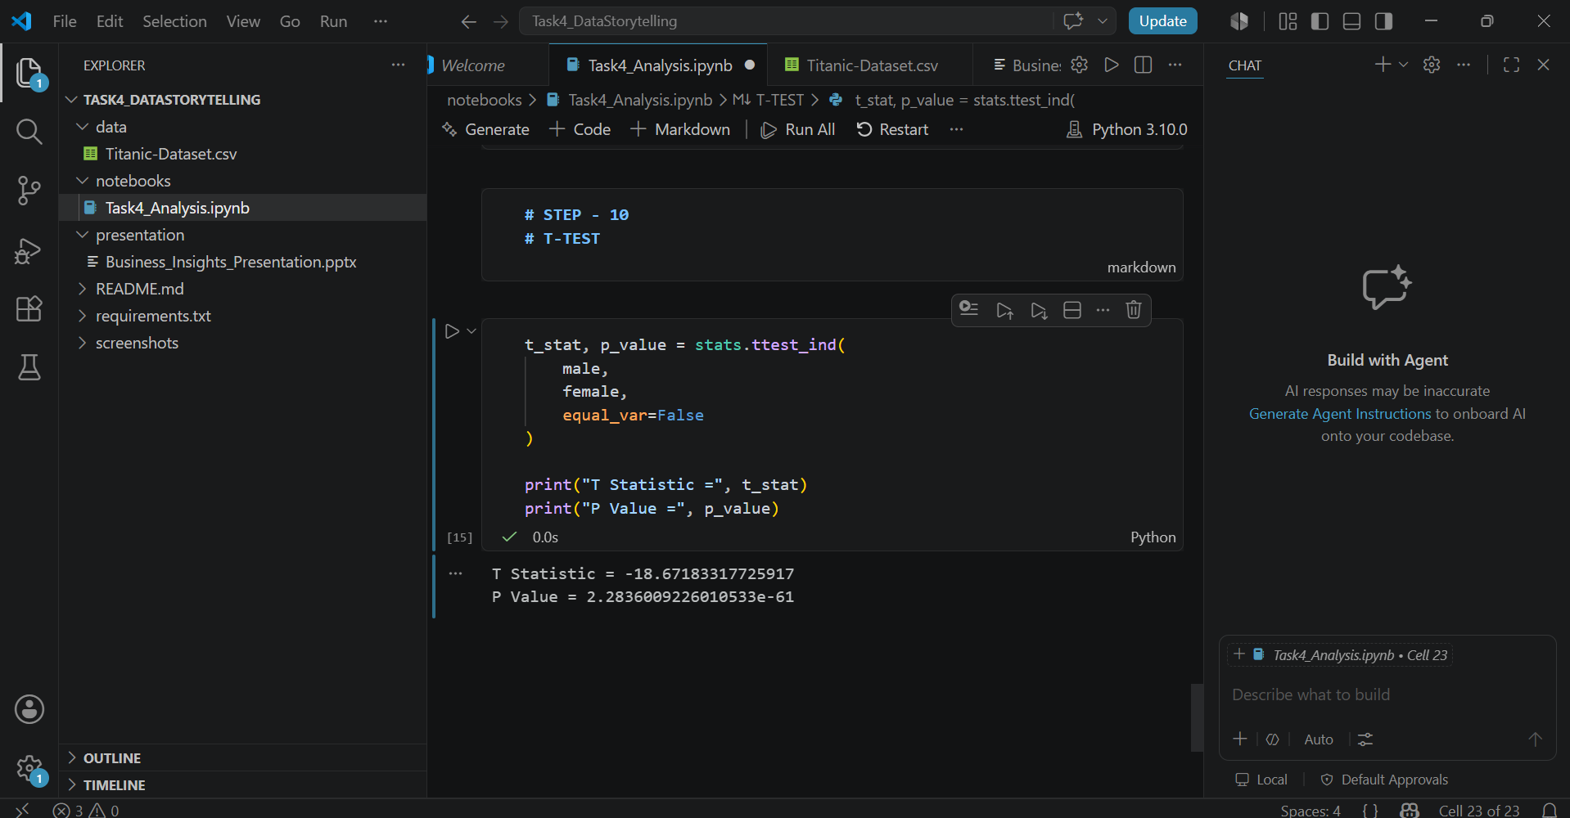
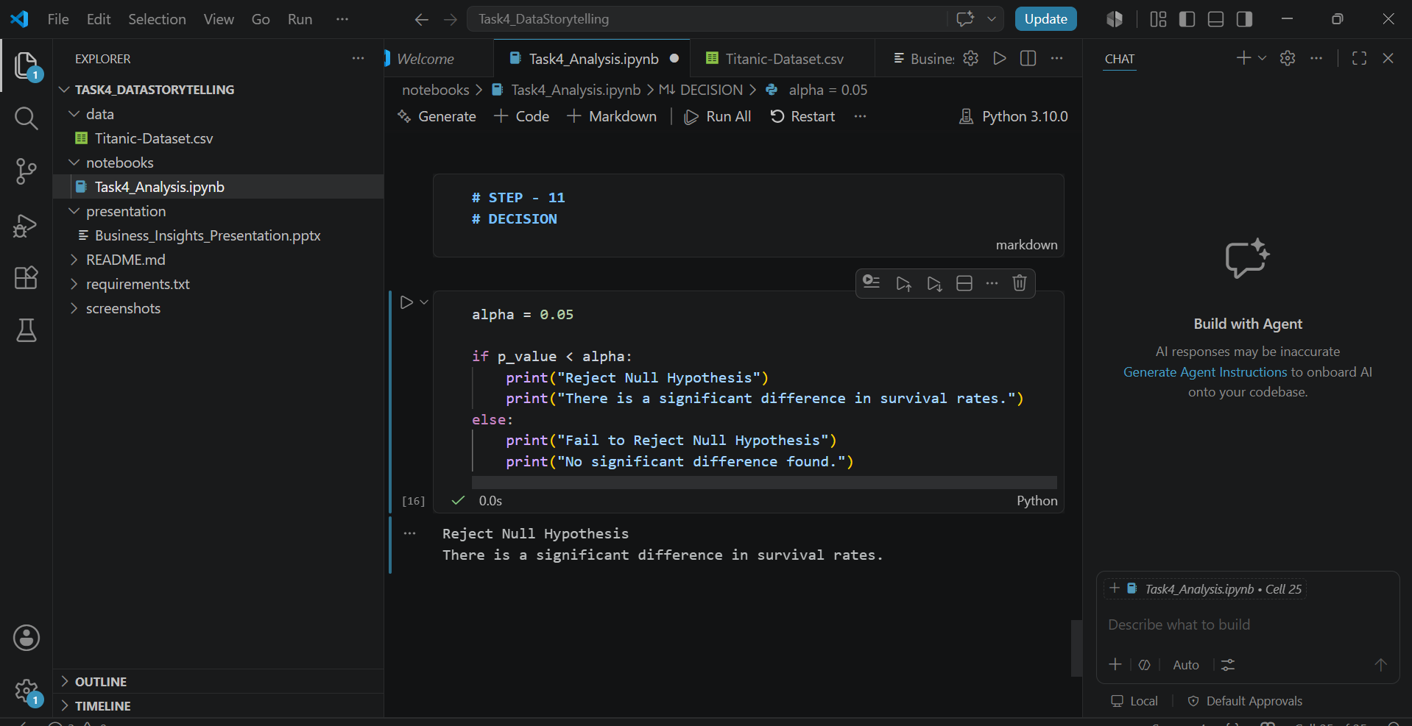
Statistical Validation
Hypothesis:
H0: Male and female survival rates are equal.
H1: Male and female survival rates are different.
T-Test was performed to validate the hypothesis.

Slide 7
Recommendations & Conclusion
Recommendations
• Improve emergency preparedness.
• Ensure equal access to safety measures.
• Use data-driven planning for passenger safety.
Conclusion
The analysis showed that gender and passenger class significantly influenced survival.
Statistical testing confirmed these findings,demonstrating the value of data storytelling
and hypothesis testing.

