Slide 1

Database Management Systems Cornerstone Project
Final Review
STUDENT BUDGET ONLINE SHOPPING SYSTEM
Presented by
A. Sumalatha(26B21AI001)
K. Sravani Jyothi(26B21AI059)
Y. Y Manasa Vihari(26B21AI116)
R. Sruthi Alekhya(22B11AIA06)
Department of Artificial Intelligence & Machine Learning

Slide 2




Presentation Outline
Abstract
Finalize title, objectives & problem statement
Identify entities & attributes
Design ER diagram & relationships
Prepare relational database schema
Define Primary & Foreign Keys
Create GitHub repo & responsibilities
Database creation & constraints
Insert sample data
DDL, DML & DQL operations
CRUD operations & SQL queries
Data integrity & validation
Project documentation
Demonstrate & present database
Conclusion

Slide 3
Design
PROJECT TITLE
Student Budget Online Shopping System
OBJECTIVE
To develop a structured database that helps students manage budgets, products, shopping activities and purchase details efficiently.
PROBLEM STATEMENT
Students often face difficulty in managing limited budgets while purchasing essential items. Manual tracking of prices, quantities and purchases makes it difficult to monitor expenditure and maintain accurate records. A centralized DBMS is required to organize student, budget, product, cart, order, payment and feedback information.

Slide 4
ENTITIES & ATTRIBUTES
1. Student — Student_ID (PK), Name, Email, Phone_Number, Department, Year
2. Category — Category_ID (PK), Category_Name, Description
3. Product — Product_ID (PK), Product_Name, Price, Stock, Category_ID (FK)
4. Budget — Budget_ID (PK), Budget_Amount, Start_Date, End_Date, Student_ID (FK)
5. Cart — Cart_ID (PK), Created_Date, Student_ID (FK)
6. Cart Item — CartItem_ID (PK), Quantity, Product_ID (FK), Cart_ID (FK)
7. Order Details — Order_ID (PK), Order_Date, Total_Amount, Student_ID (FK)
8. Order Item — OrderItem_ID (PK), Quantity, Price, Order_ID (FK), Product_ID (FK)
9. Payment — Payment_ID (PK), Payment_Date, Amount, Payment_Method, Order_ID (FK)
10. Wishlist — Wishlist_ID (PK), Added_Date, Student_ID (FK), Product_ID (FK)
11. Feedback — Feedback_ID (PK), Rating, Comment, Student_ID (FK), Product_ID (FK)

Slide 5
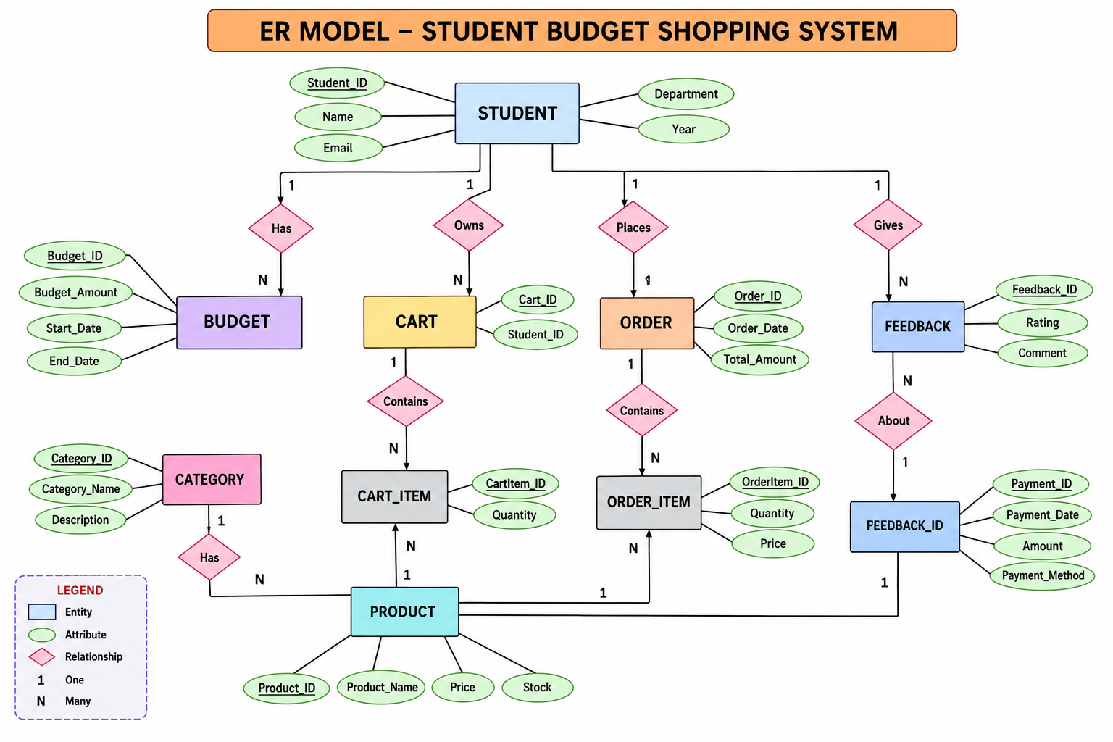
ER DIAGRAM

Slide 6
RELATIONAL DATABASE SCHEMA
Student(Student_ID PK, Name, Email, Phone_Number, Department, Year)
Category(Category_ID PK, Category_Name, Description)
Product(Product_ID PK, Product_Name, Price, Stock, Category_ID FK)
Budget(Budget_ID PK, Budget_Amount, Start_Date, End_Date, Student_ID FK)
Cart(Cart_ID PK, Created_Date, Student_ID FK)
Cart_Item(CartItem_ID PK, Quantity, Product_ID FK, Cart_ID FK)
Order_Details(Order_ID PK, Order_Date, Total_Amount, Student_ID FK)
Order_Item(OrderItem_ID PK, Quantity, Price, Order_ID FK, Product_ID FK)
Payment(Payment_ID PK, Payment_Date, Amount, Payment_Method, Order_ID FK)
Wishlist(Wishlist_ID PK, Added_Date, Student_ID FK, Product_ID FK)
Feedback(Feedback_ID PK, Rating, Comment, Student_ID FK, Product_ID FK)

Slide 7
PRIMARY & FOREIGN KEYS
PRIMARY KEY (PK)
A primary key uniquely identifies each record in a table and cannot contain NULL values.
Example: Student_ID uniquely identifies a student.
FOREIGN KEY (FK)
A foreign key references a primary key in another table. It connects related entities and maintains referential integrity.
Example: Student_ID in Budget references Student_ID in Student.
KEY MAPPING
Student → PK Student_ID
Category → PK Category_ID
Product → PK Product_ID; FK Category_ID
Budget → PK Budget_ID; FK Student_ID
Cart → PK Cart_ID; FK Student_ID
Cart_Item → PK CartItem_ID; FK Cart_ID, Product_ID
Order_Details → PK Order_ID; FK Student_ID
Order_Item → PK OrderItem_ID; FK Order_ID, Product_ID
Payment → PK Payment_ID; FK Order_ID
Wishlist → PK Wishlist_ID; FK Student_ID, Product_ID
Feedback → PK Feedback_ID; FK Student_ID, Product_ID

Slide 8
GITHUB REPOSITORY & TEAM
Repository:
github.com/sravani-kotha/student-budget-online-shopping
Repository files:
ddl.sql | dml.sql | queries.sql | diagrams/ | screenshots/ | README.md
TEAM RESPONSIBILITIES
A. Sumalatha
• ER diagram, database schema and relationships
K. Sravani Jyothi
• DDL, table creation, keys and constraints
Y. Y. Manasa Vihari
• DML, DQL, CRUD, JOIN and aggregate queries
R. Sruthi Alekhya
• Documentation, screenshots and repository organization
The project files have been committed and pushed to the shared GitHub repository.

Slide 9
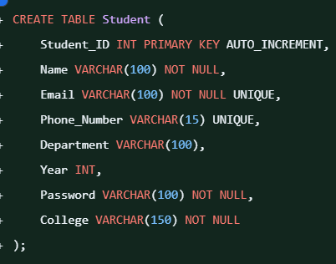
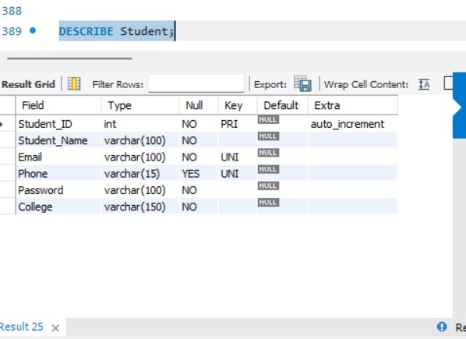
DATABASE & CONSTRAINTS

Slide 10

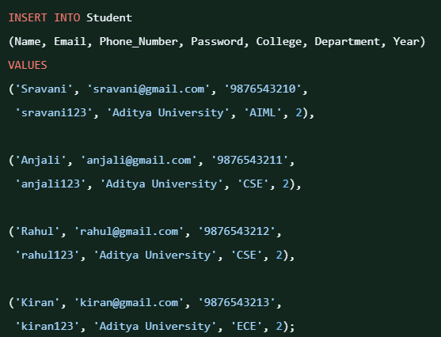
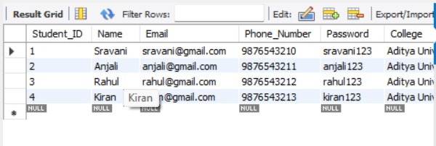
SAMPLE DATA INSERTION

Slide 11
DDL, DML & DQL OPERATIONS
DDL
CREATE TABLE ...
ALTER TABLE ...
DML
INSERT INTO ...
UPDATE ...
DELETE ...
DQL
SELECT ...
ALTER examples:
ADD Department
ADD Year
ADD Payment Amount
DQL EXAMPLE
SELECT Product_Name, Price
FROM Product
WHERE Price < 500;
JOIN
SELECT p.Product_Name,
c.Category_Name
FROM Product p
JOIN Category c
ON p.Category_ID =
c.Category_ID;
AGGREGATES
COUNT(*)
SUM(Stock)
AVG(Price)
MAX(Price)
MIN(Price)
GROUP BY
HAVING
SUBQUERY
Price > AVG(Price)
VIEW
Product_Category_View

Slide 12
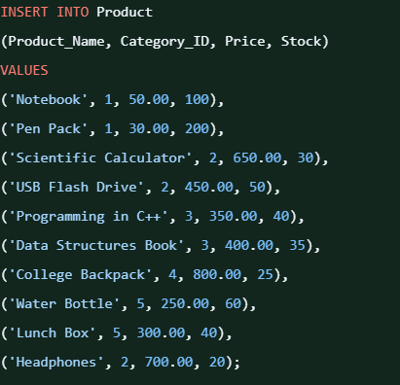
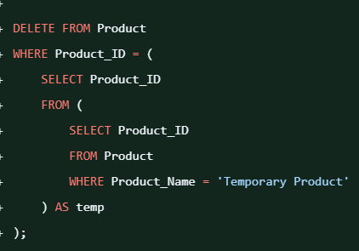
CRUD & SQL QUERIES

Slide 13
DATA INTEGRITY & VALIDATION
DATA INTEGRITY & VALIDATION
CHECK TEST
Price = -100
→ INSERT rejected
FOREIGN KEY TEST
Category_ID = 999
→ INSERT rejected
UNIQUE TEST
Duplicate student email
→ INSERT rejected
RESULT
The constraints prevent invalid,
duplicate and inconsistent records.
Examples:
• Price must be greater than 0
• Stock cannot be negative
• Rating is restricted to 1–5
• Category_ID must exist
• Student email must be unique

Slide 14
PROJECT DOCUMENTATION
The project documentation includes:
• Project abstract, objective and problem statement
• Entities and attributes
• ER diagram and relationships
• Relational database schema
• Primary and foreign key mapping
• DDL, DML and DQL queries
• CRUD, JOIN, aggregate, GROUP BY, HAVING and subquery examples
• Views and data-integrity tests
• MySQL execution screenshots
• GitHub repository and team responsibilities
Repository structure:
ddl.sql | dml.sql | queries.sql | diagrams/ | screenshots/ | README.md

Slide 15
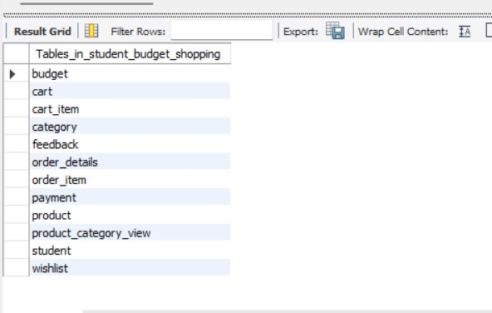
DEMONSTRATE & PRESENT
1. Open MySQL Workbench
2. Select student_budget_shopping
3. SHOW TABLES
4. Display sample table records
5. Execute CRUD query
6. Demonstrate JOIN and aggregate query
7. Demonstrate GROUP BY / HAVING
8. Show constraint validation
9. Show ER diagram
10. Open the GitHub repository and project files
The database contains the required tables:
Student, Category, Product, Budget, Cart, Orders, Payment, Wishlist, Feedback and related tables.

Slide 16
CONCLUSION
The Student Budget Online Shopping System provides a structured database for managing student budgets, products, shopping activities and purchase records.The project demonstrates practical DBMS concepts including entities, relationships, primary keys, foreign keys, constraints, SQL operations, CRUD, joins, aggregate functions, views and data validation.The completed SQL files, diagrams, screenshots and documentation are organized in the GitHub repository.

Slide 17
THANK YOU

