Slide 1
A Data-Driven Analysis of New York City Traffic Accidents
Prepared By:
Ankitaben Mungalpara (40) (Session - 1)
Sravani Kairam Konda (18) (Session – 2)
Ramana Sai Payili (32) (Session – 2)
Group - 16

Slide 2
Content
Objective
Dataset Overview
Data Pipeline
Step 1: Data Ingestion to Data Lake Storage
Step 2: Data Transformation on Azure Databricks
Step 3: Data Visualization on Azure Synapse Analytics
Conclusion

Slide 3
Objective
In the city of New York, known for its lively streets and transportation networks, the constant vehicular activity comes with challenges related to traffic safety and accident prevention. This project explores the New York City dataset capturing motor vehicle collisions reported by the Police Department.
The primary objective of this analysis is to analyze the New York City dataset efficiently using Azure tools. This includes employing Azure Data Factory for ingestion, storing raw data in Azure Data Lake Storage Gen2, leveraging Azure Databricks for transformation, storing processed data back, and utilizing Azure Synapse Analytics for comprehensive analytics.

Slide 4
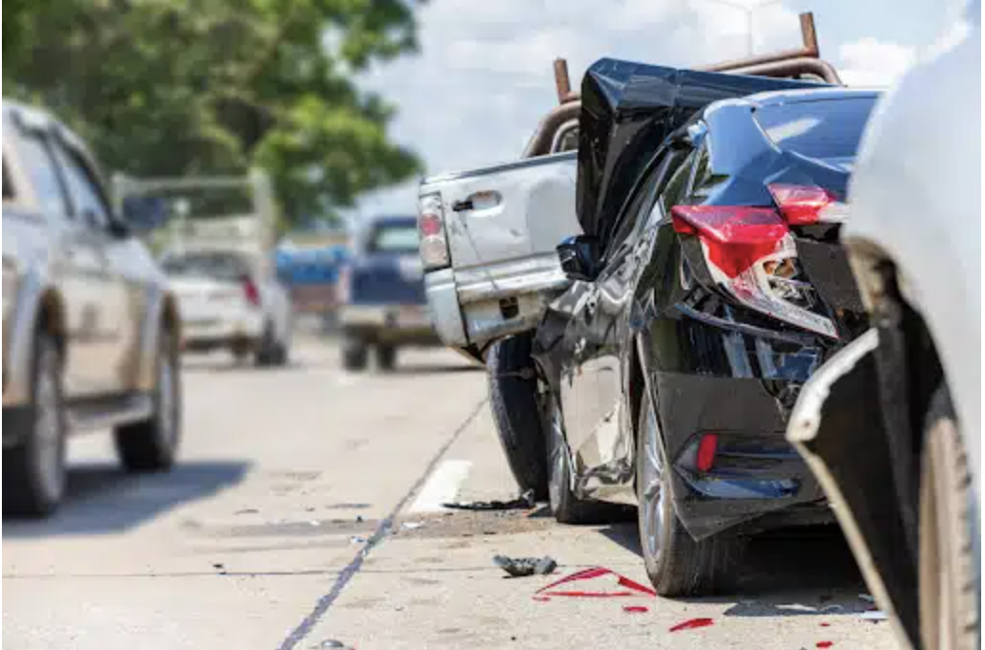
Dataset Overview
This dataset contains motor vehicle collisions reported by the New York City Police Department from January to August 2020. Each record provides detailed information about an individual collision, encompassing key aspects such as date, time, and location (borough, zip code, street name, latitude/longitude), involved vehicles and victims, and contributing factors.
Key Features:
Date and time of each collision
Spatial details including borough, zip code, and street name
Geographic coordinates (latitude/longitude)
Information on vehicles and victims
Contributing factors for each collision
Dataset Source: New York City Traffic Accidents Dataset

Slide 5
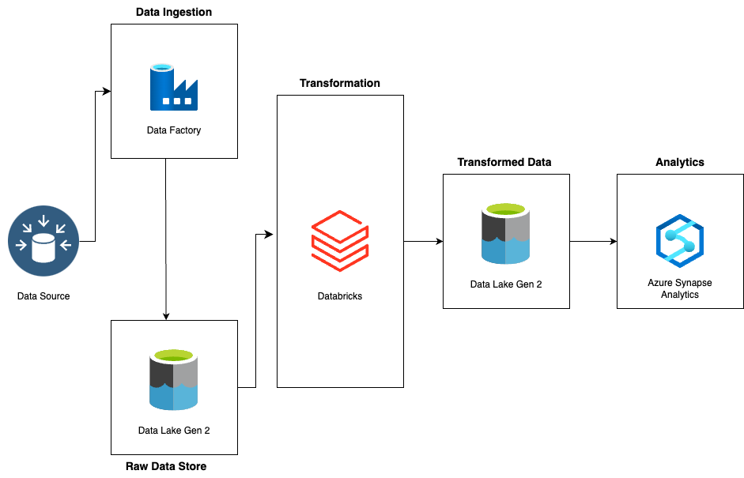
New York City Accidents Analysis Data Pipeline

Slide 6
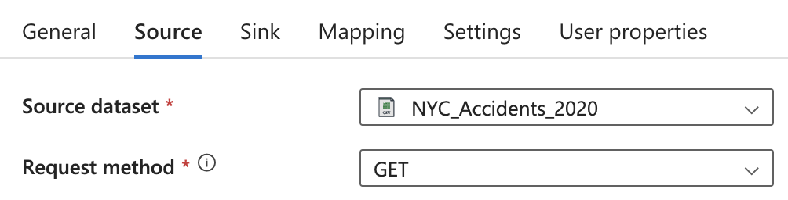
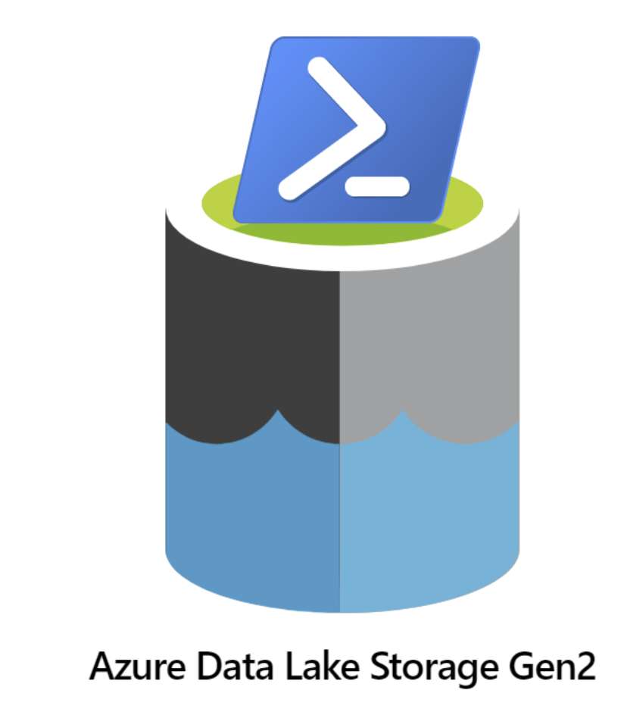

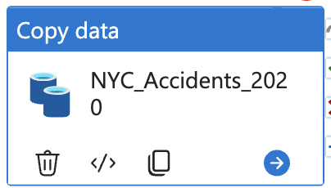
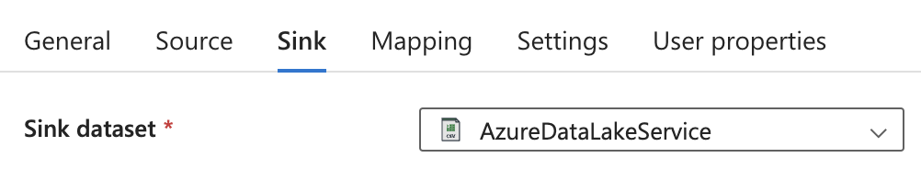
Step 1: Data Ingestion to Data Lake Storage
Efficiently ingest the New York City accidents dataset on motor vehicle collisions (January-August 2020) into Data Lake Storage, laying the foundation for structured and scalable data processing.
Development of a secure and centralized repository in Azure Data Lake Storage Gen2, ready for subsequent stages in the analytical pipeline.

Slide 7


Step 2: Data Transformation on Azure Databricks
Leveraging the capabilities of Azure Databricks to execute efficient and scalable data transformations, ensuring the dataset is refined and optimized for subsequent analytical tasks.
The steps proceed to transform the dataset, address inconsistencies, and prepare it for analysis. performed various analyses to uncover insights, including top accident counts by borough, contributing factors for fatal accidents, peak accident times, and day-of-week distribution. Finally, export the transformed data for further analysis and visualization to Azure Data Lake Storage.
Notebook
Transformation

Slide 8
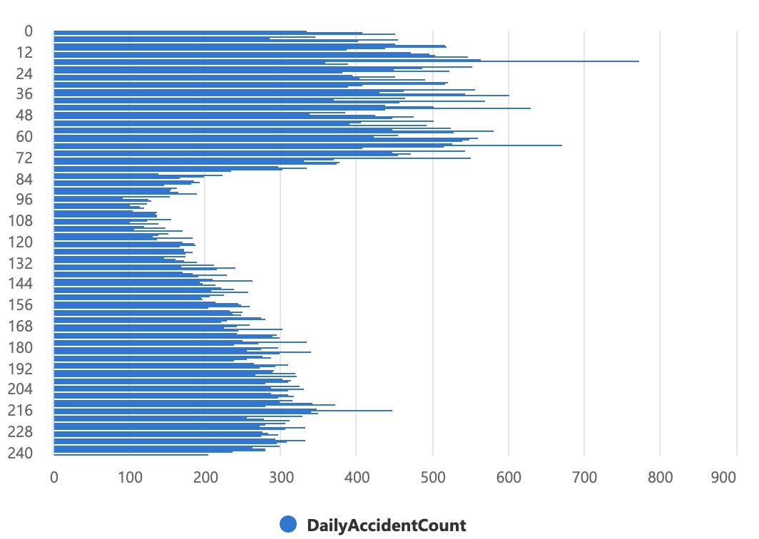
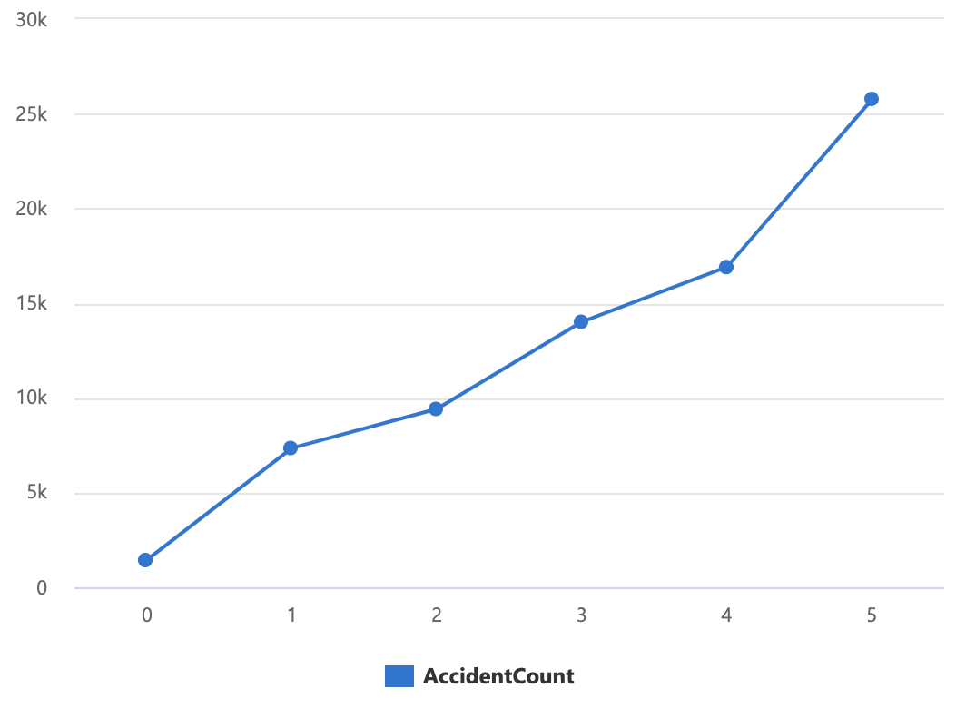
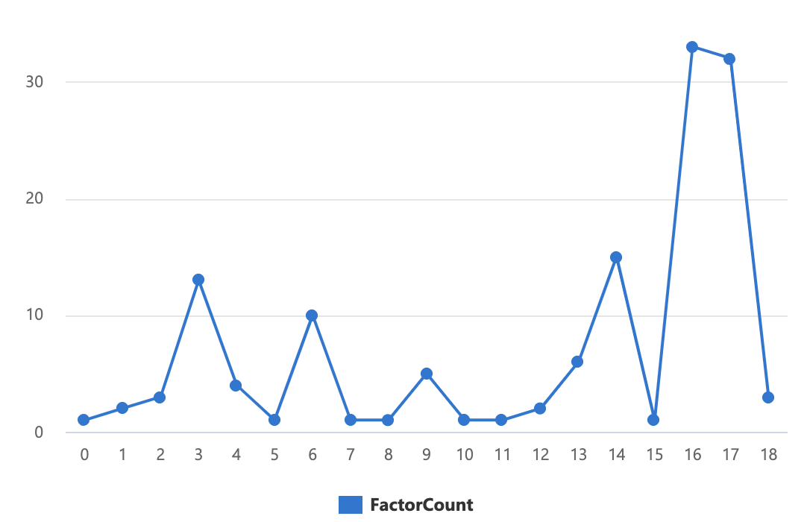
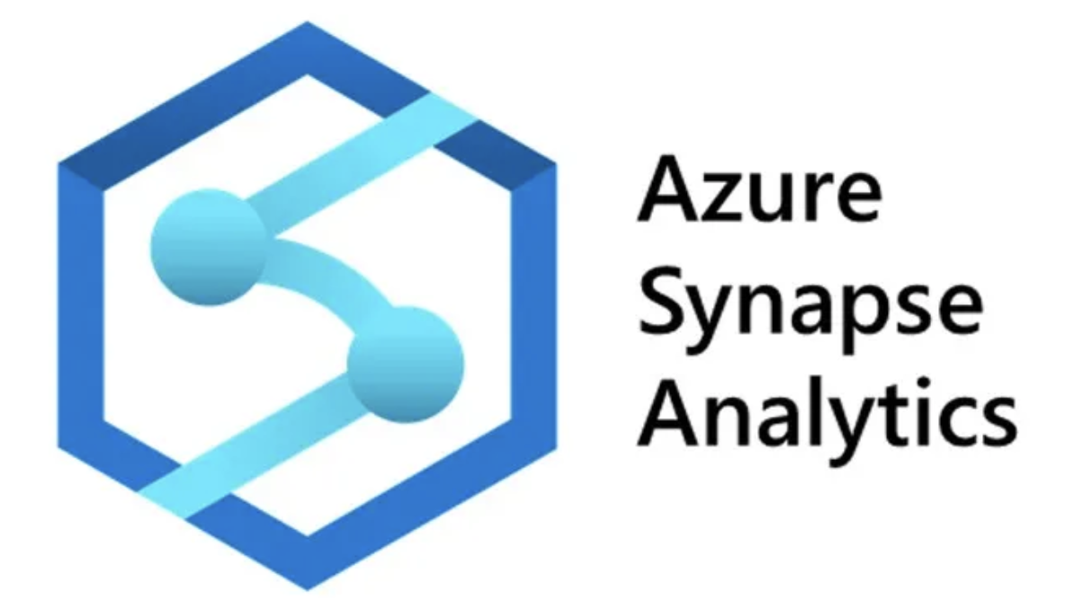
Step 3: Data Visualization on Azure Synapse Analytics
Leveraging Azure Synapse Analytics for comprehensive data visualization, transforming collision data into meaningful insights for enhanced decision-making.
This involved exploring accident counts by borough, daily accident trends, distribution of contributing factors for fatal accidents, and hourly accident trends. These visualizations provided valuable insights into the spatial, temporal, and contributing factor aspects of motor vehicle collisions in New York City.

Slide 9
Conclusion
Through this analysis of NYC motor vehicle collisions, we have gained valuable insights into patterns, trends, and key factors influencing traffic accidents. The comprehensive exploration of temporal, spatial, vehicular, victim-related, and contributing factors provided a nuanced understanding of collision occurrences.
Leveraging Azure tools facilitated efficient data processing, from ingestion to visualization, ensuring a seamless analytical pipeline. These insights contribute to informed decision-making for enhancing traffic safety measures and accident prevention strategies in the dynamic urban environment of New York City.

Slide 10
Thank you.

