Slide 1

Arrythmia/Heart Monitoring Project
Sravani Ravula
Lauren Scott
Joshua Sweet
Notes:
Sravani

Slide 2
Introduction
This project is using real health informatics data, which is analyzed in order to predict potential heart diseases.
Cardiovascular diseases, such as heart attack and congestive heart failure, are the leading cause of death in the United States and this project could make an impact on a large population.
The purpose of this project was to find an optimal machine learning model that is capable of categorizing heartbeats from Electrocardiographs (ECG).
Notes:
To do this we used an existing data base of ECG readings and a few machine learning algorithms that we had previously worked with to help us learn how to work with the data and decide what type of algorithm would be suited for this project using a open source data set called MIT Arrhythmia Database.

Slide 3
Data set
The MIT-BIH arrhythmia database is publicly available dataset which provides standard investigation material for the detection of heart arrhythmia.
The recordings were digitized at 360 samples per second per channel with 11-bit resolution over a 10 mV range. Two or more cardiologists independently annotated each record; disagreements were resolved to obtain the computer-readable reference annotations for each beat (approximately 110,000 annotations in all) included with the database.
https://www.physionet.org/content/mitdb/1.0.0/
Notes:
Since 1980, it is used for purpose of fundamental research and medical device development on cardiac rhythm and related diseases.
Data is stored in two variations, analog and digital
Analog is stored in a floating point values in the +/- 5 mV range
Digital is a conversion from analog and is stored in a 11-bit value.

Slide 4
TASKS
Analyze the MIT dataset to learn the dataset and the type of annotations it uses
We would do so by applying supervised learning, the machine learning task of learning a function that maps an input to an output based on example input-output pairs the data contains.
Determine the process of feature extraction for the dataset, which is the process of transforming the data values to more meaningful and useful information that can be used in other techniques, such as machine learning.
By extracting features about the data we can predict classifications by relating similar values to each other.
Apply an SVM based machine learning model to the dataset to get an understanding of how prediction and classification can be applied to the set.
Implement more advanced neural networking tests to determine which model returns the most accurate result. The neural network is optimal because It runs multiple trials across many epochs to evaluate a final result.
Notes:
Support vector machine

Slide 5
Software & Libraries
Python 3.7
Anaconda
Jupyter Notebook – execution environment to visualize data
Scipy (matplotlib, numpy, pandas) - Python libraries to analyze & graph data
Wfdb – python library used to process waveform database signals
Tensorflow and SVM – Machine Learning applications used to predict classifications (neural network)

Slide 6


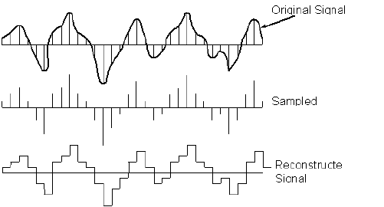


WFDB library
Calculation of analog to digital:
(analog * gain) + baseline
Reverse :
(value - baseline) / gain
Source : http://www.azimadli.com/vibman/analogtodigitalconversion.htm
Notes:
the wfdb library converts them from analog to digital with simple algebra from analog to digital, and vice versa, 2 values are required, the gain and baseline and most of files used digital singles using pickle (Pickling is a way to convert a python object into a character stream)
Due to the large amount of files in the raw data set (about 500 MB in total), the next step is parsing the data. Since we currently only need the ECG recording, lead type, annotations, and a few other values for digital-raw (and vice versa) conversion, we create a custom file that contains all of the information above. With this file, we reduce the size from about 500 MB to 44 MB.

Slide 7
Data Extraction
It is the act of processing the retrieved data from the data set for analysis.
Data which is extracted can be labeled or unlabeled.
Classification models require you to label your training set before you train it
Data may also contain formatting or just be raw digit values.
Features must be selected from extracted data.
Notes:
It the process that

Slide 8
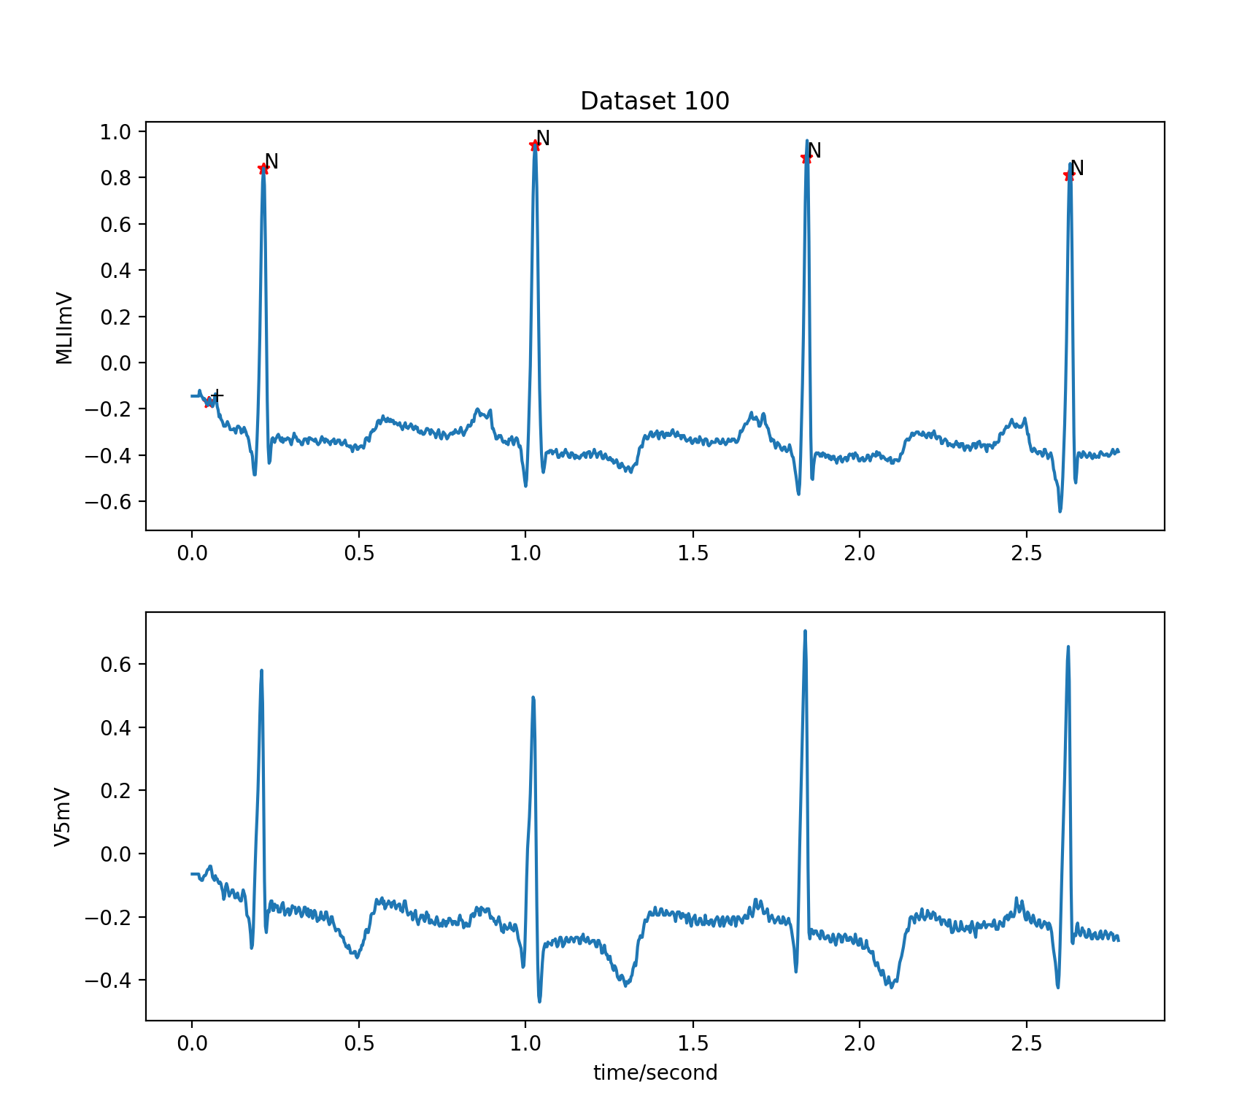
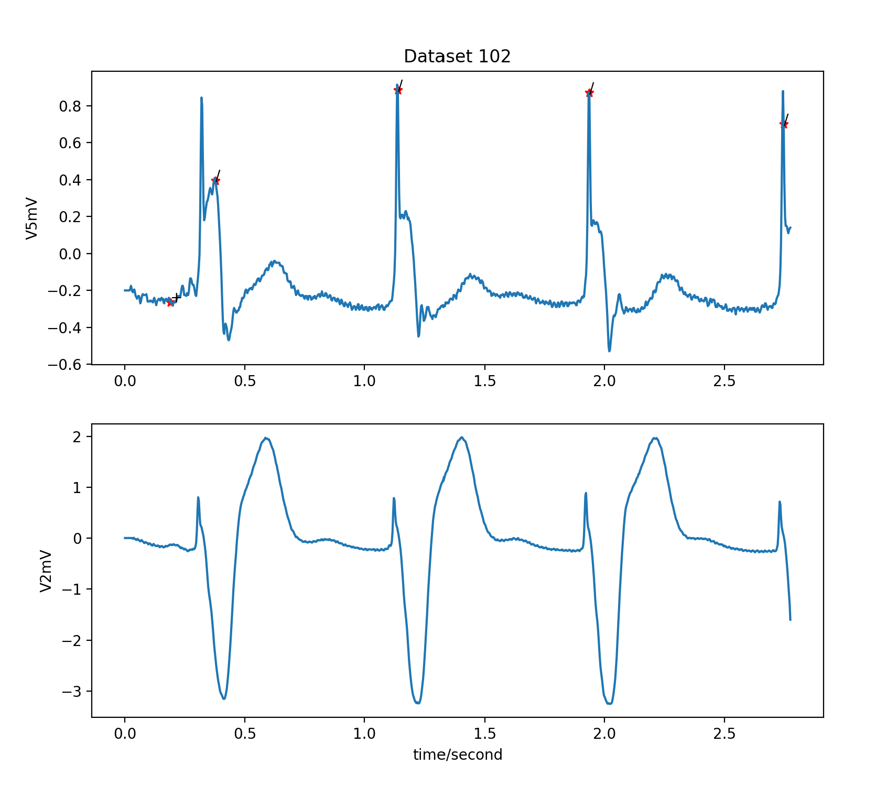
Heartbeat Data
We first visualized the data by graphing the waveforms produced by the heartbeat.
Notes:
Some of the Lead types are MIL = right arm
V5,V4,V2 and V1 = left side of the body and used sklearn matplot to visualize each the type to better understand the behaviour of the signal over time in seconds

Slide 9
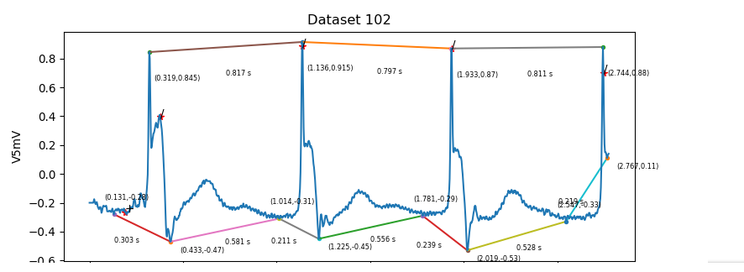
Heartbeat Data with peak
Later we annotated the graphs to give visualization of potential data points to work with the SVM model.
Notes:
the raw data contains timestamps of noteworthy rhythms. Most are located at the peak of a beat. We take advantage of this and parse our data into 1-second chunks, with the peak of the noteworthy beat at the center. With this, we have approximately 220000 1-second samples, each labeled with the respectively rhythm type.

Slide 10
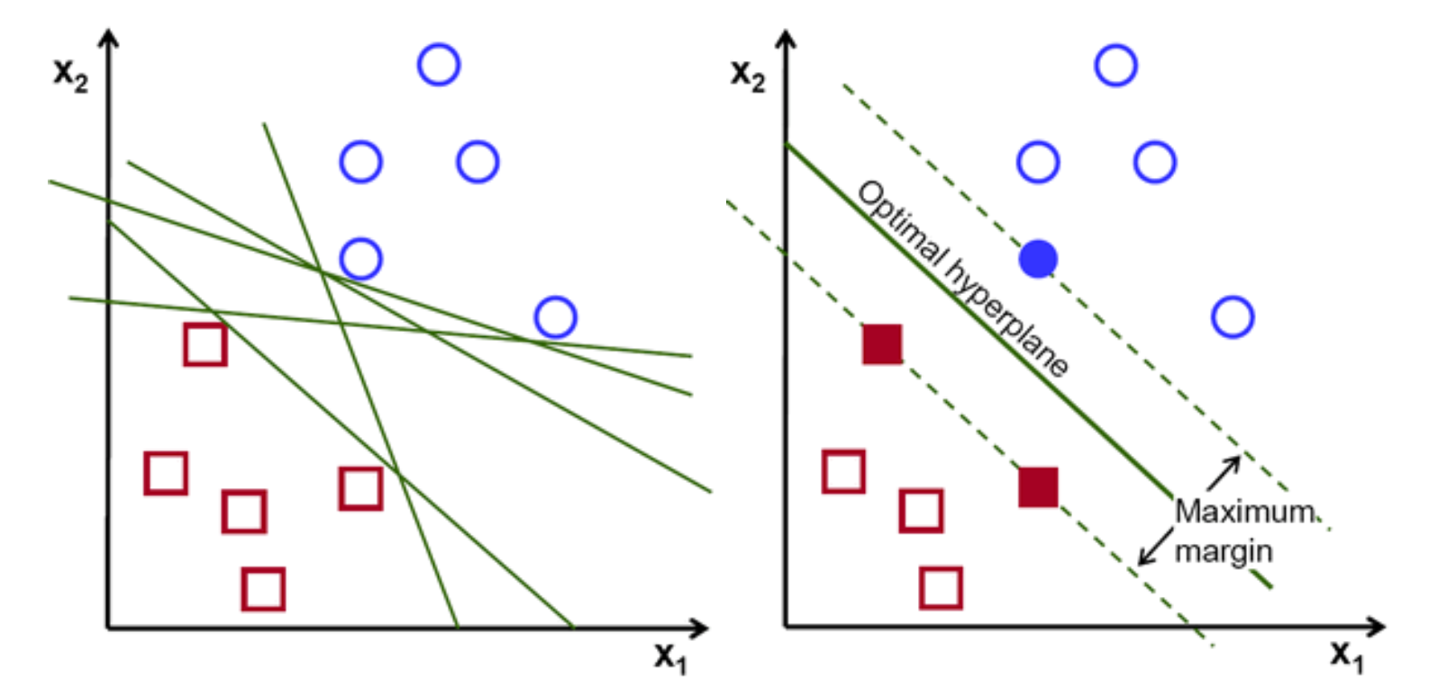
SVM
The objective of the support vector machine algorithm is to find a hyperplane in an N-dimensional space(N — the number of features) that distinctly classifies the data points.
Our goal of SVM was to get an understanding of machine learning on the dataset and what possible features should be selected using the SVM model
Notes:
Support Vector Machine as a baseline algorithm due to it’s ease of implementation and it’s ability to be used for classification and regression.

Slide 11
SVM Data Extraction
The data and annotations were extracted from the wfdb waveform sets
For each sample pulled from a specific dataset, that sample was annotated by associating 360 data values pulled from the file based around the sample number with the same annotation label extracted.
Each sample would therefore become a feature with a length of 360 data values, and each dataset would have as many features as samples.
Datasets would be compared by checking for similar features relative to the annotation given to it.
A classification can therefore be predicted by taking an unlabeled set and comparing all its features to other sets to determine what would be the proper annotation.

Slide 12
Neural Network
Once we gained an understanding of machine learning on the dataset and how feature extraction is handled we moved to neural networks.
Neural networks are a set of algorithms, modeled loosely after the human brain, that are designed to recognize patterns.
The neural networks we used predicted the dataset by repeatably going through the system, testing different iterations as it does, and then comparing the results accumulated over a set of trials.
By running the network on the dataset, it can fairly accurately predict classification values by recognizing which set of features pair to a specific annotation.

Slide 13
Neural Network
Our goal was to evaluate a set of neural networks to determine which one provides the most accurate classification percentage.
Neural network models can work differently depending on how the network is set to handle the data.
Some might predict using large sample sizes, but fewer test cases, while another might predict by being optimized differently.
The order of the Keras layers, a neural network library, can also change the result.
As this was the case, we had to test similar, but different values, for the networks that we ran.
The models we worked with were CNN, cDNN, and RNN.

Slide 14
Network Details
1. Convolutional Neural Network (CNN) takes an input and runs the input through multiple convolutional layers where each layer is connected to the next. CNN essentially acts as a fully connected network in a linear manner.
2. cDNN generates a neural network model, which in itself is built using mini neural networks, for each trial and attempts to fit the input for that trial to the model generated. It then combines those values into a main dense neural network.
3. Recurrent Neural Network (RNN) creates a set of layers, and forms a directed graph between them, then takes an input and runs it through the graph until it reaches the end. RNN allows for dynamic processing.

Slide 15
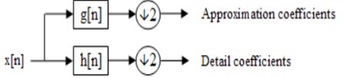
cDNN with Discrete Wavelet Transform
Splits an input into multiple sub-inputs to test individually.
Uses a neural network so that each input is given its own neural network that works independently of each other.
Combines them all afterwards to go through dense layers.
Used to perform detailed learning on the wfdb waveforms to accurately interpret the data.

Slide 16
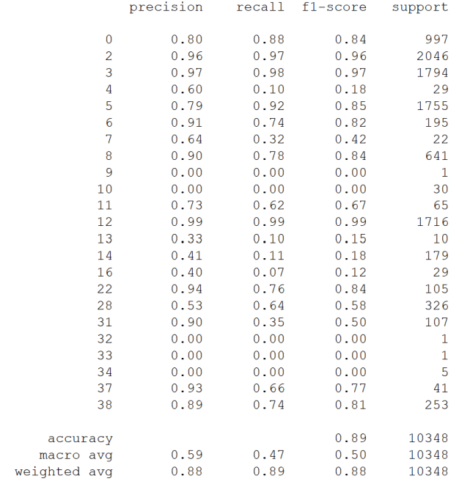
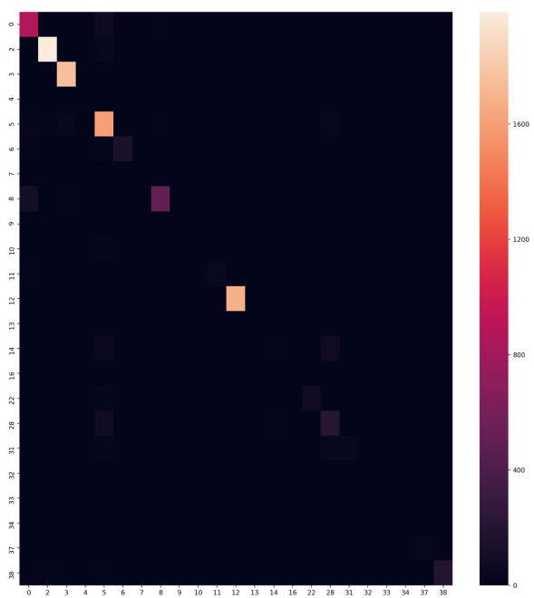
Results from the SVM Model
The results we got from the SVM model returned an accuracy of 89% correct classification results. The confusion matrix generated, which shows the density of correct vs incorrect results, shows that most classifications reside on the 'correct' diagonal line, where the brighter colors contain more total values.
Notes:
So these are our results from the SVM model, it returned an accuracy of 89% correct classification results.
This confusion matrix shows the density of correct vs incorrect results. Most classifications are on the correct diagonal line,
And the brighter colors represent higher counts of values.

Slide 17
Neural Network Results
Most neural networks, depending on the test values, could give an accuracy value greater than the SVM model for some of its trials.
However, some models, resulted in a final accuracy that was less than the SVM model for some of its test values.
CNN using 10 K-Folds (trials) and 20 epochs resulted in a final accuracy of approximately 78 percent.
After evaluating each model, is was seen that the cDNN model, which applied Discrete Wavelet Transform to the data, produced accuracy values of greater than 90 percent when running with 100 epochs for both tests performed.
We eventually came to the conclusion that Learn Wavelet Transform produced the most accurate result.
Notes:
As for our neural network results...
Most neural networks were able to give accuracy rates higher than the SVM model, depending on the test values.
But some tests yielded final accuracy that was lower than the SMV model. For example, the CNN model using 10 K-folds and 20 epochs resulted in a final accuracy of only 78%.
After evaluating each model, we concluded that the cDNN model, aka Discrete Wavelet Transform, provided the highest accuracy on the data.

Slide 18
Results
Discrete Wavelet Transform produced accuracy values of 90 percent or greater for three of the four test cases ran at 100 epochs.
Lower epochs produced lower results, but this was expected as less iterations were performed this way which means the classification was less sensitive.
 | adam 2 | adam 39 | adadelta 2 | adadelta 39
Trial 1 | Loss: 0.411 Acc: 0.947 | Loss: 0.920 Acc: 0.922 | Loss: 0.252 Acc: 0.909 | Loss: 0.622 Acc: 0.842
Trial 2 | Loss: 0.356 Acc: 0.950 | Loss: 1.143 Acc: 0.924 | Loss: 0.261 Acc: 0.906 | Loss: 0.590 Acc: 0.855
Trial 3 | Loss: 0.447 Acc: 0.952 | Loss: 1.114 Acc: 0.926 | Loss: 0.241 Acc: 0.911 | Loss: 0.593 Acc: 0.856
Trail 4 | Loss: 0.319 Acc: 0.958 | Loss: 1.124 Acc: 0.920 | Loss: 0.272 Acc: 0.900 | Loss: 0.655 Acc: 0.835
Trail 5 | Loss: 0.370 Acc: 0.959 | Loss: 0.977 Acc: 0.925 | Loss: 0.261 Acc: 0.901 | Loss: 0.615 Acc: 0.842
Avg. | Loss: 0.38 Acc 95.30 | Loss: 1.06 Acc 92.34 | Loss: 0.26 Acc 90.54 | Loss: 0.62 Acc 84.64
Notes:
This is a table showing the results we recorded using Discrete Wavelet Transform.
It produced accuracy values of 90 percent or greater for three of four test cases at 100 epochs.
Using lower epochs resulted in lower accuracy, which is an expected result.

Slide 19
Conclusion
Of the five models tested on the MIT dataset, cDNN with Discrete Wavelet Transform was able to produce the most accurate consistent final results.
Possible future classification could be done using the model.
Testing compared to even more models could be performed.
Our results helped the master students decide on possible progression with their own part of the research.
The decided model could potentially predict the actual dataset when it is available to be tested.
Notes:
Overall, we found that cDNN using Discrete Wavelet Transform produced

Slide 20
Any Questions?

Slide 21
Works Cited
Alal, Ethar. “What component in a computer plays the role of an analog to digital converter for electricity that is coming out of the wall socket?” Quora. 29 Dec, 2016, https://www.quora.com/What-component-in-a-computer-plays-the-role-of-an-analog-to-digital-converter-for-electricity-that-is-coming-out-of-the-wall-socket
Ippolito, Pier Paolo. “SVM: Feature Selection and Kernels.” Medium, Towards Data Science, 12 Sept. 2019, towardsdatascience.com/svm-feature-selection-and-kernels-840781cc1a6c.
“Discrete Wavelet Transform.” Wikipedia, Wikimedia Foundation, 22 Apr. 2020, en.wikipedia.org/wiki/Discrete_wavelet_transform.

