Slide 1
Data Visualisation Lab 2
Spring 2025

Slide 2
Choropleth
A Choropleth map is a map where geographic regions are shaded or patterned in proportion to a data variable. It's commonly used for visualizing data distributions such as population density, income level etc.

Slide 3
It visualizes quantitative data for specific regions using varying colors or patterns.
Regions can represent countries, states, districts, or any geographic boundary.
When you want to show geographic distribution or variation of data.
Suitable for normalized data (e.g., population per square kilometer, percentage of literacy).

Slide 4
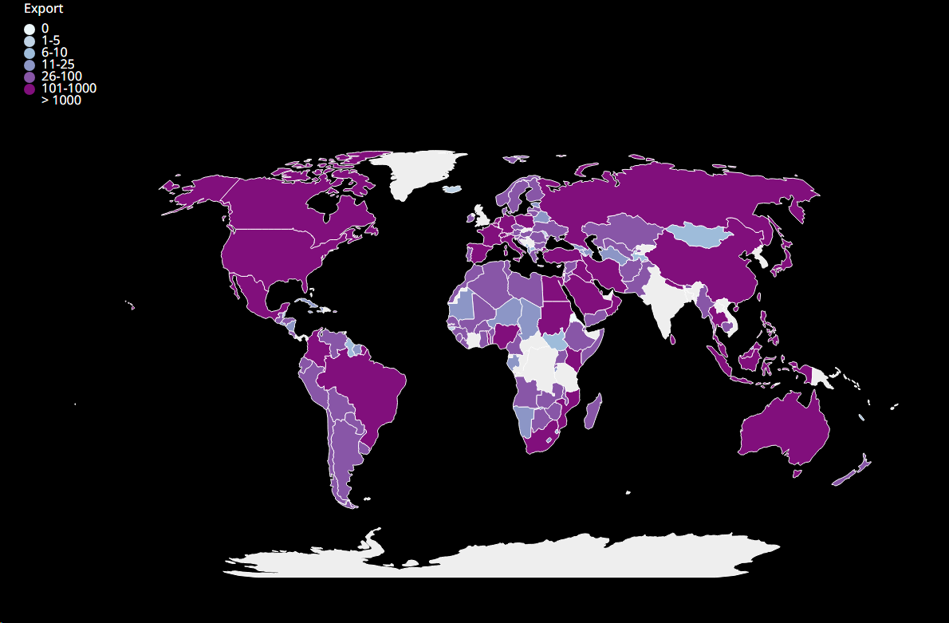
Q1
Choropleth chart :
Data: data.csv (shows total export and import with India over the years)
Create a world choropleth graph for the 2019-2020 fiscal year .
Allow the user to choose between export and import using a slider/radio button , and display the data chosen.
(Bonus) highlight the country on hovering

