Slide 1

FLIPKART MOBILE ANALSIS
USING
WEB SCRAPING
CHERUKU SRAVANI
BATCH NO: 546

Slide 2
About me
Why you want to learn Data Analyst
I enjoy working with data and finding patterns that help solve problems. Data analytics combines logical thinking, technology, and business understanding, which makes it an interesting career for me. I like turning raw data into meaningful insights that can support better decision-making
Background :(B-tech )[ANUBOSE INSTITUTE OF TECHNOLOGY]
Share your LinkedIn and GitHub profile URLs
linkedin.com/in/cheruku-sravani-103349404

Slide 3
Agenda
Business Problem
Business Problem Statement
Introduction
Analysis
Insights
Conclusion
Recommendation

Slide 4

Business Problem
Online shopping platforms offer many mobile brands and models.
Comparing prices and specifications manually takes time.
Customers need an easier way to compare mobile features and prices.
Data analysis helps identify useful patterns in the collected data.

Slide 5
BusinessProblemStatement
The main objective is to collect mobile phone data from Flipkart and analyse it to understand brand distribution, mobile prices, and the relationship between specifications and prices.
Key questions:
Which brands appear most frequently in the dataset?
What is the distribution of mobile prices?
Is there a relationship between RAM and price?

Slide 6
Introduction
This project uses web scraping to collect mobile product information.
Selenium is used for browser automation and data collection.
Pandas is used for data cleaning and preparation.
Matplotlib and Seaborn are used to create visualisations.
Exploratory Data Analysis (EDA) helps understand the dataset.

Slide 7
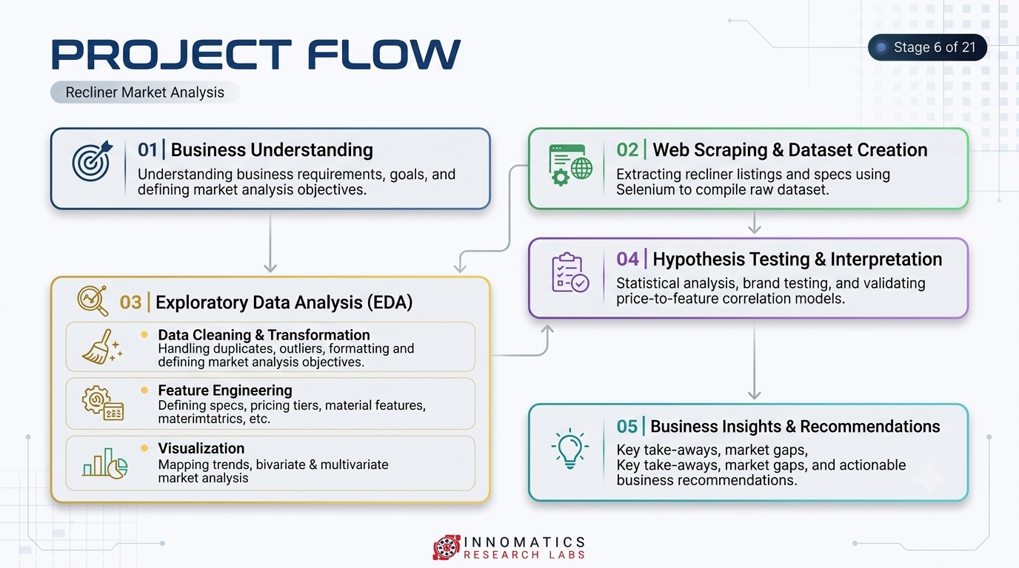

Slide 8
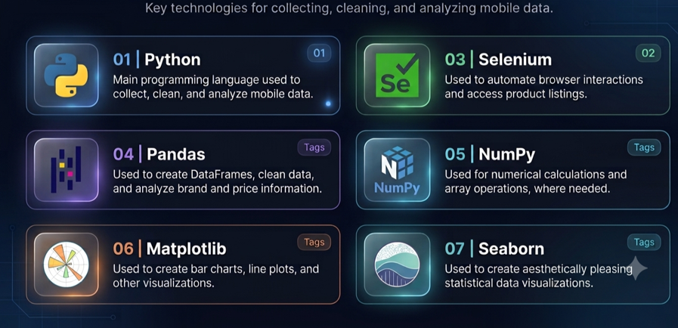
Tools and Technologies
Tool | Purpose
Python | Programming
Selenium | Collecting website data
Pandas | Data cleaning and analysis
NumPy | Numerical operations
Matplotlib | Creating charts
Seaborn | Statistical visualizations
Jupyter Notebook | Writing and running code

Slide 9
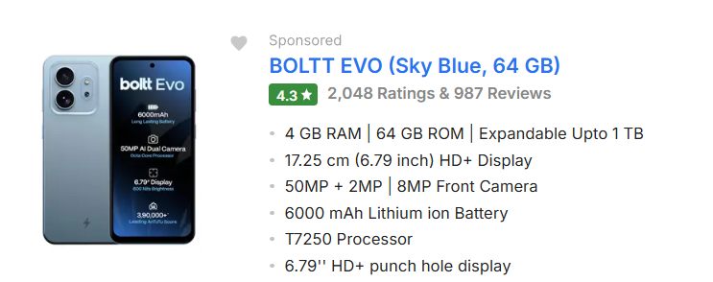
Data Collection and Dataset
Source: Flipkart mobile listings.
Method: Selenium web scraping.
Dataset: 9 columns.
Examples: Brand, model, RAM, ROM,processor, camera, battery, price, and ratings.

Slide 10
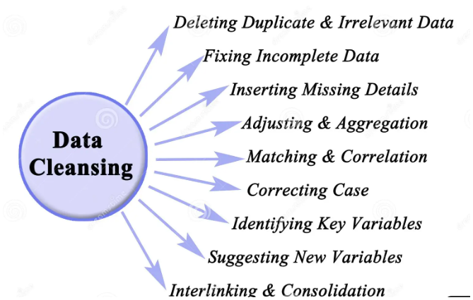
Data Cleaning and Preprocessing
After collecting the data, I checked for missing values and duplicate records. I also checked the data types and cleaned the price and specification columns.
Data cleaning is important because incorrect or incomplete data can affect the analysis results.

Slide 11
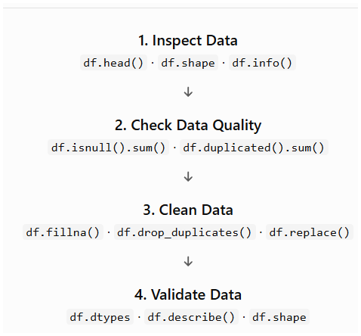
Data Inspection Functions
df.head() – Displays the first 5 rows.
df.tail() – Displays the last 5 rows.
df.shape – Shows the number of rows and columns.
df.columns – Displays all column names.
df.info() – Shows data types and non-null counts.
df.dtypes – Displays data types of each column.
df.describe() – Provides a statistical summary.
Missing Values & Duplicates
df.isnull().sum() – Counts missing values.
df.isna().sum() – Checks missing values.
df.notnull().sum() – Counts non-missing values.
df.dropna() – Removes rows with missing values.
df.fillna() – Fills missing values.
df.duplicated().sum() – Counts duplicate rows.
df.drop_duplicates() – Removes duplicate rows.

Slide 12
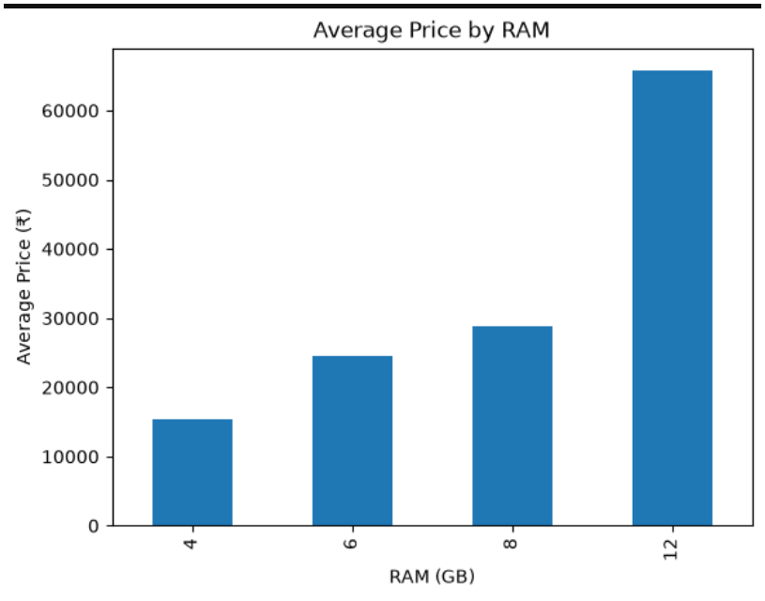
Univariate Analysis
Univariate analysis means analyzing one variable at a time. In my project, I analyzed mobile prices using a histogram and compared mobile counts by brand using a bar chart
1. Mobile Price Distribution
Used a histogram to analyze mobile prices.
Observed the distribution of mobile prices across different price ranges.
2. Number of Mobiles by Brand
Used a bar chart to count mobiles by brand.
Compared the number of mobile listings for each brand.
Conclusion: Univariate analysis helped me understand individual variables in the mobile dataset.

Slide 13
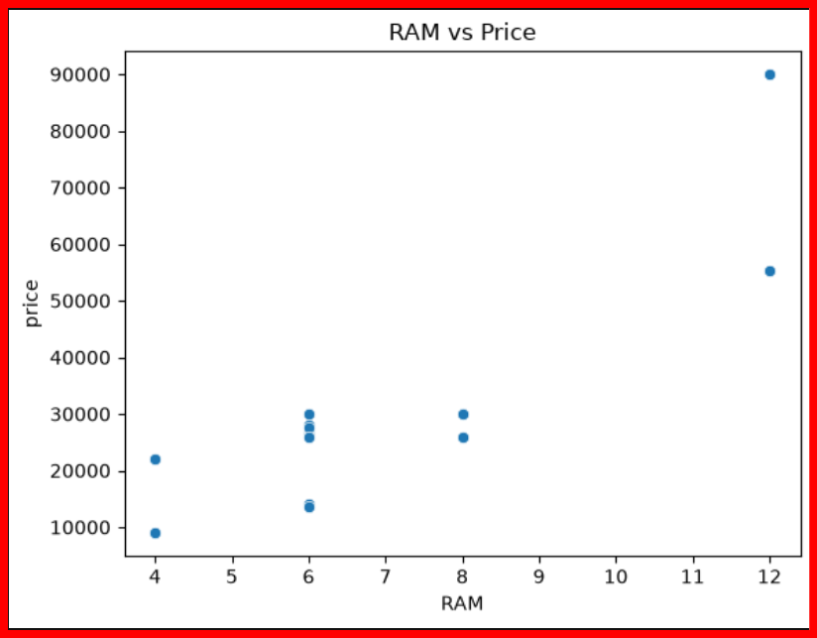
Bivariate Analysis
1. Price vs RAM
Compared mobile prices with RAM capacity.
Identified the relationship between RAM and price.
2. Price vs Rating
Compared mobile prices with customer ratings.
Observed how prices vary across different ratings.
Conclusion: Bivariate analysis helped me understand the relationship between two variables.

Slide 14
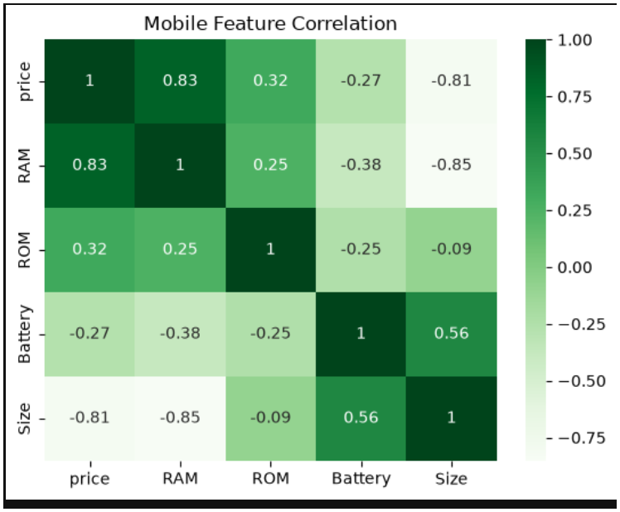
Multivariate Analysis
Analyzed multiple mobile features together.
Compared RAM, storage, and price.
Studied relationships among mobile specifications.
Considered phones priced up to ₹30,000.
Conclusion: Multivariate analysis helps understand how multiple variables relate to mobile prices.

Slide 15
Insights
From my brand analysis, Samsung has the highest number of mobile listings in my dataset, followed by Oppo and Vivo.
I also analyzed mobile price distribution and the relationship between RAM and price.
The charts helped me understand the patterns in the collected data. The exact results depend on the values in my dataset.

Slide 16
Conclusion
Collected mobile phone data from Flipkart using Selenium.
Cleaned and analyzed the dataset using Python and Pandas.
Used charts to understand mobile prices and brand distribution.
Compared mobile features such as RAM, storage, battery, and price.
The analysis helps users compare mobile phones and understand the available options under ₹30,000.

Slide 17

THANK YOU

