Slide 1

Worldwide Energy Consumption
CHERUKU SRAVANI
Batch no : 546

Slide 2
About me
Background? (B-tech or M-tech): B-tech
Why you want to learn Data Analytics
I enjoy working with data and finding patterns that help solve problems. Data analytics
combines logical thinking, technology, and business understanding, which makes it an
interesting career for me. I like turning raw data into meaningful insights that can
support better decision-making.
Share your LinkedIn profile URL
linkedin.com/in/cheruku-sravani-103349404

Slide 3
Agenda
Business Problem
Business Problem Statement
Introduction
ER Diagram
Analysis Queries
Insights
Conclusion
Recommendation

Slide 4
Business Problem
With increasing industrialization, economic growth, and population expansion, global energy demand has risen significantly, leading to higher carbon emissions and environmental concerns.
Countries differ in their energy production, consumption, GDP, and population patterns, making it challenging to understand their impact on emissions and energy efficiency.
Therefore, there is a need to analyse global energy, GDP, population, and emission data to identify trends, compare countries, and generate insights that support sustainable energy management and environmentally responsible decision-making.

Slide 5
Business Problem Statement
With increasing energy demand and carbon emissions, there is a need to understand the relationship between energy production, consumption, GDP, population, and emissions. Using MySQL, this project analyses global energy data to identify trends, compare countries, and evaluate energy efficiency for sustainable decision-making.
SQL Techniques Used:
Joins: Combine data from multiple tables.
Aggregate Functions: Calculate totals, averages, counts, etc.
GROUP BY: Group similar records together.
ORDER BY: Sort data in a specific order.

Slide 6
Business Problem Statement
CTEs: Temporary result sets for simplifying complex queries.
Subqueries: Query inside another query.
Window Functions: Analyse data across related rows.
LAG(): Access previous row value.
FIRST_VALUE(): Get first value in a group.
LAST_VALUE(): Get last value in a group.

Slide 7
Introduction
This project focuses on analysing global energy production, energy consumption, carbon emissions, GDP, and population data using MySQL. By applying SQL concepts such as Joins, Aggregate Functions, Subqueries, Common Table Expressions (CTEs), and Window Functions, the project aims to uncover trends, compare countries, measure energy efficiency, and derive meaningful insights that support sustainable energy management and data-driven decision-making.
Datasets Used:
Country | Emission
Consumption | GDP
Production | Population

Slide 8
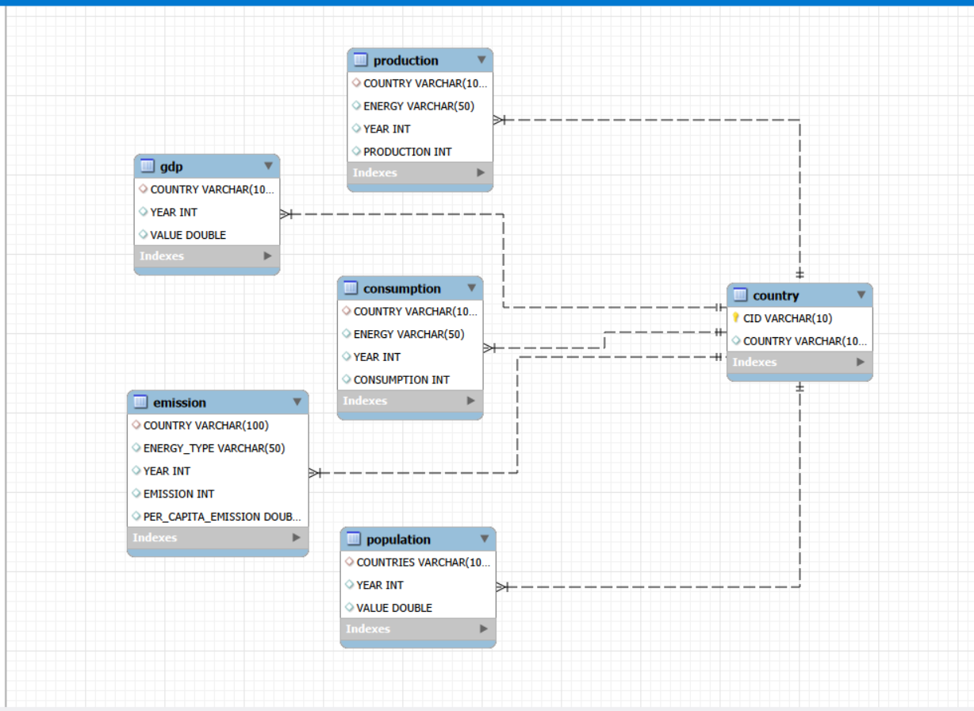
ER Diagram and Cardinality
Cardinality | Explanation
1 : M | Country to Production
1 : M | Country to Consumption
1 : M | Country to Emission
1 : M | Country to GDP
1 : M | Country to Population

Slide 9
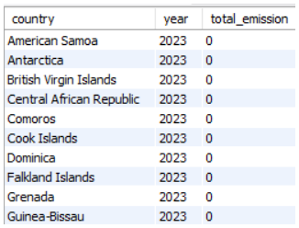
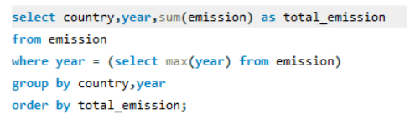
Analysis Queries
Total emission per country for the most recent year?
Purpose: Identify countries with the highest emissions.
Insight: Shows which countries contributed the most emissions in the latest available year.

Slide 10
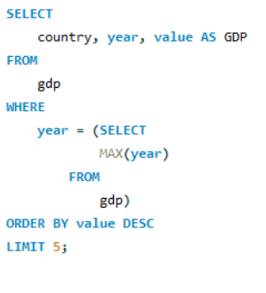
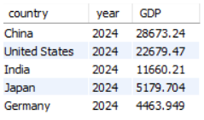
Analysis Queries
Top 5 countries by GDP in the most recent year.
Purpose: Compare the largest economies
Insight: Highlights the countries with the highest GDP in the latest available year

Slide 11
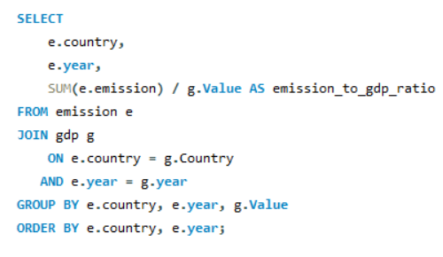
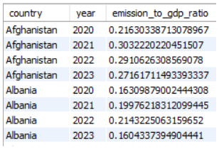
Analysis Queries
How have global emissions changed year over year?
Purpose: Analyze the global emission trend.
Insight: Shows whether global emissions increased or decreased compared with the previous year.

Slide 12
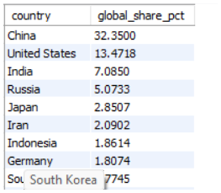
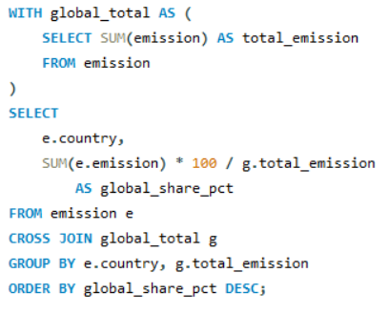
Analysis Queries
What is the global share (%) of emissions by country?
Purpose: Measure each country's contribution to total emissions.
Insight: Shows each country's percentage contribution to overall emissions.

Slide 13
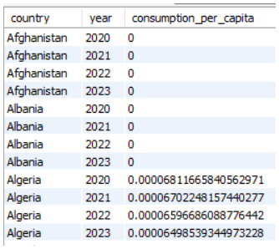
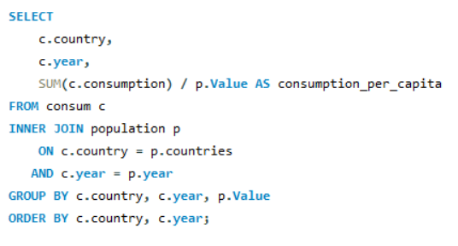
Analysis Queries
Energy consumption per capita for each country by year?
Purpose: Compare energy use relative to population.
Insight: Shows which countries have higher or lower energy consumption per person.

Slide 14
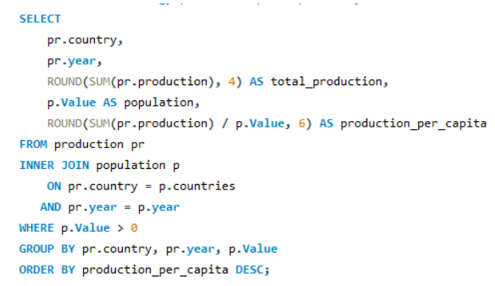
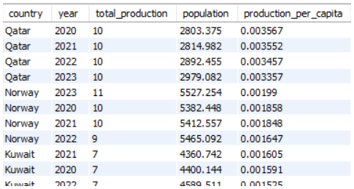
Analysis Queries
How does energy production per capita vary across countries??
Purpose: Compare energy production relative to population.
Insight : Shows differences in energy production per person across countries.

Slide 15
Insights
Carbon emissions are concentrated in a few major economies, making them the largest contributors to global emissions.
Countries with higher GDP generally consume more energy, indicating a positive relationship between economic growth and energy demand.
Energy production and consumption differ across countries, highlighting the dependence of some countries on energy imports.
Population growth influences total emissions, but industrialization and economic activity have a greater impact.
Per-capita analysis reveals differences in energy efficiency, allowing fair comparisons between countries of different sizes.
Several countries have reduced their per-capita emissions over the available years, reflecting improvements in energy efficiency and sustainability.

Slide 16
Conclusion
Successfully analysed global energy production, consumption, carbon emissions, GDP, and population data using MySQL.
Applied SQL techniques including Joins, Aggregate Functions, Subqueries, CTEs, and Window Functions to solve real-world analytical problems.
Identified key trends, compared countries, and evaluated energy efficiency using per-capita and ratio-based analysis.
The project demonstrates how SQL can transform raw data into meaningful insights that support data-driven decision-making and sustainable energy planning.

Slide 17
Recommendation
Promote Renewable Energy: Increase the adoption of renewable energy sources to reduce carbon emissions.
Improve Energy Efficiency: Encourage efficient energy production and consumption to minimize energy wastage.
Adopt Data-Driven Policies: Use data analytics to support energy planning and environmental decision-making.
Focus on Sustainable Development: Balance economic growth with environmental protection by investing in clean technologies.
Monitor Key Performance Indicators: Regularly track emissions, energy consumption, GDP, and population trends to evaluate progress and improve energy policies.

Slide 18

THANK YOU

