Slide 1
🏦
Portuguese Bank
Term Deposit Marketing Campaign Analysis
Exploratory Data Analysis & Key Insights
45,216
11.7%
2008–2010
Total Clients
Subscription Rate
Campaign Period
Banking Industry · Data Science Case Project

Slide 2
Dataset Overview & Key Questions
About the Dataset
Direct marketing campaign data from a Portuguese bank (May 2008 – Nov 2010). Goal: predict if a client will subscribe to a term deposit (variable y). Data includes demographics, financial profile, and campaign interaction details.
📋 Client Variables
📞 Campaign Variables
▸ Age, job, marital status, education
▸ Last contact: day, month, duration
▸ Account balance, housing & personal loans
▸ Number of campaign contacts
▸ Credit default status
▸ Days since previous campaign contact
▸ Contact type (cellular / telephone)
▸ Previous campaign outcome → y (target)
⚠ Class Imbalance: Only 11.7% of clients subscribed — making precise targeting critical for campaign ROI

Slide 3
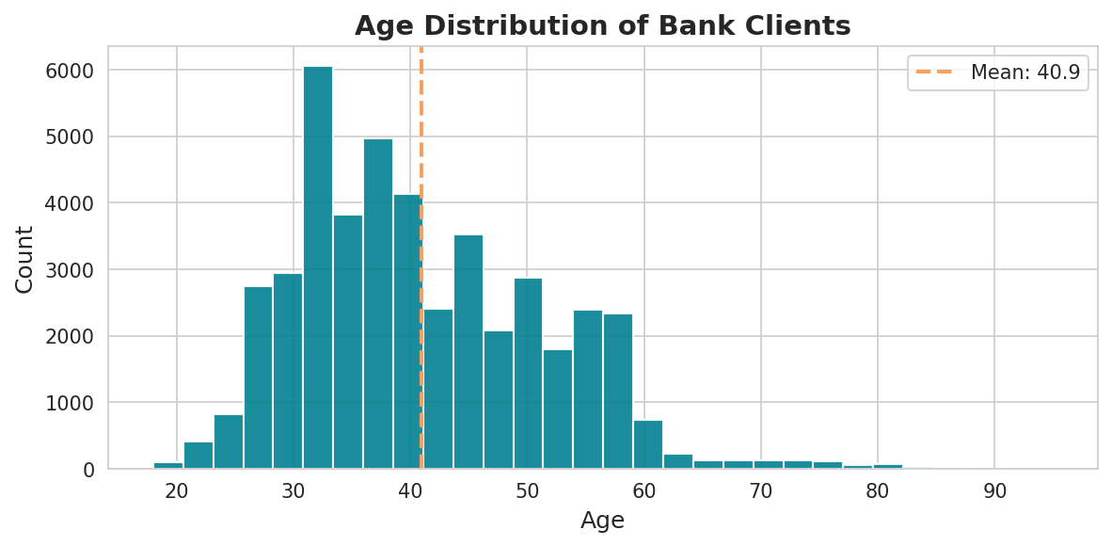
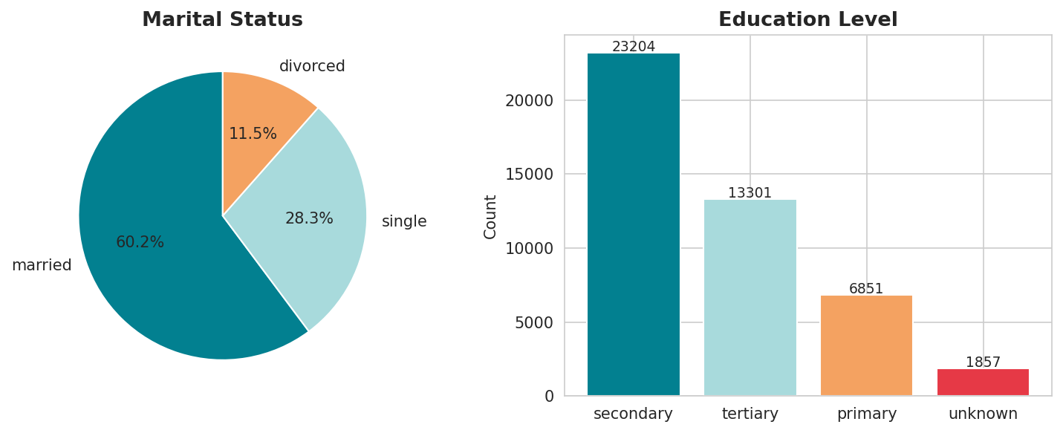
Client Demographics
Key Demographics
• Age range: 18–95 years
• Largest group: Blue-collar (21.5%)
• 60.3% of clients are married
• 51.3% have secondary education
• Singles convert 49% more than married
• Tertiary educated: 15% conversion
Age Distribution (Mean: 40.9 yrs)
Marital status & education distribution

Slide 4
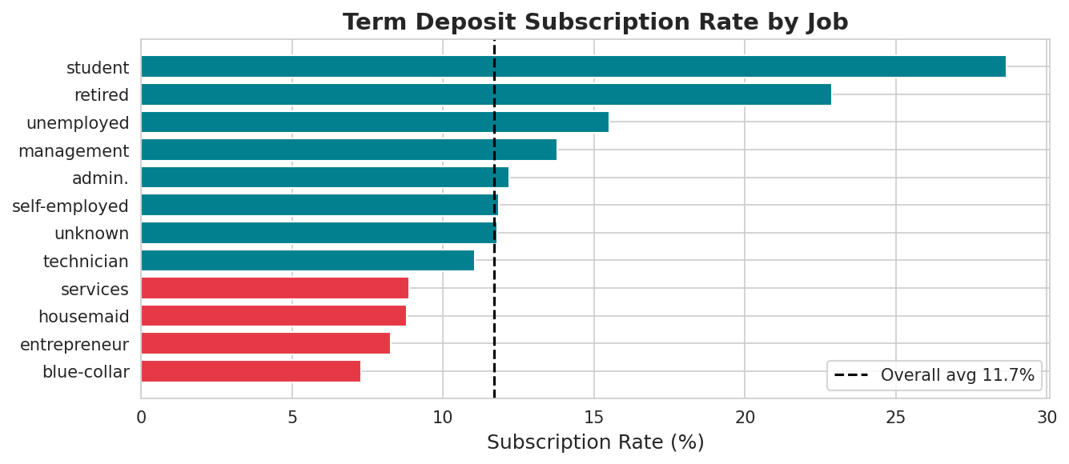
Subscription Rate by Occupation
Top Performers
Student
28.7%
Retired
22.9%
Unemployed
15.5%
Management
13.8%
Admin
12.2%
💡 Students & retirees convert at 2–3× the average rate — highest-priority target segments
Bottom Performers
Blue-collar: 7.3%
Entrepreneur: 8.3%

Slide 5
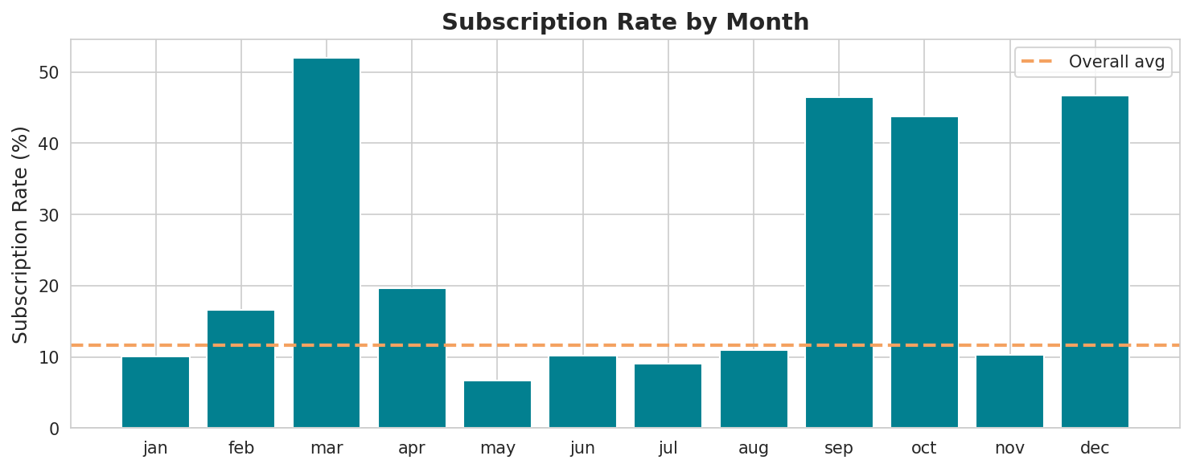
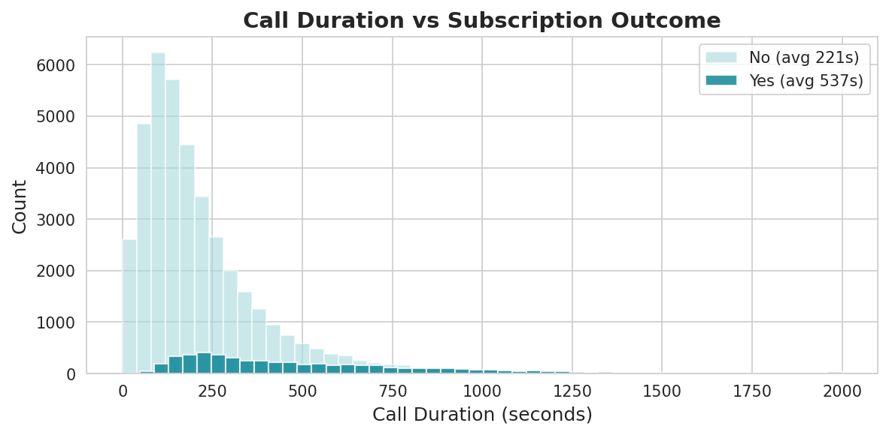
Campaign Timing & Call Analysis
Monthly conversion rates — Mar/Sep/Oct/Dec far outperform the rest
Call Duration Insight
✓ Subscribers: avg 537 sec (~9 min)
✗ Non-subscribers: avg 221 sec
📊 Correlation with y: 0.394
💡 Strongest single predictor!

Slide 6
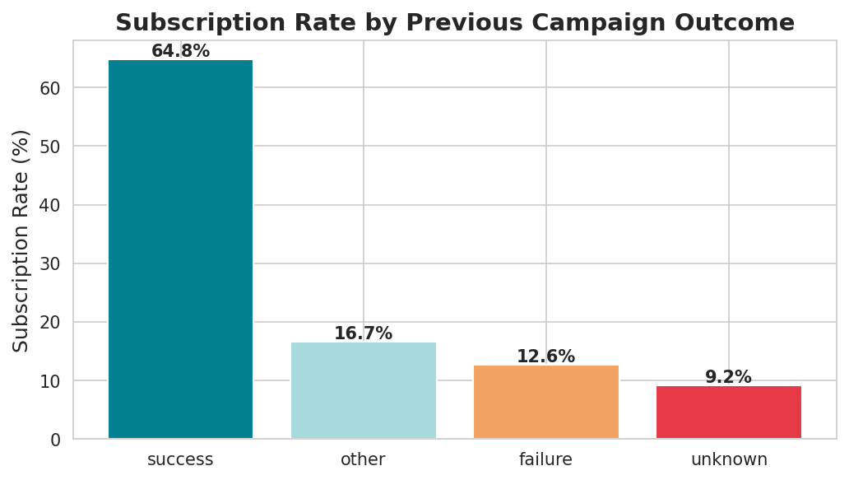
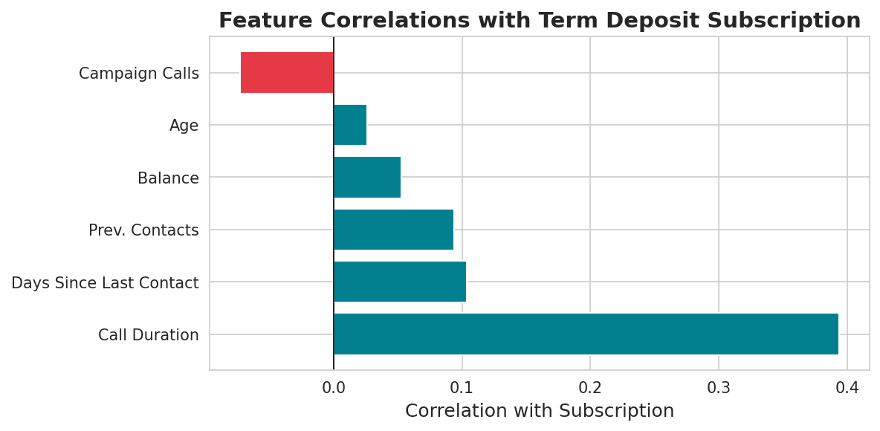
Behavioural Predictors of Subscription
64.8%
Conversion rate for clients who
succeeded in a previous campaign
vs. 9.2% for unknown prior outcome
Correlation Summary
Call Duration
+0.394
Days Since Contact
+0.104
Prior Contacts
+0.094
Account Balance
+0.053
Campaign Calls
−0.073

Slide 7
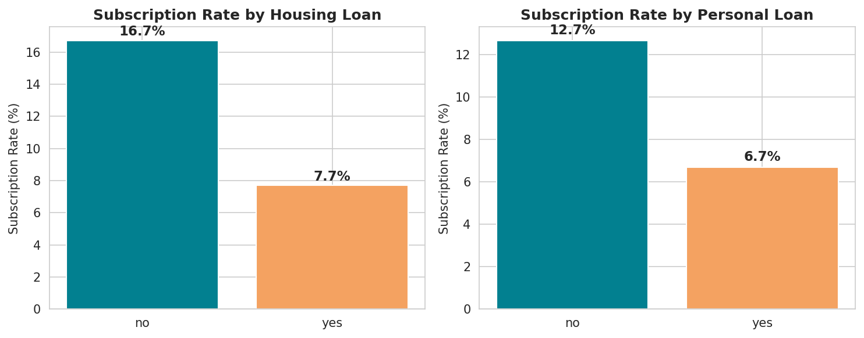
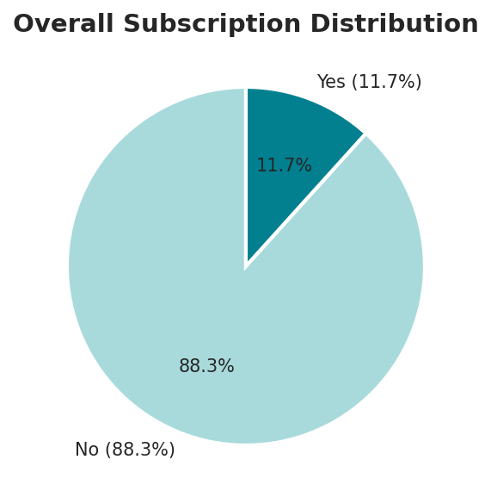
Financial Profile & Loan Impact
Balance Stats
Mean
€1,362
Median
€449
75th pct
€1,428
Min
−€8,019
Max
€102,127
Highly right-skewed:
a few wealthy clients
pull mean above median
Loan Impact on Subscriptions
• Clients WITHOUT housing loan: 16.7% conversion rate
• Clients WITH housing loan: 7.7% conversion rate (−54%)
• Clients WITHOUT personal loan: 12.7% conversion rate
• Clients WITH personal loan: 6.7% conversion rate (−47%)

Slide 8
Key Recommendations
🎯
Re-target Previous Successes
📅
Optimize Campaign Timing
64.8% conversion for prior successes — create a fast-track pipeline
Shift budget to Mar / Sep / Oct / Dec for 2–4× better ROI
📞
Prioritize Cellular Outreach
🧑‍🎓
Target Students & Retirees
14.9% conversion vs 4.1% for unknown — eliminate missing contacts
28.7% and 22.9% rates — most responsive demographic segments
⏱
Monitor Call Duration Live
🚫
Cap Excessive Contacts
Calls over 5 min signal high intent — train agents to maintain quality
More than 2–3 calls per client reduces conversion — implement hard limits
Banking Industry · Case Project · Data Science Analysis of Portuguese Bank Marketing Campaign (45,216 records, 2008–2010)

Slide 9
Thank You
Portuguese Bank — Term Deposit Campaign Analysis
Analysis Summary
45,216 clients analyzed · 11.7% subscription rate · Top predictor: Call Duration (r=0.394)
Best segments: Students & Retirees · Best months: March, September, October, December
Banking Industry · Data Science Case Project

