Slide 1
TASK 4: DASHBOARD DESIGN
Superstore Sales & Financial Dashboard

Slide 2
1. Objective & Dashboard Design
• Create an interactive dashboard for business stakeholders.
• KPIs: Total Sales, Available Profit, Record Count and Average Sales per Record.
• Filters: Category, Region and Segment.
• Charts: Sales by Region, Category and Segment.
• Focus: simple visuals that support business decisions.

Slide 3
2. KPI Snapshot
Based on the supplied CSV after structural cleaning
TOTAL SALES
$2,207,388
AVAILABLE PROFIT
$62,562
RECORDS
9,984
PROFIT ROWS
1,917

Slide 4
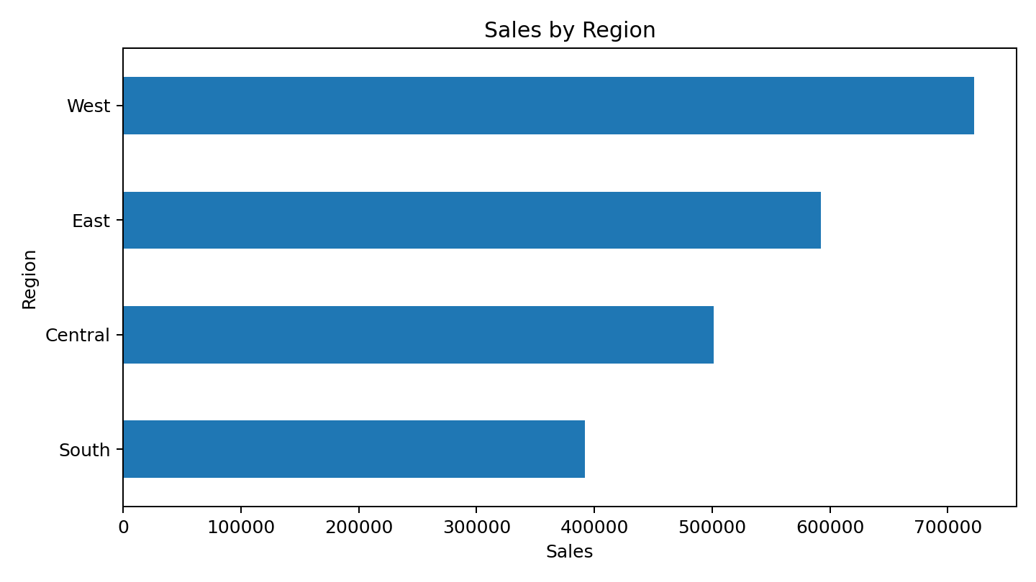
3. Regional Sales Performance
• West is the largest sales region at approximately $722,243.
• East contributes approximately $592,194.
• Regional filters are available in the Excel dashboard.

Slide 5
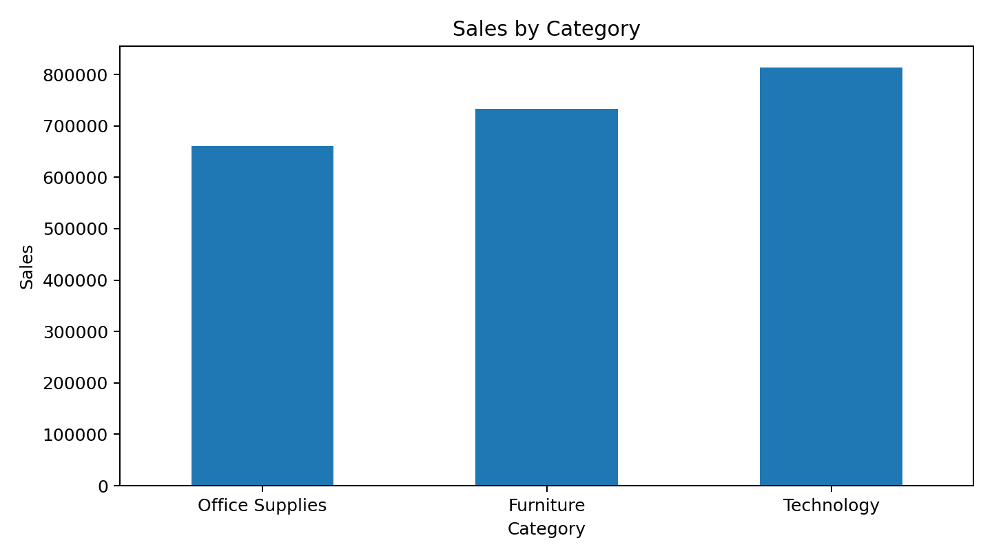
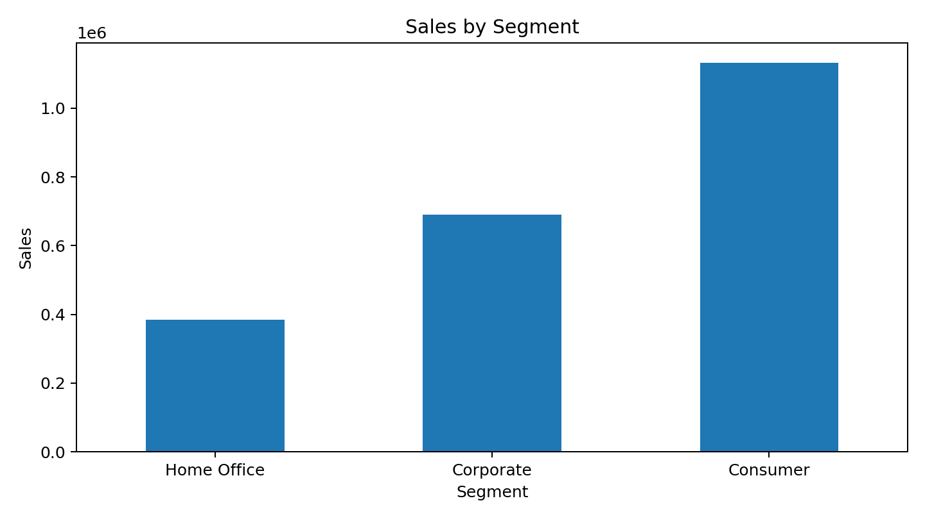
4. Category & Segment Performance
• Technology leads category sales at about $813,992.
• Consumer is the largest customer segment by sales.

Slide 6
5. Key Business Insights
• West is the strongest regional sales contributor.
• Technology is the highest-sales category and deserves strong inventory and cross-sell attention.
• Profit conclusions are directional because many Profit values are missing in the supplied CSV.
• A complete source should be used before making financial decisions based on profit.
• Discount-vs-profit analysis can be added once the complete Profit field is restored.

Slide 7
6. Data Quality & Next Steps
• Raw file rows: 9,994; structurally repaired for dashboard use: 9,984.
• Rows not fully parsed: 10.
• Profit is populated for 1,917 parsed records.
• The supplied file has no Order Date, so a genuine time-series Growth KPI cannot be produced.
• Final step: restore the complete source data, add Order Date, and load the prepared table into Power BI/Tableau.

