Slide 1
Research HUB Ai
CAPSTONE PROJECT
Presented By:
1. Goli Prasanna Sravani-Wesley PG College- MCA

Slide 2
OUTLINE
Problem
Proposed System/Solution
System Development Approach (Technology Used)
Algorithm & Deployment
Result (Output Image)
Conclusion
Future Scope
References

Slide 3
Problem Statement
A Research Agent is an AI system designed to assist with academic and scientific research tasks. It can autonomously search for literature, summarize papers, and organize references. Using natural language processing, it understands research questions and retrieves relevant information. The agent can generate reports, suggest hypotheses. It saves time by automating repetitive tasks like citation management and data extraction. Research Agents enhance efficiency, accuracy, and innovation in both academic and industrial R&D.

Slide 4
Proposed Solution
Research Hub AI is an AI-powered academic assistant built using IBM Watsonx Agent Lab.
Accepts research questions in natural language.
Uses tools like Google Search to find trusted academic content.
Summarizes retrieved content in concise, clear responses.
Provides simulated APA-style citations when asked.
Simplifies research tasks for students, educators, and researchers.

Slide 5
System Approach
Platform: IBM Watsonx Agent Lab
Framework: LangGraph
Architecture: ReAct (Reason + Act)
Tool Used: Google Search (enabled), Custom Instructions
Deployment: Cloud-hosted in IBM Watsonx (Lite plan)

Slide 6
Algorithm & Deployment
Logic Flow:
Input Stage: The user enters a research question in natural language.
Search Stage: The agent uses the Google Search tool to find relevant and trustworthy academic content.
Summarization Stage: The agent processes the retrieved content and presents a concise summary in 2–3 lines.
Citation Stage: If the user asks, the agent generates a simulated APA-style citation based on the result.
Deployment Stage: The project is currently in the Development and Testing phase within IBM Watsonx using Lite services. The agent is deployed in the cloud and tested via the Watsonx Agent Lab interface.

Slide 7
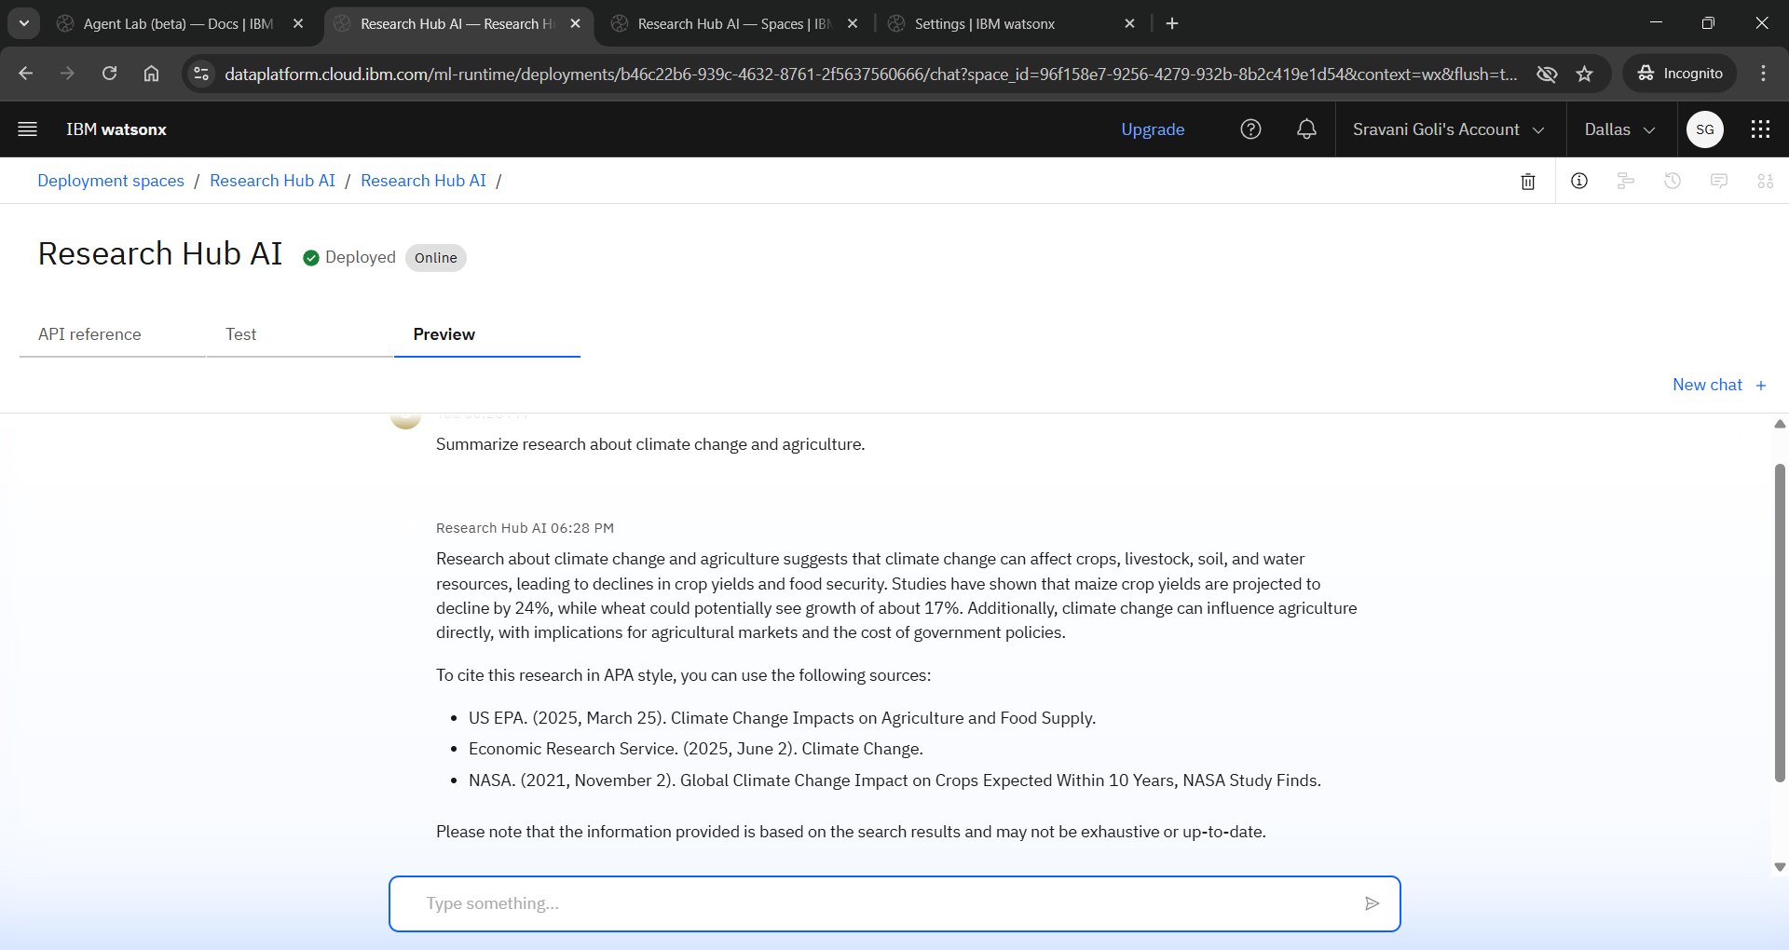
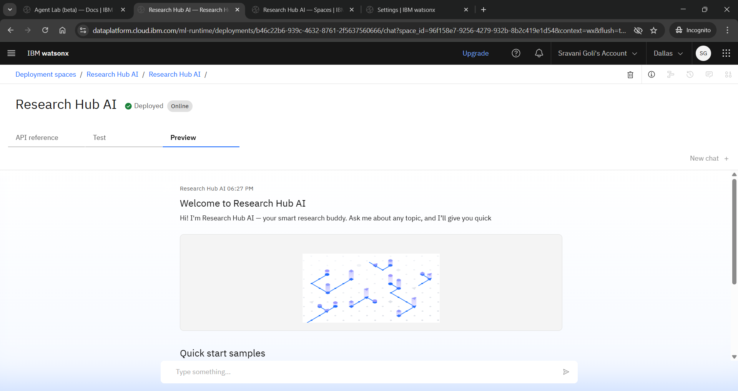
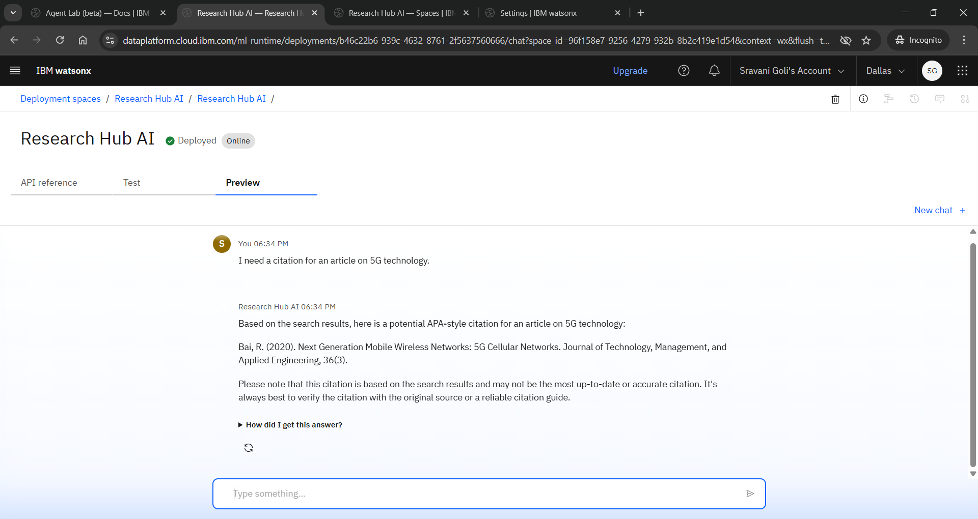
Result

Slide 8
Conclusion
The Research Hub AI successfully simulates the behavior of a smart academic assistant. It enhances the research process by responding to user queries, summarizing relevant content, and offering citation assistance. This project demonstrates how structured tools and predefined logic can simplify academic research for students and educators.

Slide 9
Future scope
Extend the agent’s ability to handle more diverse and complex research questions.
Improve summarization quality using advanced prompt engineering techniques.
Incorporate citation formatting for multiple styles beyond APA (e.g., MLA, Chicago).
Integrate a feedback loop to let users rate summaries and improve future outputs.
Explore multilingual capabilities to support regional academic needs.
Expand into a fully interactive research chatbot platform with document upload support.

Slide 10
References
IBM Watsonx Documentation
Google Search Results
APA Citation Style Guide
Research articles retrieved during testing

Slide 11
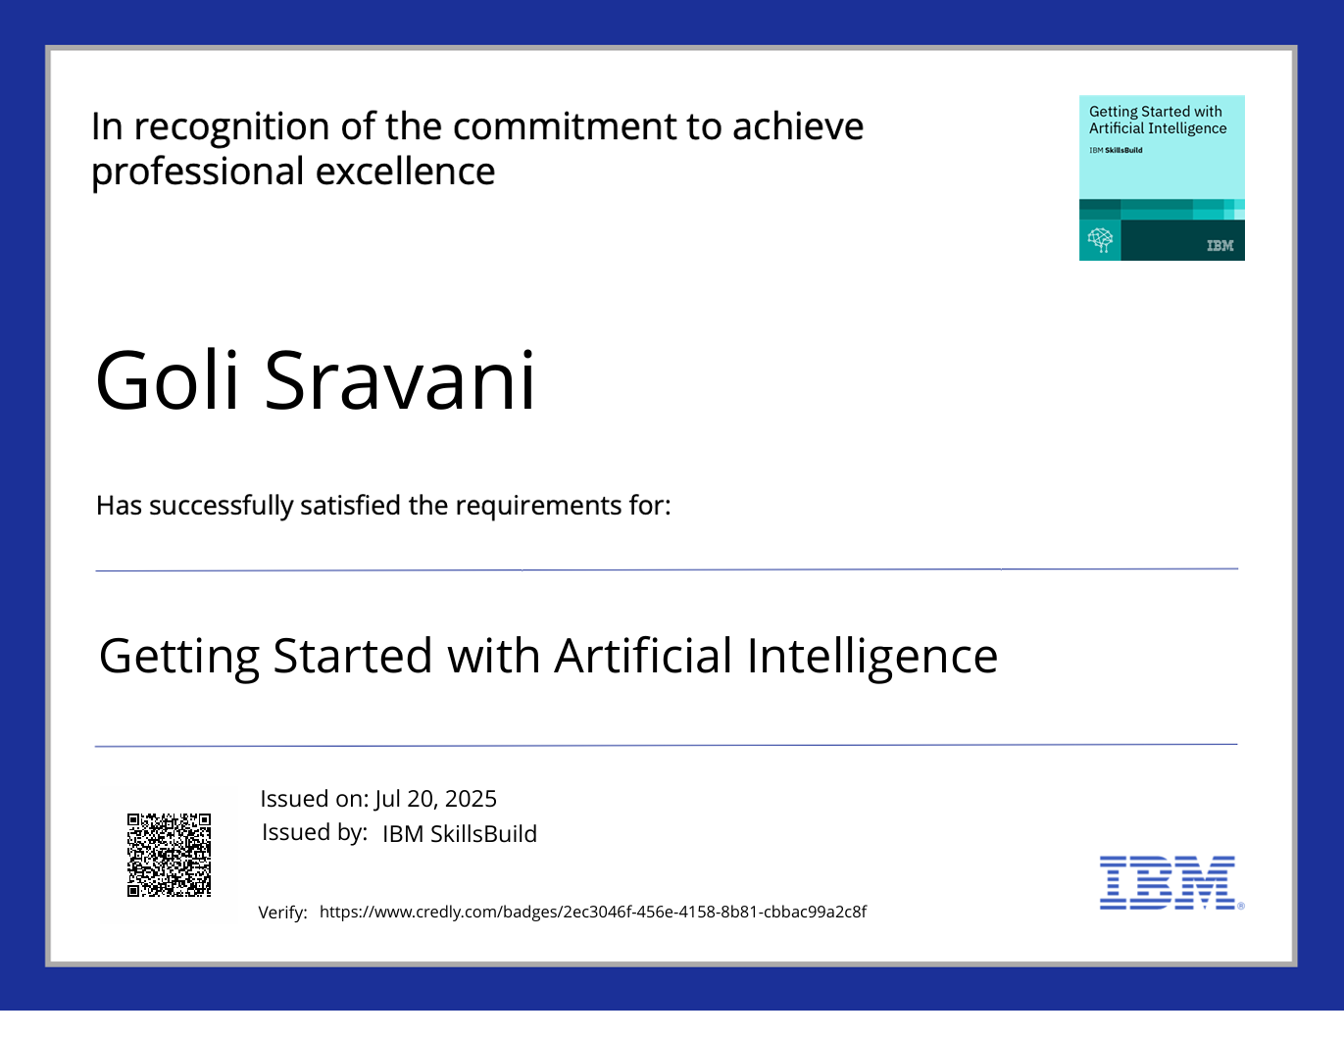
IBM Certifications

Slide 12
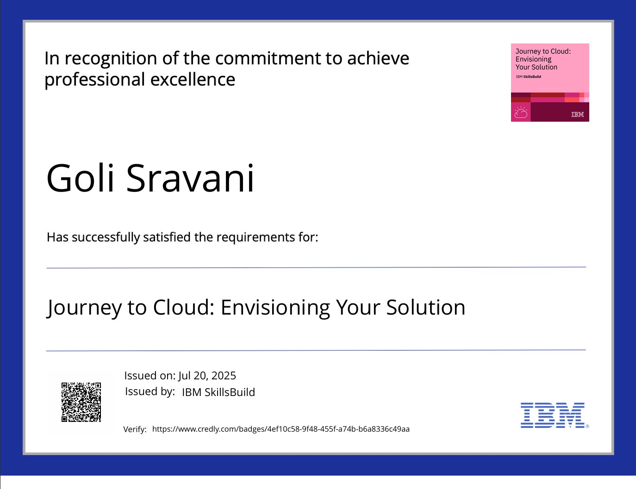
IBM Certifications

Slide 13
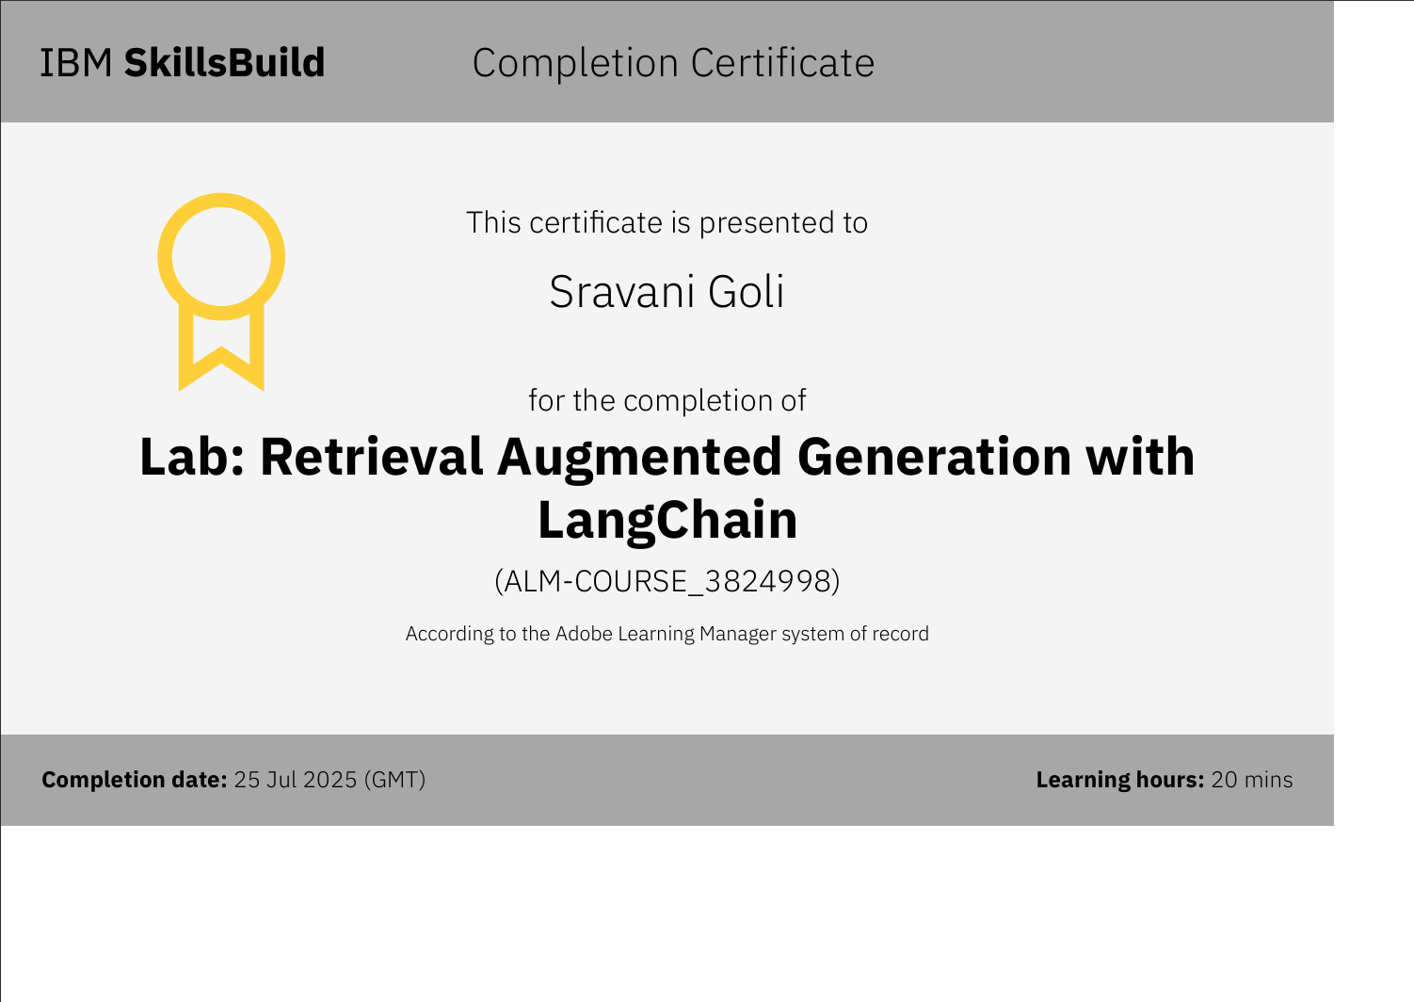
IBM Certifications

Slide 14
THANK YOU

