Slide 1
TASK 4 | DASHBOARD DESIGN
Supermart Grocery Sales\nInteractive Tableau Dashboard & Business Summary
Data Analyst Internship • Dataset period: 2015–2018

Slide 2
Executive Summary
A snapshot of sales performance from the supplied dataset
TOTAL SALES
TOTAL PROFIT
ORDERS
PROFIT MARGIN
₹14,956,982
₹3,747,121
9,994
25.1%
• 9,994 transaction rows across 50 customers and 7 product categories.
• Date coverage: 02 Jan 2015 to 30 Dec 2018.
• Average sales per order: ₹1,497.
• The dataset contains one state (Tamil Nadu); state-level comparisons are therefore not meaningful.

Slide 3
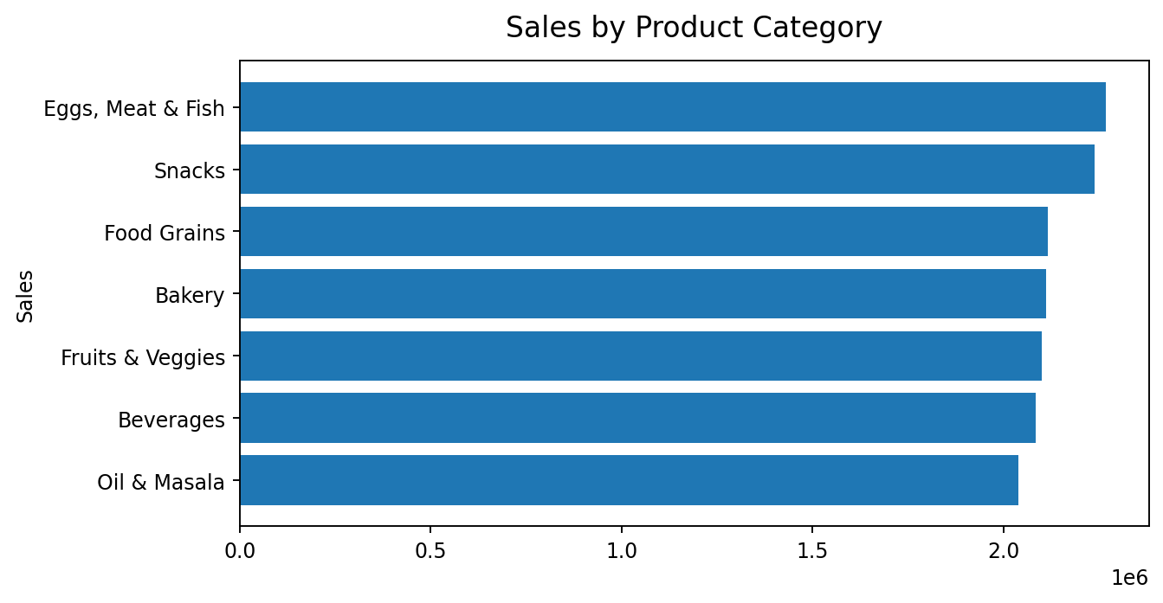
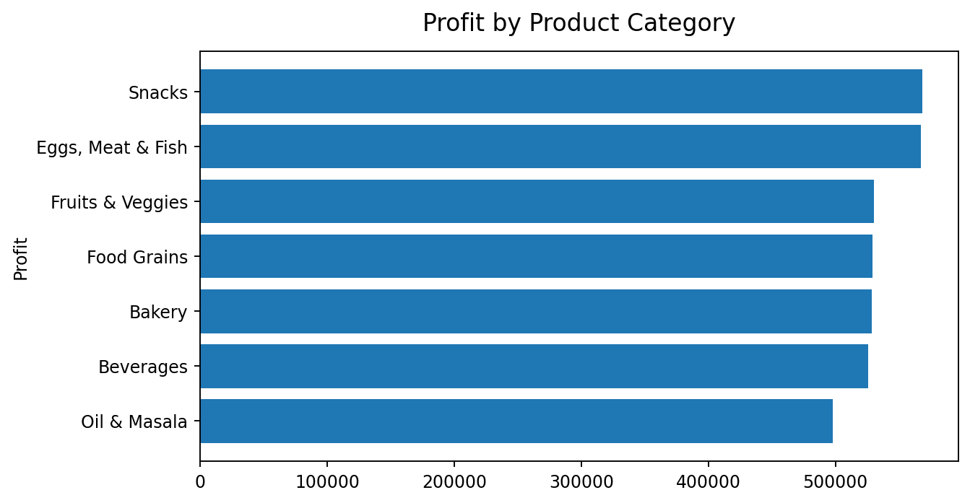
Category Performance
Sales and profit vary modestly across the seven categories
Top sales category: Eggs, Meat & Fish (₹2,267,401) | Highest profit category: Snacks (₹568,179)

Slide 4
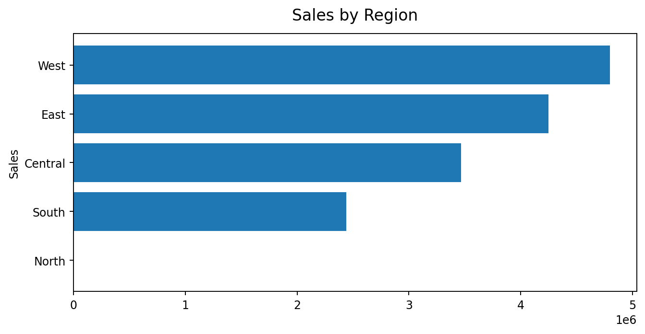
Regional Performance
West and East contribute the largest shares of sales
• West: ₹4,798,743 sales and ₹1,192,005 profit.
• East: ₹4,248,368 sales and ₹1,074,346 profit.
• Central: ₹3,468,156 sales.
• South and North are much smaller in this dataset; North has only one record, so avoid over-interpreting it.

Slide 5
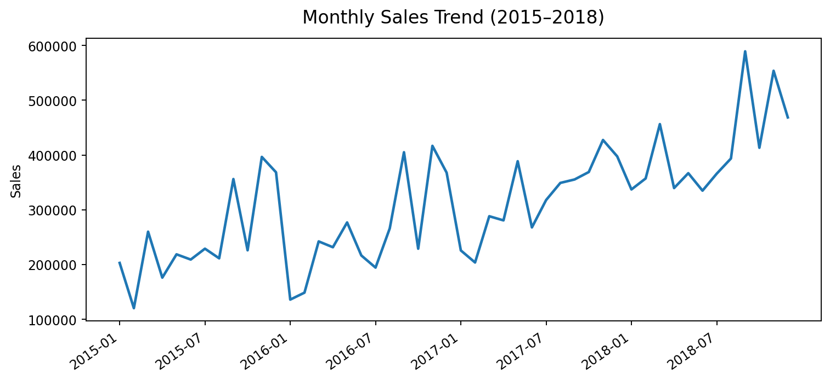
Time-Series Analysis
Monthly sales trend across the available four-year period
Highest monthly sales: 2018-09 (₹589,384). Use year/month filters to investigate seasonal patterns.

Slide 6
Business Insights & Recommendations
Actions suggested by the observed dataset patterns
1. Protect category leaders: Eggs, Meat & Fish has the highest total sales; monitor stock availability and campaign performance.
2. Replicate strong regional practices: West leads sales, followed by East; compare category mix and customer behaviour in these regions.
3. Track profitability, not just sales: overall profit margin is 25.1%; use category and region filters to identify margin differences.
4. Review monthly peaks: compare high-sales months with promotions, inventory and fulfilment data before attributing causes.
5. Improve geographic coverage: the dataset contains only Tamil Nadu, so broader state-level conclusions require more data.
Note: these are descriptive findings; the dataset does not include marketing spend, inventory, or causal variables.

Slide 7
Dashboard Layout & Interactivity
Recommended Tableau dashboard controls and views
KPI cards
• Total Sales
• Total Profit
• Order Count
• Profit Margin
Charts
• Monthly sales trend
• Sales by category
• Profit by category
• Sales by region
Filters / slicers
• Order Date (year/month)
• Region
• Category
• Sub-Category
Interactions
• Filter actions from charts
• Hover tooltips for exact values
• Click-to-filter category/region
• Reset filters control (if available)

Slide 8
Data & Methodology
Based on the supplied Task 4 brief and original spreadsheet
Source: Supermart Grocery Sales dataset supplied with Task 4.
Rows: 9,994 | Columns: 11 | Date range: 2015-01-02 to 2018-12-30
Measures calculated: Sales total, Profit total, distinct Order ID count, distinct Customer Name count, profit margin (Profit ÷ Sales), monthly and category/region aggregates.
Dashboard requirements follow the brief: KPIs, filters, time-series analysis, summary cards and consistent visual styling.
Currency display uses ₹ for presentation; the source dataset does not specify a currency field.
Important: verify the generated workbook in Tableau Desktop/Tableau Public before submission.

