Slide 1
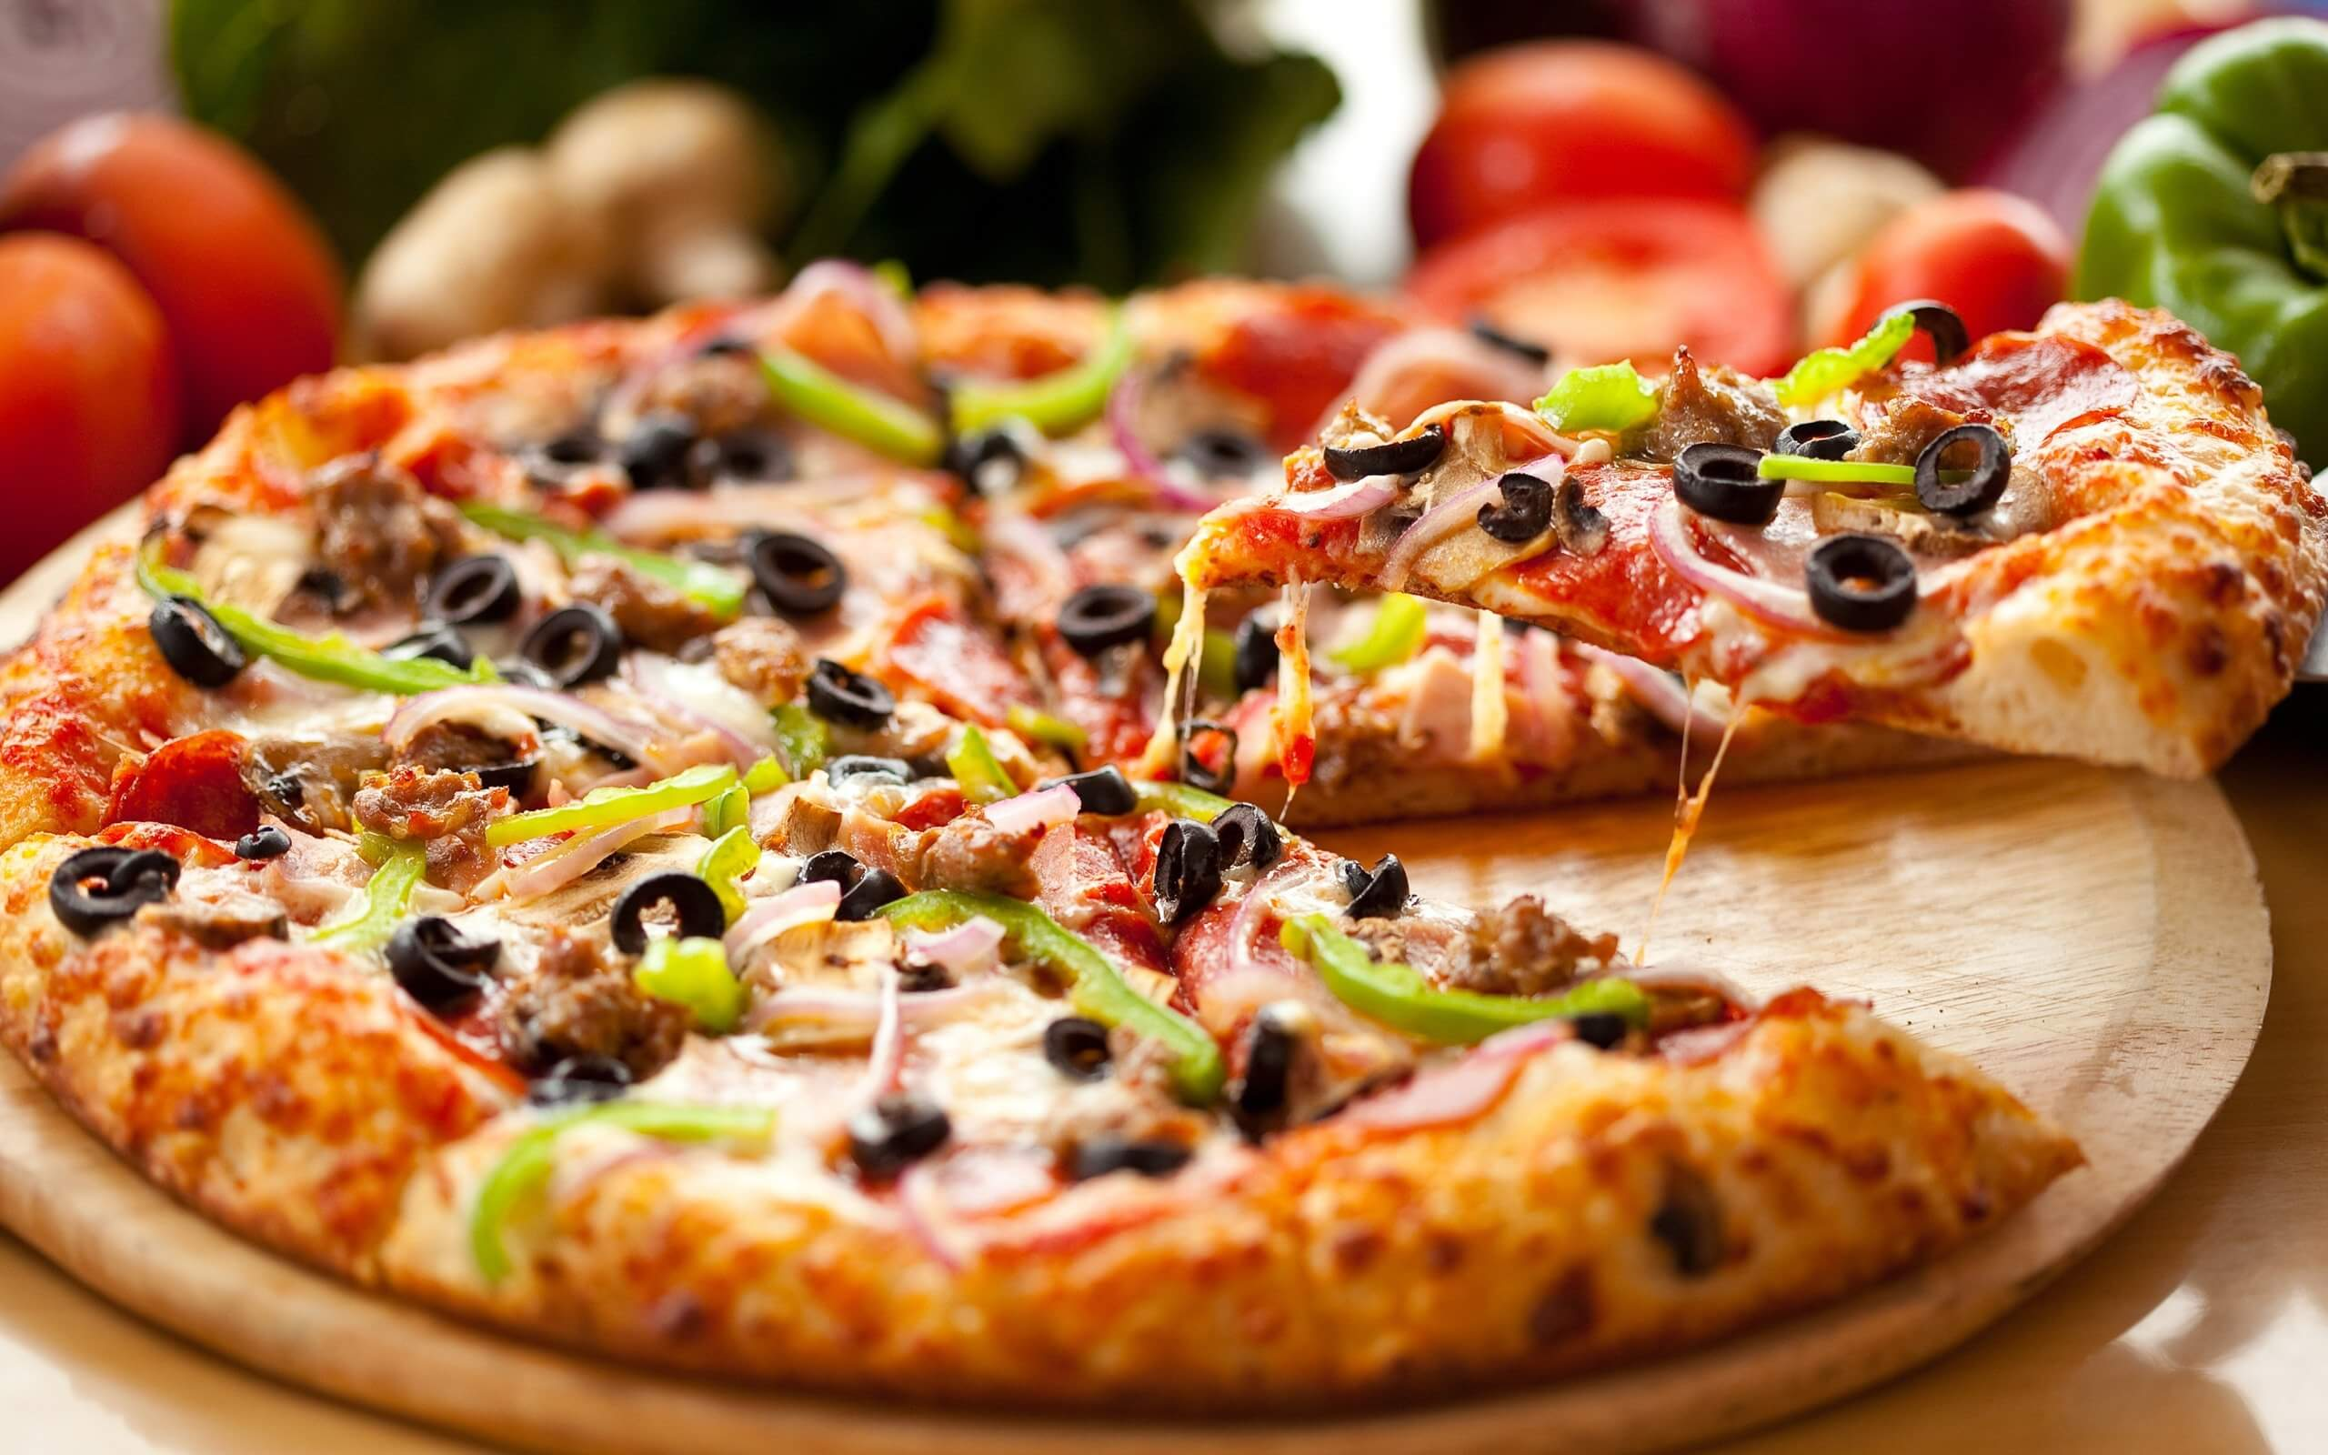
Pizza Sales Analysis Using SQL
Presented by: SRAVANI REDDY

Slide 2
Introduction
Why This Project?
Pizza is one of the most loved fast foods worldwide. Understanding sales trends helps businesses improve inventory management, pricing strategies, and marketing campaigns.
This project focuses on analyzing pizza sales data using SQL to uncover key insights, such as:
Best-selling pizzas
Peak ordering times
Revenue distribution
Customer preferences

Slide 3
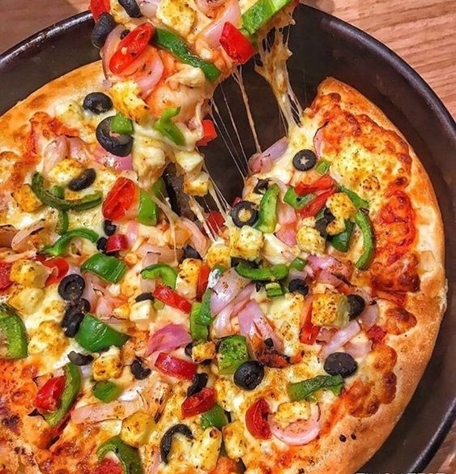
Dataset Overview
The dataset contains four main tables:
orders – Stores order details such as order ID, date, and time.
order_details – Contains information about each order, including pizza type and quantity.
pizzas – Includes pizza pricing and size details.
pizza_types – Describes the pizza names and categories.

Slide 4
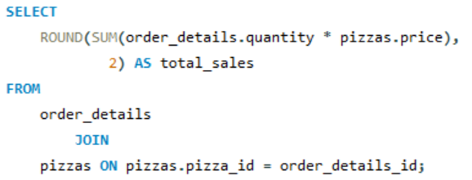
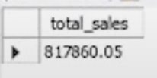
Basic Analysis
We started with some fundamental queries to understand the sales data:
Total Orders: SELECT COUNT(order_id) AS total_orders FROM orders;
Insight: The total number of orders placed gives an overview of business performance.
Insight: This query calculates total sales revenue, helping to understand overall business earnings.

Slide 5
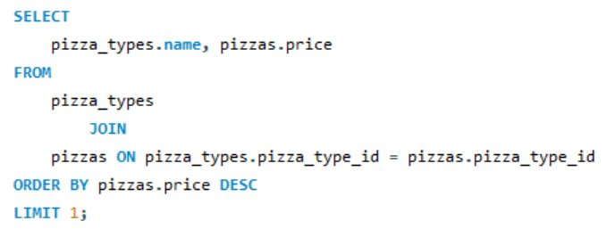

Best-Selling & Highest-Priced Pizzas
Most Expensive Pizza:
Insight: Identifies the most premium pizza on the menu.

Slide 6
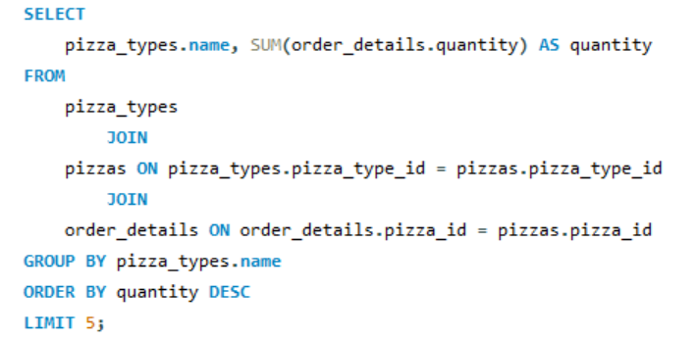
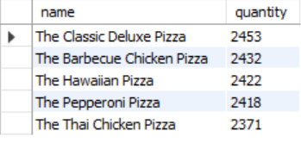
Best-Selling & Highest-Priced Pizzas
Top 5 Most Ordered Pizzas:
Insight: Helps understand customer preferences and popular pizzas.

Slide 7
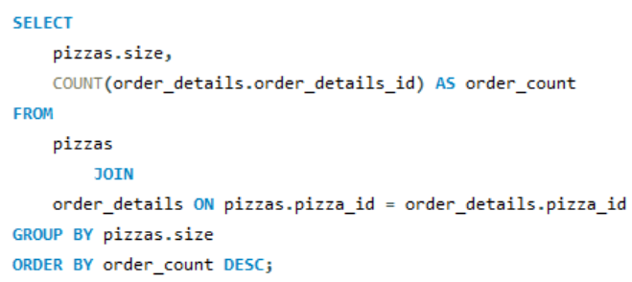
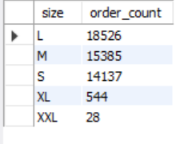
Customer Ordering Patterns
Most Common Pizza Size Ordered:
Insight: Knowing the most preferred pizza size helps with inventory management.

Slide 8
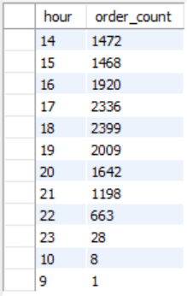
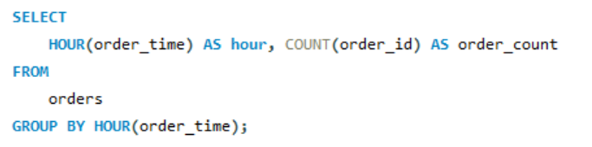
Customer Ordering Patterns
Peak Ordering Hours:
Insight: Identifies rush hours to optimize staff allocation and delivery speed.

Slide 9
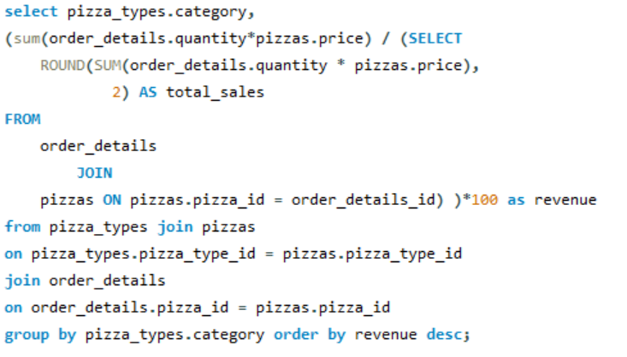
Revenue Insights
Insight: Determines which pizza category contributes the most to revenue.

Slide 10
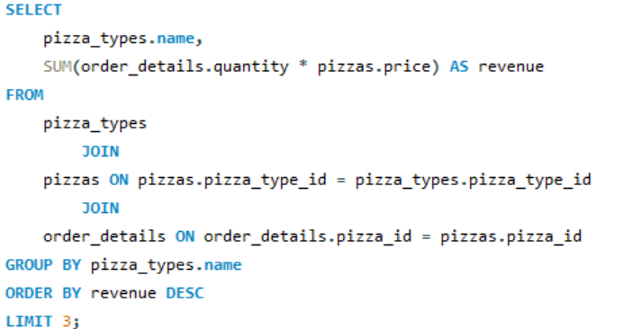
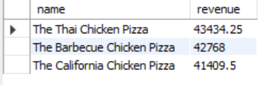
Revenue Insights
Top 3 Pizzas by Revenue:
Insight: Helps businesses focus on their highest-earning pizzas.

Slide 11
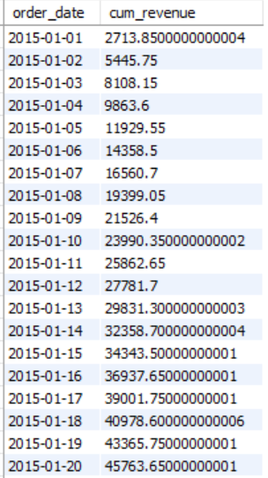
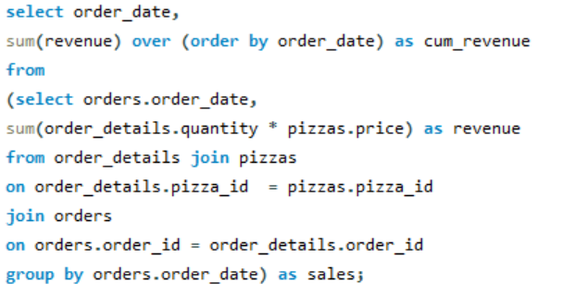
Advanced Insights
Cumulative Revenue Over Time:
Insight: Tracks business growth over time.

Slide 12
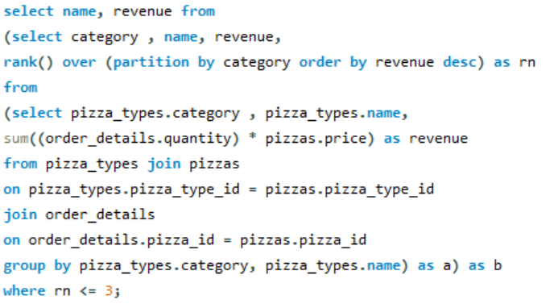
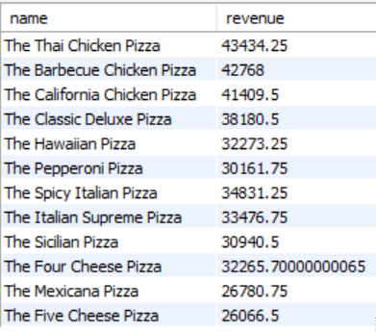
Advanced Insights
Top 3 Pizzas by Category:
Insight: Identifies the best-selling pizzas in each category.

Slide 13
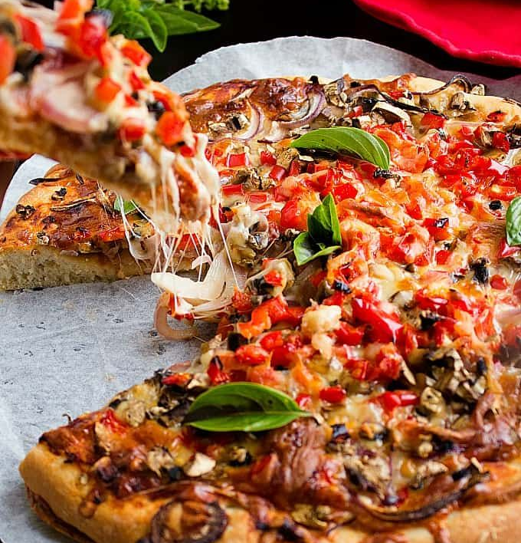
Key Takeaways & Business Impact
Key Findings:
✔️ The most ordered pizza type and size help optimize inventory. ✔️ Peak hours analysis assists in better workforce planning. ✔️ Revenue contribution by category guides pricing and promotional strategies. ✔️ Tracking cumulative revenue helps businesses measure growth.
Business Applications:
Optimize menu offerings based on bestsellers. 🔹 Adjust pricing strategies for high-revenue pizzas. 🔹 Improve marketing campaigns based on customer preferences.

Slide 14
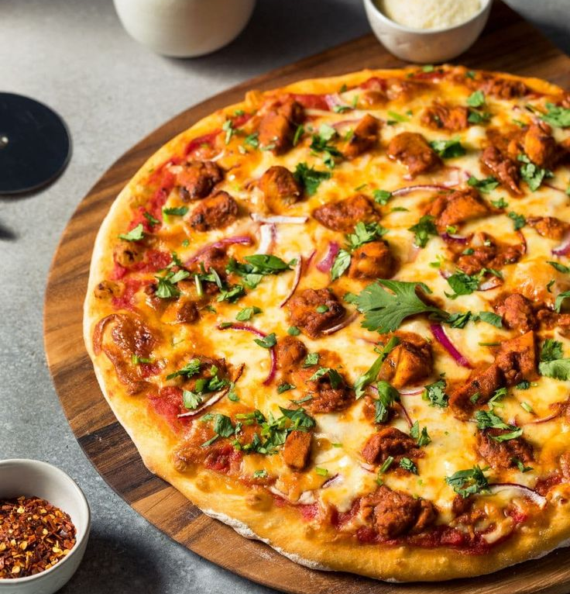
Conclusion & Future Scope
Summary: This SQL-based pizza sales analysis provided deep insights into customer preferences, ordering patterns, and revenue distribution.
🔹 Future Enhancements:
Integrating customer feedback analysis.
Exploring seasonal trends in pizza sales.
Predicting future sales using machine learning.

Slide 15

THANK YOU

