Slide 1
Bluestock MF Analytics
Mutual Fund Data Analytics Pipeline
Capstone Project Presentation
Sravani Surepalli
BSc Data Science (Graduate 2026) · University of Mumbai
Data Analytics Intern · Bluestock Finserv Pvt. Ltd.
June 2026
github.com/sravanisurepalli21/bluestock_mf_capstone
1 / 12

Slide 2
Problem & Objective
Why this project matters
The Problem
Our Objective
Mutual fund data lives in 15+ disconnected CSV files
No unified view of NAV, AUM, SIP & investor behaviour
Manual analysis is slow and error-prone
Distributor teams lack self-service analytics
No performance benchmarking vs. category indices
Build an end-to-end ETL pipeline in Python
Design a star schema SQLite database
Conduct EDA across all 5 analytical domains
Benchmark fund performance vs. indices
Deliver an interactive Power BI dashboard
Create a rule-based fund recommender
Bluestock Finserv Pvt. Ltd. · MF Analytics Capstone · 2026
2 / 12

Slide 3
Data Sources
15 CSV files across 6 analytical domains
NAV
Transactions
Performance
nav_history.csv
investor_transactions.csv
redemption_data.csv
scheme_performance.csv
benchmark_returns.csv
AUM & SIP
Schemes
Investors
aum_data.csv
sip_inflows.csv
sip_registrations.csv
scheme_master.csv
fund_manager.csv
category_benchmark.csv
investor_master.csv
expense_ratios.csv
dividend_history.csv
portfolio_holdings.csv
Bluestock Finserv Pvt. Ltd. · MF Analytics Capstone · 2026
3 / 12

Slide 4
Pipeline Architecture
Extract → Transform → Load → Analyse → Visualise
EXTRACT
VALIDATE
TRANSFORM
LOAD
ANALYSE
ingest_data.py
15 CSV files
validate.py
Quality checks
clean_data.py
Clean & standardise
load_db.py
SQLite star schema
eda_analysis.py
advanced_analytics.py
Outputs
bluestock_mf.db
(SQLite)
Final_Report.pdf
(24 pages)
Power BI
Dashboard
Recommender
JSON output
Bluestock Finserv Pvt. Ltd. · MF Analytics Capstone · 2026
4 / 12

Slide 5
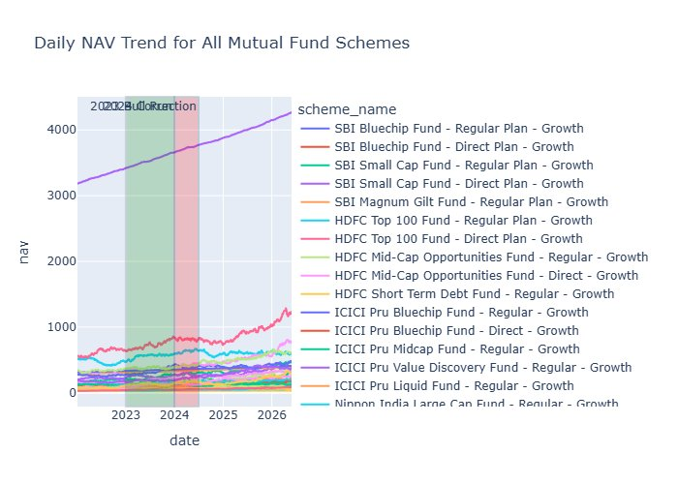
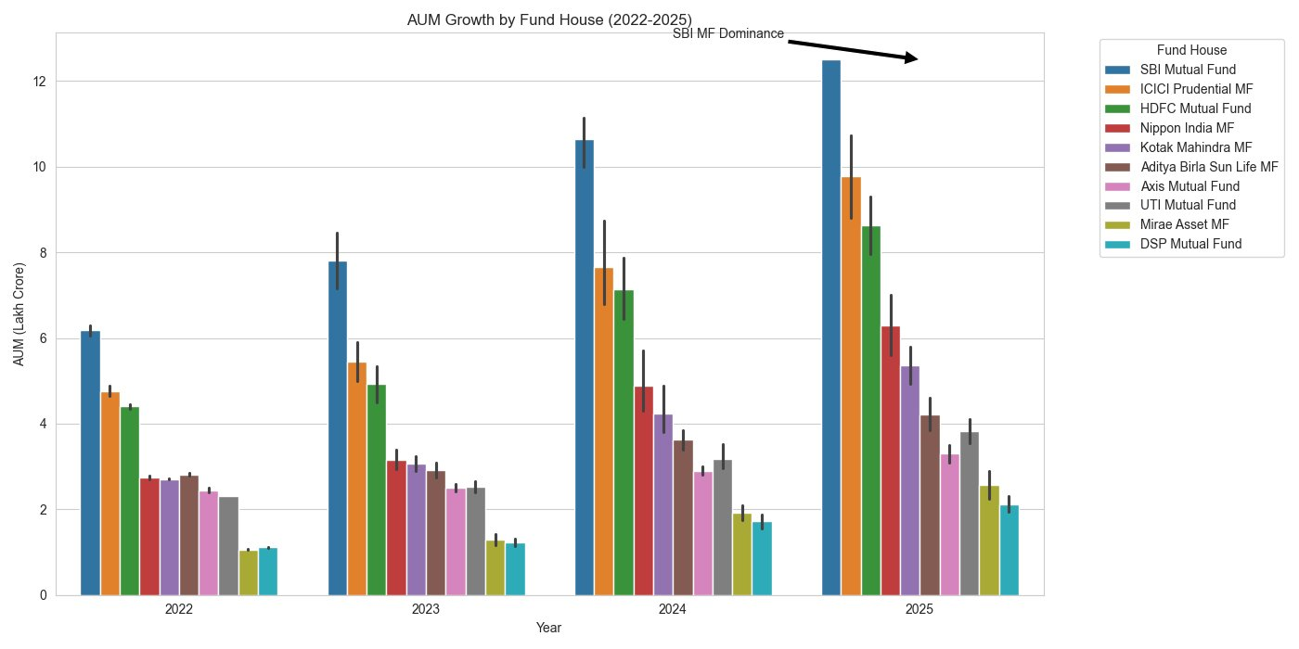
EDA Highlights — NAV & AUM
Real charts from the analytics pipeline
SBI MF leads AUM growth (₹6.2 → ₹12.5 Lakh Cr, 2022–2025); SBI Bluechip Fund shows the highest NAV trajectory.
Bluestock Finserv Pvt. Ltd. · MF Analytics Capstone · 2026
5 / 12

Slide 6
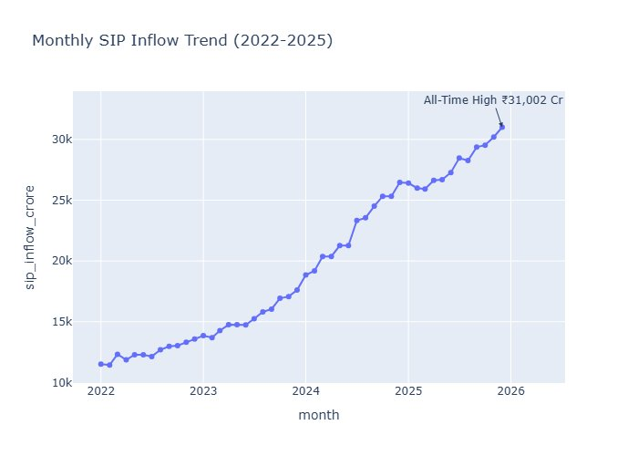
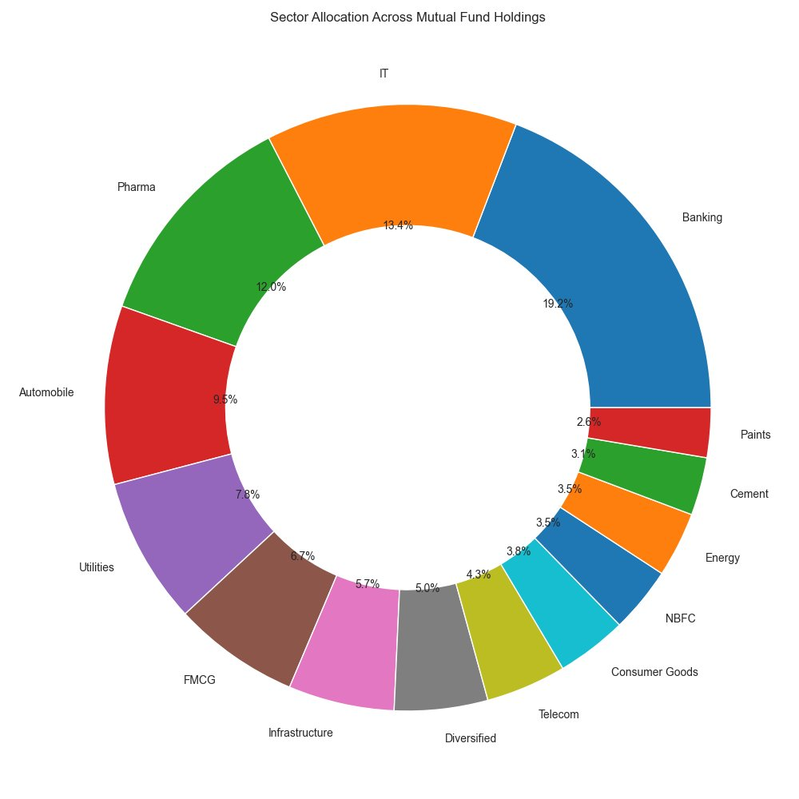
EDA Highlights — SIP & Sector Allocation
Investor behaviour and portfolio composition
Monthly SIP inflows hit an all-time high of ₹31,002 Cr. Banking (19.2%) and IT (13.4%) dominate sector allocation.
Bluestock Finserv Pvt. Ltd. · MF Analytics Capstone · 2026
6 / 12

Slide 7
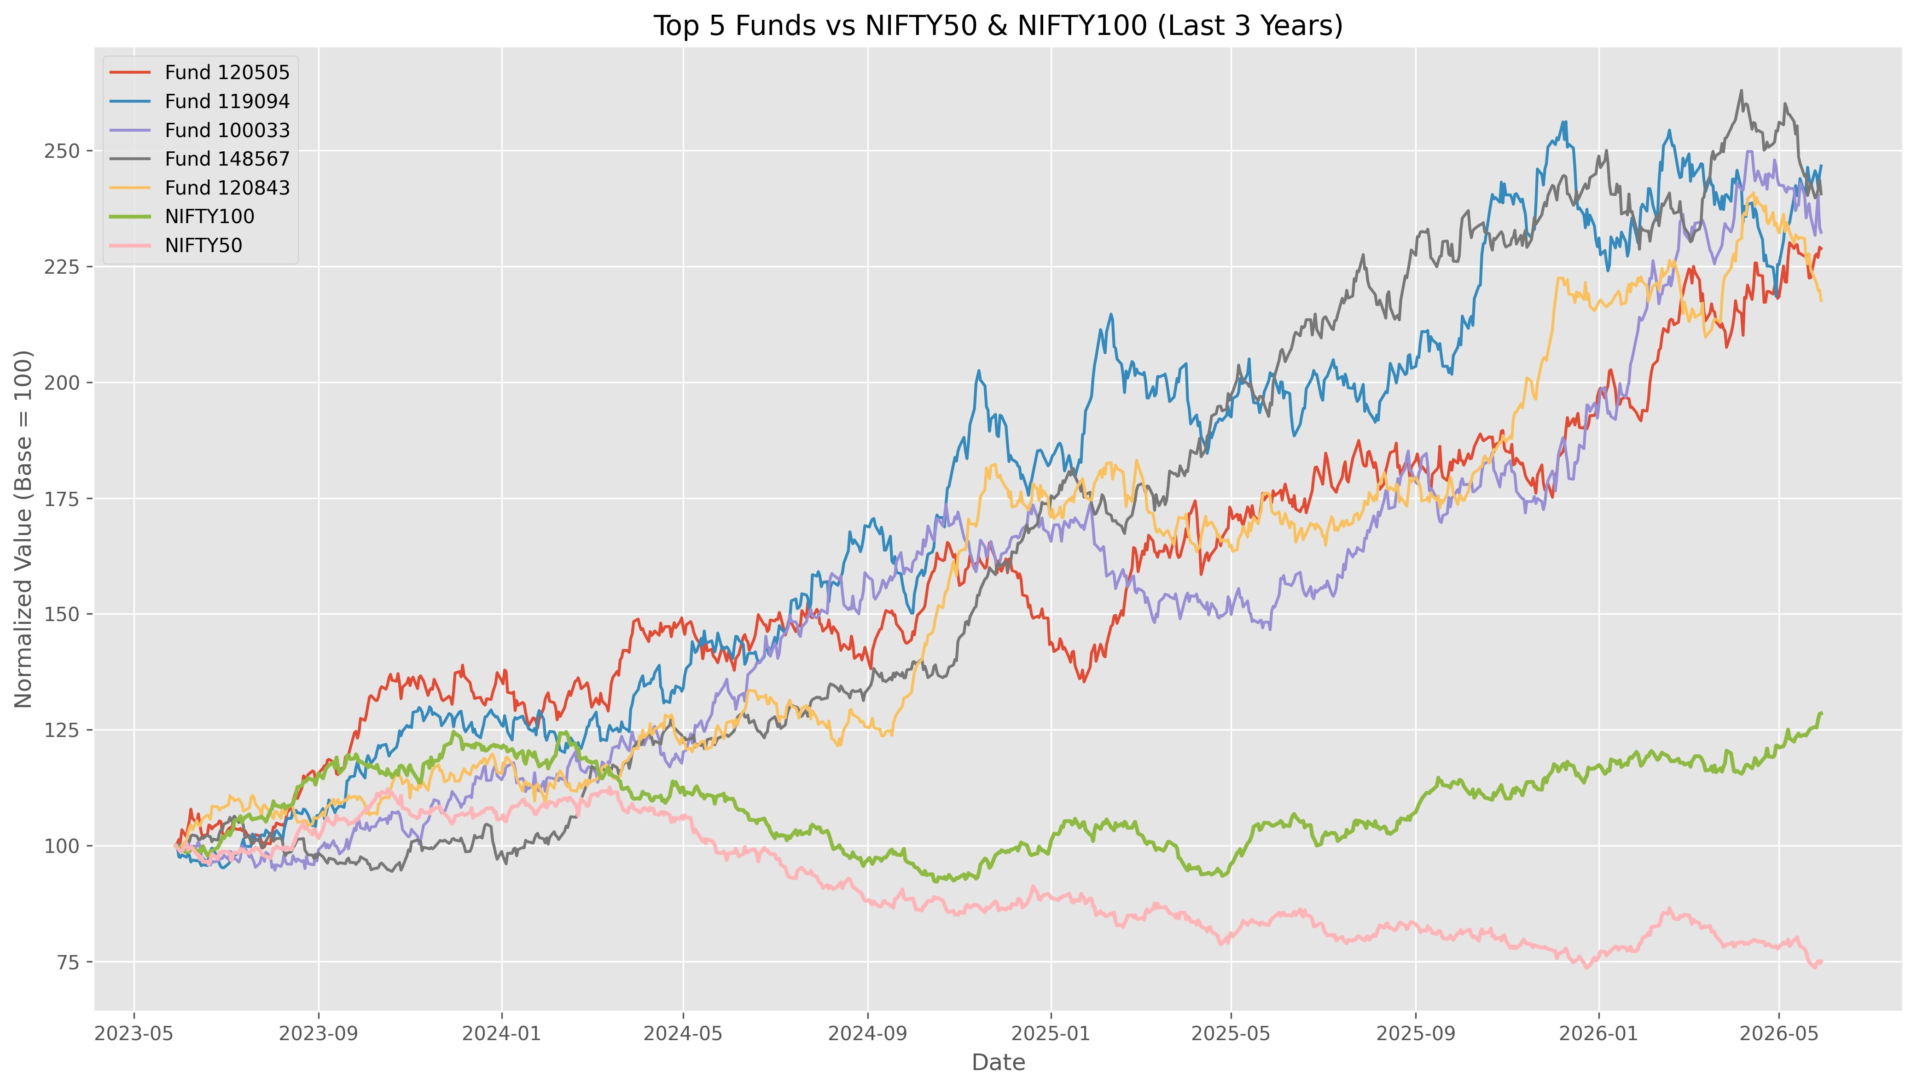
Performance Analytics — Benchmarking
Top 5 funds vs. NIFTY50 & NIFTY100 (3 years)
All 5 top active funds significantly outperformed both benchmarks; Fund 119094 & Fund 148567 led with 2.5x normalised growth.
Bluestock Finserv Pvt. Ltd. · MF Analytics Capstone · 2026
7 / 12

Slide 8
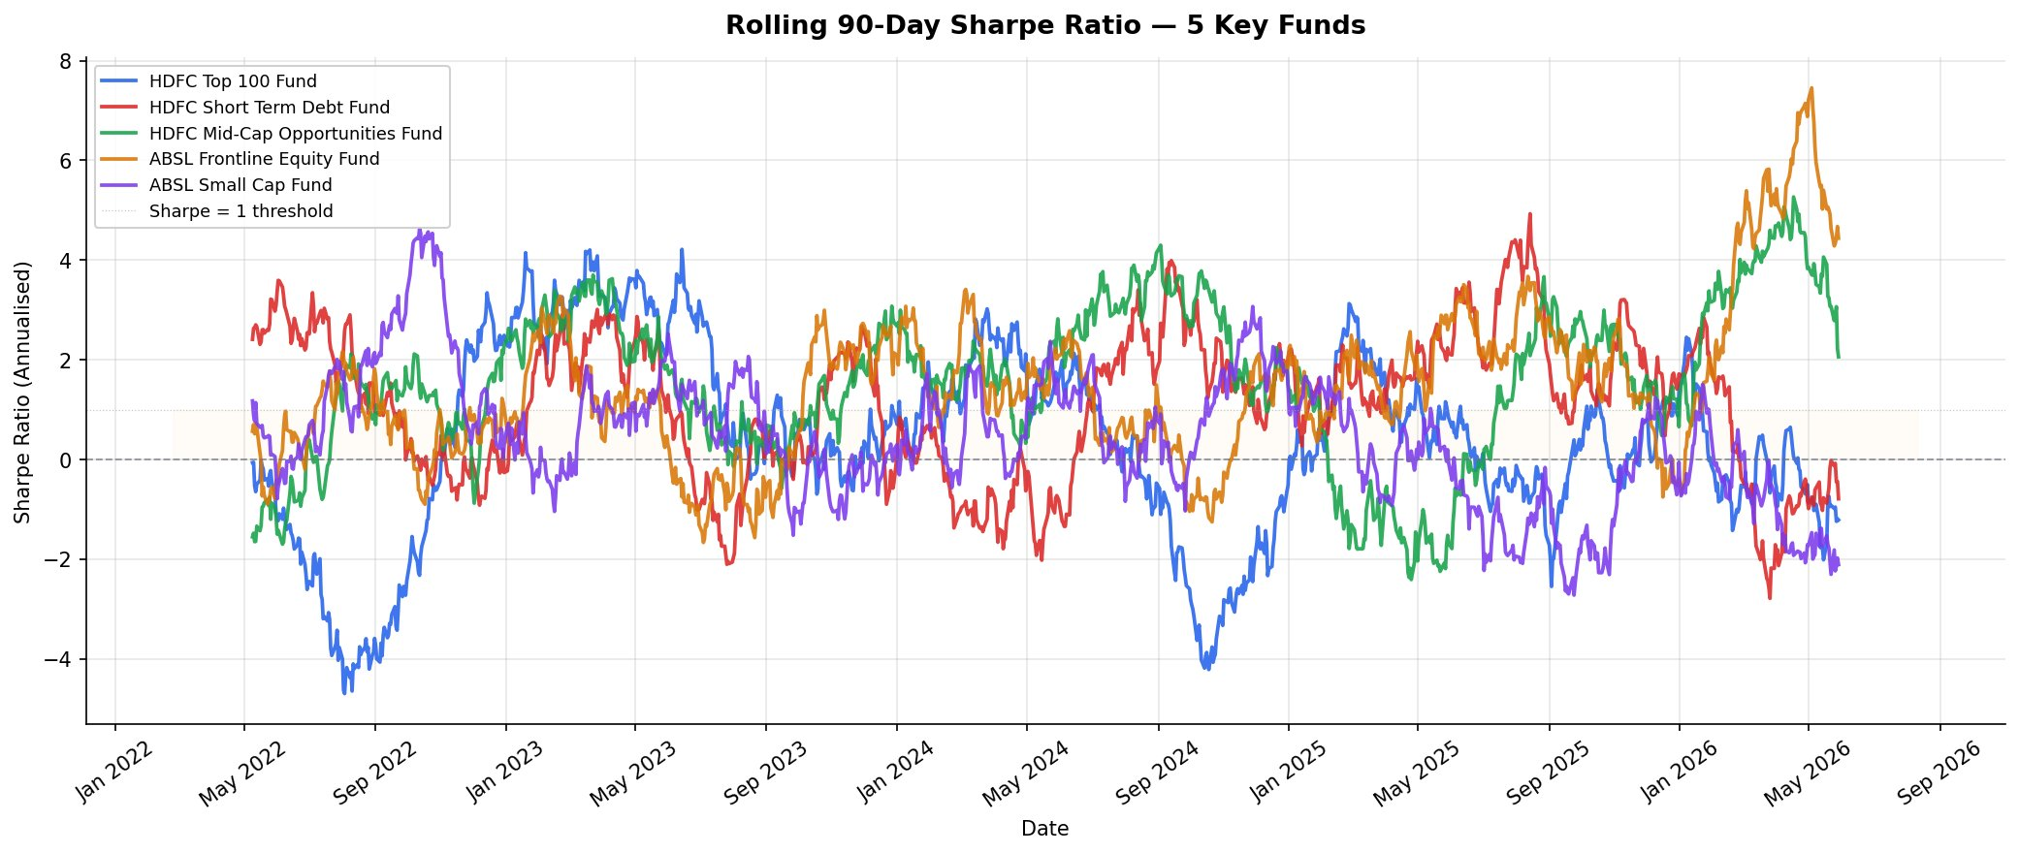
Performance Analytics — Risk-Adjusted Returns
Rolling 90-day Sharpe ratio, 5 key funds (2022–2026)
ABSL Frontline Equity reaches a Sharpe of ~7.5 by mid-2026; HDFC Top 100 shows the most volatile risk-adjusted performance.
Bluestock Finserv Pvt. Ltd. · MF Analytics Capstone · 2026
8 / 12

Slide 9
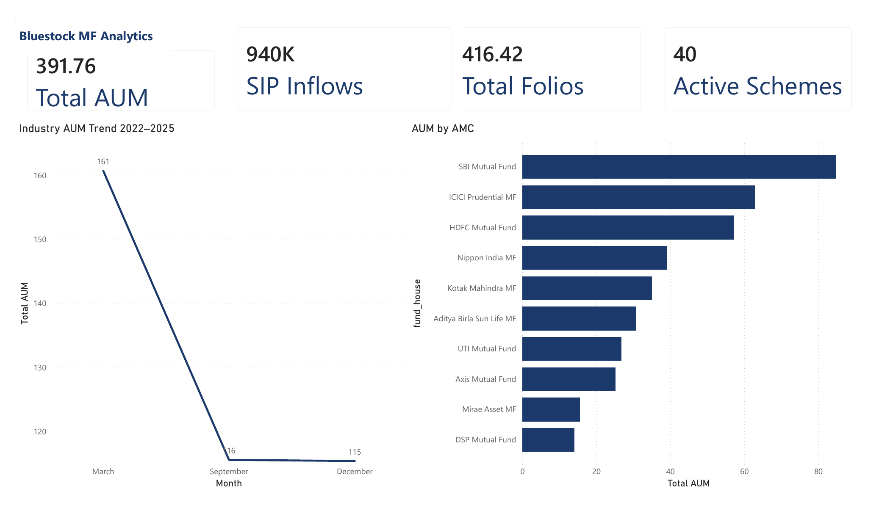
Investor Analytics Dashboard — Industry Overview
Power BI Desktop · Page 1 of 5
Total AUM ₹391.76 Lakh Cr · Total Folios 416.42 Lakh · 40 Active Schemes · SBI Mutual Fund leads AUM by AMC.
Bluestock Finserv Pvt. Ltd. · MF Analytics Capstone · 2026
9 / 12

Slide 10
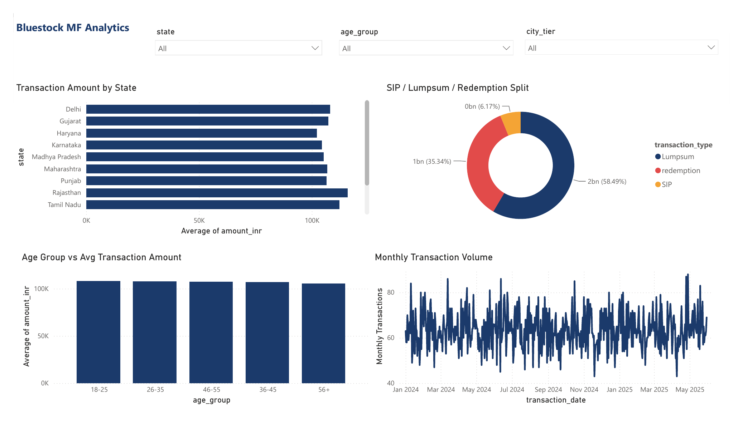
Dashboard — Investor Transactions
Power BI Desktop · Page 3 of 5
Lumpsum dominates at 58.49% of transaction value; SIP 35.34%; Redemption 6.17%. Monthly volume tracked Jan 2024–May 2025.
Bluestock Finserv Pvt. Ltd. · MF Analytics Capstone · 2026
10 / 12

Slide 11
Key Findings & Recommendations
What the data tells us — and what to do about it
📊
SBI MF AUM nearly doubled: ₹6.2 → ₹12.5 Lakh Cr (2022–2025)
Diversify distribution to reduce concentration risk
📈
Top 5 active funds beat NIFTY50/100 by up to 2.5x over 3 years
Promote active equity funds for long-horizon investors
🗓
Monthly SIP inflows hit all-time high of ₹31,002 Cr
Sustain SIP momentum with goal-based nudges
📍
Madhya Pradesh, Punjab & Telangana lead SIP amounts by state
Expand digital outreach to these high-performing states
👥
26–35 age group dominates investor base (41.1%)
Build targeted micro-SIP products for 18–25 cohort
Bluestock Finserv Pvt. Ltd. · MF Analytics Capstone · 2026
11 / 12

Slide 12
Thank You
Bluestock MF Analytics — Capstone Complete
Sravani Surepalli
BSc Data Science (Graduate 2026) · University of Mumbai
Data Analytics Intern · Bluestock Finserv Pvt. Ltd.
GitHub: github.com/sravanisurepalli21/bluestock_mf_capstone · Tag: v1.0
12 / 12

