Slide 1
Motivation
COVID has affected employment across the globe.
“The unemployment rate jumped in April 2020 to a level not seen since the 1930s”
Certain employment sectors like hospitality and leisure are impacted the most.
Mask mandating had a significant impact on the employment situation

Slide 2
Problem Statement
How did COVID affect different employment sectors in the New Haven County?
Did mask mandating help relax the employment situation?
Are there any specific employment sectors that are affected the most?

Slide 3
How is it human centered?
People centered design
Multiple analysis are performed, however only interpretable results are selected for the final analysis
Ethical considerations
The data used is aggregated at county level and does not focus on a specific demographic.
Fairness and transparency
The analysis is performed using explainable statistical algorithms instead of opaque algorithms

Slide 4
Datasets
COVID-19 fatality data from John Hopkins University
Jan 2020 to Sept 2022
The CDC data of masking mandates
Jan 2020 to Sept 2022
Employment data from US Bureau of Labor Statistics
Jan 2018 to Sept 2022
Labor force data
Jobs availability data (cumulative & sector wise)
*All datasets are filtered for New Haven County data

Slide 5
Methodology Data collection and preparation
All the 3 datasets used in the analysis are available on public data repositories, which are exported in CSV data file format
10 individual employment sector level metrics are combined to obtain a single sector wise data file
5 final datasets are obtained after performing data cleaning operations
COVID confirmed cases, masking mandates, labor force (employed & unemployed), cumulative jobs availability, Employment sector wise jobs availability

Slide 6
Methodology Notable data transformations
The frequency of employment data is monthly, to tie these datasets, the confirmed cases data is aggregated to a monthly frequency.
CDC mask mandating data is missing for certain date ranges, it is assumed to have no mandates during that period.

Slide 7
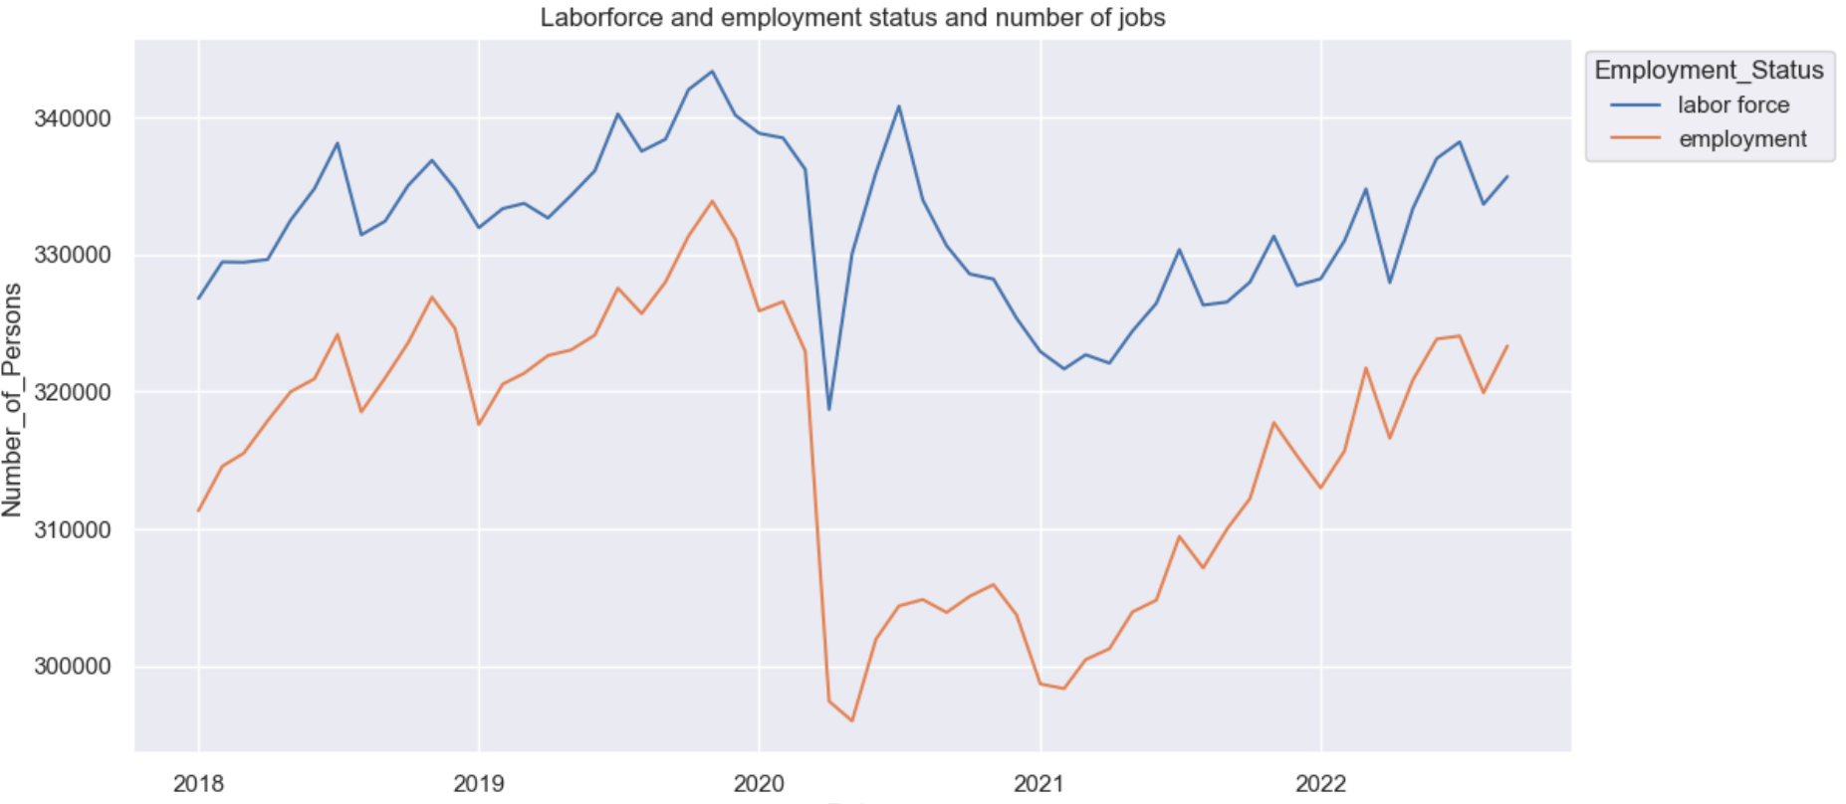
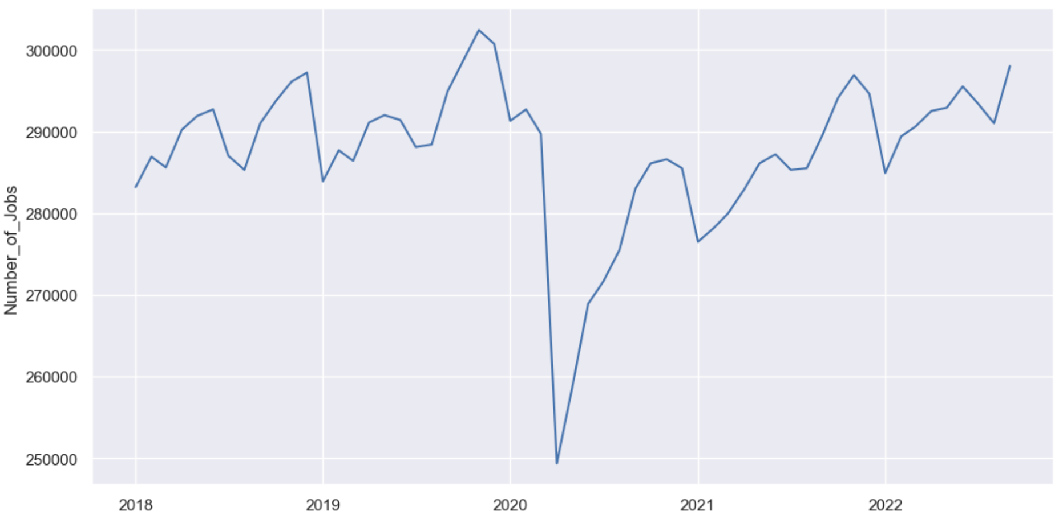
Methodology Visual Analysis
The we a major dip in all the graphs - available labor force, employment, and the available jobs.
The impact in available jobs seem to be the highest of all.

Slide 8
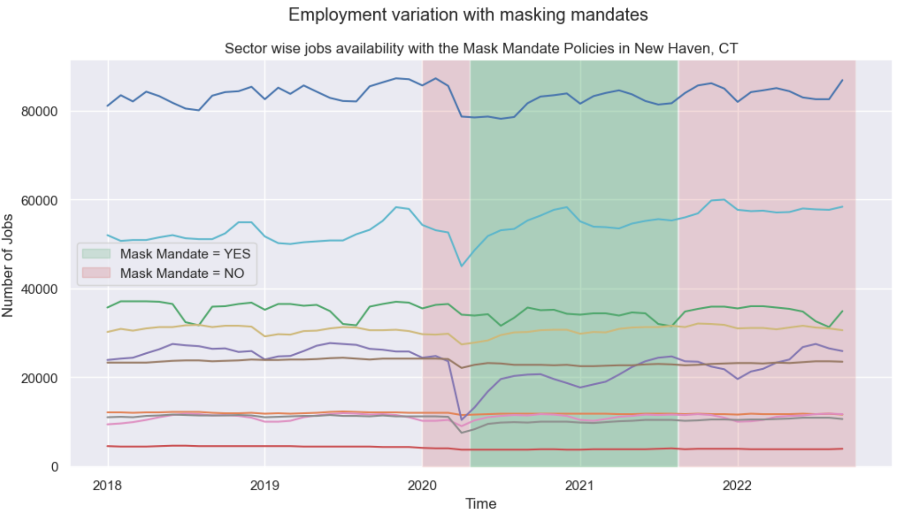
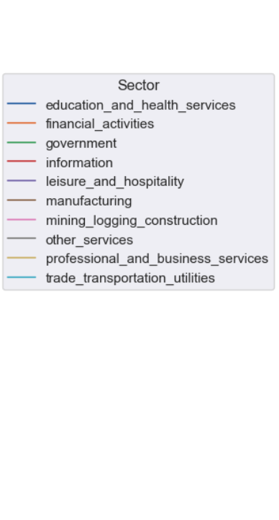
Methodology Visual Analysis
The affect varies widely on different employment sectors
We see an improvement in the situation with masking mandates

Slide 9
Methodology Tests for statistical significance
The data is broken into pre and post COVID periods
(before and after 2020-01-01)
Welch’s T-test for employment impact significance
Causal Impact Analysis
Bayesian Structural Time Series Model (BSTS)

Slide 10
Results Hypothesis Testing (Welch’s T-test)
Goal:
To test if the intervention caused a significant change in the response variable.
Results:
Welch's t-test= 2.8544
p-value = 0.0063
Statistically significant!*
Concern:
*Though t-test could be used on time series data, we might get overoptimistic inferences since the residuals might still have autocorrelation.

Slide 11
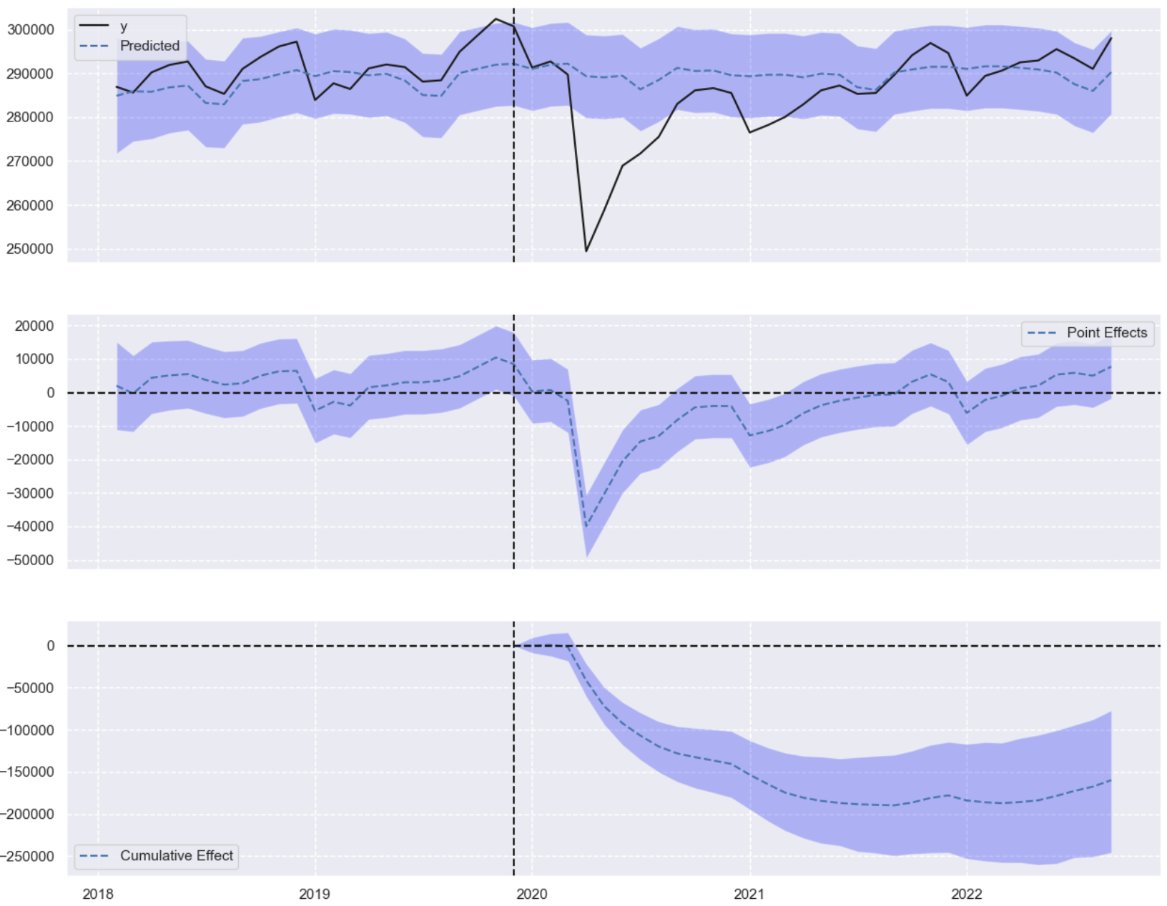
Results Causal Impact Analysis
Goal:
To test if the intervention caused a significant negative change in the response variable.
Results:
Bayesian one-sided tail-area probability p = 0.0
Statistically significant negative effect of the intervention

Slide 12
Why these results matter?
The obtain results help us understand the impact of pandemics like COVID on employment and labor force
They helps us understand how different sectors are impacted over different periods of the pandemic
They showcase the effectiveness of policies like masking mandates

