Slide 1


Recent Call Tracker using Queue
Bachelor of Technology
Computer Science & Engineering
Submitted To:- Guidance Under:-
Submitted By:-

Slide 2


CONTENTS
1. Title Slide
2. Introduction
3. Objective of the Project
4. Scope of the Project
5. Requirement Specifications
6. Modules of the Application
7. Flow Chart
8. Data Flow Diagram
9. Architecture
10. Screenshot of Project
11. Conclusion
12. References

Slide 3

1. Title Slide
Project Title
• Recent Call Tracker using Queue
Subtitle
• “Track all calls received in the last 60 seconds using a time-based queue”
Your Name / Team Name
• [Your Name / Team Name Here]

Slide 4



2. Introduction
1
What is real-time call tracking?
2
Importance of tracking recent interactions
3
Why use a queue?
• A queue allows for efficient handling of incoming calls by organizing them in the order they are received.
• Real-time call tracking is a system that records incoming call data as it happens, allowing businesses to analyze interactions with customers instantly.
• Tracking recent interactions is crucial for understanding customer needs and preferences.
• It enables timely follow-ups and enhances customer satisfaction by ensuring that no call details are overlooked.
• It ensures that the system can manage data effectively, especially when dealing with high volumes of calls in a short timeframe.
• It provides insights into call patterns, helps in improving customer service, and supports decision-making processes.

Slide 5


3. Objective of the Project
Goals
Track only recent calls (within 60 seconds) to maintain relevant data.
Ensure efficient memory and time handling to optimize system performance.
Log call details with precise time stamps for accurate record-keeping.

Slide 6




4. Scope of the Project
Features
Real-time simulation in a console-based environment for immediate feedback.
Logging support to maintain a history of calls for future reference.
The system can be extended to support IVR (Interactive Voice Response) or call center software for broader applications.

Slide 7


5. Requirement Specifications
Technical Requirements
Programming Language: C++
Libraries:
• for managing the call queue,
• for time-related functions,
• for handling concurrent operations,
• for file operations,
• for formatting output.
System Requirements:
• GCC/G++ Compiler for compiling C++ code,
• Terminal for running the application.

Slide 8
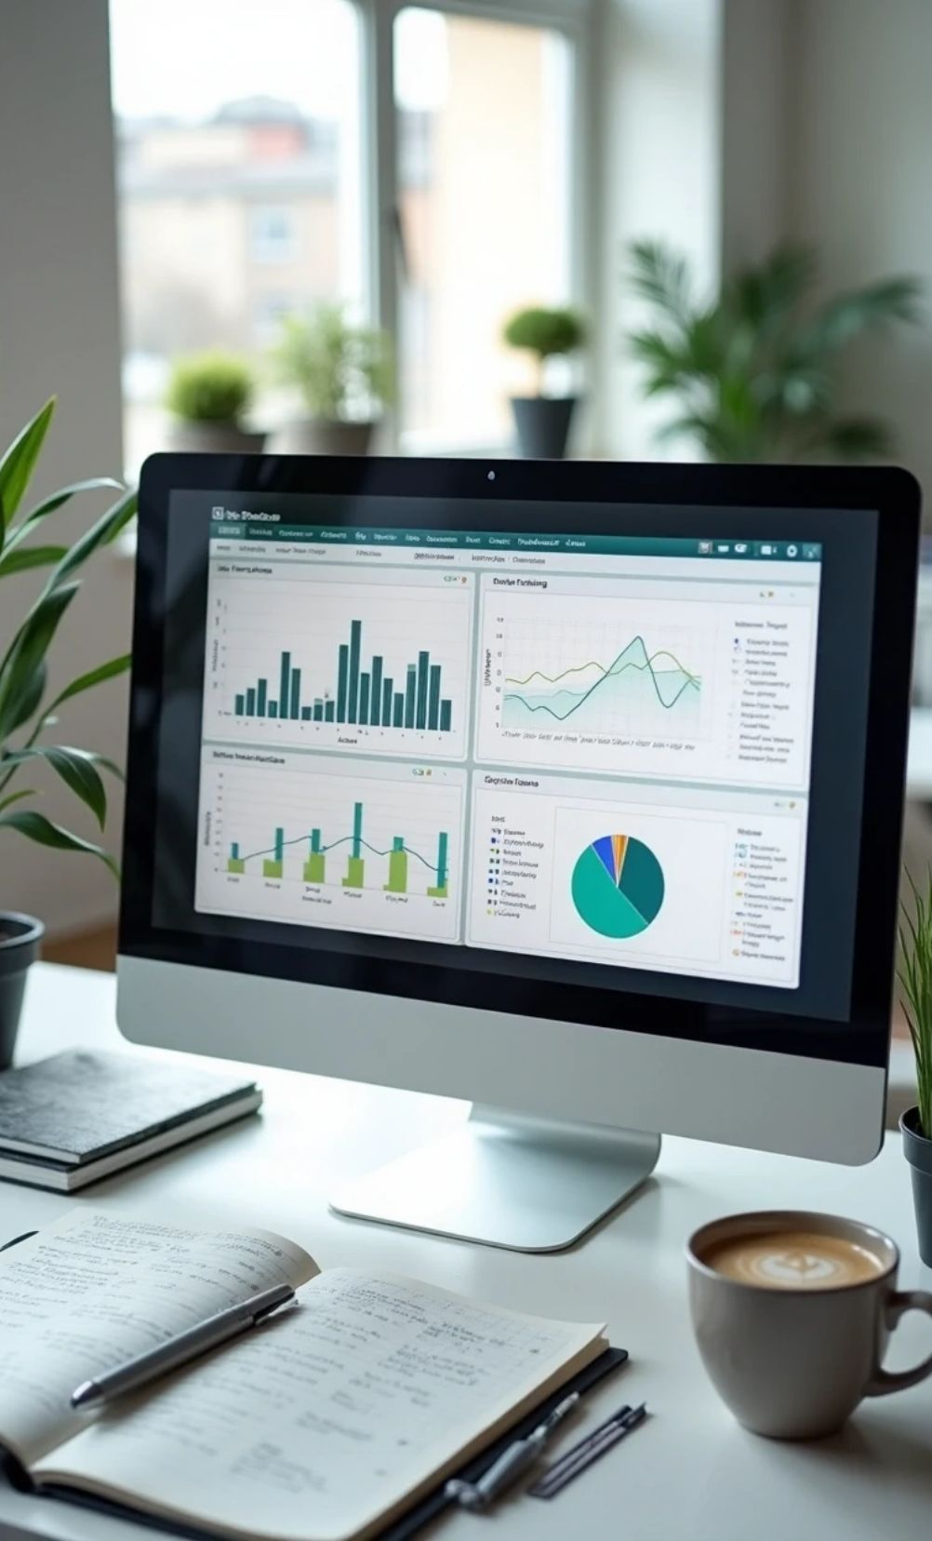
6. Modules of the Application
Key Components
1
Call Structure: Defines the attributes of a call such as callerId, timestamp, and duration.
2
RealTimeCallTracker Class: Manages queue handling, performs cleanup of expired calls, and logs call details to a file.
3
Main Loop: Simulates the reception of random calls, triggering the logging and queue operations.

Slide 9
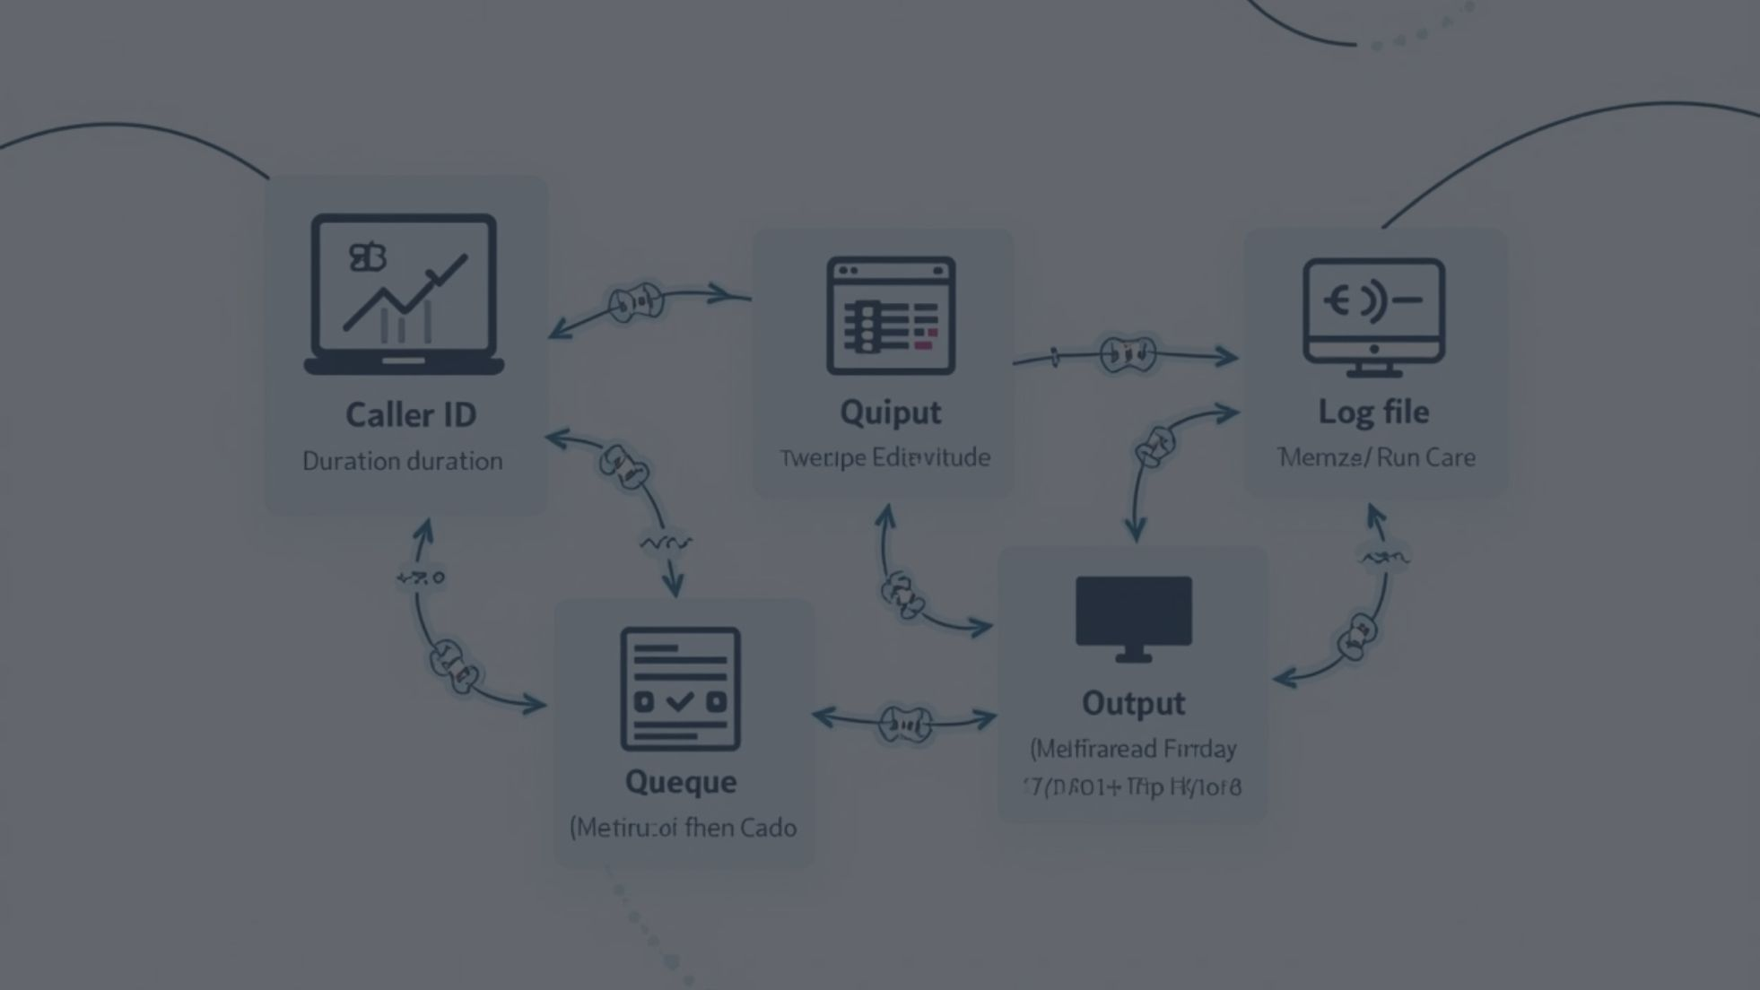

8. Data Flow Diagram
Diagram Overview
1
2
3
Input
Processing
Output
Caller ID & Duration received from the incoming call.
Queue operations including addition of calls and cleanup of expired entries.
Displayed on the console and saved in the log file.

Slide 10
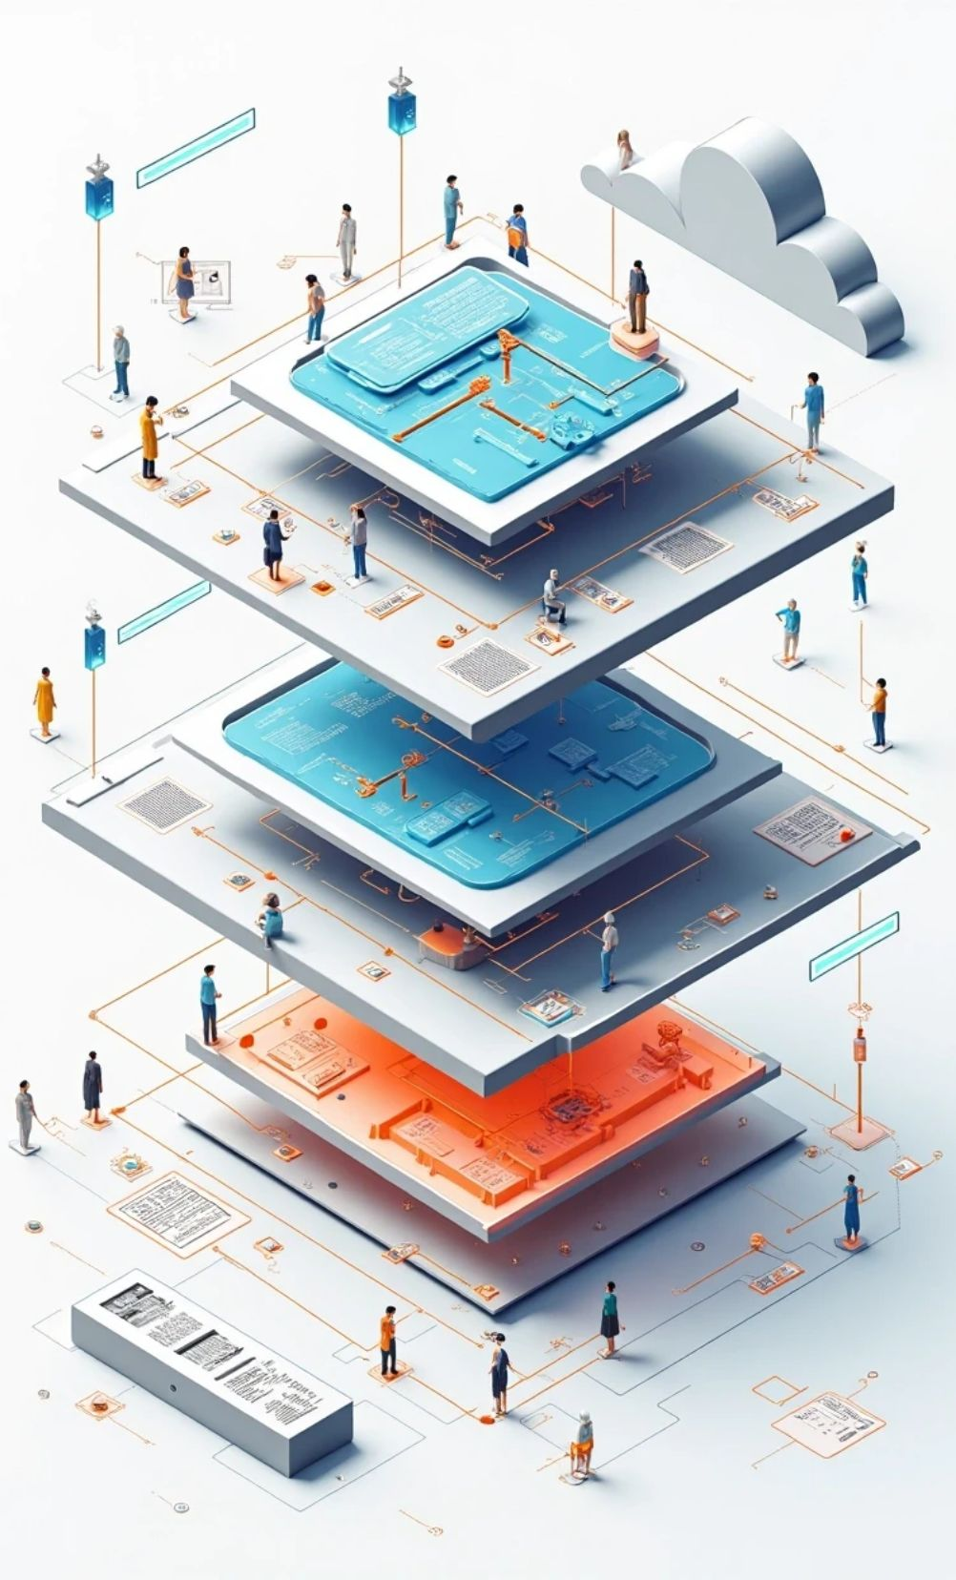
9. Architecture
System Components
Components:
• Caller Simulation: Generates random caller data.
• Time Queue: Manages the queue of incoming calls based on time.
• Logger: Handles logging of call details.
Layered Architecture Diagram: Show separation of concerns among different components.

Slide 11

10. Screenshot of Project
Optional Code Snippet
void receiveCall(int callerId, int duration) { // Function to handle the reception of a call // Logic to add call to the queue and log the details }

Slide 12


11. Conclusion
Summary
1
The project implements an efficient real-time system for call tracking.
2
It handles a limited memory window by focusing on the most recent calls.
3
The architecture is designed to be easily extendable, allowing for future enhancements.

Slide 13
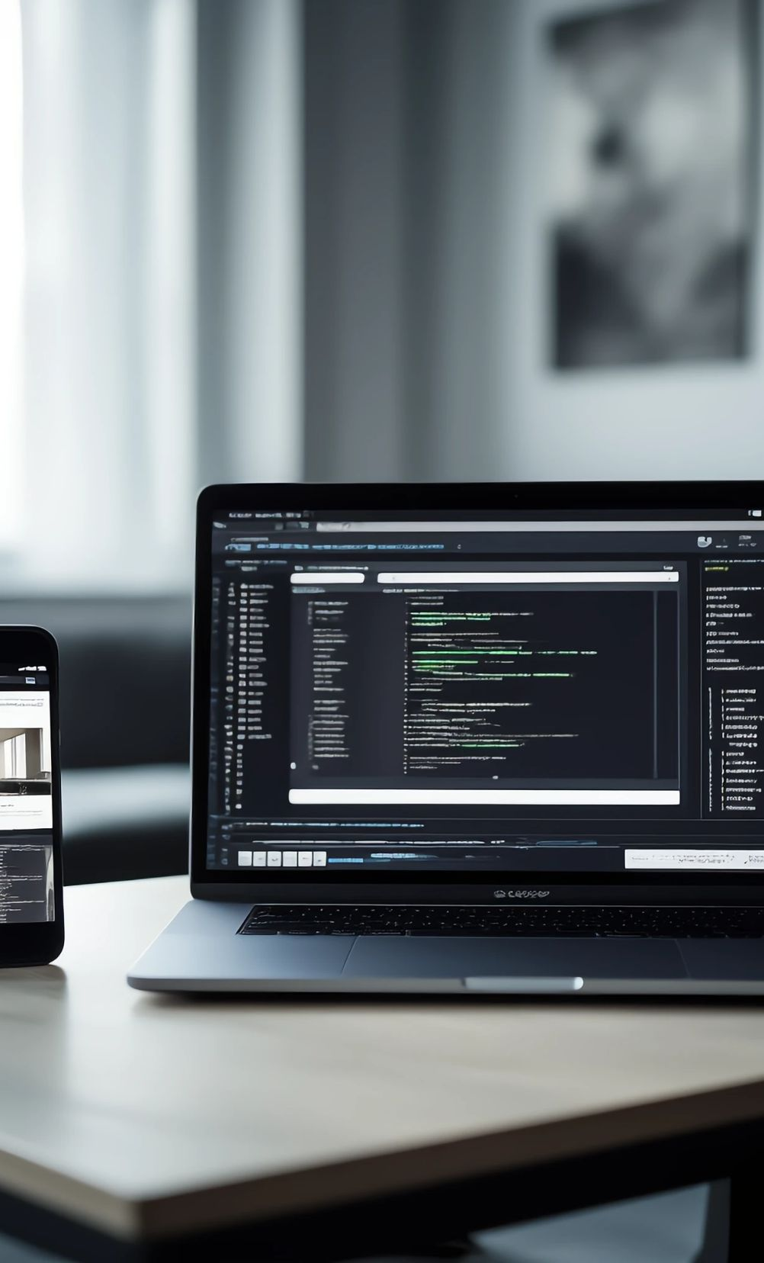

12. References
C++ Documentation: cppreference
Stack Overflow Discussions: Various threads on call tracking implementations.
Your Own Source Code: The complete codebase for further review and experimentation.

Slide 14


Thank You

